Slide 1












$$p(y)$$
$$Υ_{π_{θ}}$$
: support for policy $π_{θ}$
$$π_{θ}$$
$$Υ_{π_{ref}}$$
: support for policy $π_{ref}$
$$Υ_{all}$$
: global sample space
$$π_{ref}$$
off-policy
set
$$Υ_{π_{θ}}$$
$$y$$
$$Υ_{π_{ref}}$$
$$Υ_{all}$$

Slide 2
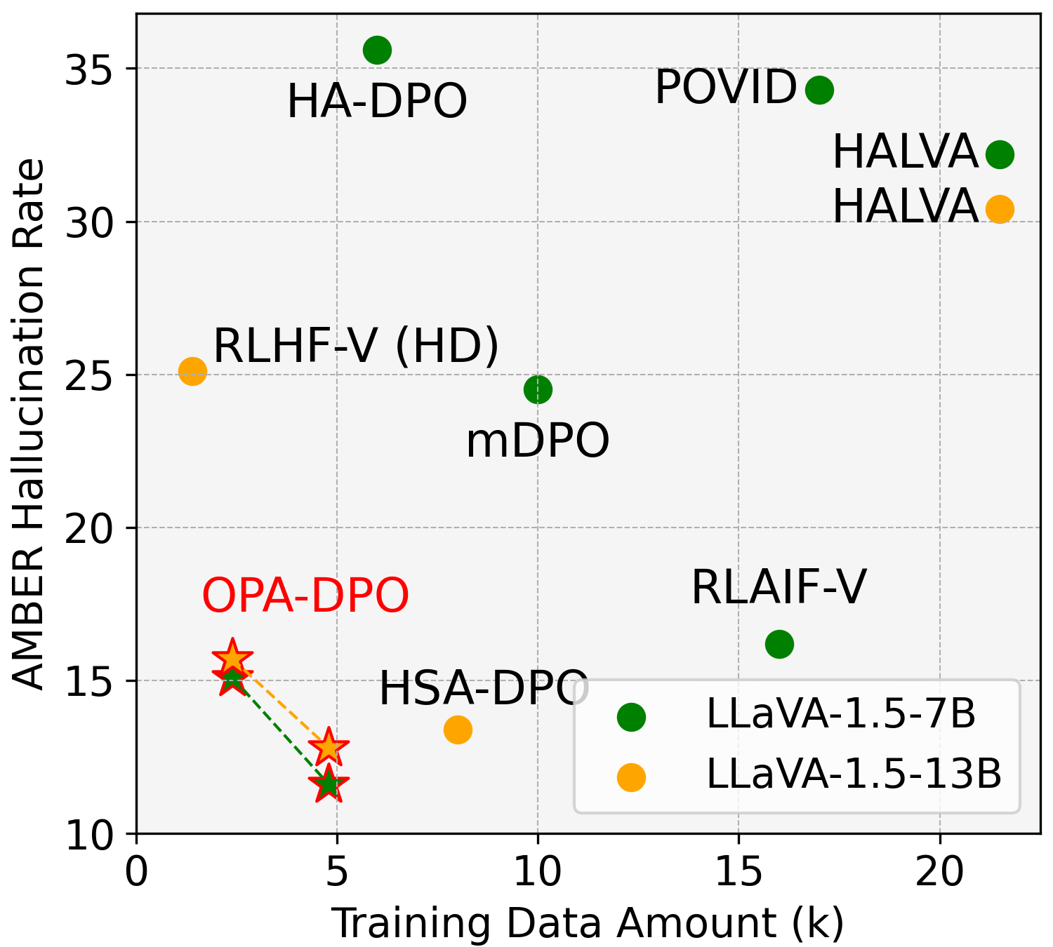
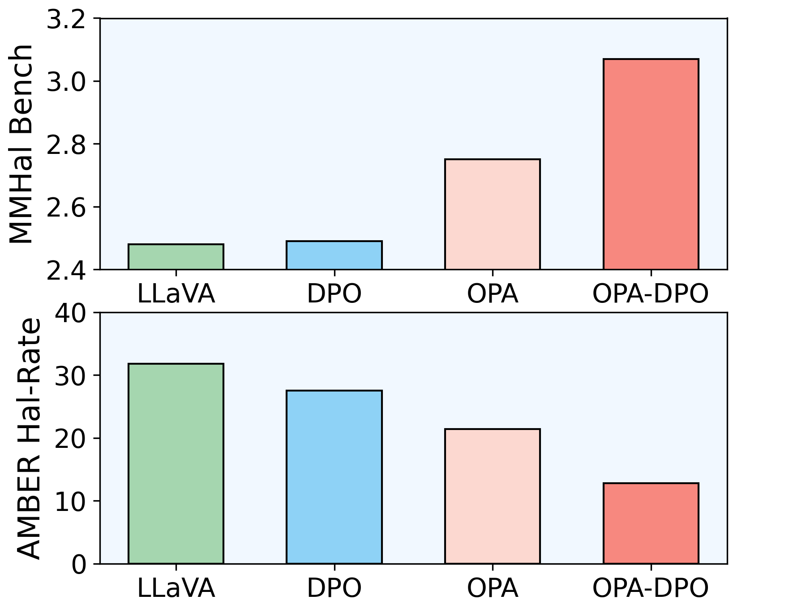








(a)
: correct response
: DPO w/o OPA
: hallucination response
: OPA-DPO
: preference pairs
Classical DPO
for Hallucination Recognition
Our OPA-DPO
$$π_{DPO}^{true}$$
$$p(y)$$
$$π_{DPO}^{expect}$$
$$p(y)$$
$$π_{ref}$$
$$π_{OPA−DPO}$$
$$π_{ref}$$
$$π_{OPA}$$
0
0
$$y$$
$$y$$
off-policy preferred responses
cannot be learnt
OPA solves the problem
(b)
(c)
Higher Better
Lower Better
Lower Better

Slide 3










on
: on-policy response
off
: off-policy response
: hallucination description
: correct description
: correct response
Method 1 Hallucination Injection
: hallucination response
: preference pair
on
or
off
off
DPO Training
$$p(y)$$
$π_{DPO}^{true}$ (not change too much)
on
or
off
off
Hallucination
Injection
>
$$π_{DPO}^{expect}$$
$$π_{ref}$$
Prompt
Prompt
Ground-truth
response
Prompt
Hallucination
response
Ground-truth
response
Hallucination
response
0
Method 2 Hallucination Recognition
$$y$$
$$π_{DPO}^{true}$$
on
off
DPO Training
$$p(y)$$
Hallucination
Recognition
off
on
>
$$π_{ref}$$
$$π_{DPO}^{expect}$$
Prompt
Generated
response
Revised
response
Prompt
Revised
response
Prompt
Generated
response
0
$$y$$
Method 3 Self Evolution
: half-correct response
on
Response
Assessment
on
: expected preference pairs
DPO Training
$$π_{DPO}^{true}$$
on
on
$$p(y)$$
>
Preferred
$$π_{DPO}^{expect}$$
on
Prompt
Prompt
$$π_{ref}$$
Prompt
on
Preferred
response
Rejected
response
0
Note that hallucination may exist in both responses
$$y$$
Multiple-generated
response
Rejected

Slide 4


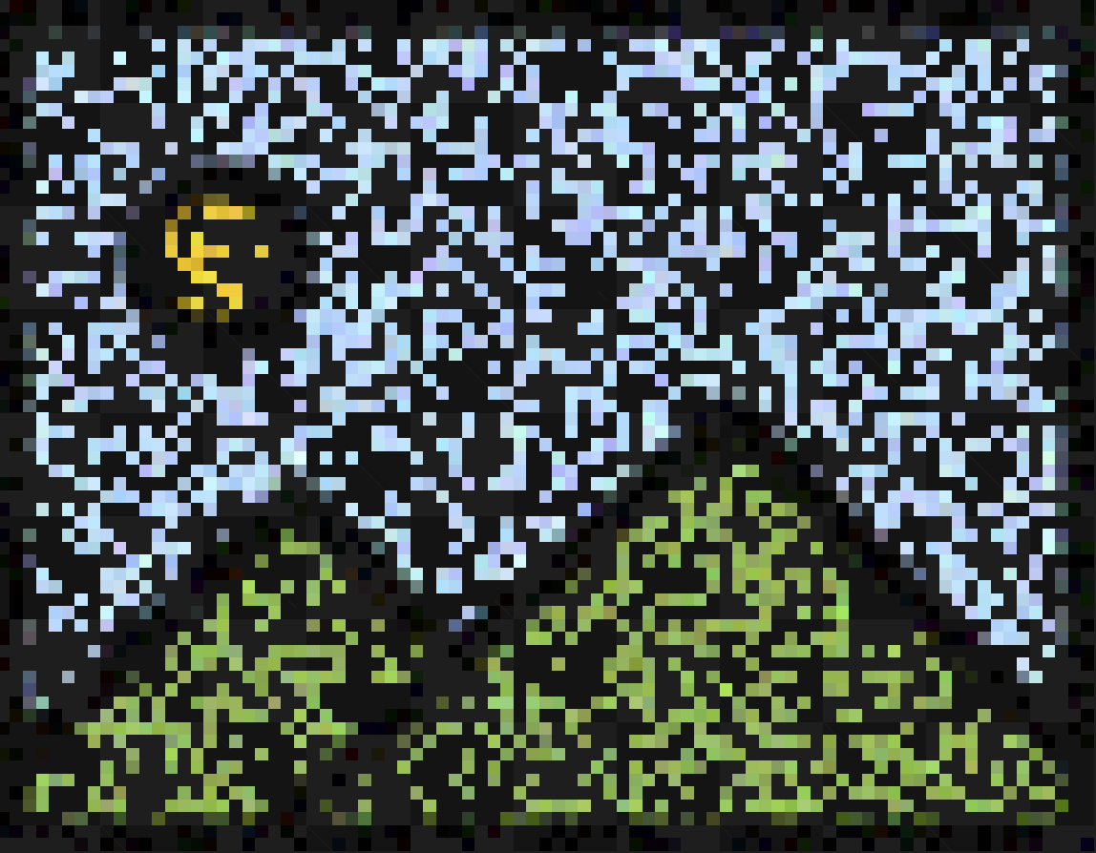


: off-policy data flow
: on-policy data flow
: LMM training flow
Instruct-Dataset
①
Generated
response
②
Revised
response
off
Original
policy
on
off
Hallucination
Recognition
Prompt
Ground-truth
response
(Gen.)
DPO Training (six pairs)
④
Ground-Truth
Revised
③
On-Policy
Alignment
+
on
+
on
G.T.
Rev.
on
off
Prompt
>
Prompt
>
Ground-truth Response
(G.T.)
Language Correction
on
on
+
Gen.
+
Gen.
New
policy
Prompt
Prompt
+
on
+
on
LoRA-SFT
G.T.
Rev.
Prompt
>
Prompt
>
Image Focus
on
on
on
off
+
G.T.
+
Rev.
Revised Response
(Rev.)
Prompt
Prompt
+
on
+
on
G.T.
Rev.
Anchor
Prompt
>
Prompt
>
All three responses w.r.t. the new policy are “on-policy”
DPO will start from this policy
$$δ$$
$$δ$$

