Slide 1
2D simulation manual
Zhaoyuan Ma (zma3@wpi.edu)

Slide 2
Structure
Env
world
contacts
rope
pinned
rod
section 0
body
position
gripper
section 1
…
section n

Slide 3
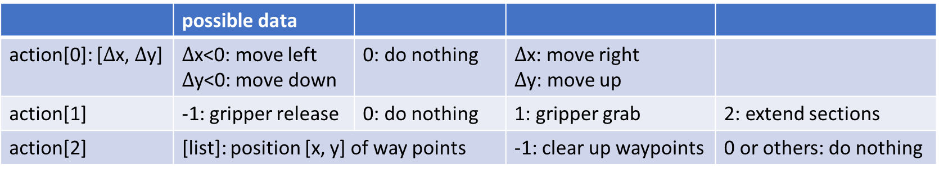
S, A, R, S’
Action space:
Reward: Return at each step, but not necessary with value (leaving an opening will give a reward of 0) The agent will not always check for the reward, only check when it needs to ().
 | possible data
action[0]: [$Δ$x, $Δ$y] | $Δ$x<0: move left $Δ$y<0: move down | 0: do nothing | $Δ$x: move right $Δ$y: move up
action[1] | -1: gripper release | 0: do nothing | 1: gripper grab | 2: extend sections
action[2] | [list]: position [x, y] of way points |  | -1: clear up waypoints | 0 or others: do nothing

Slide 4
Item | categoryBits | maskBits | collide with | ignore
rod | 0x02 | 0x04+0x08+0x10 | section(0x04), pinned(0x08), gripper(0x10) | n/a
section*n | 0x04 | 0x02 | rod(0x02) | section, pinned, gripper
pinned (fix gripper) | 0x08 | 0x10+0x02 | rod(0x02), gripper(0x10) | section
gripper | 0x10 | 0x08+0x02 | rod(0x02), pinned(0x08) | section
section sensor | 0x20 | 0x20+0x40 | section sensor(0x20) gripper sensor(0x40)
gripper sensor | 0x40 | 0x20 | section sensor(0x20)

Slide 5
contact.py (ContactDetector)

Slide 6
coil2d_env.py
SECT_NUM: total number of initial sections.
ATTACH_NO: the gripper attach to section_ATTACH_NO
self.rope: [pinned, section_0, section_1, …] length: SECT_NUM+1
self.grabbed: indicate which section to grab, use the sections’ serial number, or -1 as not grabbed.
Attach one section, then join two sections ([-2] & [-1]) with a joint
Finally attach the gripper to section_ATTACH_NO

Slide 7
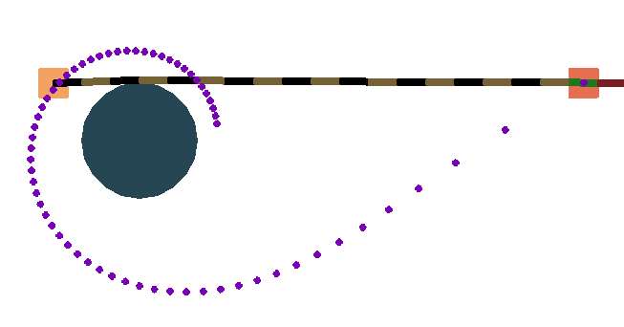






Generate the trajectory
param[0]==1: move around rod in a CW manner
positive angle
spiral coordinate
end pos
Basics: $r=aθ^{n}$ $n\text{: }\text{given} \text{as}\text{ −1/2 (}\text{Lituus}\text{)}$
Parameters:
Direction (CW/CCW):
$θ_{0}$: the angle of the starting position (spiral coordinate) $θ_{0}>0$
$θ_{e}$: the angle of the end position (spiral coordinate) $θ_{e}>θ_{0}+2π$
Granularity (dynamic)
Relationship between the spiral coordinate and the world coordinate:
The offset between the spiral coordinate and the world coordinate as: $θ_{0}+θ_{offset}$, $θ_{offset}$ is calculated from the starting position to the world coordinate
$θ_{0}$ (t_0)
starting pos
$θ_{offset}$ (t_os)
$Δθ$ (dt)
world coordinate
$θ_{e}$ (t_e)
intermediate pos$θ$
$$r\left(θ\right)=r(θ_{0}+Δθ)$$

Slide 8
param[0]==1: move around rod in a CW manner
positive angle
spiral coordinate
end pos
$θ_{0}$ (t_0)
starting pos
$θ_{offset}$ (t_os)
$Δθ$ (dt)
world coordinate
$θ_{e}$ (t_e)
intermediate pos$θ$
$$r\left(θ\right)=r(θ_{0}+Δθ)$$

Slide 9
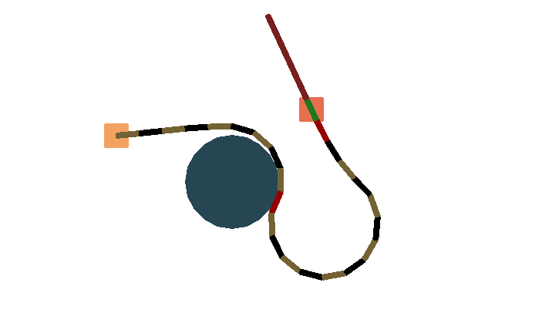
Bug
No. 9
No. 22

