Slide 2
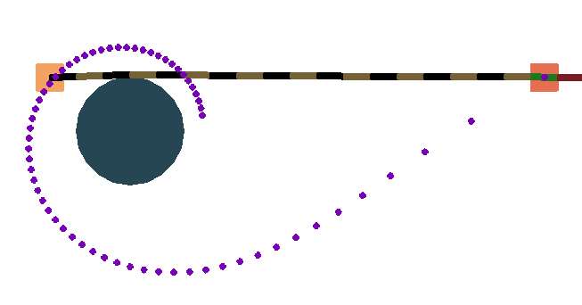






param[0]==1: move around rod in a CW manner
positive angle
spiral coordinate
Basics: $r=aθ^{n}$ $n\text{: }\text{given} \text{as}\text{ -1/2 (}\text{Lituus}\text{)}$
Parameters:
Direction (CW/CCW):
$θ_{0}$: the angle of the starting position (spiral coordinate) $θ_{0}>0$
$θ_{e}$: the angle of the end position (spiral coordinate) $θ_{e}>θ_{0}+2π$
Granularity (dynamic)
Relationship between the spiral coordinate and the world coordinate:
The offset between the spiral coordinate and the world coordinate as: $θ_{0}+θ_{offset}$, $θ_{offset}$ is calculated from the starting position to the world coordinate
end pos
$θ_{0}$ (t_0)
starting pos
$θ_{offset}$ (t_os)
$Δθ$ (dt)
world coordinate
$θ_{e}$ (t_e)
intermediate pos$θ$
$$r\left(θ\right)=r(θ_{0}+Δθ)$$

Slide 3

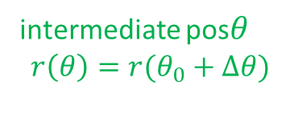



param[0]==1: move around rod in a CW manner
positive angle
spiral coordinate
end pos
starting pos
$θ_{0}$ (t_0)
$θ_{offset}$ (t_os)
pybox2d coordinate
$Δθ$ (dt)
$θ_{e}$ (t_e)
intermediate pos$θ$
$$r\left(θ\right)=r(θ_{0}+Δθ)$$

