Slide 2





<Research team> <Introduction> <Model> <Result> <Cooperation>

Slide 3
Supervisor
xxxxxxxxxxxxxx, Associate Professor of Harbin Institute of Technology, CHINA
Department : School of Energy Science and Engineering
URL : http://homepage.hit.edu.cn/xxxxxx
E-mail : xxxxxxxxx@hit.edu.cn
Reporter
xxxxxxxxxxx, Master student of Harbin Institute of Technology, CHINA
and Master student of Moscow Aviation Institute, RUSSIA
Department : School of Energy Science and Engineering
Research Interest : gas combustion and plasma assistant combustion
E-mail xxxxxxxxx@hit.edu.cn

Slide 4
<Research team> <Introduction> <Model> <Result> <Cooperation>

Slide 5
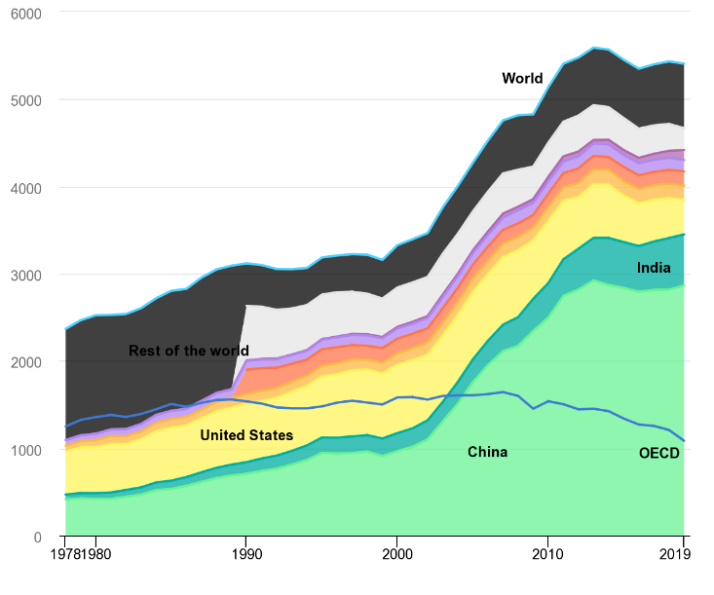
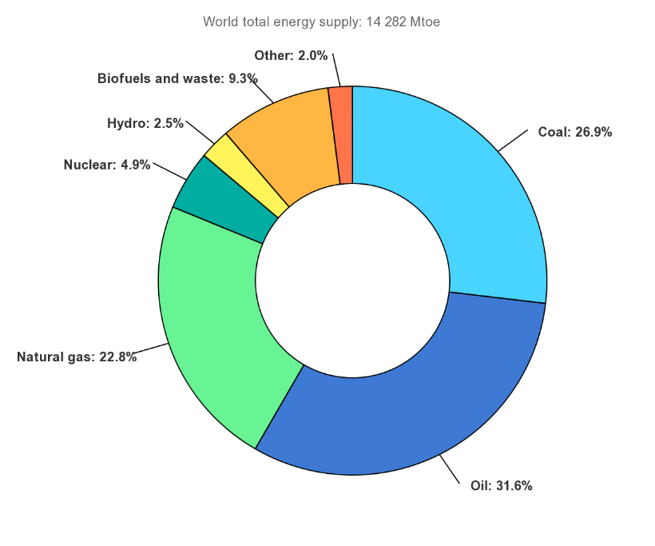
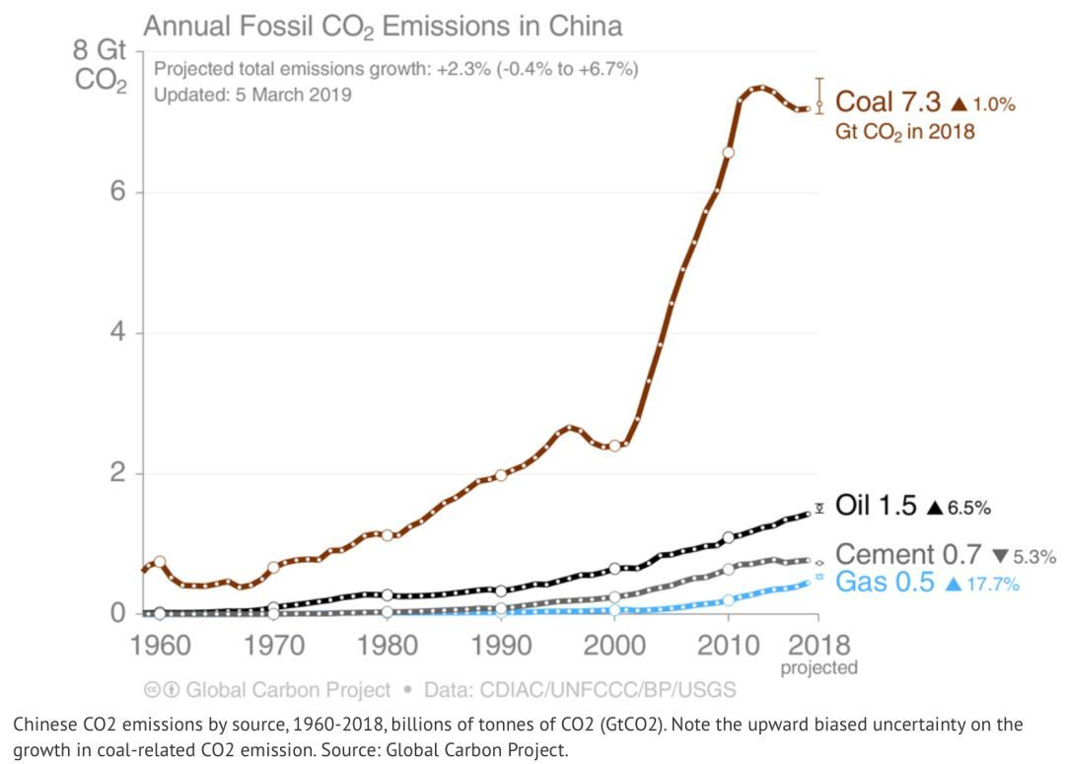
Research Background
World coal consumption, 1978-2019
Global share of total energy supply by source, 2018
CO₂ emissions by energy source, China 1990-2017
Coal is still the main fuel of the global energy system. Coal power accounts for nearly 40% of the world’s total power generation, and energy-related CO2 emissions exceed 40%.
In 2018, coal consumption accounted for 58% of my country’s primary energy consumption, and coal-fired CO2 emissions accounted for more than 75% of China energy consumption carbon emissions.

Slide 6
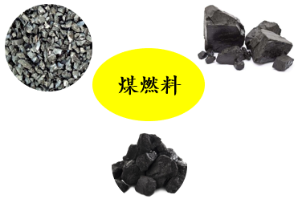

Research Background
O₂
Demineralization
Coal
Generator
Coal
Hyper-coal
Advanced
Turbine
Grid
Coal
Cycled H₂O
Storage
/EOR
CO₂
Condenser
emission
Greenhouse effect
problem
CO₂ Recovery
Water pollution
Water Processor
Waste of resources
Excess H₂O
OCCSS system
Efficient and clean
The thermal efficiency of the power plant can reach 53.4%, using deashed coal to remove impurities and pollutants before combustion
OCCSS
Use H2O to adjust the flame temperature to reduce the size of the system by 2/5
Lower cost
Doesn’t need the flue gas circulation equipment
High-concentration CO2 is directly obtained, and the capture cost is low
High resource utilization
Significantly reduce CO2 emissions while obtaining high-purity CO2 for utilization

Slide 7
<Research team> <Introduction> <Model> <Result> <Cooperation>

Slide 8
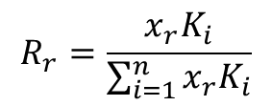
working condition
In order to analyze the influence of H₂O and different syngas composition on the discharge, this research calculates six cases with different composition: CO: H₂: O₂: H₂O as 1: 5: 3: 1, 2: 4: 3: 1, 3: 3: 3: 1, 4: 2: 3: 1, 5: 1: 3: 1, 1: 1: 1: 0.
cross section
The reaction collision cross section is from the www.Lxcat.net, where H₂ and H₂O are from the Morgan database, CO is from the Phelps database, and O₂ is from the Biagi database. Contains a total of 60 collision reactions, include rotational excited, vibrational excited, electronical excited, attachment, Dissociation and Ionization.
software and parameters
This research use the BOLSIG+ to calculate energy loss coefficient, mean energy of electron and Townsend coefficient. This software can be obtained from http://www.bolsig.laplace.univ-tlse.fr/ freely.
We use a new parameter energy loss coefficient ratio(Rr) to characterize the direction of electron energy deposition:
Among them, x represents the initial mole fraction of the reactant r, Ki is the energy loss coefficient[1], which represents the energy loss per unit time of a certain collision process i.
$$R_{r}=\frac{{x_{r}K}_{i}}{\sum_{i=1}^{n}{x_{r}K_{i}}}$$
[1]. G. J. M. Hagelaar and L. C. Pitchford, Solving the Boltzmann equation to obtain electron transport coefficients and rate coefficients for fluid models, Plasma Sources Sci. Technol. 2005, 14, 722-733.

Slide 9
<Research team> <Introduction> <Model> <Result> <Cooperation>

Slide 10
result and discussion
the energy loss fraction of H₂ and CO does not show a linear change with the change of the CO concentration in the mixed gas, and although the proportion of O₂ has not changed, the energy dissipation with O₂ excitation still has a relatively significant drop.
the lower the proportion of CO, the higher the mean energy during discharge.
when the reduced electric field is lower than 20 Td, the H₂O in the mixed gas absorbs most of the discharge energy, and the energy loss coefficient ratio of H₂ and CO is highly sensitive to the reduced electric field of the discharge.
Figure 1. Energy loss coefficient under different CO mole fraction
Figure 2. mean energy vs reduced electric field
Figure 3. The graph of the energy loss coefficient ratio versus the reduced electric field when the CO ratio is 0.3

Slide 11
<Research team> <Introduction> <Model> <Result> <Cooperation>

Slide 12
cooperation and contact
We have research interests in gas phase chemical reactions, plasma-assisted combustion, and clean utilization of fuels, and looking forward to cooperating with you!
Contact Email: xxx@hit.edu.cn Tel: (+86) 1111111111111111111111111

Slide 13





Numerical study of the mechanism of plasma enhanced syngas combustion
内容提纲
Спасибо за внимание ！
Thank you !

