Slide 1
Week3
Zhaoliang

Slide 2
Current Progress
Goal:
Identify error probabilities of u=0,1 for n dimensional case not just at last time step:t+1, but also t+1:t+n
To have the ability to calculate n-d binary hypothesis testing
Deliverables:
Structurized code
A simulation that generates simulation data with input of sequential ut
Different figures that show simulated n-d data with different sequential ut
A program that proceeds binary hypothesis testing on n-d data
Figures that show different situations for different relationship between 2d data.

Slide 3
Structurized code
Core programs
Utility programs
Simulation-nd
Plot figures-nd
✓
✓
Kalman filter-nd
✓
Convert_data-nd
✓
Planning-nd
Combine Matrices
✓
✓

Slide 4
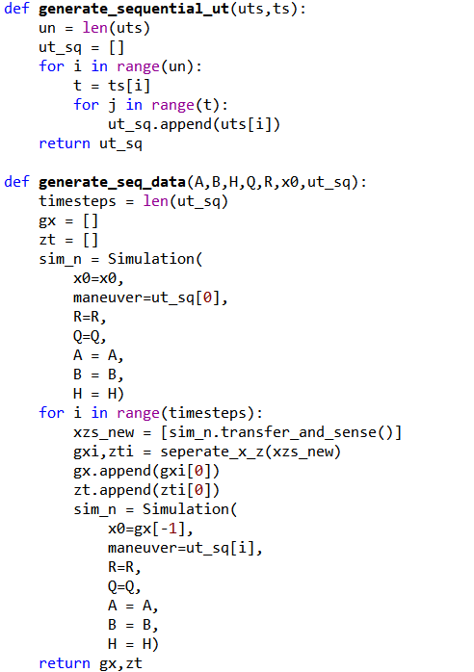
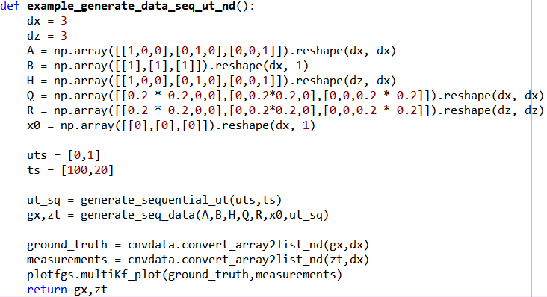
Generate sequential ut
This simulation is to generate sequential ut based on inputs ut and time span ts.
System matrices would determine the dimension of our simulated data

Slide 5
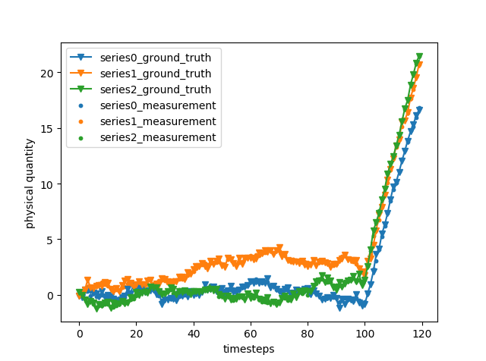
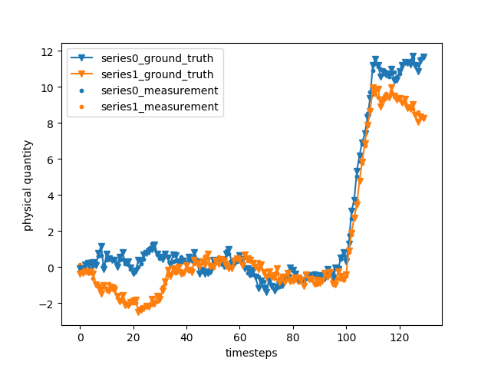
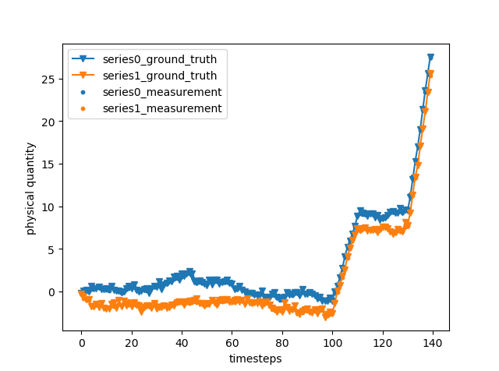
Show the simulated results with sequential ut
nd = 3
uts = [0,1]
ts = [100,20]
nd = 2
uts = [0,1,0]
ts = [100,10,20]
nd = 2
uts = [0,1,0,2]
ts = [100,10,20,10]

Slide 6
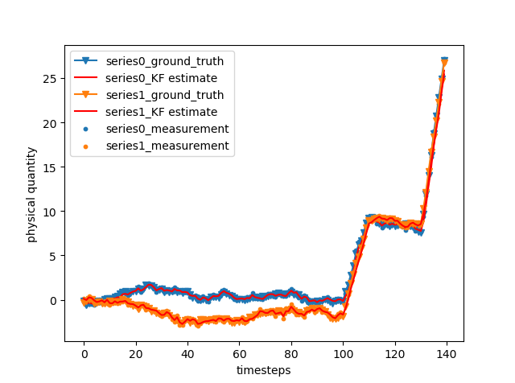
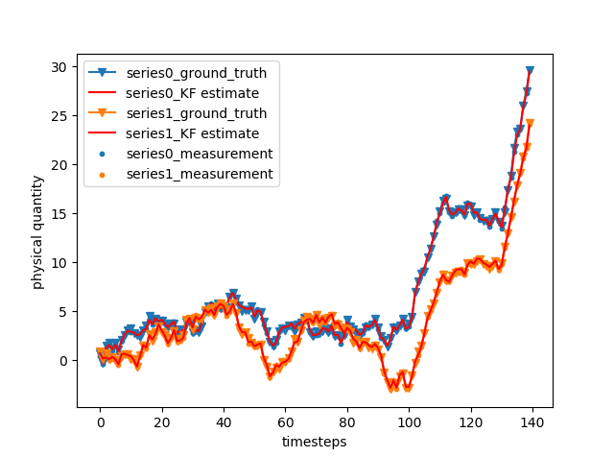
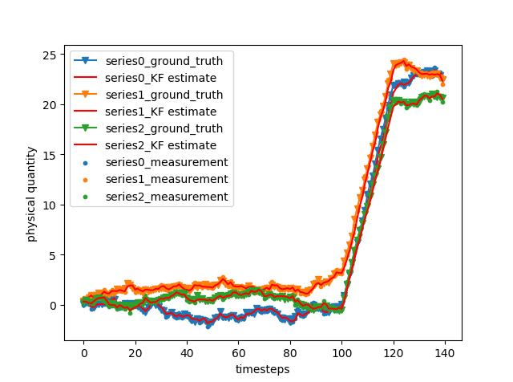
KF estimate on n-d data
Simulated data with different A,B,H,Q,R, and different sequential ut can be estimated.

Slide 7
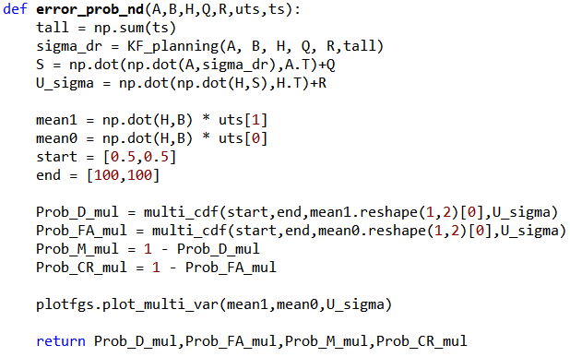
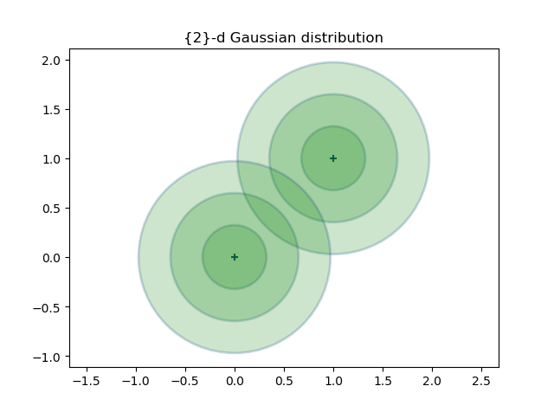

Binary hypothesis testing on n-d data
Multivariate_gaussian distribution:
$f\left(x\right)=\frac{1}{\sqrt{{\left(2π\right)}^{k}detΣ}}exp⁡(−\frac{1}{2}{\left(x−μ\right)}^{T}Σ^{−1}(x−μ))$
$P_{D}=∫_{λ }^{∝}f_{H_{1}}\left(U\right)dU= ∫_{λ }^{∝}N^{k}\left(HB∗1,σ^{2}\right)$
$P_{FA}=∫_{λ }^{∝}f_{H_{0}}\left(U\right)dU=∫_{λ }^{∝}N^{k}\left(HB∗0,σ^{2}\right)$
Where k represents the n-dimensional data

Slide 8
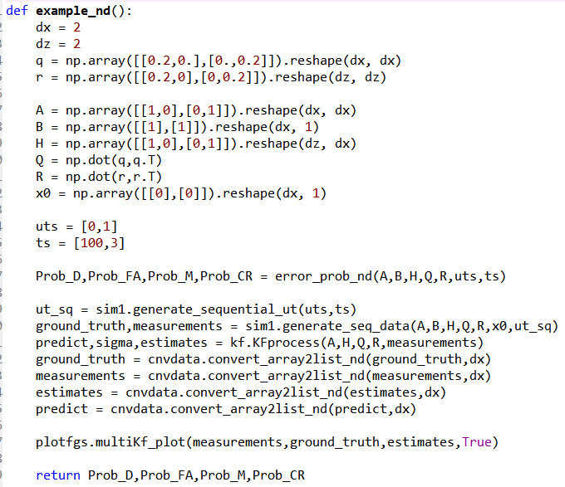
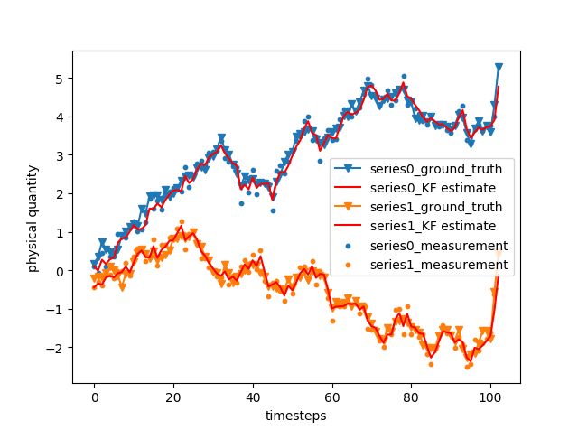
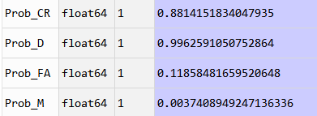

Show the results
The example function here is to show one example of calculating $P_{D}$, $P_{FA}$, $P_{M}$, $P_{CR}$

Slide 9
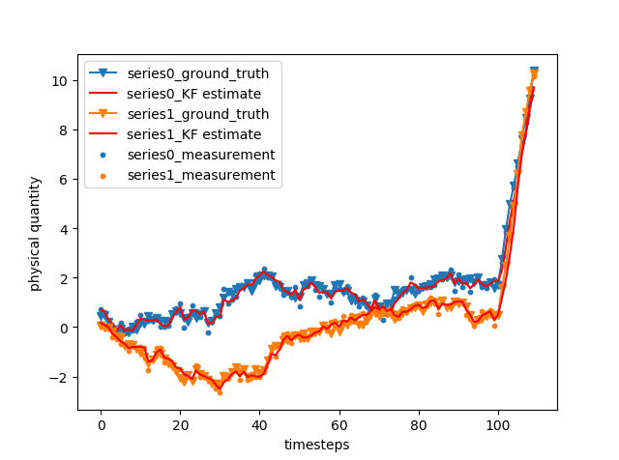
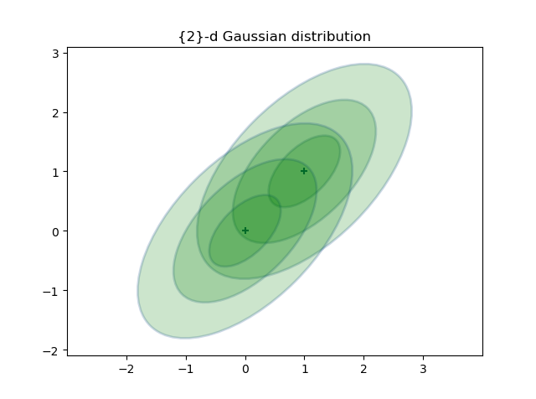
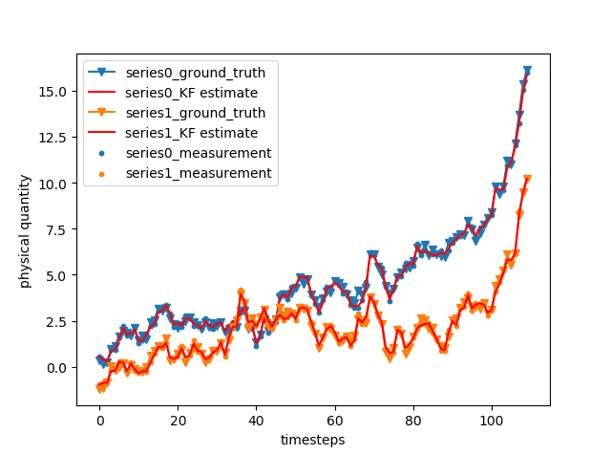
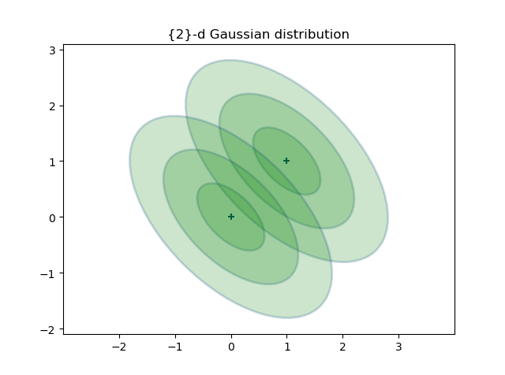
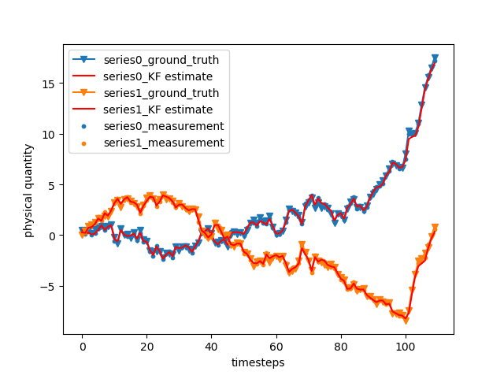
Different situations
Case 1:
uts = [0,1];ts = [100,10]
Variables are independent of each other
Case 2:
uts = [0,1];ts = [100,10]
Variables have positive correlation
Case 3:
uts = [0,1];ts = [100,10]
Variables have negative correlation

Slide 10



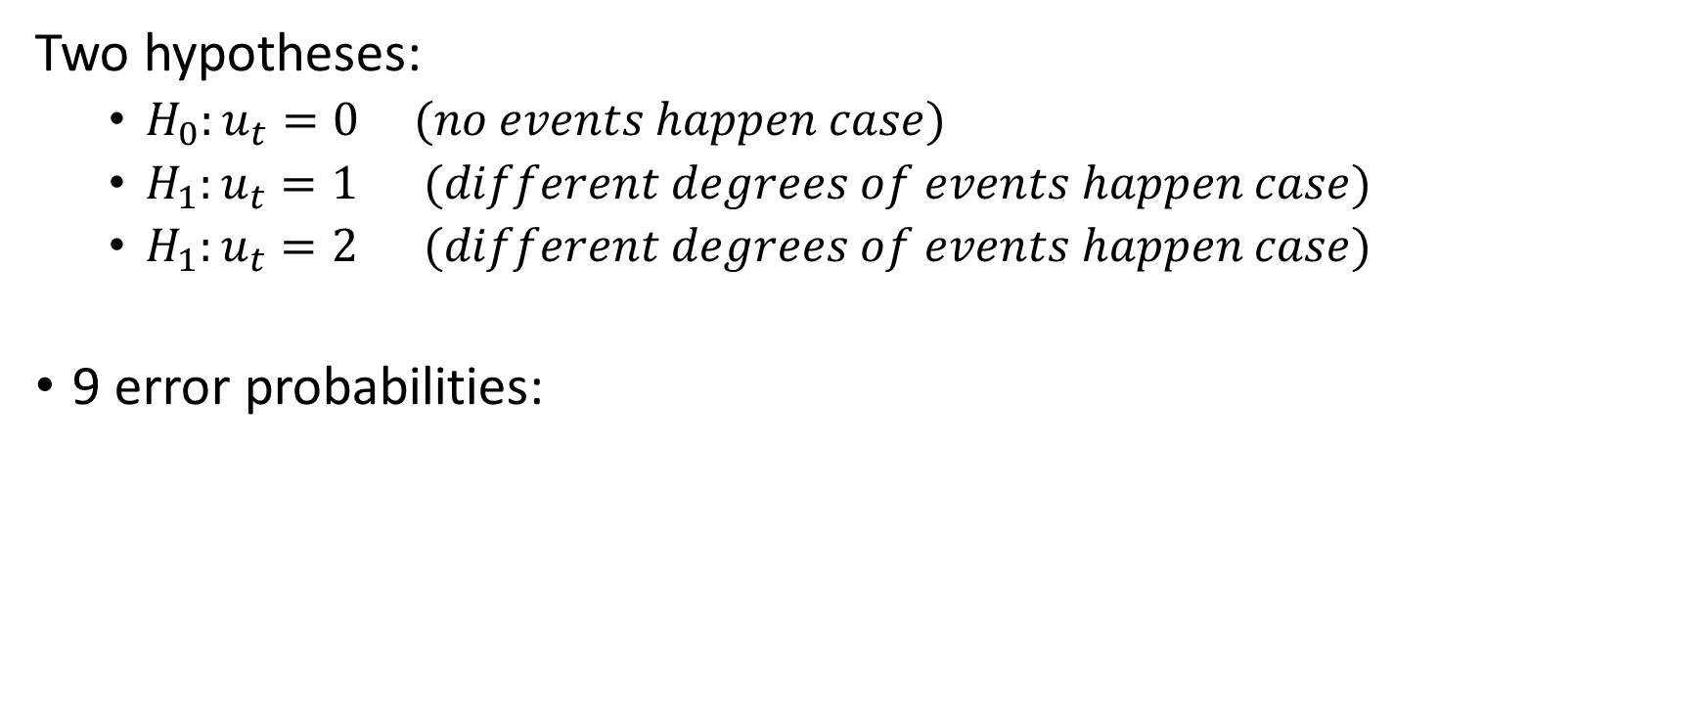






Multi-hypothesis testing?
Two hypotheses:
$H_{0}:u_{t}=0 (no events happen case)$
$H_{1}:u_{t}=1 (different degrees of events happen case)$
$H_{1}:u_{t}=2 (different degrees of events happen case)$
9 error probabilities:
$$Prob\{decide H_{0}|H_{0} true\}$$
$$Prob\{decide H_{1}|H_{1} true\}$$
$$Prob\{decide H_{2}|H_{2} true\}$$
$$Prob\{decide H_{1}|H_{0} true\}$$
$$Prob\{decide H_{0}|H_{1} true\}$$
$$Prob\{decide H_{0}|H_{2} true\}$$
$$Prob\{decide H_{2}|H_{0} true\}$$
$$Prob\{decide H_{2}|H_{1} true\}$$
$$Prob\{decide H_{1}|H_{2} true\}$$

