Slide 1
Week3
Zhaoliang

Slide 2
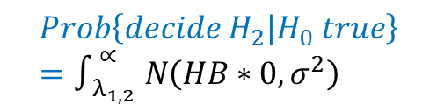

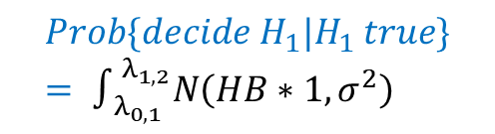
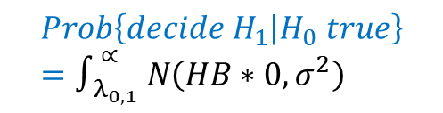


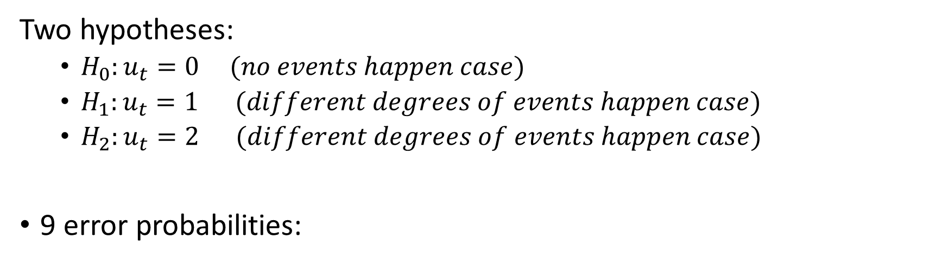

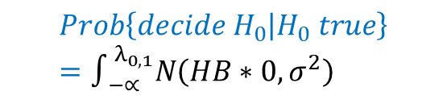
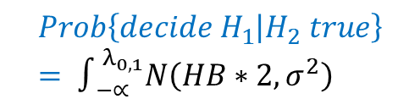
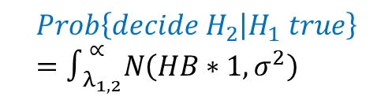

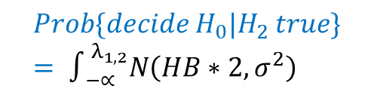
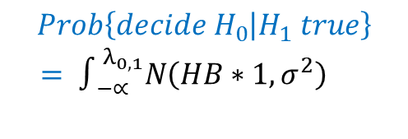
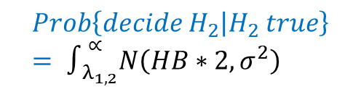

Multi-hypothesis testing
$$f_{H_{0}}\left(U\right)$$
$$f_{H_{1}}\left(U\right)$$
$$f_{H_{2}}\left(U\right)$$
Two hypotheses:
$H_{0}:u_{t}=0 (no events happen case)$
$H_{1}:u_{t}=1 (different degrees of events happen case)$
$H_{2}:u_{t}=2 (different degrees of events happen case)$
9 error probabilities:
$$λ_{0,1}$$
$$λ_{1,2}$$
$$U$$
$$Prob\left\{decide H_{0} | H_{0} true\right\}=∫_{−∝}^{λ_{0,1}}N\left(HB∗0,σ^{2}\right)$$
$$Prob\{decide H_{1}|H_{1} true\}= ∫_{λ_{0,1} }^{λ_{1,2}}N\left(HB∗1,σ^{2}\right)$$
$$Prob\left\{decide H_{2} | H_{2} true\right\}= ∫_{λ_{1,2}}^{∝}N\left(HB∗2,σ^{2}\right)$$
$$Prob\left\{decide H_{1} | H_{0} true\right\}=∫_{λ_{0,1} }^{∝}N\left(HB∗0,σ^{2}\right)$$
$$Prob\left\{decide H_{0} | H_{1} true\right\}$$
$= ∫_{−∝}^{λ_{0,1}}N\left(HB∗1,σ^{2}\right)$
$$Prob\{decide H_{0}|H_{2} true\}= ∫_{−∝}^{λ_{1,2}}N\left(HB∗2,σ^{2}\right)$$
$$Prob\left\{decide H_{2} | H_{0} true\right\}=∫_{λ_{1,2} }^{∝}N\left(HB∗0,σ^{2}\right)$$
$$Prob\left\{decide H_{2} | H_{1} true\right\}=∫_{λ_{1,2}}^{∝}N\left(HB∗1,σ^{2}\right)$$
$$Prob\left\{decide H_{1} | H_{2} true\right\}= ∫_{−∝}^{λ_{0,1}}N\left(HB∗2,σ^{2}\right)$$

