Slide 1
Binary hypothesis testing on n-d data
Zhaoliang

Slide 2
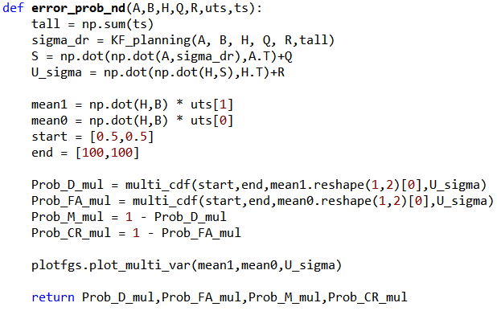
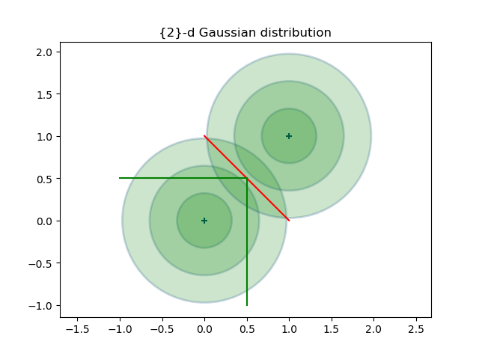
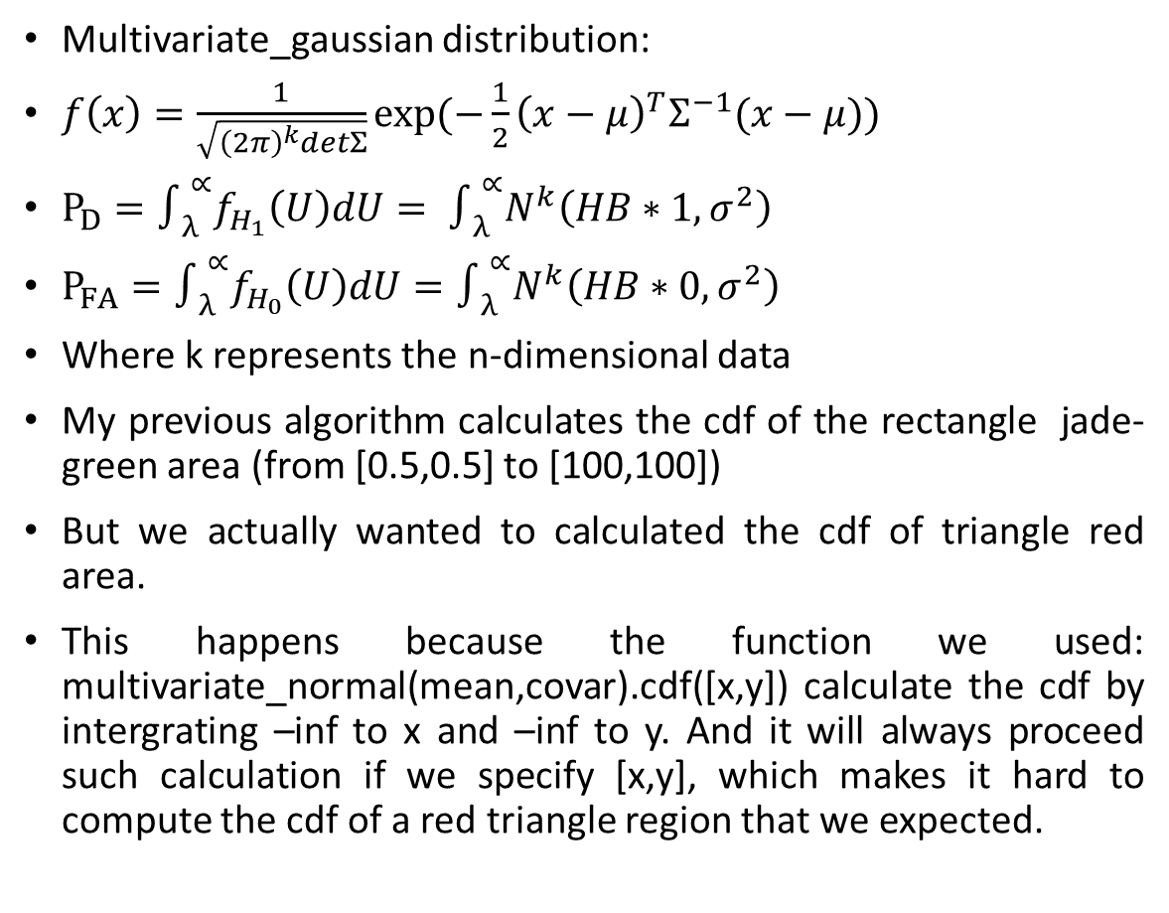
Previous mistakes
Multivariate_gaussian distribution:
$f\left(x\right)=\frac{1}{\sqrt{{\left(2π\right)}^{k}detΣ}}exp⁡(−\frac{1}{2}{\left(x−μ\right)}^{T}Σ^{−1}(x−μ))$
$P_{D}=∫_{λ }^{∝}f_{H_{1}}\left(U\right)dU= ∫_{λ }^{∝}N^{k}\left(HB∗1,σ^{2}\right)$
$P_{FA}=∫_{λ }^{∝}f_{H_{0}}\left(U\right)dU=∫_{λ }^{∝}N^{k}\left(HB∗0,σ^{2}\right)$
Where k represents the n-dimensional data
My previous algorithm calculates the cdf of the rectangle jade-green area (from [0.5,0.5] to [100,100])
But we actually wanted to calculated the cdf of triangle red area.
This happens because the function we used: multivariate_normal(mean,covar).cdf([x,y]) calculate the cdf by intergrating –inf to x and –inf to y. And it will always proceed such calculation if we specify [x,y], which makes it hard to compute the cdf of a red triangle region that we expected.

Slide 3
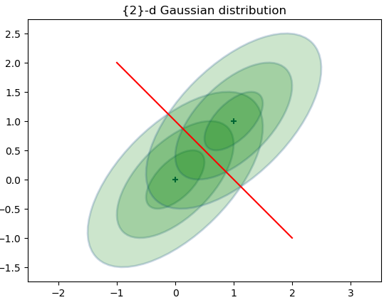
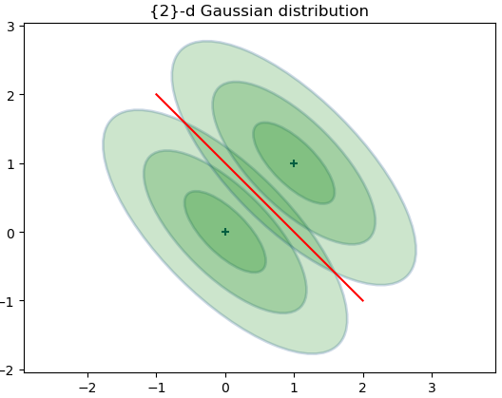
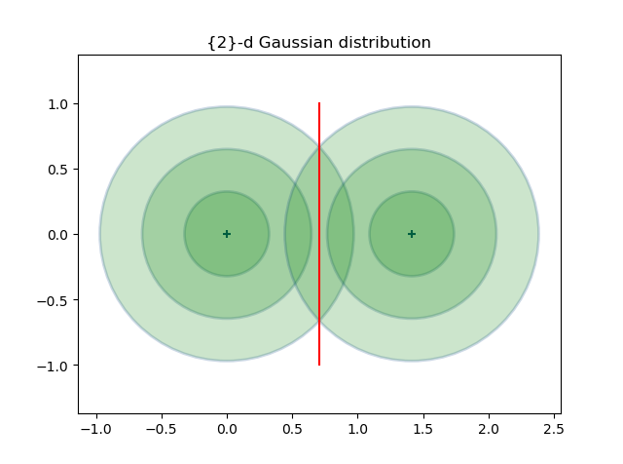
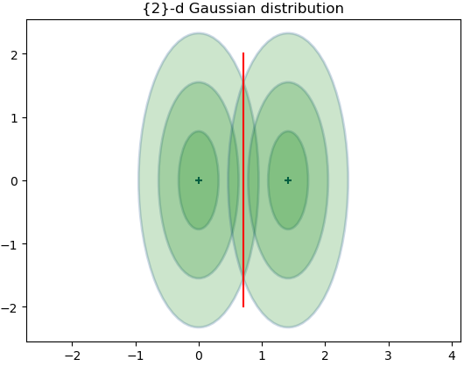
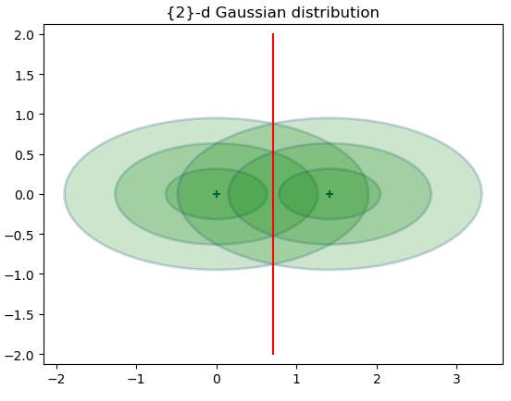
Method1: one solution for 2d case
Used SVD to “rotate” the mean of two Gaussian distributions to the X-axis:

Slide 4
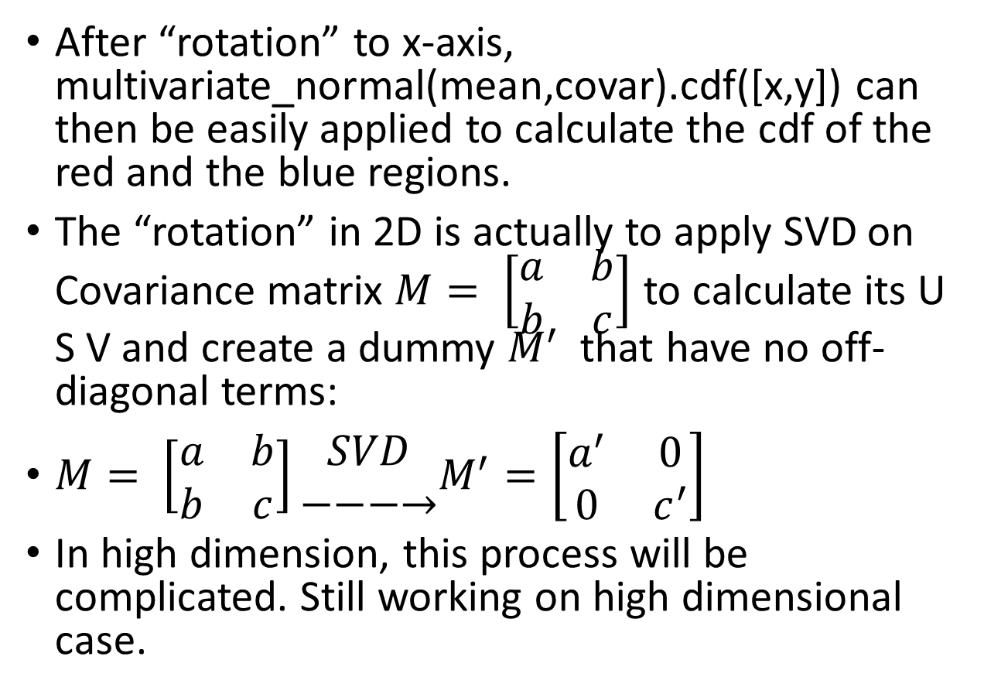
Compute cdf of a particular 2D area
After “rotation” to x-axis, multivariate_normal(mean,covar).cdf([x,y]) can then be easily applied to calculate the cdf of the red and the blue regions.
The “rotation” in 2D is actually to apply SVD on Covariance matrix $M= \left[\begin{matrix}a & b \\ b & c\end{matrix}\right]$ to calculate its U S V and create a dummy $M^{′}$ that have no off-diagonal terms:
$M= \left[\begin{matrix}a & b \\ b & c\end{matrix}\right]\begin{matrix}SVD \\ −−−→\end{matrix}M^{′}=\left[\begin{matrix}a^{′} & 0 \\ 0 & c^{′}\end{matrix}\right]$
In high dimension, this process will be complicated. Still working on high dimensional case.

Slide 5
Method2: The other solution
To sum the pdf of region like an integral in 1d case.
Defect: This will be computationally heavy when it come to n-dimension.

