Slide 1
Week2
Zhaoliang

Slide 2
Current Progress
Goal:
To have the ability to extend the simulation to a sensor with multiple2 observation case(n-dimensional case)
To generate simulated data that capture u=0,1,2… at the last time step
Deliverables:
A program dedicated to drawing statistical histograms and comparisons
A simulation that could generate n-dimensional data
A simulation that generates simulated data when u=0,1,2… at the last time step given n-d ABHQR
A algorithm that combines ABHQR of multiple observation

Slide 3
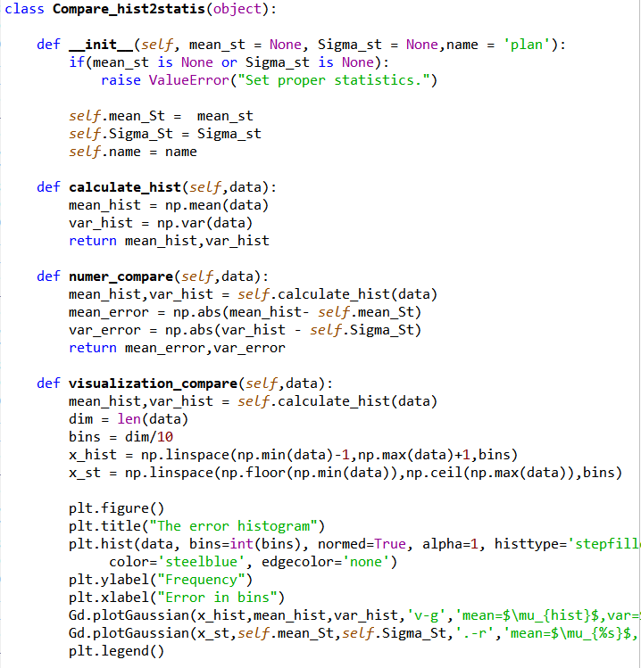
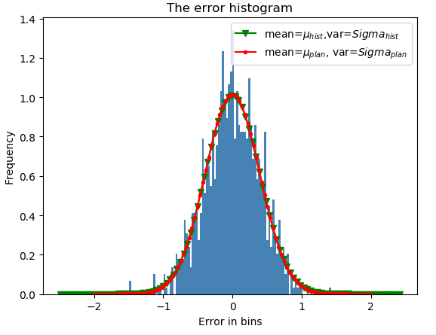
Statistical histograms and comparisons
This program is going to take statistical data to calculate its mean and variance and then to compare with the theoretical mean and variance.

Slide 4
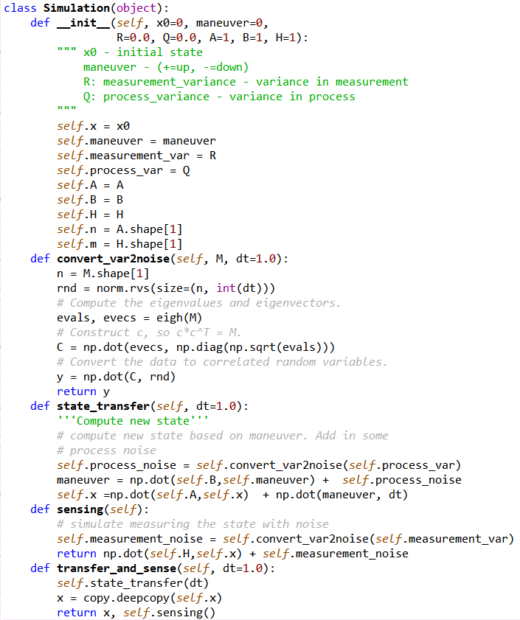

A simulation (n-dimension)
For any symmetric matrix, eigenvalue decomposition(EVD) exists:
$Σ=UΛU^{T}=\left(UΛ^{\frac{1}{2}}\right){\left(UΛ^{\frac{1}{2}}\right)}^{T}=CC^{T}$
The code implementation is on the right.

Slide 5
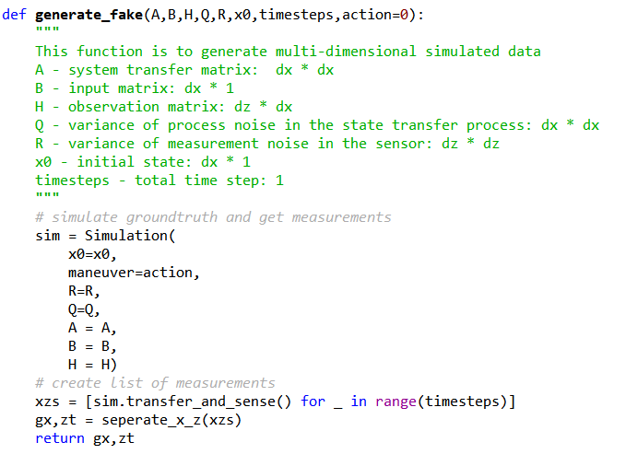
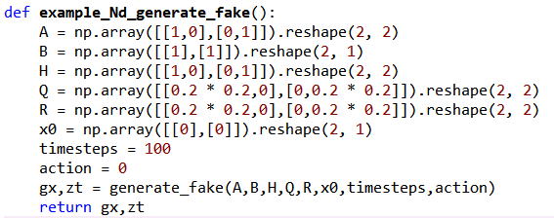
Generate n-d data
Generate_fake function is to generate simulated data and output ground truth data and measurements.
The example function shows the ability that given n-d ABHQR, we could now generate n-d data.

Slide 6
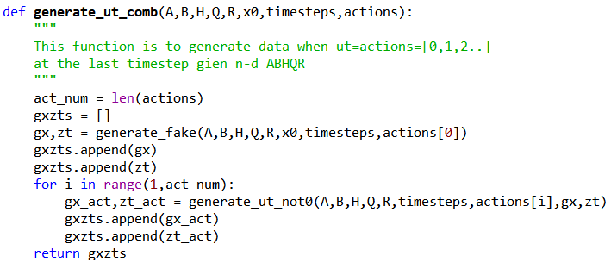
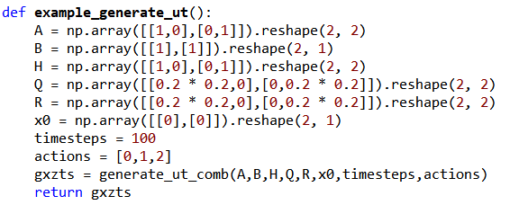
A simulation (u=0,1,2.. For n-d)
Generate_ut_comb takes random actions (ex:[0,1,2],[0,1]) as input and output the simulated data in different scenarios.
Example here shows that given nd ABHQR, we now have the ability to generate simulated data given ut = stochastic actions at the last time step.

Slide 7
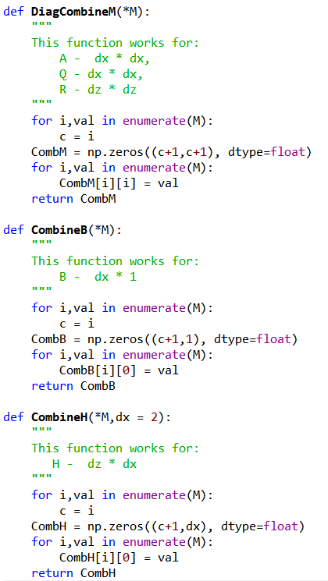
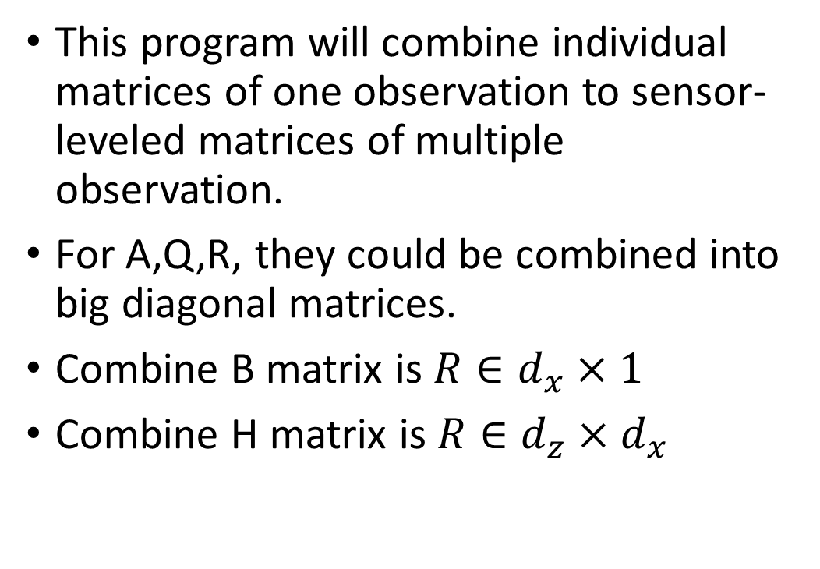
Combine system matrices
This program will combine individual matrices of one observation to sensor-leveled matrices of multiple observation.
For A,Q,R, they could be combined into big diagonal matrices.
Combine B matrix is $R∈d_{x}×1$
Combine H matrix is $R∈d_{z}×d_{x}$

