Slide 1
Test Hypothesis 1D
Zhaoliang

Slide 2
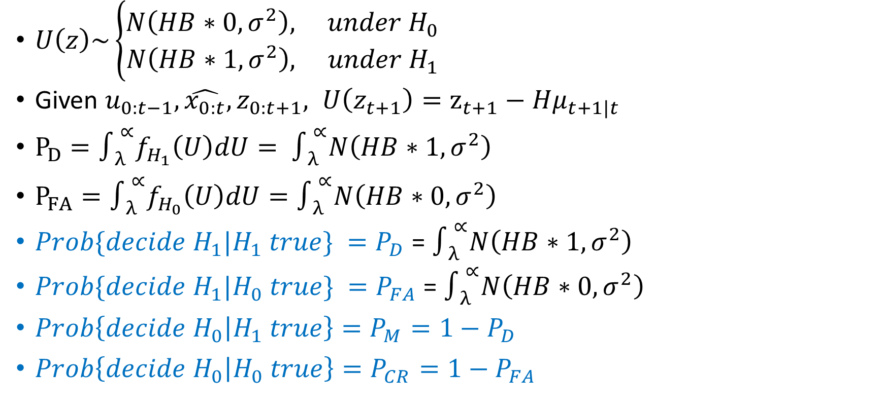
Equations recall
$U\left(z\right)\sim \left\{\begin{aligned}N\left(HB∗0,σ^{2}\right), under H_{0} \\ N\left(HB∗1,σ^{2}\right), under H_{1}\end{aligned}\right.$
Given $u_{0:t−1},\hat{x_{0:t}}, z_{0:t+1}, U\left(z_{t+1}\right)=z_{t+1}−Hμ_{t+1|t}$
$P_{D}=∫_{λ }^{∝}f_{H_{1}}\left(U\right)dU= ∫_{λ }^{∝}N\left(HB∗1,σ^{2}\right)$
$P_{FA}=∫_{λ }^{∝}f_{H_{0}}\left(U\right)dU=∫_{λ }^{∝}N\left(HB∗0,σ^{2}\right)$
$Prob\{decide H_{1}|H_{1} true\} =P_{D}$ = $∫_{λ }^{∝}N\left(HB∗1,σ^{2}\right)$
$Prob\{decide H_{1}|H_{0} true\} =P_{FA}$ = $∫_{λ }^{∝}N\left(HB∗0,σ^{2}\right)$
$Prob\left\{decide H_{0} | H_{1} true\right\}=P_{M}=1−P_{D}$
$Prob\left\{decide H_{0} | H_{0} true\right\}=P_{CR}=1−P_{FA}$

Slide 3
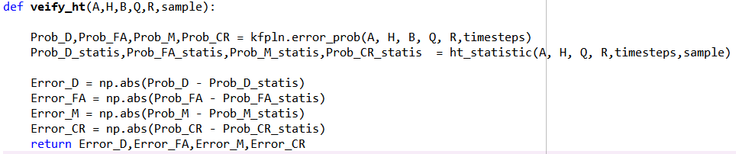
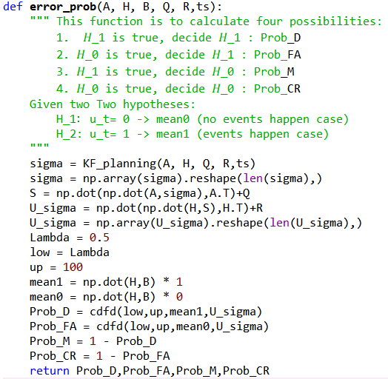
Code implementation
Error_prob in KF planning calculates the error probabilities based on equations.

Slide 4
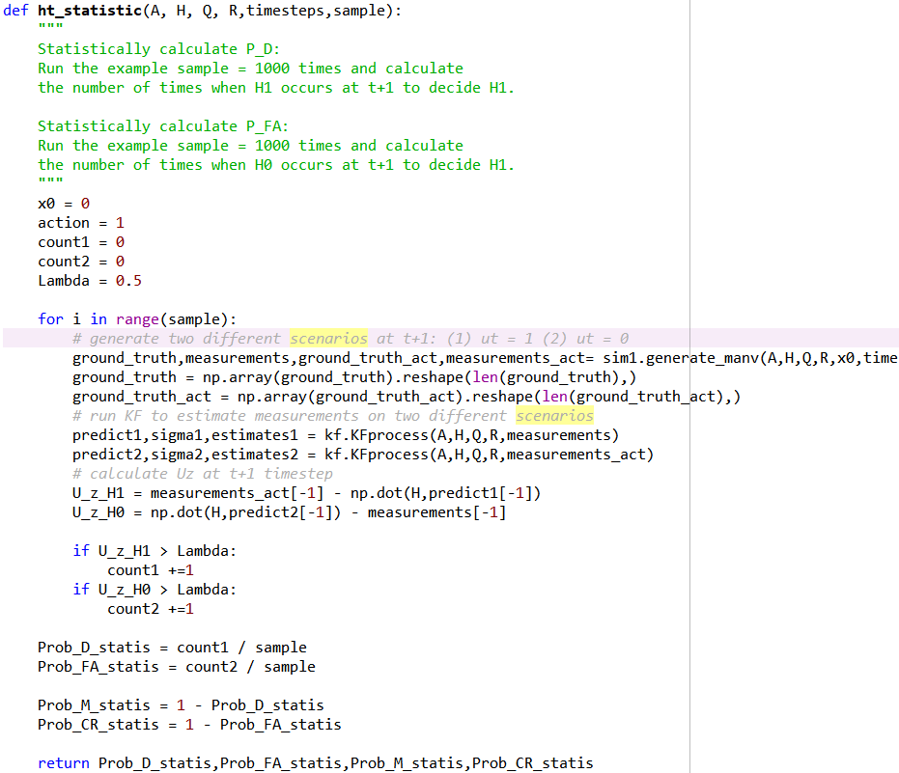
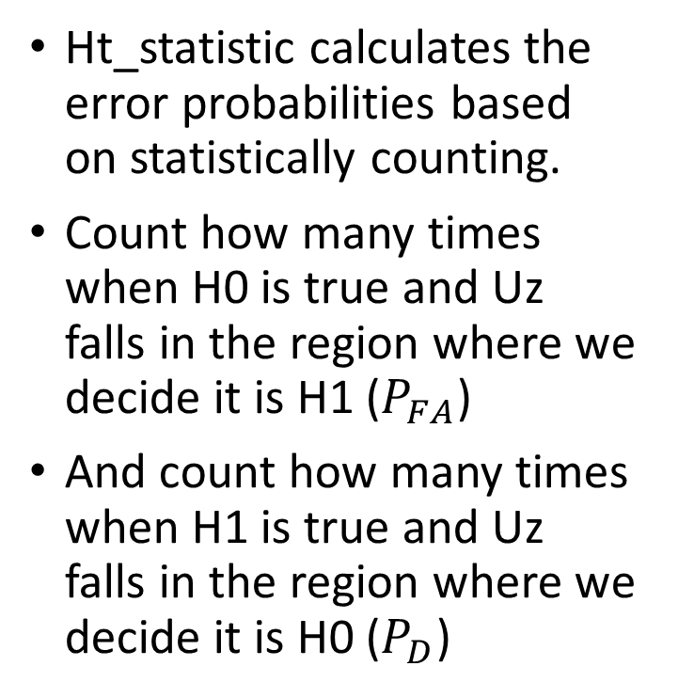
Statistical Calculation
Ht_statistic calculates the error probabilities based on statistically counting.
Count how many times when H0 is true and Uz falls in the region where we decide it is H1 ($P_{FA}$)
And count how many times when H1 is true and Uz falls in the region where we decide it is H0 ($P_{D}$)

