Slide 1
Testing different n-d A,B,H,Q,R
zhaoliang

Slide 2
Problem clarification
In the testing, we are going to test my algorithm given different A,B,H,Q,R
Outputs two kinds of figures:
KF estimate
Error between ground truth and estimate can be drawn in gaussian with co-variance Sigma from KF planning
Progress:
Through running different A,B,H,Q,R combination, debugged some part of my code to make it more general.

Slide 3
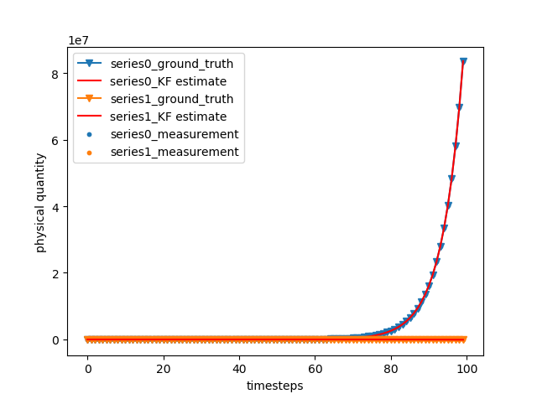
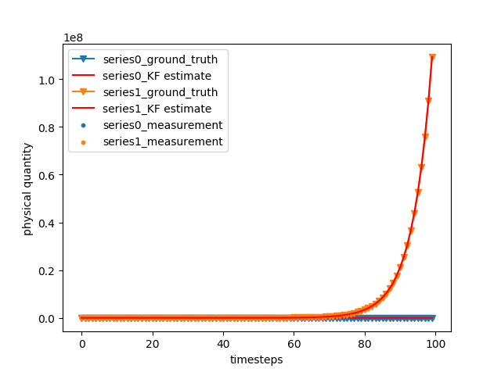
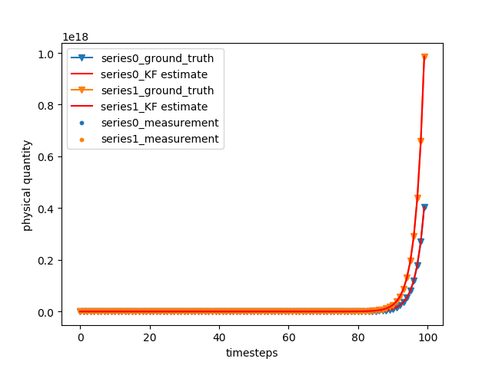
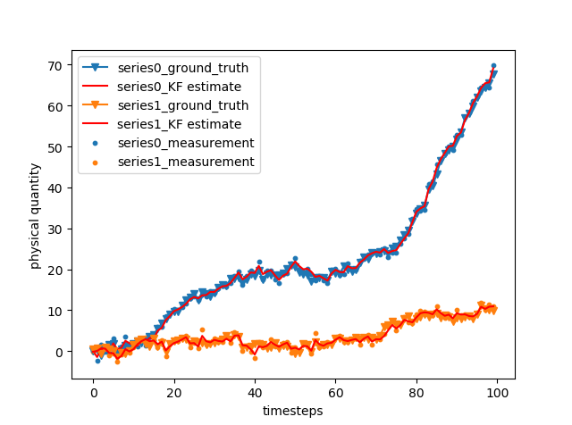
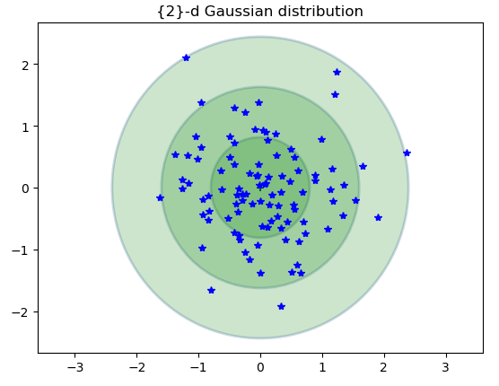
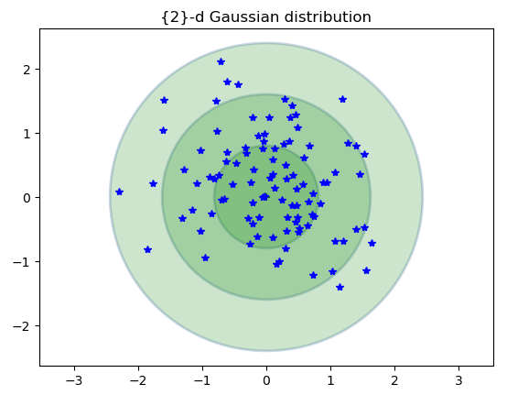
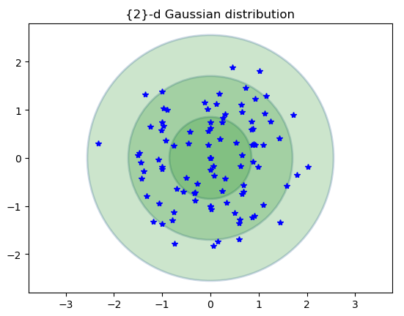
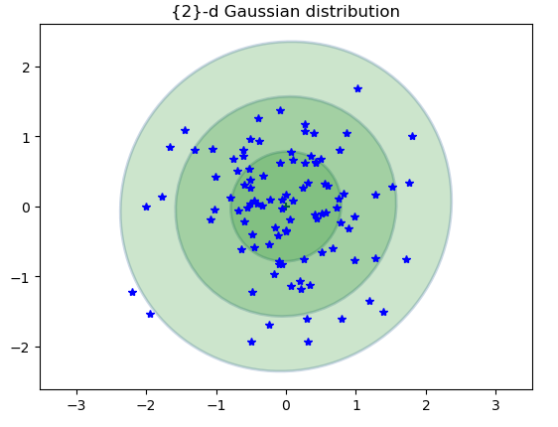




Different A with t=100
$A= \left[\begin{matrix}1.2 & 0 \\ 0 & 1.1\end{matrix}\right]$
$A= \left[\begin{matrix}1.1 & 0 \\ 0 & 1.2\end{matrix}\right]$
$A= \left[\begin{matrix}1.5 & 0 \\ 0 & 1.5\end{matrix}\right]$
$A= \left[\begin{matrix}1. & 0.2 \\ 0 & 1.\end{matrix}\right]$

Slide 4
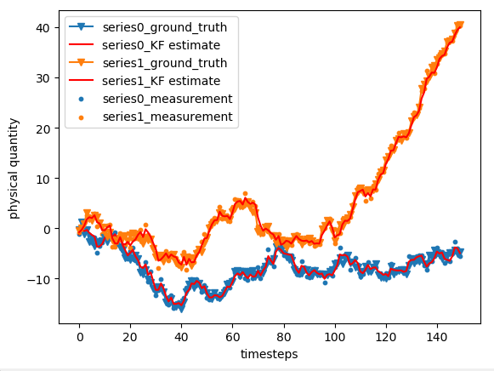
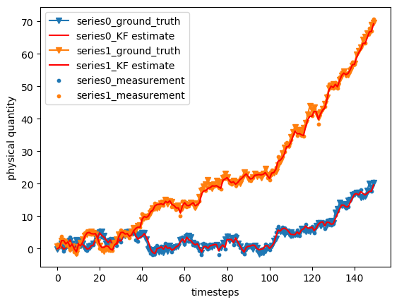
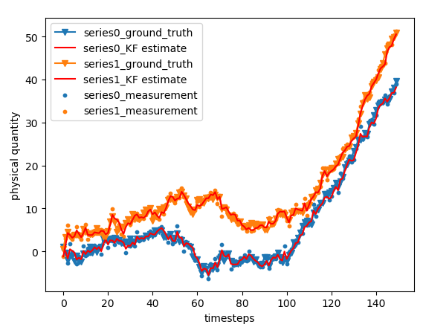
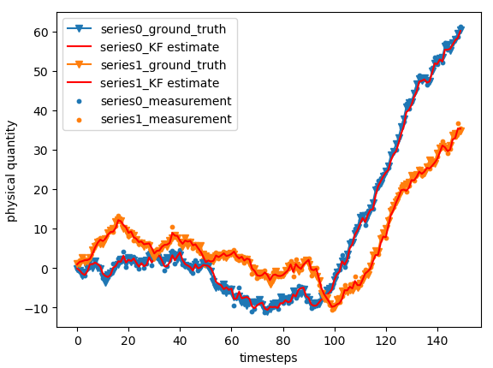
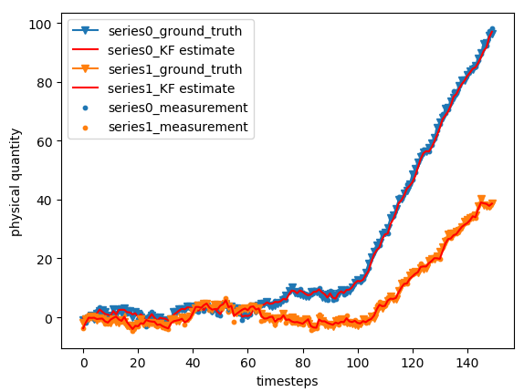
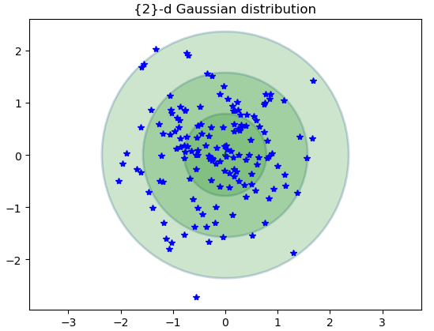
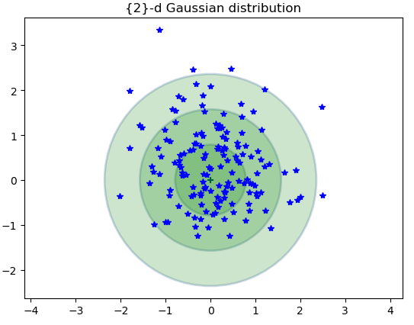
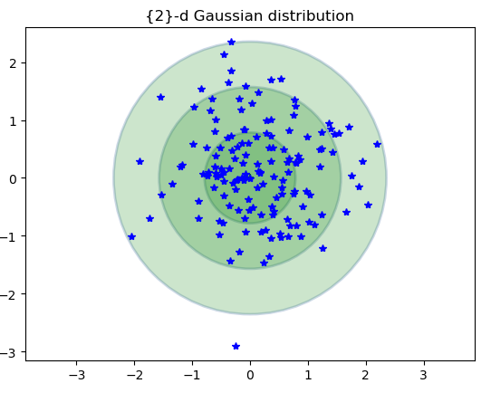
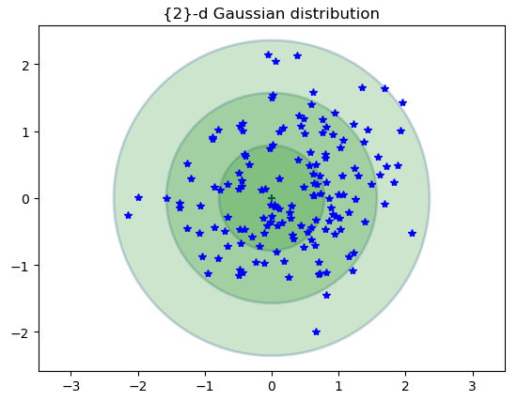
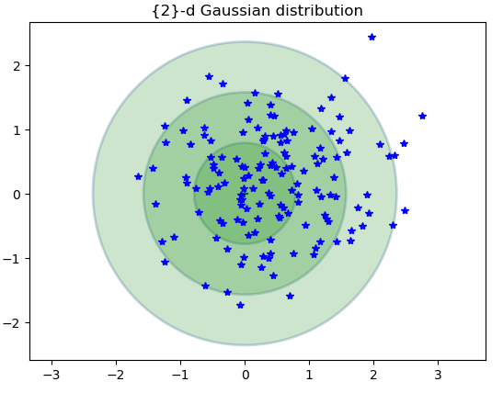

Different B with t1= 100 for ut=0 and t2 = 50 for ut =1
$B= \left[\begin{matrix}0.1−2.1 \\ 1\end{matrix}\right]$

Slide 5
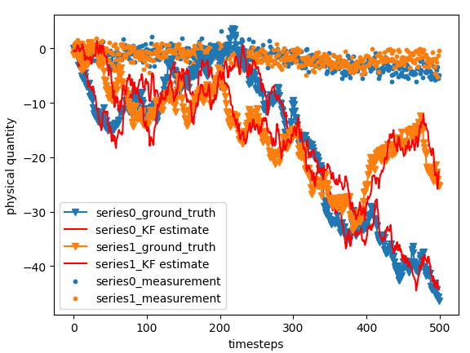
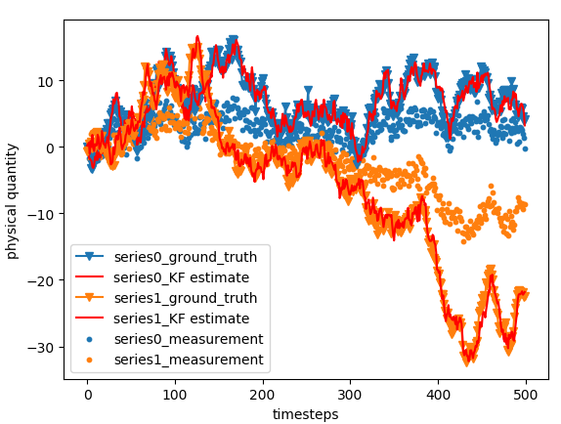
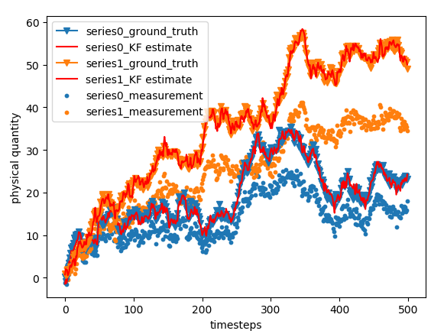
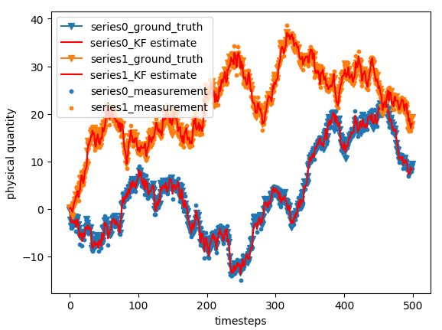
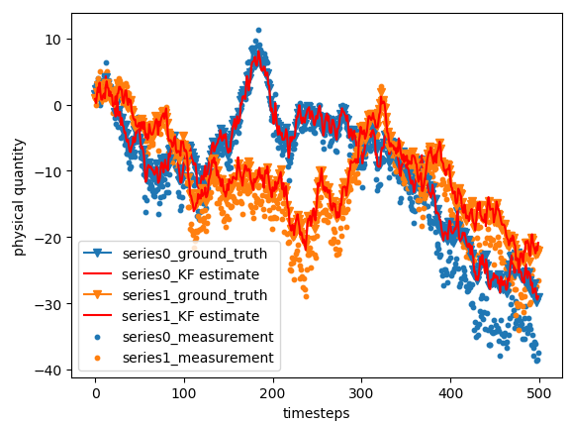
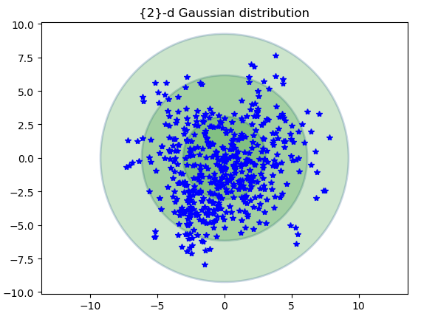
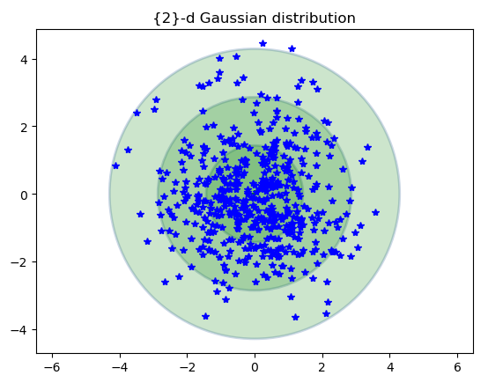
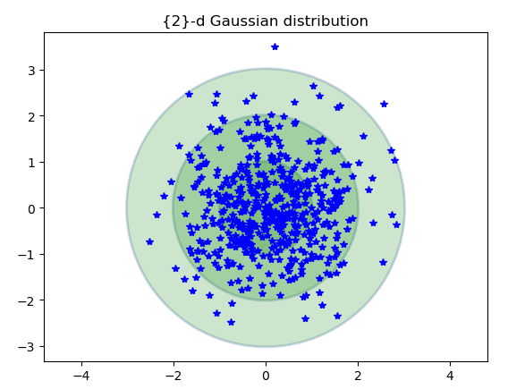
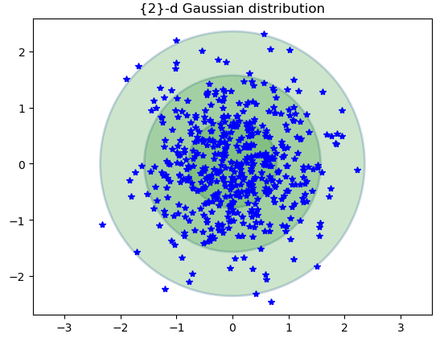
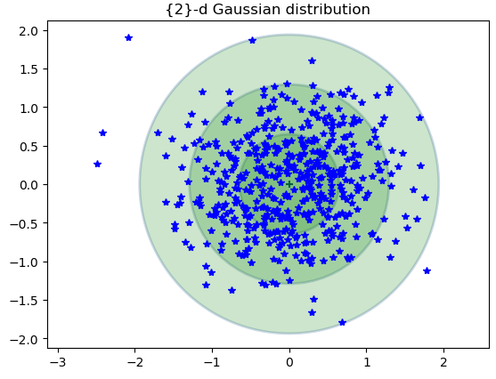

Different H with t= 500
$H= \left[\begin{matrix}0.1−1.6 & 0 \\ 0 & 0.1−1.6\end{matrix}\right]$

Slide 6
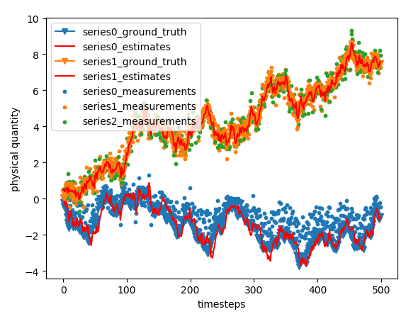
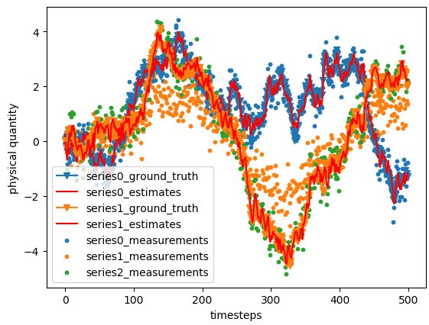
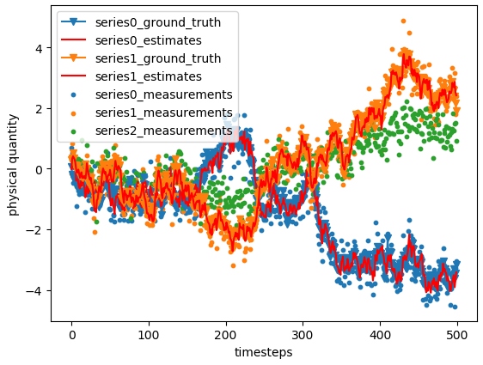
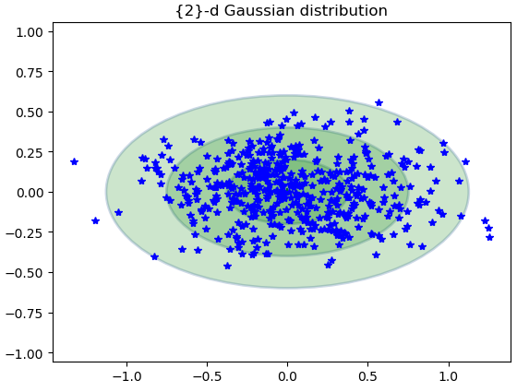
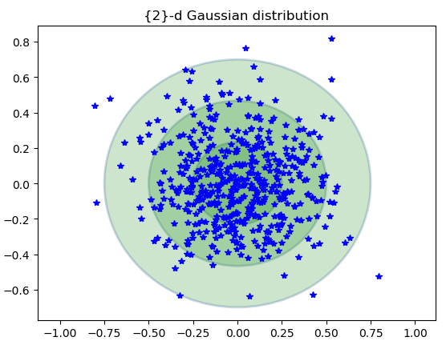
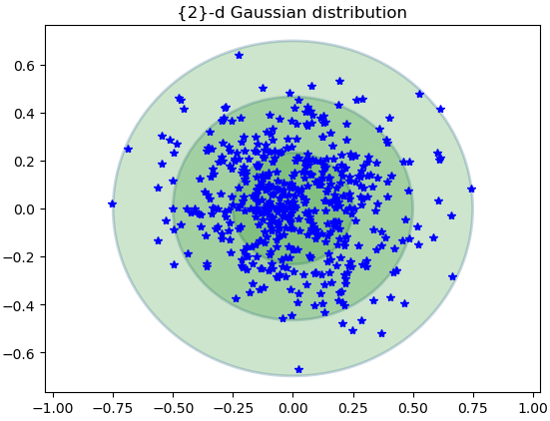

Different H with t= 500
$H= \left[\begin{matrix}0.5−1 & 0 \\ 0 & 0.5−1 \\ 0 & 0.5−1\end{matrix}\right]∈R^{3×2} dz ≠dx$

Slide 7
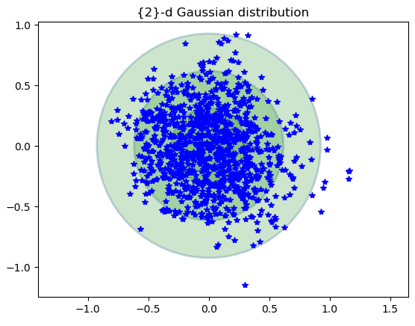
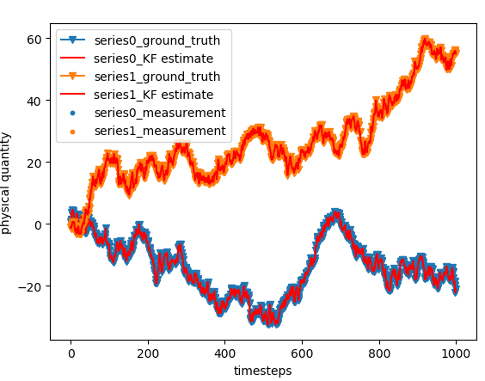
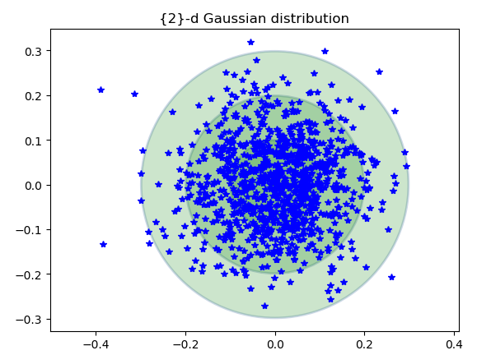
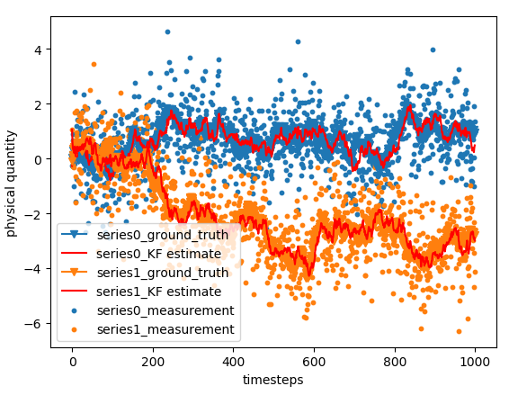
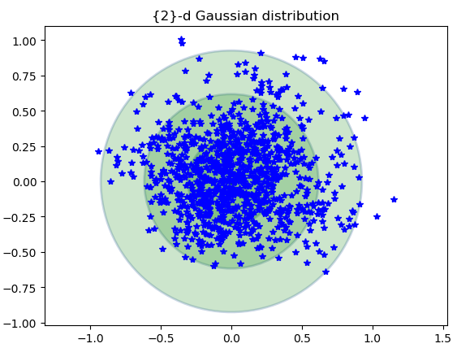
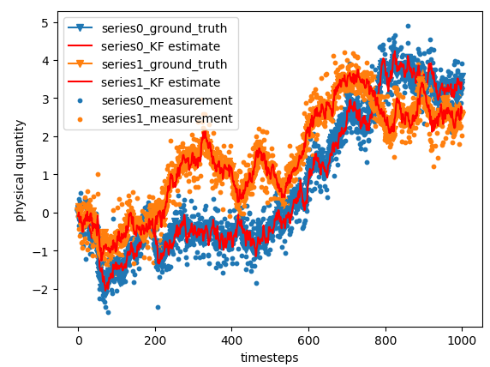
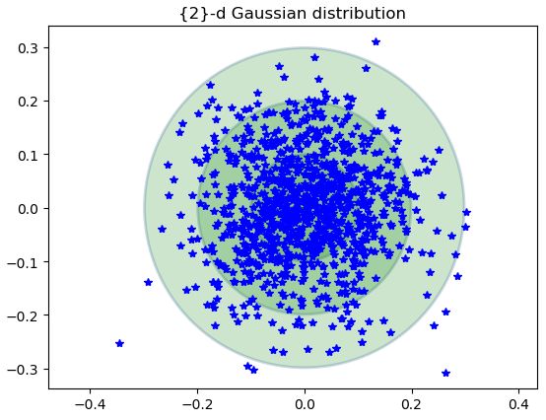
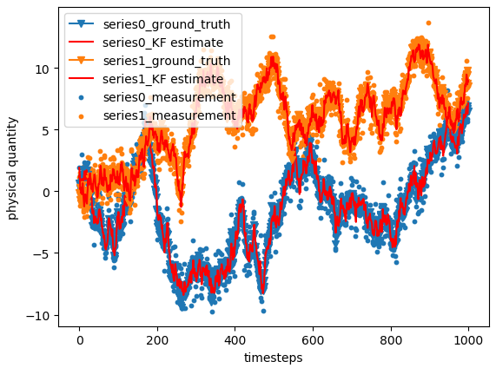
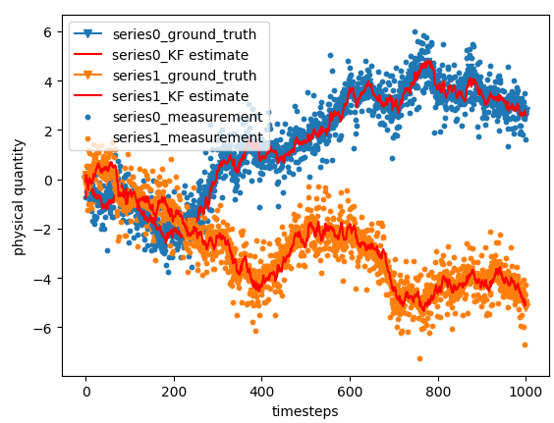
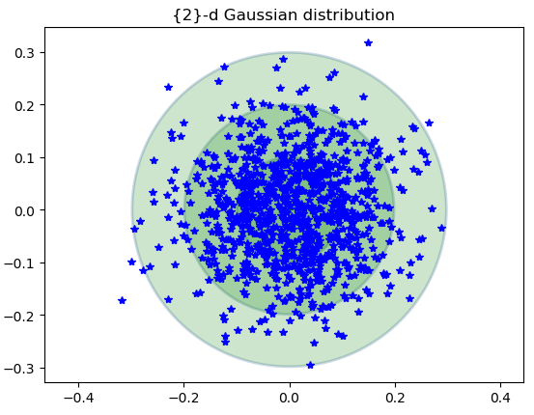
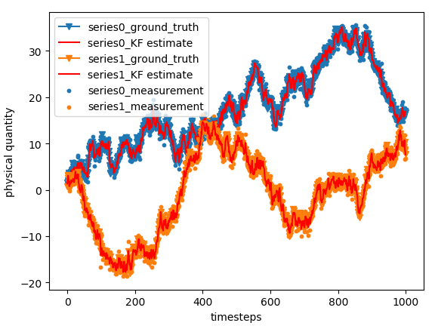
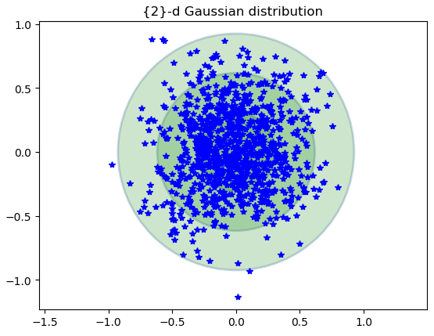
Different Q,R with t= 1000
$$Q= \left[\begin{matrix}0.1−1.2 & 0 \\ 0 & 0.1−1.2\end{matrix}\right]$$
$$R= \left[\begin{matrix}0.1−1.2 & 0 \\ 0 & 0.1−1.2\end{matrix}\right]$$

