Slide 1
Comprehensive tests on n-d states
Zhaoliang

Slide 2
Comprehensive test
Goal:
Test the robustness of our n-d KF planning and n-d KF estimation algorithm
Setup:
Each set of individual variables will run the simulation data 1000 trials, and calculate the error between the ground truth value and the estimated value of each time step when the total time step is 100 or 1000.
For each trial, we will calculate the mean and the covariance of the error and compare to the Gaussian distribution with covariance calculated from KF planning algorithm.
Then compute the total compared error mean of those 1000 trials.

Slide 3
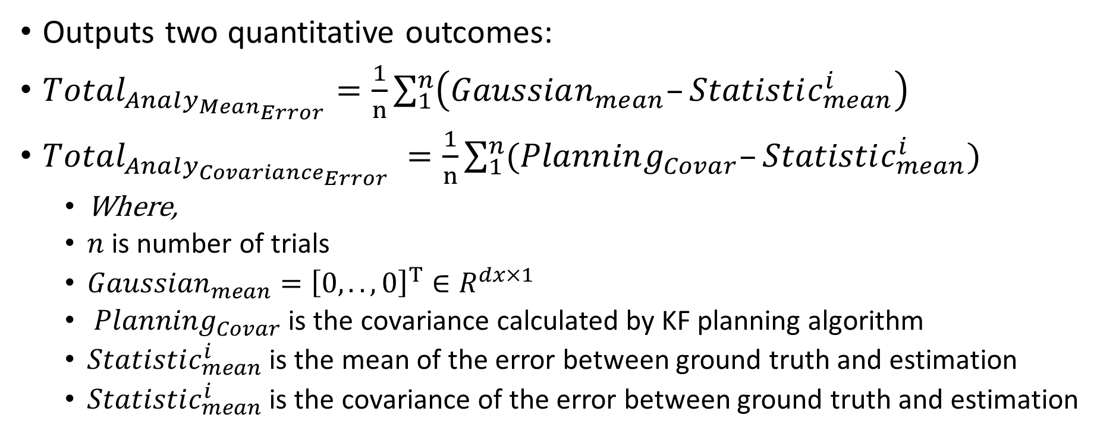
Comprehensive test pseudocode
Outputs two quantitative outcomes:
$Total_{Analy_{Mean_{Error}}}=\frac{1}{n}\sum_{1}^{n}{\left(Gaussian_{mean}–Statistic_{mean}^{i}\right) }$
$Total_{Analy_{Covariance_{Error}}} =\frac{1}{n}\sum_{1}^{n}{(Planning_{Covar}–Statistic_{mean}^{i})}$
Where,
$n$ is number of trials
$Gaussian_{mean}={\left[0,..,0\right]}^{T}∈R^{dx×1}$
$Planning_{Covar}$ is the covariance calculated by KF planning algorithm
$Statistic_{mean}^{i}$ is the mean of the error between ground truth and estimation
$Statistic_{mean}^{i}$ is the covariance of the error between ground truth and estimation

Slide 4

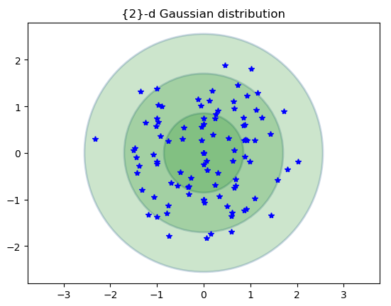



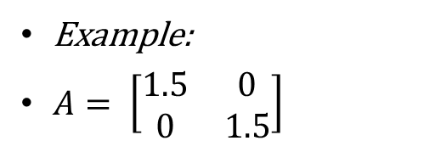

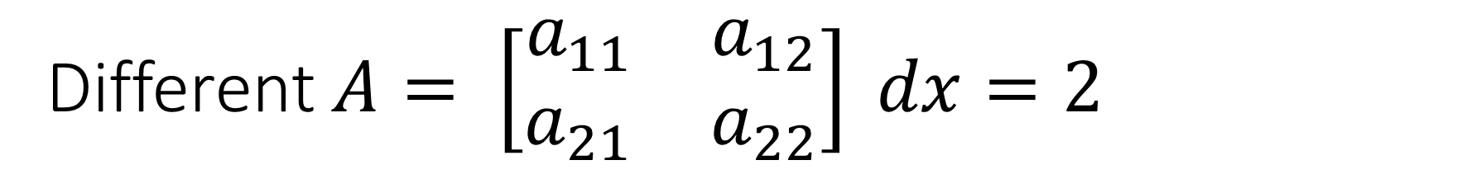
Different $A= \left[\begin{matrix}a_{11} & a_{12} \\ a_{21} & a_{22}\end{matrix}\right] dx=2$
Trials = 1000, ts = 100
Scenario1: $a_{11}=a_{22}=\{0.1\sim 2\},a_{12}=a_{21}=0$
$a_{11}=a_{22}=0.1$
$a_{11}=a_{22}=0.5$
$a_{11}=a_{22}=1$
$a_{11}=a_{22}=2$
Example:
$A= \left[\begin{matrix}1.5 & 0 \\ 0 & 1.5\end{matrix}\right]$

Slide 5


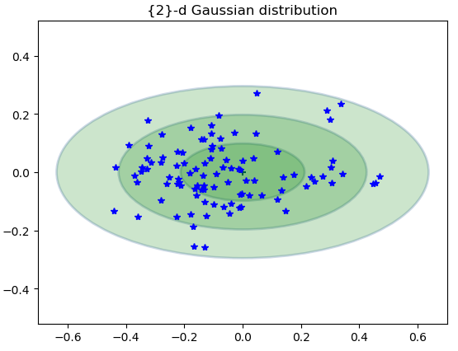
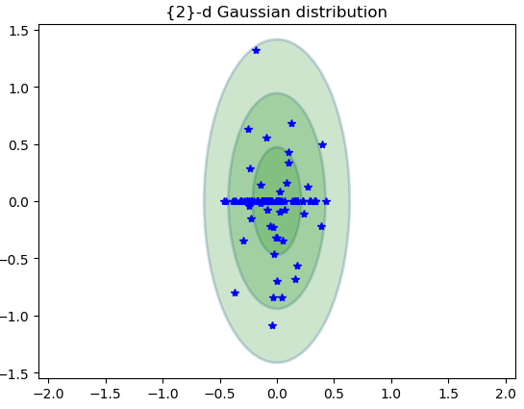



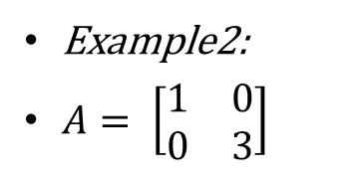
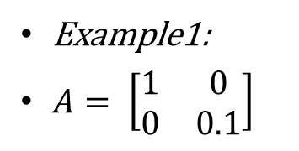
Different $A= \left[\begin{matrix}a_{11} & a_{12} \\ a_{21} & a_{22}\end{matrix}\right] dx=2$
Trials = 1000, ts = 100
Scenario2: $a_{11}=1≠a_{22}=\{0.1\sim 3\},a_{12}=a_{21}=0$
$a_{22}=0.1$
$a_{22}=0.5$
$a_{22}=2$
$a_{22}=3$
Example1:
$A= \left[\begin{matrix}1 & 0 \\ 0 & 0.1\end{matrix}\right]$
Example2:
$A= \left[\begin{matrix}1 & 0 \\ 0 & 3\end{matrix}\right]$

Slide 6
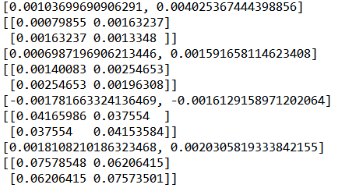
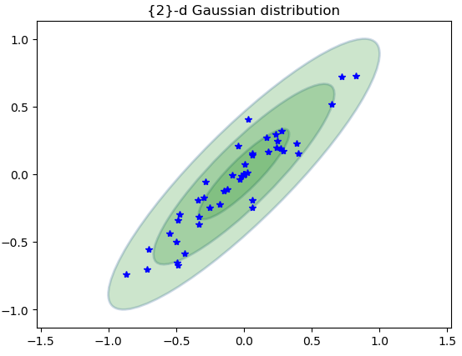

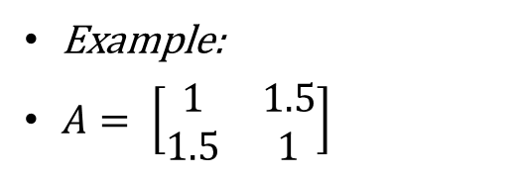
Different $A= \left[\begin{matrix}a_{11} & a_{12} \\ a_{21} & a_{22}\end{matrix}\right] dx=2$
Trials = 1000, ts = 100
Scenario3: $a_{11}=a_{22}=1,a_{12}=a_{21}=\{0.1\sim 2\}$
$a_{12}=a_{21}=0.1$
$a_{12}=a_{21}=0.5$
$a_{12}=a_{21}=1$
$a_{12}=a_{21}=2$
Example:
$A= \left[\begin{matrix}1 & 1.5 \\ 1.5 & 1\end{matrix}\right]$

Slide 7
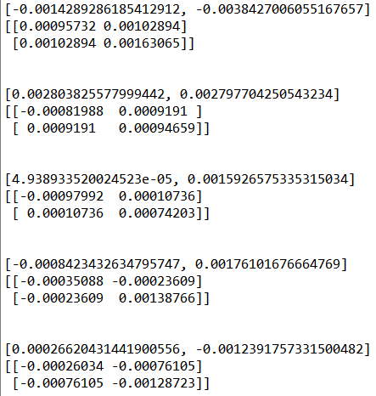
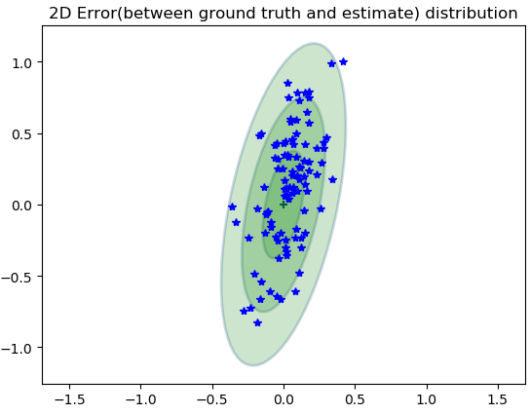

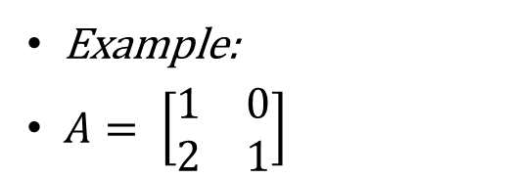
Different $A= \left[\begin{matrix}a_{11} & a_{12} \\ a_{21} & a_{22}\end{matrix}\right] dx=2$
Trials = 1000, ts = 100
Scenario4: $a_{11}=a_{22}=1,a_{12}=0≠a_{21}=\{0.1\sim 3\}$
$a_{12}=a_{21}=0.1$
$a_{12}=a_{21}=0.5$
$a_{12}=a_{21}=1$
$a_{12}=a_{21}=2$
$a_{12}=a_{21}=3$
Example:
$A= \left[\begin{matrix}1 & 0 \\ 2 & 1\end{matrix}\right]$

Slide 8
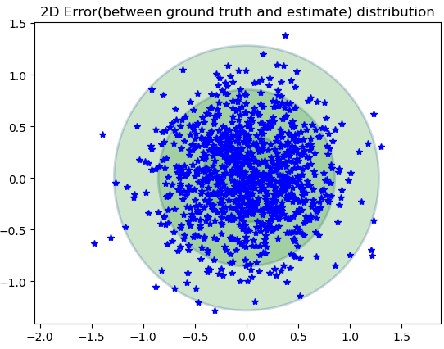
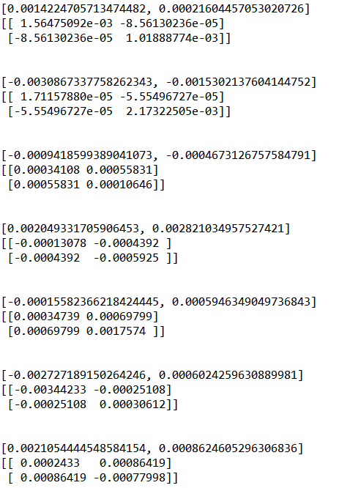




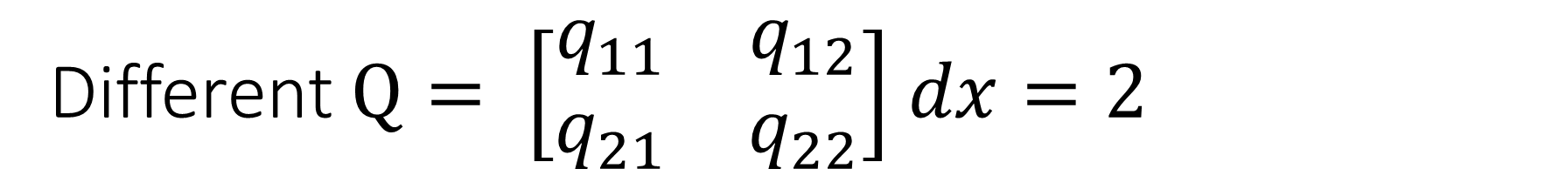


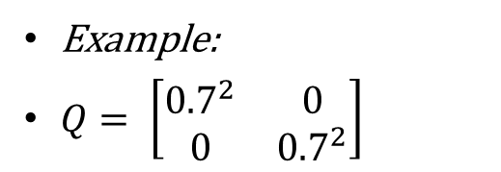

Different $Q= \left[\begin{matrix}q_{11} & q_{12} \\ q_{21} & q_{22}\end{matrix}\right]$ $dx=2$
Example:
$Q= \left[\begin{matrix}{0.7}^{2} & 0 \\ 0 & {0.7}^{2}\end{matrix}\right]$
Trials = 1000, ts = 1000
Scenario1: $q_{11}=q_{22}=\{{0.1}^{2}\sim 4^{2}\},q_{12}=q_{21}=0$
$$q_{11}=q_{22}={0.1}^{2}$$
$$q_{11}=q_{22}={1.5}^{2}$$
$$q_{11}=q_{22}={0.5}^{2}$$
$$q_{11}=q_{22}=2^{2}$$
$$q_{11}=q_{22}={0.7}^{2}$$
$$q_{11}=q_{22}=4^{2}$$

Slide 9
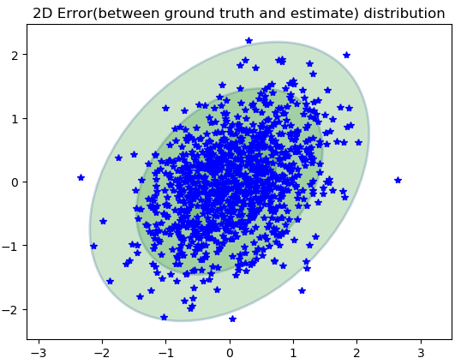

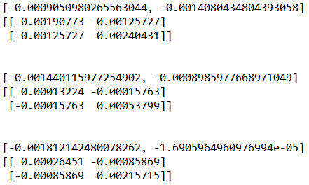





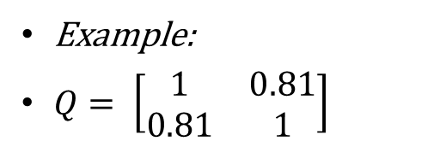
Different $Q= \left[\begin{matrix}q_{11} & q_{12} \\ q_{21} & q_{22}\end{matrix}\right]$ $dx=2$
Example:
$Q= \left[\begin{matrix}1 & 0.81 \\ 0.81 & 1\end{matrix}\right]$
Trials = 1000, ts = 1000
Scenario1: $q_{11}=q_{22}=1, q_{12}=q_{21}=\{{0.1}^{2}\sim {0.9}^{2}\}$
$$q_{12}=q_{21}={0.1}^{2}$$
$$q_{12}=q_{21}={0.5}^{2}$$
$$q_{12}=q_{21}={0.7}^{2}$$
$$q_{12}=q_{21}={0.9}^{2}$$

Slide 10
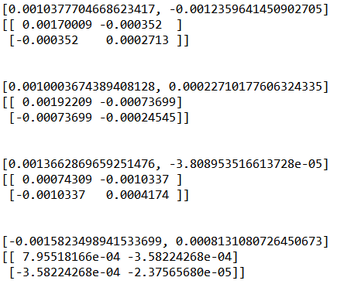
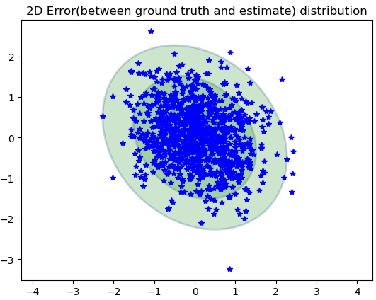





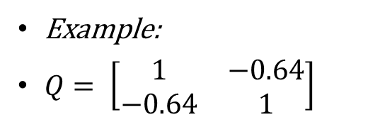
Different $Q= \left[\begin{matrix}q_{11} & q_{12} \\ q_{21} & q_{22}\end{matrix}\right]$ $dx=2$
Trials = 1000, ts = 1000
Scenario1: $q_{11}=q_{22}=1, q_{12}=q_{21}=\left\{{−0.1}^{2}\sim {−0.9}^{2}\right\}$
Example:
$Q= \left[\begin{matrix}1 & −0.64 \\ −0.64 & 1\end{matrix}\right]$
$$q_{12}=q_{21}=−{0.1}^{2}$$
$$q_{12}=q_{21}={−0.5}^{2}$$
$$q_{12}=q_{21}={−0.7}^{2}$$
$$q_{12}=q_{21}={−0.9}^{2}$$

Slide 11
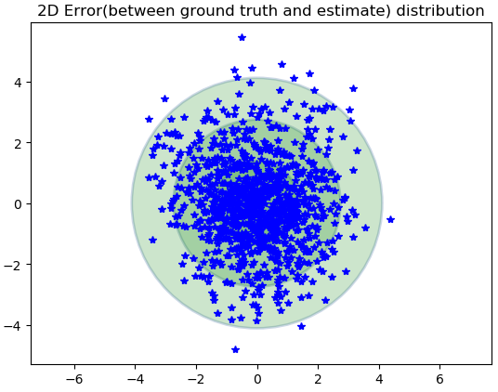
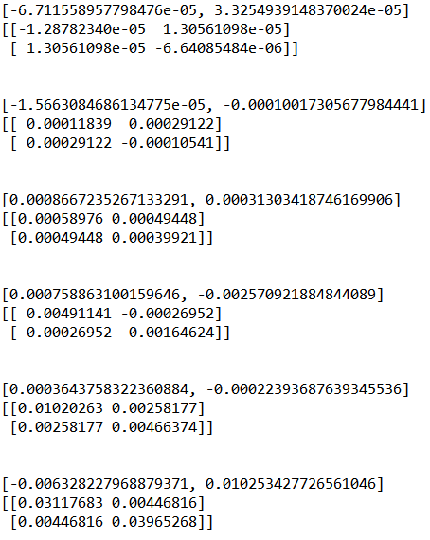



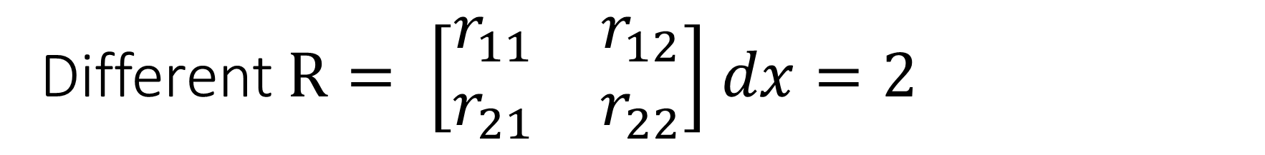



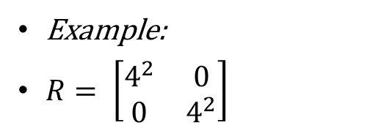

Different $R= \left[\begin{matrix}r_{11} & r_{12} \\ r_{21} & r_{22}\end{matrix}\right]$ $dx=2$
Example:
$R= \left[\begin{matrix}4^{2} & 0 \\ 0 & 4^{2}\end{matrix}\right]$
Trials = 1000, ts = 1000
Scenario1: $r_{11}=r_{22}=\{{0.1}^{2}−4^{2}\},r_{12}=r_{21}=0$
$$r_{11}=r_{22}={0.1}^{2}$$
$$r_{11}=r_{22}={1.5}^{2}$$
$$r_{11}=r_{22}={0.5}^{2}$$
$$r_{11}=r_{22}=2^{2}$$
$$r_{11}=r_{22}={0.7}^{2}$$
$$r_{11}=r_{22}=4^{2}$$

Slide 12
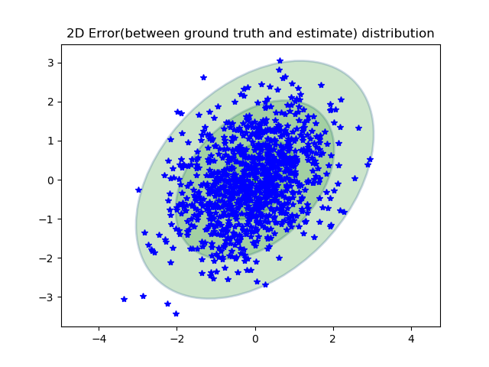
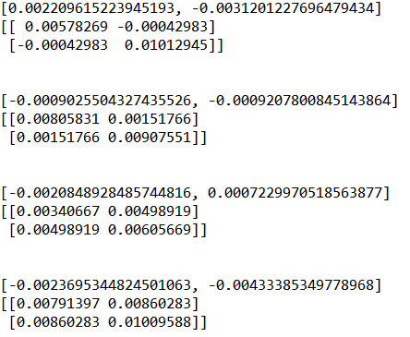





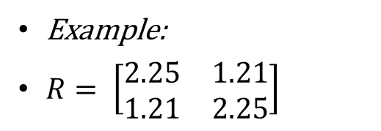
Different $R= \left[\begin{matrix}r_{11} & r_{12} \\ r_{21} & r_{22}\end{matrix}\right]$ $dx=2$
Example:
$R= \left[\begin{matrix}2.25 & 1.21 \\ 1.21 & 2.25\end{matrix}\right]$
Trials = 1000, ts = 1000
Scenario1: $r_{11}=r_{22}=4, r_{12}=r_{21}=\{{0.1}^{2}\sim {1.9}^{2}\}$
$$r_{12}=r_{21}={0.2}^{2}$$
$$r_{12}=r_{21}={0.7}^{2}$$
$$r_{12}=r_{21}={1.5}^{2}$$
$$r_{12}=r_{21}={1.9}^{2}$$

Slide 13
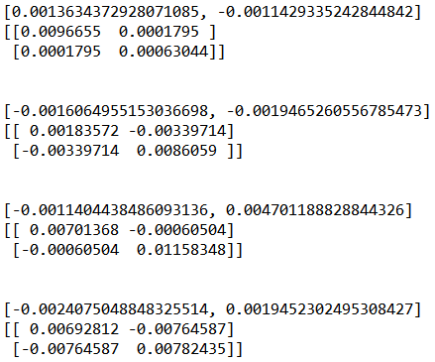
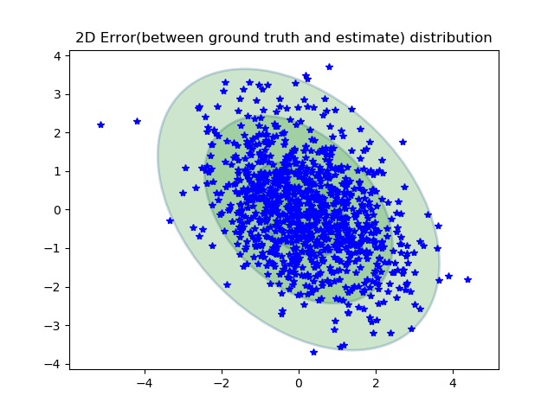





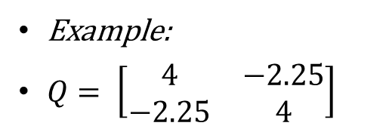
Different $R= \left[\begin{matrix}r_{11} & r_{12} \\ r_{21} & r_{22}\end{matrix}\right]$ $dx=2$
Trials = 1000, ts = 1000
Scenario1: $r_{11}=r_{22}=4, r_{12}=r_{21}=\{{−0.1}^{2}\sim −{1.9}^{2}\}$
Example:
$Q= \left[\begin{matrix}4 & −2.25 \\ −2.25 & 4\end{matrix}\right]$
$$r_{12}=r_{21}={−0.2}^{2}$$
$$r_{12}=r_{21}={−0.5}^{2}$$
$$r_{12}=r_{21}={−1.3}^{2}$$
$$r_{12}=r_{21}={−1.8}^{2}$$

Slide 14





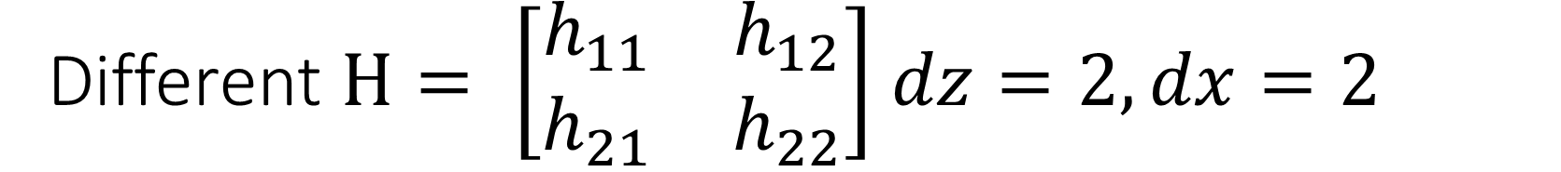


Different $H= \left[\begin{matrix}h_{11} & h_{12} \\ h_{21} & h_{22}\end{matrix}\right]$ $dz=2,dx=2$
Trials = 1000, ts = 1000
Scenario1: $h_{11},h_{22}=\left\{0.1\sim 4\right\},h_{12}=h_{21}=\{0.1\sim 4\}$
$$H= \left[\begin{matrix}0.1\sim 4 & 0 \\ 0 & 0.1\sim 4\end{matrix}\right]$$
$$H= \left[\begin{matrix}1 & 0.1\sim 4 \\ 0.1\sim 4 & 1\end{matrix}\right]$$
$$H= \left[\begin{matrix}1 & 0.1\sim 4 \\ 0 & 1\end{matrix}\right]$$

Slide 15
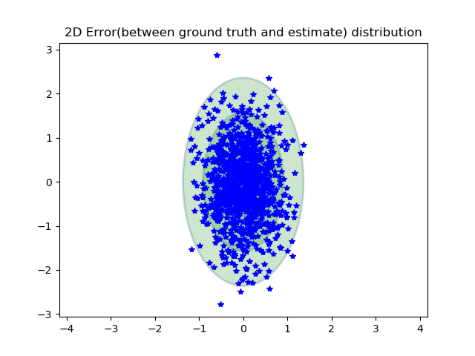
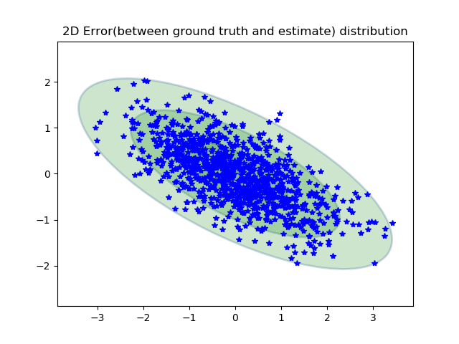
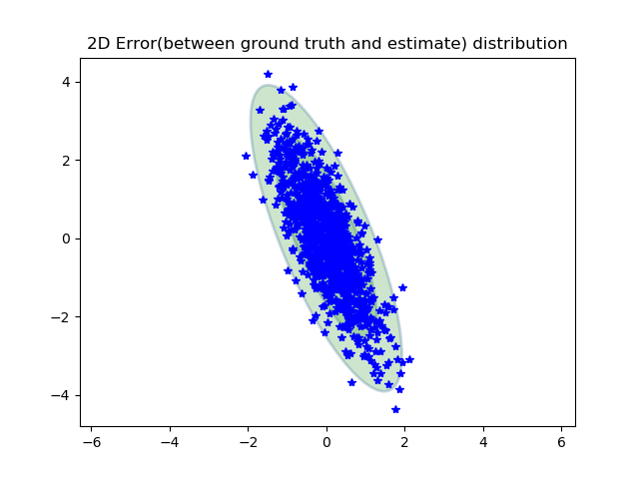
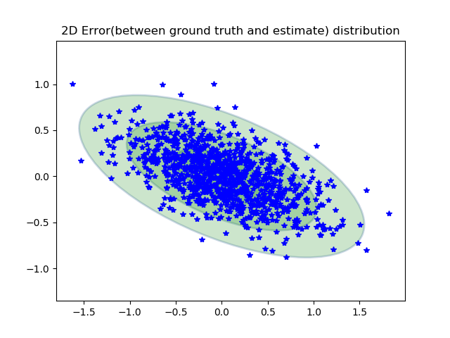





Different $H= \left[\begin{matrix}h_{11} & h_{12} \\ h_{21} & h_{22}\end{matrix}\right]$ $dz=2,dx=2$
Example1:
$H= \left[\begin{matrix}2 & 0 \\ 0 & 1\end{matrix}\right]$
Example2:
$H= \left[\begin{matrix}1 & 1.5 \\ 0 & 1\end{matrix}\right]$
Example3:
$H= \left[\begin{matrix}1 & 0 \\ 2 & 1\end{matrix}\right]$
Example3:
$H= \left[\begin{matrix}1 & 4 \\ 2 & 1\end{matrix}\right]$

Slide 16










Different $H= \left[\begin{matrix}h_{11} & h_{12} \\ h_{21} & h_{22} \\ h_{31} & h_{32}\end{matrix}\right]$ $dz=3,dx=2$
Trials = 1000, ts = 1000
Scenario: $h_{11}=h_{22}=h_{32}=1,h_{12}=h_{21}=\{0.1\sim 4\}$
$$H= \left[\begin{matrix}1 & 0.1\sim 4 \\ 0 & 1 \\ 0 & 0.1\sim 4\end{matrix}\right]$$
$$H= \left[\begin{matrix}1 & 0.1\sim 4 \\ 0 & 1 \\ 0 & 1\end{matrix}\right]$$
$$H= \left[\begin{matrix}1 & 0.1\sim 4 \\ 0.1\sim 4 & 1 \\ 0 & 1\end{matrix}\right]$$
$$H= \left[\begin{matrix}1 & 0.1\sim 4 \\ 0.1\sim 4 & 1 \\ 0.1\sim 4 & 1\end{matrix}\right]$$

Slide 17









Different $H= \left[\begin{matrix}h_{11} & h_{12} \\ h_{21} & h_{22} \\ h_{31} & h_{32}\end{matrix}\right]$ $dz=3,dx=2$
Examples:
$$H= \left[\begin{matrix}1 & 2 \\ 0 & 1 \\ 0 & 1\end{matrix}\right]$$
$$H= \left[\begin{matrix}1 & 2 \\ 0 & 1 \\ 0 & 3\end{matrix}\right]$$
$$H= \left[\begin{matrix}1 & 2 \\ 4 & 1 \\ 0 & 1\end{matrix}\right]$$
$$H= \left[\begin{matrix}1 & 2 \\ 3 & 1 \\ 4 & 1\end{matrix}\right]$$

Slide 18










Different $H= \left[\begin{matrix}h_{11} & h_{12}\end{matrix}\right]$ $dz=1,dx=2$
$$H= \left[\begin{matrix}1 & 1\end{matrix}\right]$$
Trials = 1000, ts = 1000
Scenario: $h_{11},h_{12}=\{0.1\sim 4\}$
$$H= \left[\begin{matrix}1 & 0.1\sim 4\end{matrix}\right]$$
$$H= \left[\begin{matrix}1 & 3\end{matrix}\right]$$

Slide 19






DifferentDifferent $A= \left[\begin{matrix}a_{11} & a_{12} & a_{13} \\ a_{21} & a_{22} & a_{23} \\ a_{31} & a_{32} & a_{33}\end{matrix}\right]$ dx = 3 dz = 3
$\text{Trials}\text{ = 1000, }\text{ts}\text{ = 1000}$
$\text{Scenario}\text{1: }a_{11}=a_{22}=a_{33}=\{{0.1}^{2}\sim 2^{2}\}$
$$A= \left[\begin{matrix}{0.1}^{2}\sim 2^{2} & 0 & 0 \\ 0 & {0.1}^{2}\sim 2^{2} & 0 \\ 0 & 0 & {0.1}^{2}\sim 2^{2}\end{matrix}\right]$$
$$A= \left[\begin{matrix}1 & {0.1}^{2}\sim 2^{2} & 0 \\ {0.1}^{2}\sim 2^{2} & 1 & 0 \\ 0 & 0 & 1\end{matrix}\right]$$

Slide 20





DifferentDifferent $R= \left[\begin{matrix}r_{11} & r_{12} & r_{13} \\ r_{21} & r_{22} & r_{23} \\ r_{31} & r_{32} & r_{33}\end{matrix}\right]$ dx = 3 dz = 3
Trials = 1000, ts = 1000
$$R= \left[\begin{matrix}{0.1}^{2}\sim 2^{2} & 0 & 0 \\ 0 & {0.1}^{2}\sim 2^{2} & 0 \\ 0 & 0 & {0.1}^{2}\sim 2^{2}\end{matrix}\right]$$
$$R= \left[\begin{matrix}2^{2} & {0.1}^{2}\sim 2^{2} & {0.1}^{2}\sim 2^{2} \\ {0.1}^{2}\sim 2^{2} & 2^{2} & 0 \\ {0.1}^{2}\sim 2^{2} & 0 & 2^{2}\end{matrix}\right]$$

Slide 21





DifferentDifferent $Q= \left[\begin{matrix}q_{11} & q_{12} & q_{13} \\ q_{21} & q_{22} & q_{23} \\ q_{31} & q_{32} & q_{33}\end{matrix}\right]$ dx = 3 dz = 3
Trials = 1000, ts = 1000
$$Q= \left[\begin{matrix}{0.1}^{2}\sim 2^{2} & 0 & 0 \\ 0 & {0.1}^{2}\sim 2^{2} & 0 \\ 0 & 0 & {0.1}^{2}\sim 2^{2}\end{matrix}\right]$$
$$Q= \left[\begin{matrix}2^{2} & 0 & {0.1}^{2}\sim 2^{2} \\ 0 & 2^{2} & {0.1}^{2}\sim 2^{2} \\ {0.1}^{2}\sim 2^{2} & {0.1}^{2}\sim 2^{2} & 2^{2}\end{matrix}\right]$$

