Slide 1
Input:
Basic SM Params
SM: system model
U: event hypothesis
T: simulation time
uts: sequential ut
y: Ax+Bu+w
z: Hx+v
x_est: updated x|z
pdf: probability density function
Prob(mi|mi): mi correctly detected
Structure of End-to-End Test
System Setup
SM params
System Generator
SM/T/U
Kalman Planner
Generate Sequential Data
P_x
uts
Simulator
Ut Planner
z (T), y (T)
Sensor Planner
Σ_ut
KF estimator
Simulation
n-d Hypothesis Testing
x_est, Σx
Decision Making
nd ~ N(μ，Σ)
pdf(ut|zt)
Error Probability by sampling
Error Probability by statistics
Prob(m_i|m_i) /Prob(m_j|m_i)
Output:
Error Comparison

Slide 2
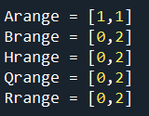

End-to-End Test Usage
The entrance of the end-to-end test is in E2E_test/E2E_validation.py
Set basic parameters of the system
A/B/H/Q/R numerical range. Please be careful about the value, because we would iterate the A/B/H/Q/R for many times. If it too small/large, the value of those matrix would be explode or vanish.
Mode: 1d/nd. Since 1d have more convenient realization, so we separately realize 1d test. Of course you can omit the option and just choose nd mode.
num: numbers of system models. Please note that this num of different from params – trials. num means how many models we try to iterate. trials means each model we test many times

Slide 3



End-to-End Test Usage
2. Set basic parameters of the system
nHy: means the hypothesis of u. For example, nHy = 3 means u can be 0/1/2
nd: means dimension of nd means z is n dimentions (or x contains n sensors).
dx/dz: dx means the dimension of state X, dz means the dimension of observation Z. Typically, dx could be equal to dz. However, it is not strict corresponding relationship between dx and dz.
3. How to run this test(take spyder IDE as example):
After you set those parameters, add path into your system:
cd E2E_test and run it:

Slide 4
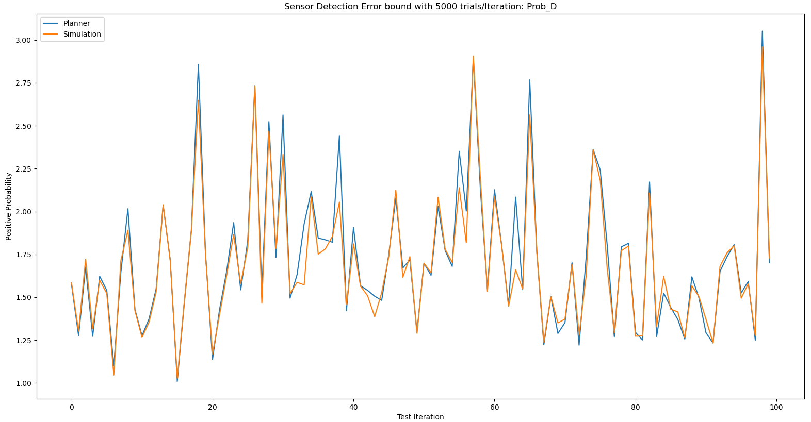
Test result
We set params as follows with 5000 trials in each model iteration:
Num=100; nHy=4, nd=3;
Then Prob_D comparison between sensor planner and simulation result is:
Mean error of the comparison is 0.02721, which is acceptable and should be considered that our simulation can demonstrate the theoretical sensor planner.

