Slide 1
UNET: Massive Scale DNN on Spark

Slide 2
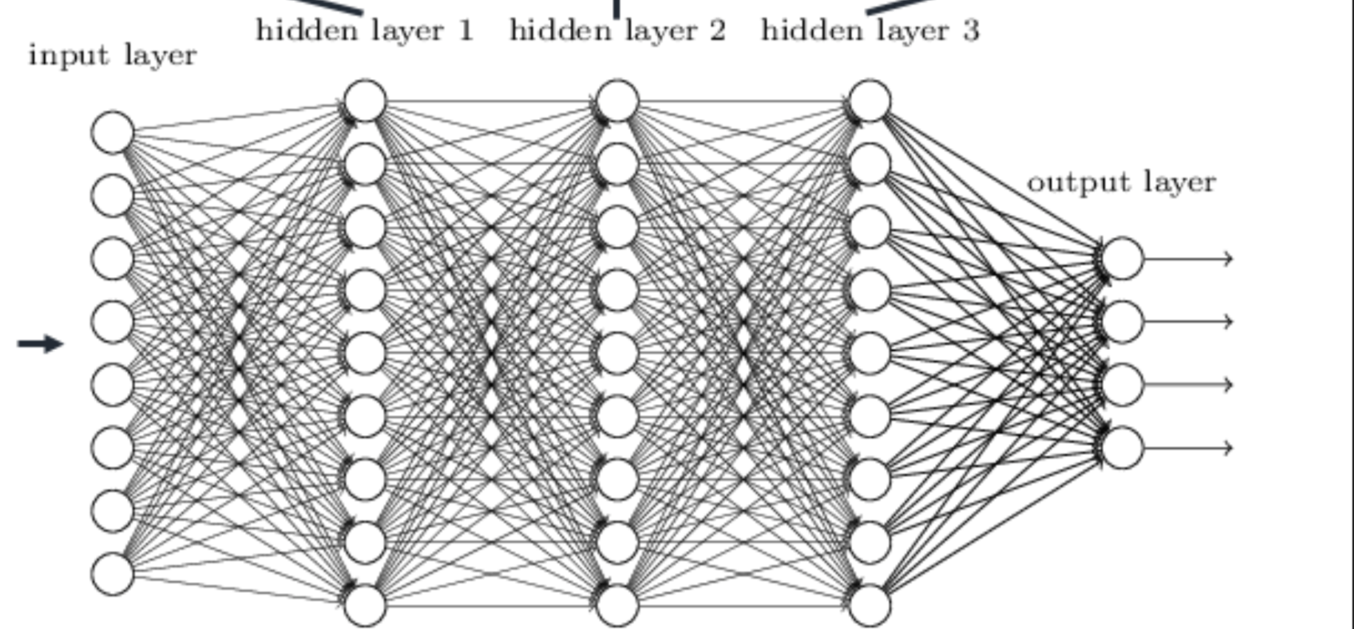
Deep Neural Net
Input Layer Hidden Layer 1 Hidden Layer 2 Hidden Layer 3

Slide 3
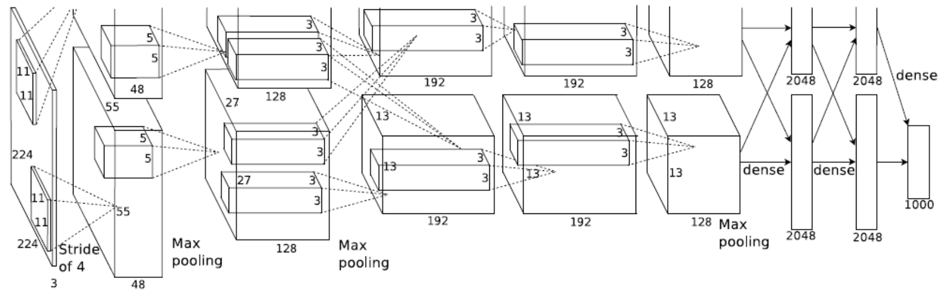
Convolutional Neural Net

Slide 4
Overview
Components: Solver, Parameter Server, Model Splits.
Massive Scale: Data Parallel & Model Parallel.
Train Method: Async and Sync
Algorithms: RBM, DA, SGD, CNN, LSTM, AdaGrad, L1/L2, L-BFGS. CG, etc.
Extensibility: Can be extended to any algorithm that can be modeled as data flow.
Highly optimized with lock free implementation, and software pipeline maximizing the performance.
Highly flexible and modulized to support arbitrary network.

Slide 5
Architecture: Data / Model Parallel
Model1_1
Model1_2
Solver
Θ
Θ
PS_1
PS_2
One Solver RDD
(1 partition)
One Parameter Server RDD
(3 Partitions)
Three Replicated Model RDD
(3 Partitions Each)
Θ
Model1_3
PS_3

Slide 6
Data Parallel
Component: Models & Parameter server
Multiple models trained independently
Each model fits one splits of training data, and calculates the sub-gradient
Asynchronously, each model update/retrieve parameters to/from parameter server

Slide 7
Data Parallel
(2 replicated Models with 1 Parameter Server)
Parameter Sync
Θ
Model_{X}
Parameter Server
Model_{Y}

Slide 8
Model Parallel
Model is huge, and cannot be hold in one machine.
Training is computational heavy
Model partitioned into multiple splits.
Each split may located in different physical machines.

Slide 9
Model Parallel
(3 Partitions)
Control RPC traffic
Netty based Data Traffic
Executor
Data Communication:
node-level
group-level
Master
Executor
Executor

Slide 10
Data / Model Parallel
Model1_1
Model1_2
Solver
Θ
Θ
PS_1
PS_2
One Solver RDD
(1 partition)
One Parameter Server RDD
(3 Partitions)
Three Replicated Model RDD
(3 Partitions Each)
Θ
Model1_3
PS_3

Slide 11
A Simple Network
Convolutional Fully Mesh Softmax Facility Master

Slide 12
Parameter Management
ParamMgr.Node for fully meshed layer
Managed by individual node.
ParamMgr.Group for convolutional layer
Shared by all nodes in the group, and managed by the group. The group gather/scatter the parameters from its members, which may locate in different executors.
ParamMgr.Const for softmax master layer
The parameters are constant.

Slide 13
Parameter Type (Link vs. Node)
Each parameter is associated with either a link or a node.
Each node/link may have multiple parameters associated.
Link parameters are managed by upstream.
Each category of parameters may be managed by either the node or the group.
θ_{1,I} ^{l}
θ_{2,I} ^{l}
θ_{3,I} ^{l}
^{Left-link Params}
θ_{i,1}
θ_{i,2}
θ_{i,3}
θ_{i,4}
Node Params
θ_{i,1}^{l+1}
θ_{i,2}^{l+1}
θ_{i,3}^{l+1}
_{Right-link Params}

Slide 14
Network Partitioning
z(σ_{z}=3)
y (σ_{y}=2)
x(σ_{x}=3)
The DNN network is organized by layers
Each layer is defined as three-dimension cube by (x, y, z).
Each dimension can be arbitrarily partitioned, defined as (σ_{x}, σ_{y}, σ_{z}), σ specifies the number of partitions of one dimension.
One layer can be in multiple executors, and one partition is the basic unit to be distributed in executors.

Slide 15
Software Components
Layer: logical group in deep neuron net.
Group: logical unit having similar input/output topology and functionality. A group can further have subgroups.
Node: the basic computation unit provide neuron functionality.
Connection: define the network topology between layers, such as fully meshed, convolutional, tiled convolutional, etc.
Adaptors: mapping the remote upstream/down stream neuron to local neuron in the topology defined by connections.
Function: define the activation of each neuron.
Master: provide central aggregation and scatter for softmax neuron.
Solver: central place to drive the model training and monitoring.
Parameter Server: the server used by neuron to update/retrieve parameters.

Slide 16
Memory Overhead
Neuron does not need to keep the inputs from upstream, but only keeps the aggregation record.
The calculation is associative in both forward/backward path (through function split trick).
The link gradient is calculated and updated in the upstream
Memory overhead is O(N + M), N is the neuron size and M is the parameter size.

Slide 17
Network Overhead
Neuron forwards same output to its upstream/downstream neurons.
Receiving neurons compute the input or update the gradient.
Neuron forwards its output to the executors only if it hosts neurons requesting it.
Neuron forwards its output to an executor only once regardless of the number of neurons requesting it.

Slide 18
Complexity
Memory: O(M+N) independent of network partition mechanism.
M: the number of parameters
N: The number of nodes.
Communication: O(N)
Realized by
Each node managing its outgoing link parameter instead of incoming link parameter
The trick to split the function across the layers

Slide 19
Distributed Pipeline
MicroBatch: The number of training examples in one pipeline stage
max_buf: the length of the pipleline.
Batch algorithms: Significantly improve the performance when the training data set is big enough to fully populate the pipeline.
SGD: the improvement is limited, because the pipeline cannot be fully populated if the miniBatch size is not big enough.
T₁ T₂ T₃ T₄
Executor 4
Executor 3
Executor 2
Executor 1
Micro Batch i +1
Micro Batch i +1
Micro Batch i +2
Micro Batch i +1
Micro Batch i +2
Micro Batch i +3
Micro Batch i +1
Micro Batch i +2
Micro Batch i +3
Micro Batch i +4

Slide 20
Connections
Easy extensible through Adaptors.
Adaptor is used to mapping global status to its local status.
Fully Meshed
(Tiled) Convolutional
NonShared Convolutional

