Slide 1
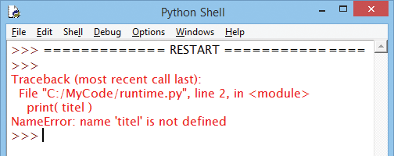
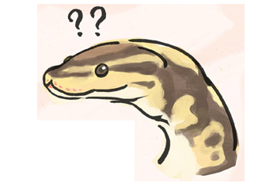
Association Mapping across Numerous Traits Reveals Patterns of Functional Variation in Maize Wallace et al.
Replicated by ”Perplexed Pythons”
- Zihao Zheng
- Zainab Riaz
- Timothy Nessel
(william-snekspeare.tumblr.com)

Slide 2
Rationale
To identify genetic loci governing phenotypic variation in maize.
The intent was to uncover genetic patterns behind function variation.
Using
Maize Nested Association Mapping (NAM)
Genome-wide association Studies (GWAS)
Results (spoilers)
Notes:
The study attempted to find what kinds of genetic loci were more likely to have a functional phenotypic polymorphism. It was not meant to characterize specific genetic loci
“NAM was designed to capture a large fraction of this variation by crossing 25 diverse founder lines to the reference line, B73, and generating 200 recombinant inbred lines (RILs) from each cross [11]. The hierarchical design of NAM provides both the high power of traditional linkage analysis and the high resolution of genome-wide association.”
High confidence due to rapid LD decay, high number of polymorphisms (41), and power of NAM

