Slide 1
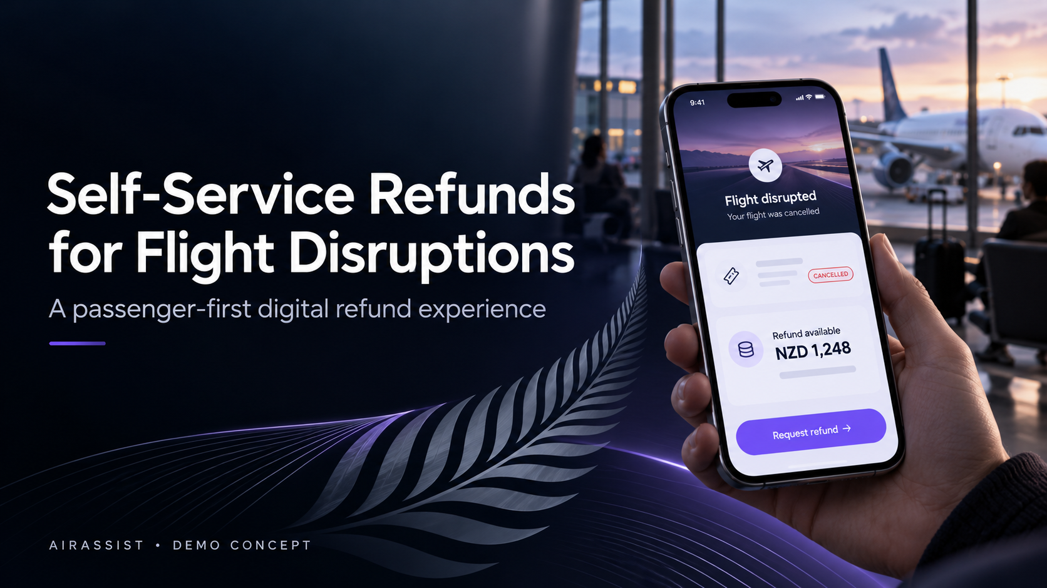

Slide 2
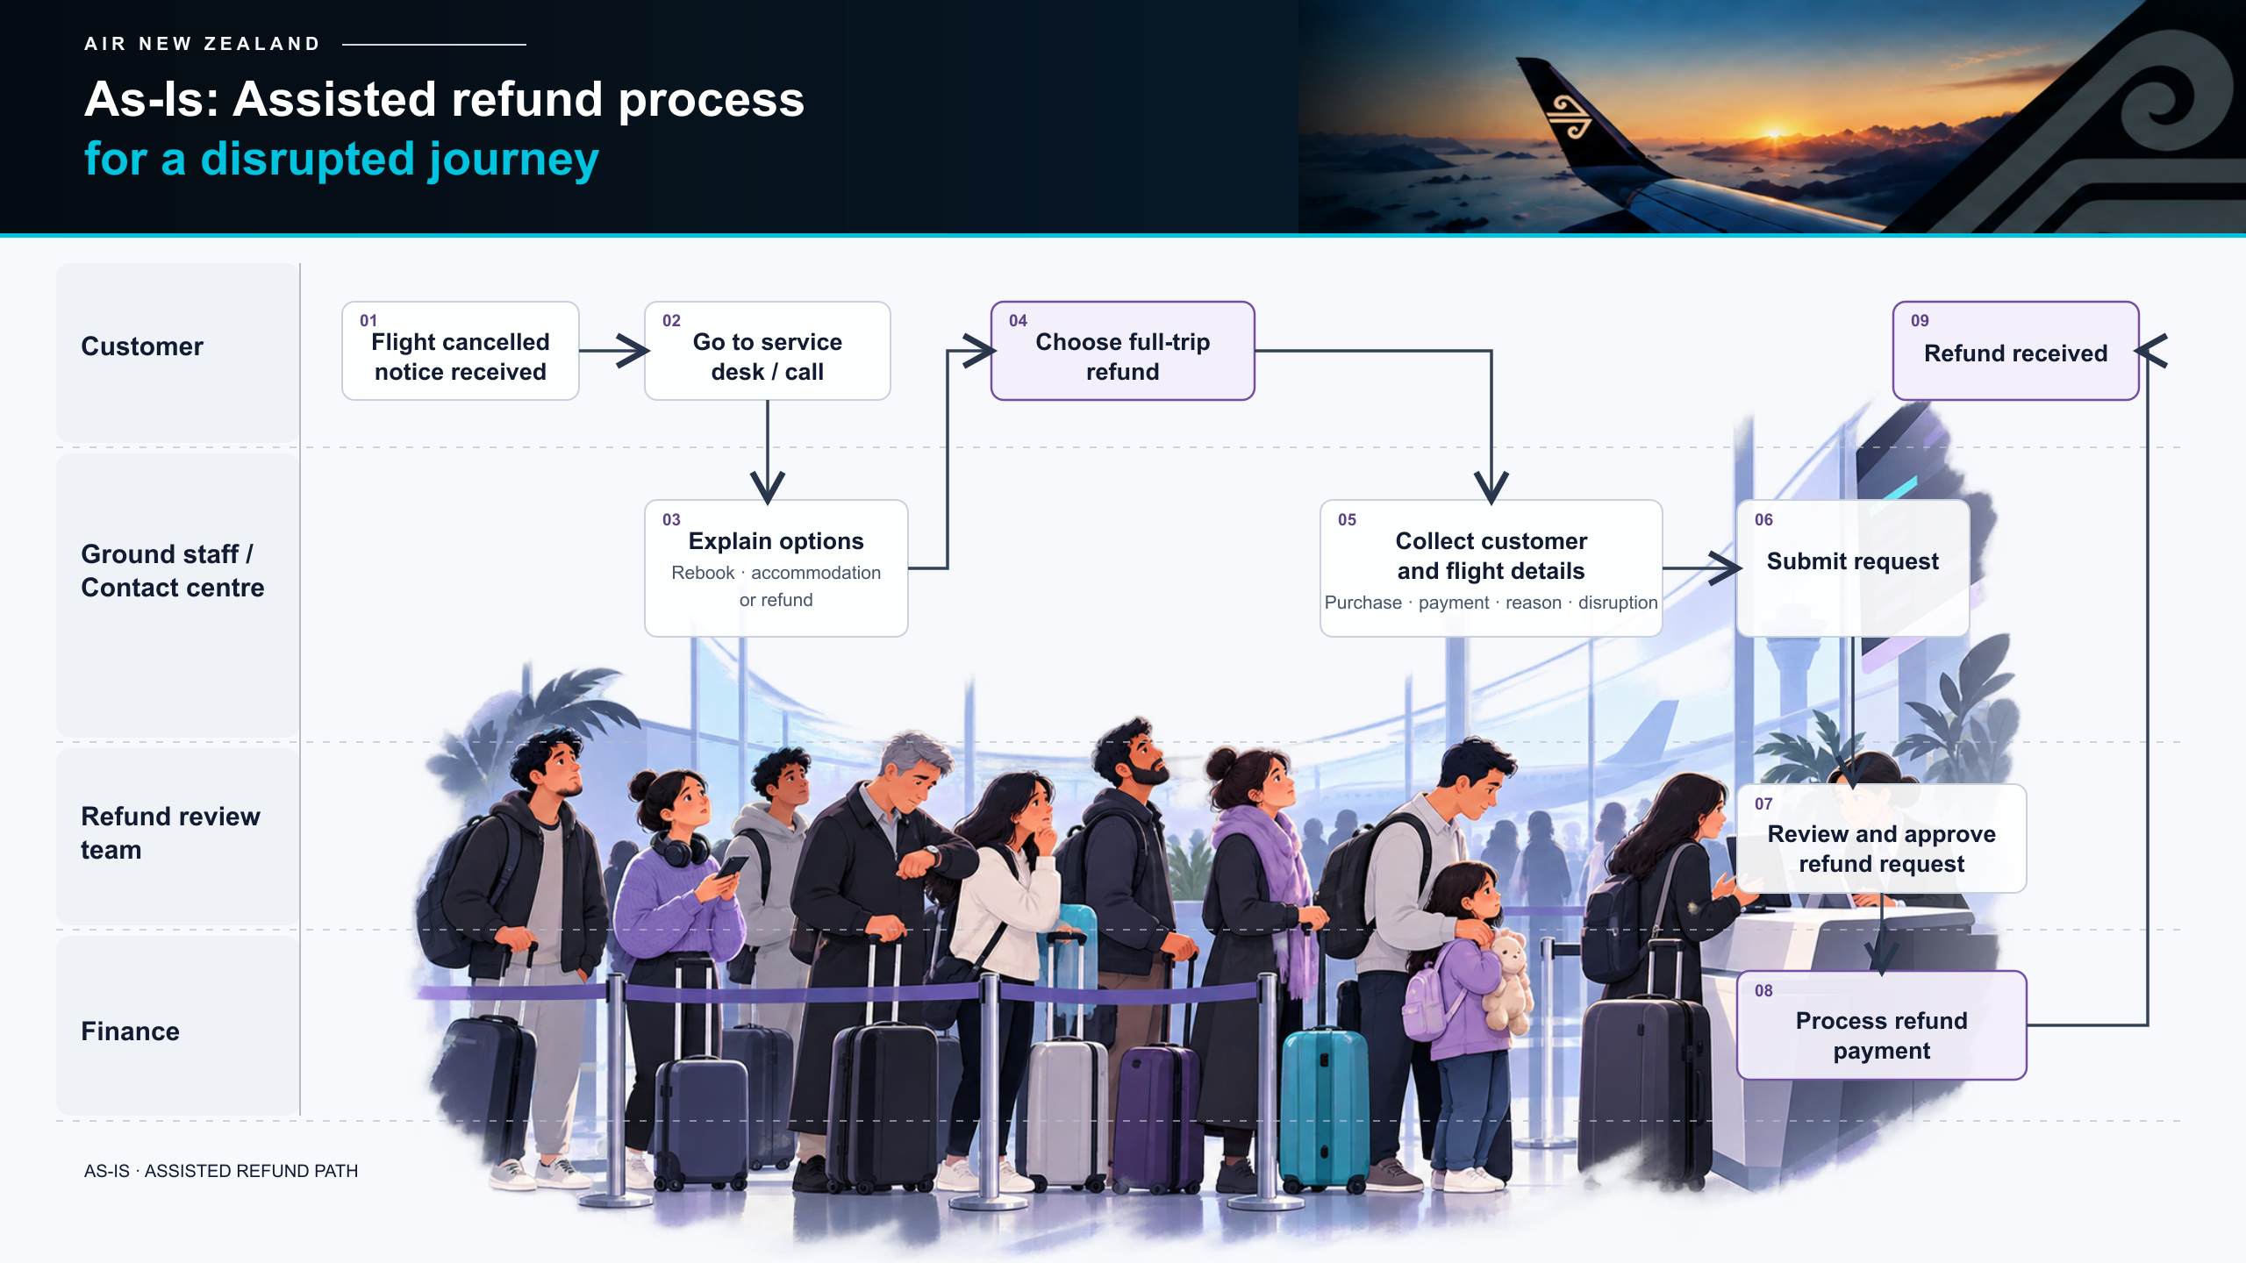
Notes:
During Cyclone Gabrielle, 821 flights cancelled and 49,000 passengers are impacted

Slide 3
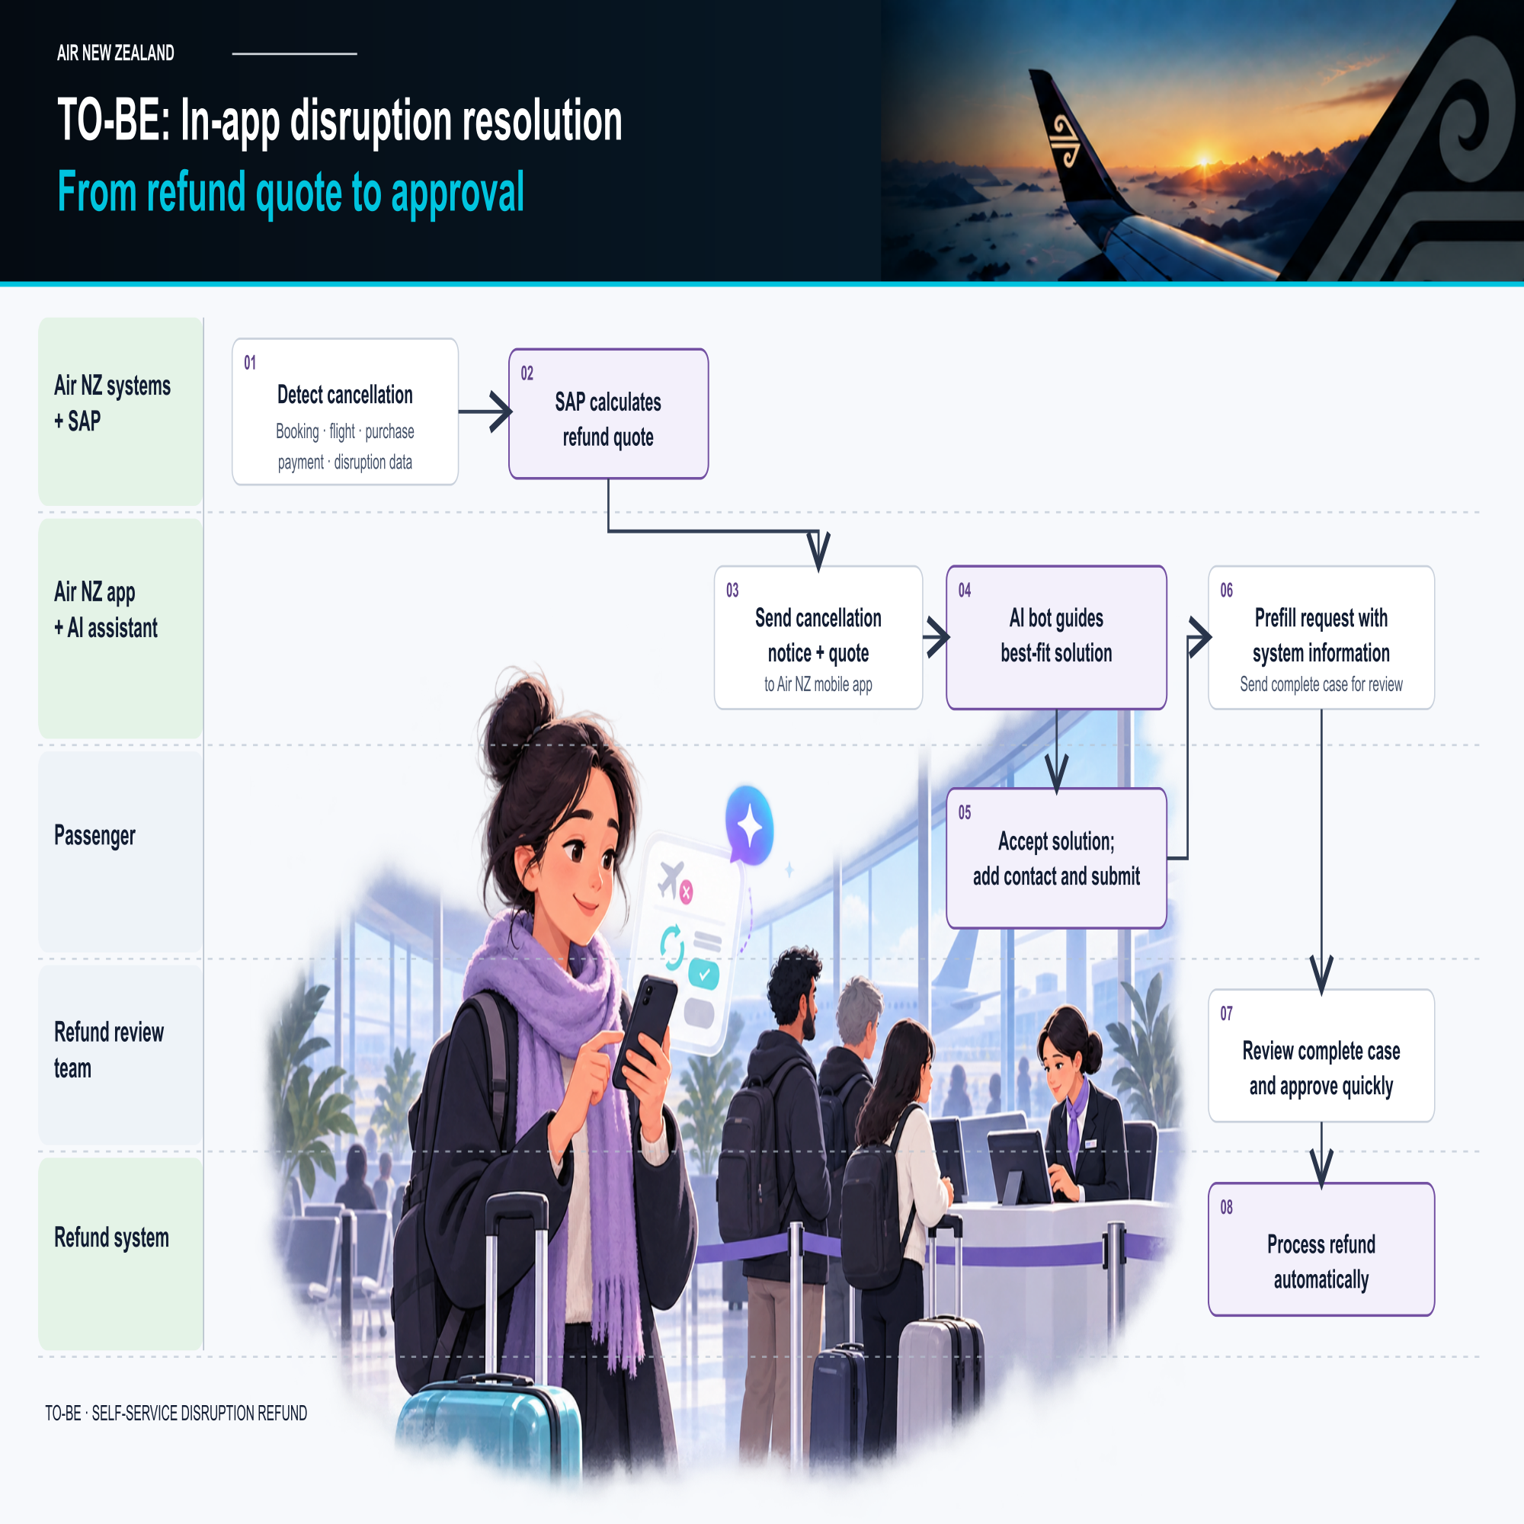

Slide 4
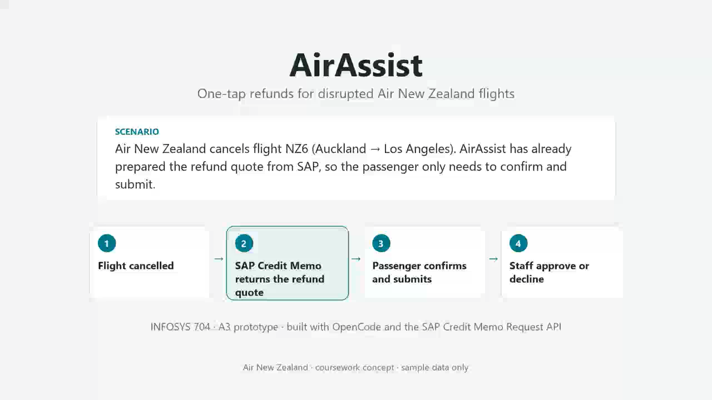

Slide 5

TODAY
APP VALUE
2–3%
70%
PROJECT
SELF-SERVICE
NZ$90k
FLIGHTS CANCELLED · ~400K PAX / YR
22 min
111K
ESTIMATED BUILD COST (INDICATIVE)
CASES MOVED FROM COUNTER / PHONE TO APP
AVG PHONE WAIT (2020)
22,300
< 2 months
90+ min
staff hours saved / yr
PAYBACK · BASE CASE, LABOUR ONLY
PEAK WAIT IN A DISRUPTION (2020)
37,000
waiting hours saved / yr
20 weeks
~2 weeks
NZ$0.7–2.2M
PILOT TO PRODUCTION
REFUND COMPLETION (ASSUMPTION)
COST SAVED / YEAR
RESOLUTION
DEMO ESTIMATES — NOT MEASURED APP RESULTS · BASELINE AND BENEFITS TO BE VALIDATED IN A PILOT WITH OPERATIONS DATA · REFUND SETTLEMENT TIME NOT ASSUMED TO IMPROVE

Slide 6
GROUPWORK MANAGEMENT DISCLAIMER
We take equal contribution in groupwork seriously, and marks may be deducted where there is a significant inequality in the team’s contribution. In the following table, state each group member’s contribution* to this assignment. You may also include any comments to support the % contribution indicated on the table.
*No contribution to the deliverable may result in a deduction of marks in the group assignment.
Criteria explanation:
1. UPI: Enter Team Member’s UPI.
2. % Contribution: Enter a % of contribution for each member that should add up to 100% for the team.
3. Comments (optional): Add a comment if needed to support your indication of the % contribution.
GROUPMEMBER | Yi Han | Xiao Lin | Zhuyi Xia | Zihang Zhang | Total
UPI: | yhan606 | xlin031 | zxia461 | zahz503
2. % Contribution: | 25% | 25% | 25% | 25% | 100%
3. Comments:

