Slide 1



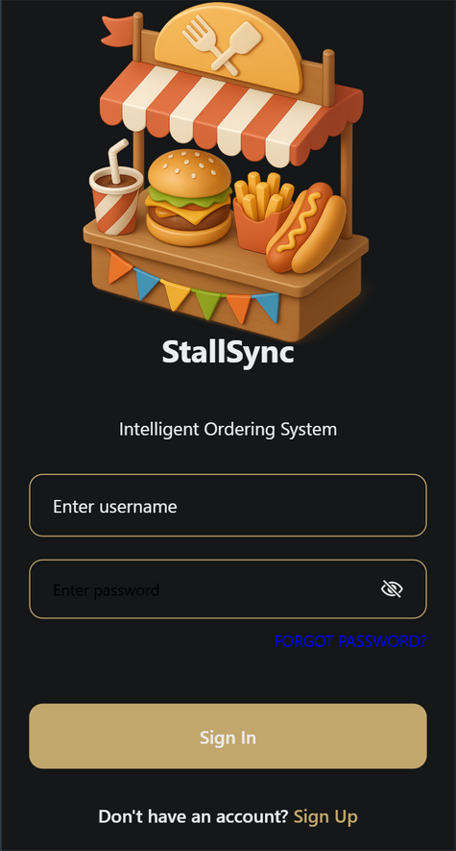

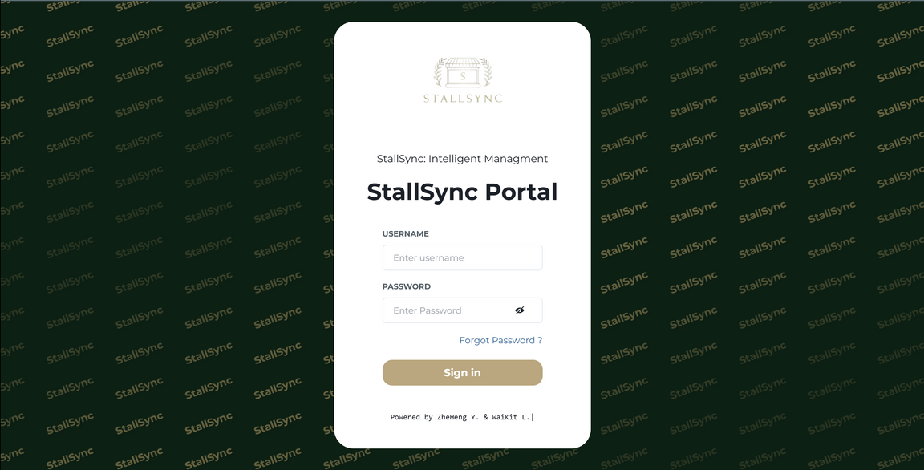




Project Objectives
Problem Statement
Launch personalized, AI-powered menu system (Month 3)
Reduce customer anxiety and enhance patience
Develop StallSync (Admin): Web-based management platform
Develop StallSync (Client): Intelligent mobile/web food ordering
Enable smart record-keeping with real-time dashboards
Use predictive analytics for sales, demand, and staffing forecasts
No data-driven insights for better decision-making
Manual records cause errors and delays
Outdated cash-only payment systems
Overwhelming menu options create choice fatigue
Menu anxiety and fear of choosing the wrong dish
Cluttered menus reduce readability and satisfaction
No real-time order status updates
Long wait times frustrate customers
Poor staff scheduling and performance tracking
Difficult for canteen admins to manage multiple stalls
Old systems cause IT inefficiencies
Project Scope
Web-based management system for stall owners, staff, and administrators
Mobile/web application for customers with personalized food recommendations and ordering
Visit our site to order food

