Slide 1

Pundra University of Science & Technology
eLearning System
Project Name: Academy
Presented by - Name : Md. Sagar Hossain ID: 011182060021 Dept. of CSE | Supervisor - Name : MST. FARJANA ALAM Lecturer Dept. of CSE Pundra University of Science & Technology

Slide 2
Outline
Introduction
Objectives
Benefits
System Design
- Use Case Diagram
Testing
Conclusion

Slide 3

Introduction
An online learning platform is a webspace or portal for educational content and resources that offers a student everything they need in one place: lectures, resources, opportunities to meet and chat with other students, and more. It is also an excellent way for the student and the teacher to monitor student progress

Slide 4
Objectives
To give access to a pool of resources
To eliminate the traditional barriers
To make learning effective
To effortlessly blend in technology
To give the privilege of accessing content anytime
To considerably save time, energy and money
To customize the learning sessions as per the requirements
To make the evaluation and feedback an easy process

Slide 5
Benefits
Asynchronous learning offers a decisively effective learning experience that enables students to benefit from the following:
Never miss a class
Learn at any pace
Personalize and optimize the learning experience
Revisit lessons as needed to improve comprehension and retention
Take advantage of extra time to process, practice, and respond

Slide 6
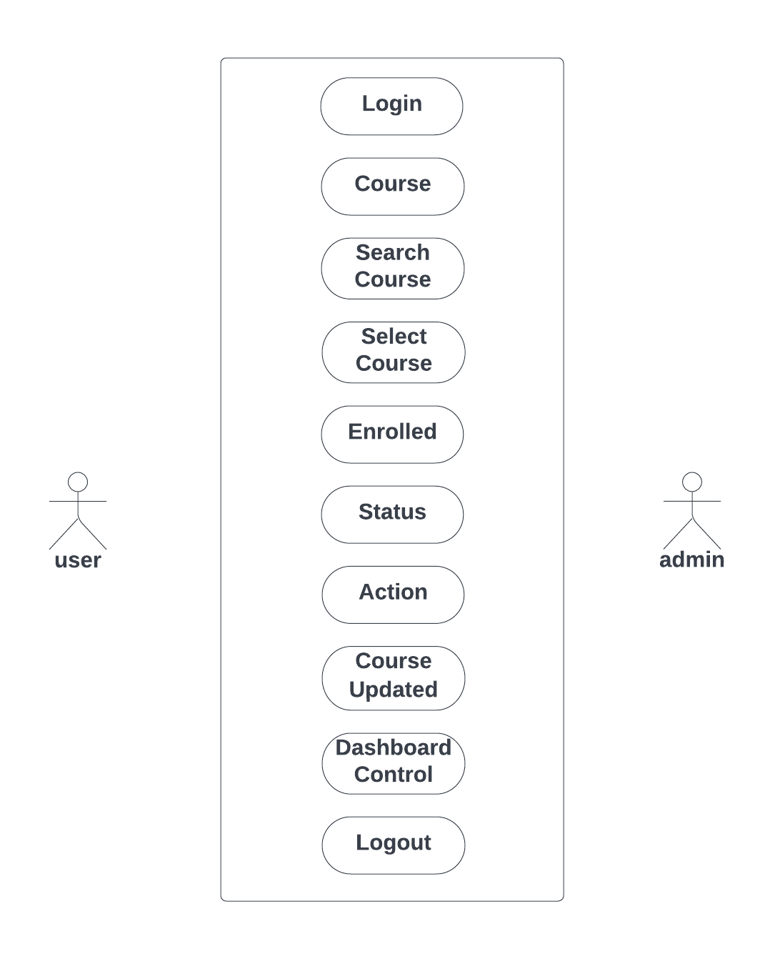
System Design
Use Case Diagram

Slide 7
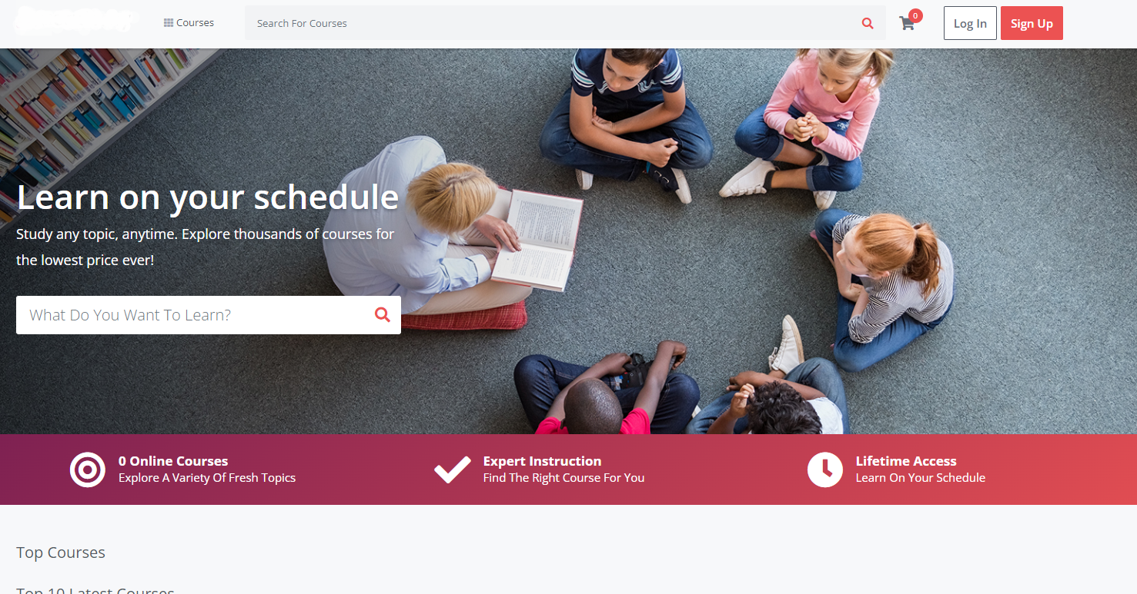
Home Page

Slide 8
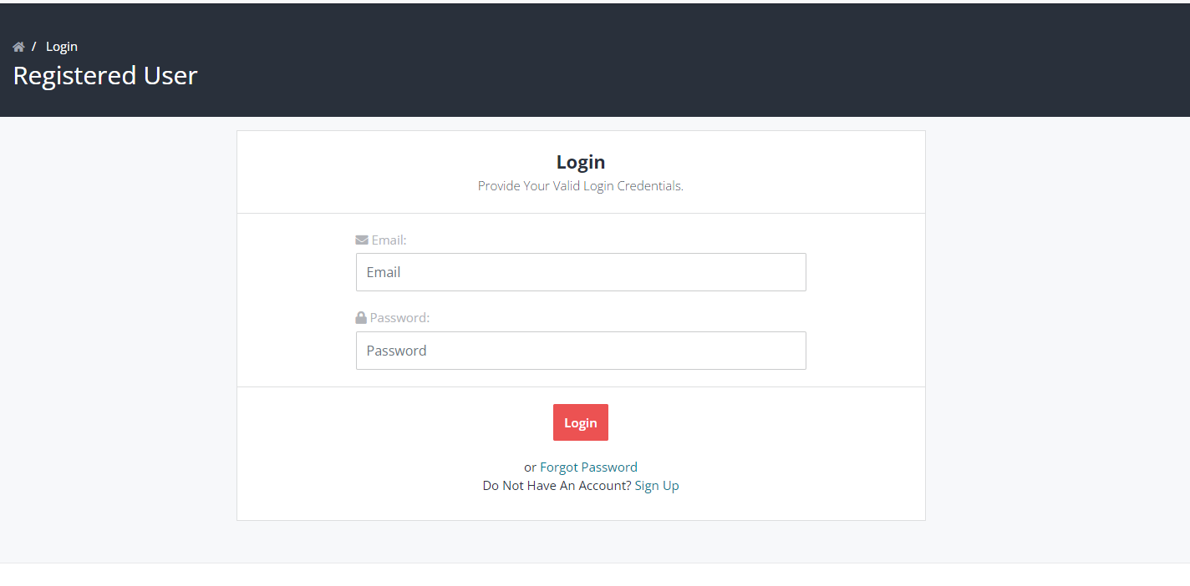
Login Page

Slide 9
Conclusion
It can be concluded that eLearning is an innovation in the current era as it clearly has an impact on the Education. Since it is very useful and becoming more popular, eLearning is a good solution to create an active platform for learning. Therefore, it is important to understand on setting the right eLearning goals to enhance better teaching and learning for both educators and students.

Slide 10
Thank You

