Slide 1
小测验讲解及复习

Slide 2
Assume a database with the schemas below:
SUPPLIER (sid, sname, scity)
PRODUCE (sid, pid, quantity)
PART (pid, pname, dno)
DEPARTMENT (dno, dname, dcity)
Facts:
  Primary keys are underlined and foreign keys in italics.
  Each part is used by exactly one department (denoted as Part.dno), and is produced by at least one supplier.
  A department may use several parts.
  Each supplier produces at least one part.

Slide 3
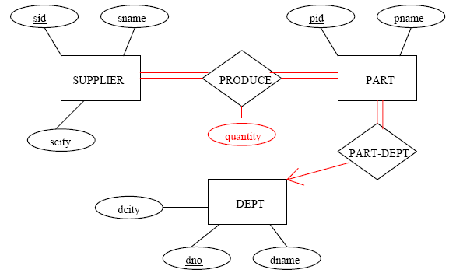
Draw ER Diagram which can be converted to the above tables, without any NULL value. You should not add any other entity set or relationship set.

Slide 4
Write relational algebra and SQL queries for the following problems. “Let us refer to each tuple in PRODUCE as an order. For example, tuple (s1, p1, 1000) represents an order, where the supplier with sid = s1 should produce 1000 products with pid = p1. Find the names of suppliers which only receive orders with quantities ≥ 1000.”
relational algebra:
SQL:
SELECT S.sname
FROM SUPPLIER S
WHERE NOT EXISTS
(SELECT PR.sid
FROM PRODUCE PR
WHERE PR.sid = S.sid AND PR.quantity < 1000)

Slide 5
Suppose that we have a schema R(A, B, C, D, E). You are given the following dependencies:
A → B
BC → E
ED → A
List all candidate keys for R.
The keys are therefore ACD, BCD, ECD.
Is R in 3NF? If it is, justify your answer. If not, produce a decomposition of R into 3NF.
Yes. Since A, B and E all belong to a candidate key, so it is in 3NF.

Slide 6
Is R in BCNF? If it is, justify your answer. If not, produce a decomposition of R into BCNF.
No, not BCNF.
Violations A→ B, BC→ E, ED→ A
One possible decomposition is:
First, use A→ B to decompose to {AB} and {ACED}
Then, use ED→ A to decompose to {AB}, {ADE} and {CDE}

Slide 7
Consider a database with 3 tables
T1(id, age),
T2(id, salary),
T3(id, start_year).
The following are the useful statistics.
  Each disk page stores precisely 50 tuples of each table;
  T1,T2, T3 have 50k, 50k, and 20k tuples, respectively;
  Tuples in T1, T2, T3 are sorted by age, salary, start_year on disk, respectively;
  In T1, the minimum/maximum age is 20/60. In T2, the minimum/maximum salary is 20k/120k.
  A primary B-tree with 3 levels is created on age of T1 and salary of T2 respectively. No index is available for T3.
  A disk page accommodates exactly 100 B-tree entries.
  T1 and T2 contain the same set of ids, while T3 includes a subset of these ids.
  Our memory is large enough to hold 100 pages.

Slide 8
We have the following queries.
  Q1: SELECT * FROM T1, T2 WHERE T1.id=T2.id
  Q2: SELECT * FROM T1, T3 WHERE T1.id=T3.id
  Q3: SELECT * FROM T1, T2, T3 WHERE T1.id=T2.id and T2.id=T3.id and T1.age>=50 and T2.salary>=112k
Once computed, the results are output to the screen directly.
Q1: What are the expected result sizes of these 3 queries respectively?
ANSWER:
  Q1: 50k
  Q2: 20k
  Q3: Joining T1, T2 and T3 results in a table (id, age, salary) with 20k tuples. In this table, the minimum/maximum age (salary) is 20/60 (20k/120k.)
  Age selectivity: 10/40 = 0.25.
  Salary selectivity: 8/100 = 0.08
  Overall selectivity: 0.25 × 0.08 = 0.02
  Expected join result = 20000 × 0.02 = 400

Slide 9
Q2: What is the number of block transfers in answering query Q1 using block nested loop, and hash-join, respectively? (Assume perfect, evenly distributed, hash functions used).
ANSWER:
BNL: 1000 × 1000 / 99 + 1000 = 12000
HJ: 3 × (1000 + 2000) = 6000

