Slide 1
Review
Chapter1 Introduction
Chapter2 Intro to UML
Chapter3 Understanding Requirements
Chapter4 Object Oriented Analysis
Chapter5 Object Oriented Design
Chapter6 Database Design

Slide 2
Chapter1 Introduction
Basic concepts of OO
  Abstraction
  Encapsulation
  Inheritance
  Polymorphism
Modeling
  What is model?
  Why do we modeling?
  What is visual modeling ?
Software Process
  A Definition of Process
  Waterfall Development
  Iterative Development

Slide 3
  UP (Unified process)
    Six Best Practices
      Develop Iteratively , Manage Requirements, Use Component Architectures, Model Visually , Verify Quality, Control Changes
    UP Structure
      4 phases + 9 workflows
Software Architecture
  What is software Architecture?
  Architecture view (4+1 view)
Pattern
  What is Pattern?
  Design Pattern (example)
  Architectural Pattern (example)
    Typical Layering Approach

Slide 4
Chapter2 UML
What is UML
Building Blocks of the UML
  1) Things in the UML
    Structural things, Behavioral things ,Grouping things, Annotational things
  2) Relationships in the UML
    Association, Dependency,Generalization, Realization
  3) Diagrams in the UML
Extensibility mechanisms in the UML
  Stereotype
  Tagged value
  Constraint

Slide 5
Diagrams in the UML
  Definition, Purpose, Elements, Drawing
  ( for each Diagram )
  Use Case Diagram (*)
    Actor & Use Case
    Use Case Specification
      Use-Case Flow of Events, Scenarios
    Relationship between Use-cases
      Include, extend, Generalization

Slide 6
Interaction Diagram
  Sequence diagrams (*)
    link, message, sequencing, object lifeline, focus of control
  Collaboration diagrams
  Comparison
StateChart Diagram (*)
  State, transition, Substate, History States
Activity Diagram
  Activity , Decisions, guard conditions ,synchronization bar
  Swimlane
Comparison

Slide 7
  Class Diagram (*)
    Scope , Visibility, Template classes
    multiplicity, navigation, Association Class
    Comparison
      Associations, Aggregation, & Composition
      Association, Dependency & Generalization
  Component Diagram
    Components , Interfaces
    Dependency, Realization
  Deployment Diagram
    Node, Connection

Slide 8
Chapter3 Understanding Requirements
What is Requirements
Types of Requirements
Requirements Documents
  Vision
  SRS
Use-Case Modeling
  What Is System Behavior
  Key Concepts
  Use-Case Diagram
  Use-Case Specification
  Relationship between Use-case

Slide 9
Chapter4 Object Oriented Analysis
OO Analysis Overview
  What is OOA?
  The difference between OOA & OOD
Domain Modeling
  What is Domain Models
  How to do Domain Modeling
    Identifying conceptual classes
    Finding Associations
    Adding Attribute
    Modeling Generalization
  UML (Class diagram)

Slide 10
What is GRASP
    General Principles in Assigning Responsibilities
    Five GRASP pattern
        Information Expert ,Creator, Low Coupling, High Cohesion, Controller
Architectural Analysis
  The purpose of Architectural Analysis
  What is Architectural Mechanism
    Categories (example )
Use-Case Analysis
  The purpose of use case Analysis
  What is use case Realization?
  Analysis classes
    Boundary, Entity ,Control classes

Slide 11
Chapter 5 Object Oriented Design
OO Design Overview
  What is OOD?
  The difference between OOA & OOD
Architectural Design
  Logical Architecture
    Typical Layering Approach (Four layer)
    Tiers, Layers, and Partitions
    Packages versus Subsystems
  Describe run-time Architecture
    Purpose, Steps
  Describe distribution
    Purpose, Steps
    Distribution patterns----C/S(3 Tier) , P2P

Slide 12
Use Case Design
  Purpose
  Steps
Subsystem Design
  Purpose
  Steps
Class Design
  Purpose
  Steps

Slide 13
Chapter6 Database Design
Comparison
  The Relational Data Model and Object Model
What is Persistence Frameworks
Database Design
  Purpose
  steps

Slide 14
题型
一、选择题 （15题，30分）
二、简答题（6题，30分）
三、OO建模题 （2题，40分）
注：考试会有小的调整

Slide 15
选择题
1) A UML composition is ( D )
A. a process for instantiating UML models
B. the interrelation among components and packages
C. a specific dependency among objects
D. an aggregation with additional semantics
2) Which of the following are not the Extension Mechanisms of UML? ( C )
A. TaggedValue
B. Constraint
C. Concurrent
D. Stereotype
3）Which is a step in the Describe the Run-time Architecture activity?( B )
Create initial design class
Identify Processes and Threads
Indentify Events and Signals
Allocate System Elements to Nodes

Slide 16
简答题
Explain the six best practices of software engineering.
Explain with example what is multiplicity.
Please describe the typical differences between a UML analysis model and a UML design model.
……..

Slide 17
OO 建模题
1. On the scut campus, students can apply for a consumed-card .The card administrator would create a new consumed-card when receiving an application. The consumed-card can be used in the campus super-market. When the students consume with the card , the salesperson would deduct the money from the card. Also , The card administrator can deposit money into the card for the students . Imagine that you have been hired to develop the supporting software.
1) Draw a UML use case diagram for the system.
2) Produce a sequence diagram to model the scenario of consuming with card.
3) Draw a class diagram for the system.
4) Produce a statechart diagram for the consumed-card Class.

Slide 18
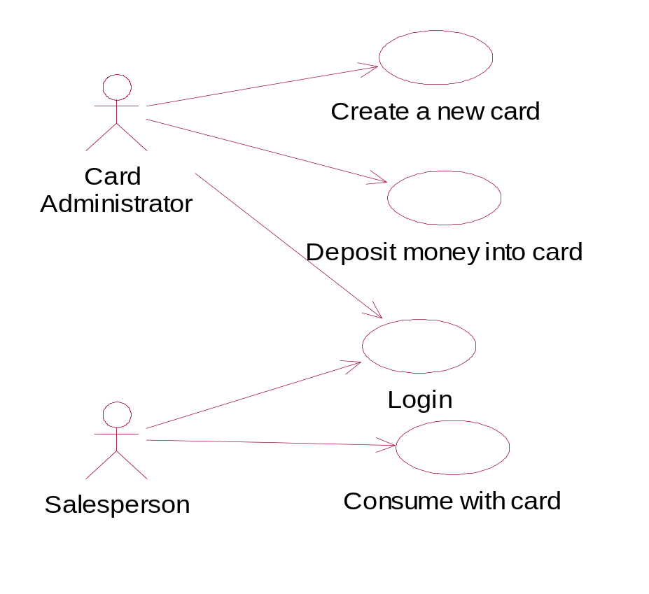
1)

Slide 19
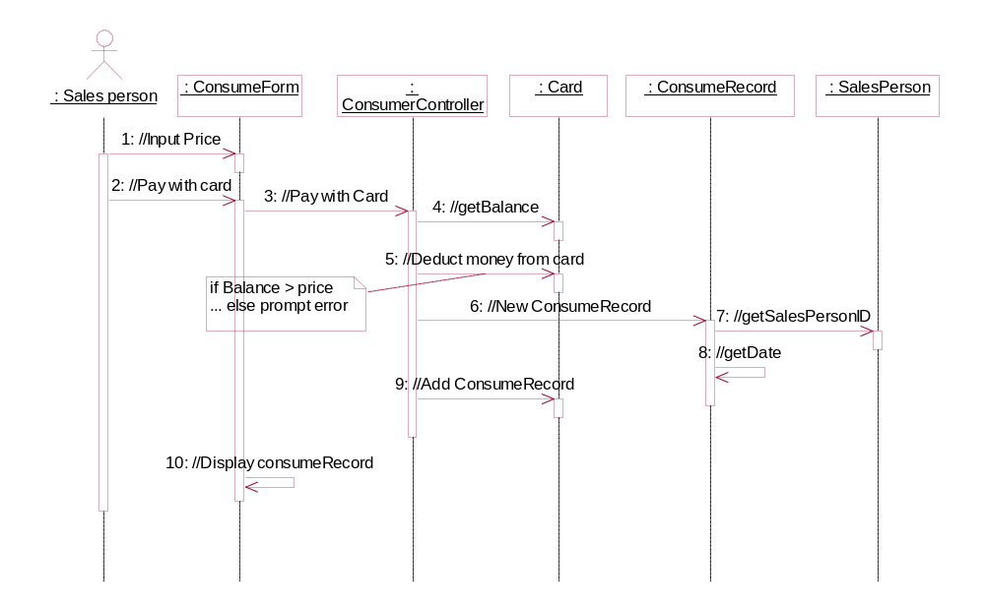
2)

Slide 20
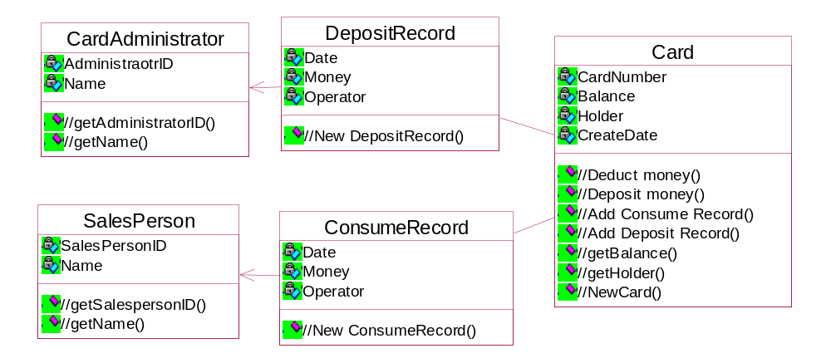
3)

Slide 21
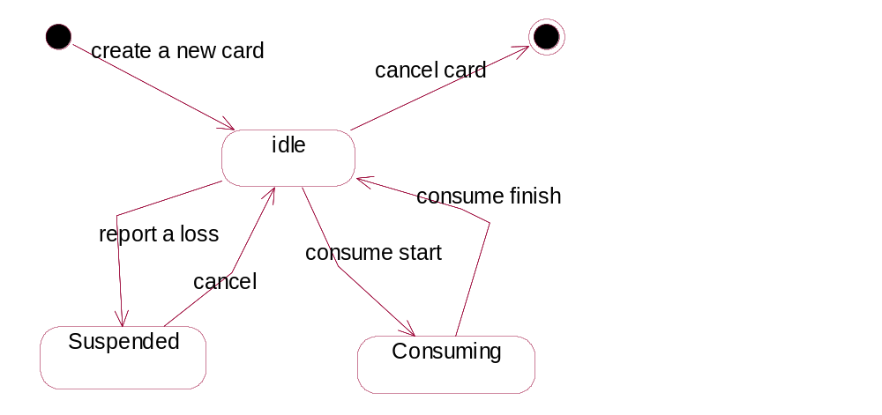
4)

Slide 22
OO 建模题
2. Consider developing a campus classroom facilities management system.
The campus has a collection of classrooms. Each classroom has a collection of equipments, which may include microphone, blackboard, overhead projector, TV, Internet connection, etc. Each equipment has information such as history, condition, as well as information specific to the equipment, such as size for blackboard and TV, mobile or not for microphone, and speed of connection to Internet. Each classroom has a list of courses scheduled to take place in it, the instructor for each course, requested equipments and setups for each course, and a manager in charge of setting up the equipments.
The system should allow instructors to look up the list of equipments in a classroom, request equipments and setups, and query the setup status. The system should send request for equipments and setups in a classroom to the classroom manager. The manager can update equipment information and setup status. In case of an equipment can not be setup according to the request, the manager should notify the instructor as soon as possible. The system should also allow anyone to send comments to the manager.
Draw the use case diagrams for this system.
Draw the class diagrams for this system.

Slide 23
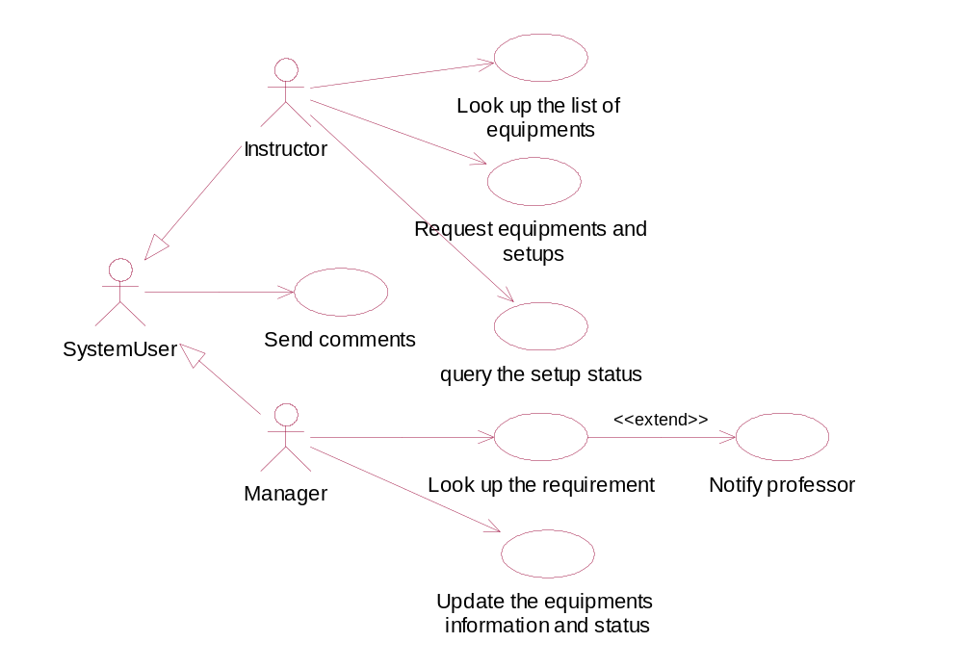
1)

Slide 24
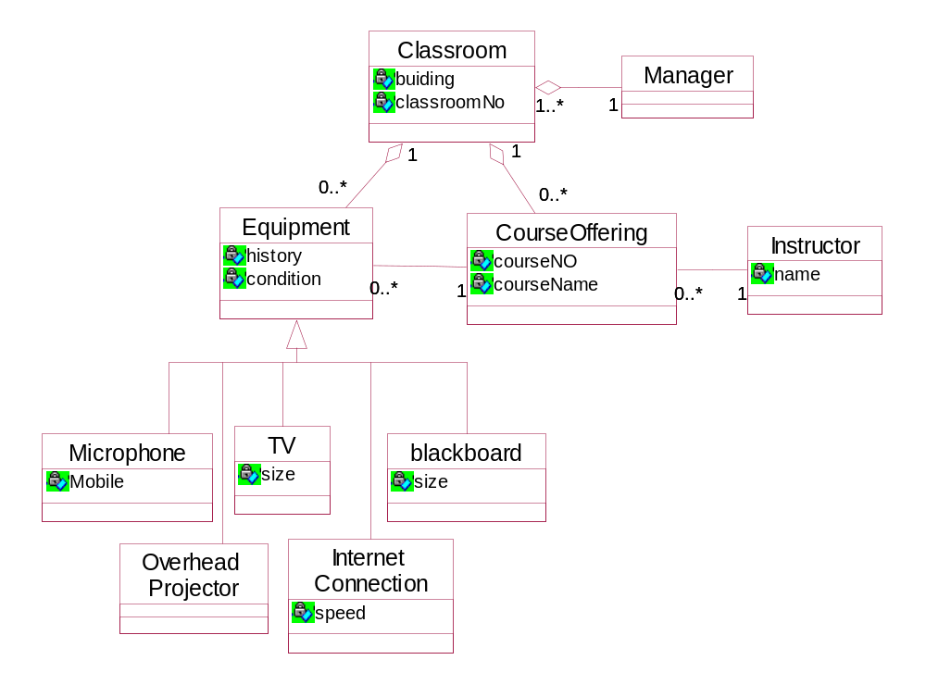
2)

