Slide 1
Training pipeline overview
Ingestion
Training
Evaluation

Slide 2
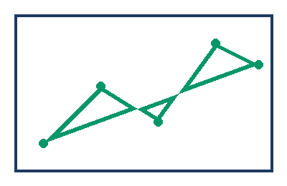
Evaluation curve
Validation accuracy improved across five checkpoints.

