Slide 1
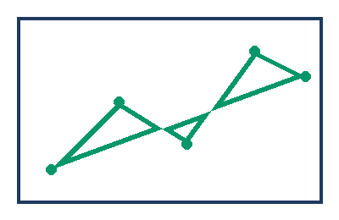
Evaluation curve, full subject

