Slide 1

QUANTITATIVE TRADING WITH MACHINE LEARNING
REPRODUCTION & EXTENSION
Predicting VW stock returns from its supply chain - Glawion (Stanford CS229)
UE24CS352A Machine Learning | Team: Zia Kadijah (PES2UG24CS620), Harshavardhan (PES2UG25CS817)
Notes:
Intro (20s): we reproduced the four models of the paper and added one new model, RBF SVR. Roadmap: problem, data, method, reproduction, trading, new model, conclusions, demo.
1

Slide 2
THE TASK: FORECAST VW FROM ITS SUPPLIERS
REFERENCE: GLAWION, QUANTITATIVE TRADING WITH MACHINE LEARNING (STANFORD CS229)
QUESTION: DO SUPPLY-CHAIN STOCK RETURNS PREDICT VW'S H-DAY RETURN, AND CAN IT BE TRADED?
PART 1: REPRODUCE ELASTIC NET, DECISION TREE, XGBOOST, LIGHTGBM (RMSE + TRADING PROFIT)
PART 2: ADD RBF SUPPORT VECTOR REGRESSION, SAME DATA / SPLIT / METRICS
31
stocks (VW + 30 suppliers)
850
features (27 lags x 31 + 13 macro)
109
monthly rolling refits
UE24CS352A Machine Learning | Mini-Project
Notes:
Problem: regress future VW return on lagged supplier returns and macro variables; then trade on forecasts. Paper's claim: Elastic Net best, trading profit up to 3x buy-and-hold. Our two parts: reproduce, then add one model.
2

Slide 3
DATA AND VALIDATION: ROLLING, NEVER SHUFFLED
TRAIN: 5 YRS (GROWS MONTHLY)
VALIDATE: 1 YR
Test 1m
then roll forward one month, 109 times (Jan 2011 - Dec 2019)
FEATURES: 27 DAILY-RETURN LAGS FOR VW AND 30 SUPPLIERS, PLUS 13 MACRO SERIES (EURIBOR, SWAP, ITRAXX, CPI, BUND, OUTPUT GAP)
TARGETS: VW RETURN OVER THE NEXT H = 1, 5, 20 DAYS
TUNING: GRID SEARCH ON VALIDATION MSE; METRIC RMSE / MAE
TRADING: EUR 1,000; LONG IF FORECAST > C, SHORT IF < C; NO COSTS
UE24CS352A Machine Learning | Mini-Project
Notes:
Data: author's public replication parquet, Frankfurt closes 2005-2019, 3,809 days. Missing values set to zero as in the paper. Split: 5y train, 1y validation to pick hyperparameters, 1 month test, roll forward monthly -> 109 refits, 2,156 test days. Trading rule: long/short one share, threshold c, no costs.
3

Slide 4
PART 1: PREDICTION ERROR IS REPRODUCED
MODEL | H | PAPER | OURS | DIFF
Elastic Net | 1 | 0.0174 | 0.0174 | +0.1%
Elastic Net | 5 | 0.0401 | 0.0401 | -0.1%
Elastic Net | 20 | 0.0751 | 0.0754 | +0.4%
Decision Tree | 1 | 0.0190 | 0.0175 | -8.0%
Decision Tree | 5 | 0.0422 | 0.0407 | -3.5%
Decision Tree | 20 | 0.0952 | 0.0824 | -13.5%
XGBoost | 1 | 0.0176 | 0.0179 | +1.9%
XGBoost | 5 | 0.0410 | 0.0420 | +2.5%
XGBoost | 20 | 0.0850 | 0.0857 | +0.8%
LightGBM | 1 | 0.0177 | 0.0179 | +0.9%
LightGBM | 5 | 0.0408 | 0.0406 | -0.6%
LightGBM | 20 | 0.0815 | 0.0830 | +1.8%
0.4%
MAX GAP, ELASTIC NET VS PAPER
ELASTIC NET BEST AT EVERY HORIZON; ERROR GROWS WITH H.
DECISION TREE GAP IS OUR SMALLER GRID.
UE24CS352A Machine Learning | Mini-Project
Notes:
Elastic Net matches the paper within 0.4 percent at all three horizons. XGBoost and LightGBM within 2.5 percent. Decision Tree is better than the paper by 3-14 percent - likely because our reduced grid offers only sqrt/log2 max_features and depth <= 20, i.e. more regularised trees; we did not test it. Timings not comparable: one CPU, smaller grids, different tuning schedule. Paper metric = mean of monthly RMSEs; pooled RMSE also in the repo.
4

Slide 5
TRADING PROFITS: VERIFIED SIMULATOR, FRAGILE RESULT
Elastic Net, c = 0% | h=1 | h=5 | h=20
Paper (Table 2) | -9.07 | +9.56 | +21.49
Author's predictions, chronological | -5.47 | +12.80 | +19.98
Our predictions, chronological | +20.58 | +8.37 | +15.28
Buy and hold | +7.8 | +7.8 | +8.0
SIMULATOR VERIFIED
96/96 cells of Table 2 match exactly using the author's own predictions
ORDERING MATTERS
paper's code orders days inside a month by an unstable sort
ONLY H=20 IS ROBUST
about 1.9-2.5x buy and hold before costs; h=1, 5 flip sign
UE24CS352A Machine Learning | Mini-Project
Notes:
We ported the author's simulator. Fed with his saved predictions it matches all 96 cells of Table 2 exactly (profit and trades). BUT his code sorts predictions within each month with an unstable sort, so published profits depend on arbitrary ordering. Headline cell Elastic Net h=20 c=0: paper +21.5, author's predictions chronological +20.0, ours chronological +15.3, buy-and-hold about 8. So about 1.9-2.5x, not 3x, but h=20 is robust; h=1 and h=5 flip sign (EN h=1: +20.6 ours vs -9.1 paper) so treat as noise. No transaction costs.
5

Slide 6
PART 2: RBF SUPPORT VECTOR REGRESSION
WHY SVR?
  Not in the paper - a genuinely new model
  Small data (1.3-3k rows), 850 features: kernels fit well
  Smooth non-linear regulariser: complements linear (EN) and tree models
  SETUP
  Standardised inputs; grid C, epsilon; tuned on validation year
  Same data, 109 windows, same RMSE / trading rule
TEST RMSE | H=1 | H=5 | H=20
Elastic Net | .0174 | .0401 | .0754
SVR (NEW) | .0183 | .0417 | .0774
LightGBM | .0179 | .0406 | .0830
XGBoost | .0179 | .0420 | .0857
Decision Tree | .0175 | .0407 | .0824
SVR: worse than Elastic Net (+3 to +5%), similar to boosting at h=1, 5, second-best at h=20.
UE24CS352A Machine Learning | Mini-Project
Notes:
Why SVR: not used or mentioned in the paper; small high-dimensional data suits kernel methods; different inductive bias from linear (EN) and tree models. Standardise inputs on the training window. Grid C in {0.1,1,10}, epsilon {0.001,0.01}, retuned every 6 months. C=0.1 was chosen in about 95 percent of windows, i.e. strong regularisation. Result: worse than EN at every h (+5, +4, +3 percent) but second at h=20, beating DT, XGB, LGBM.
6

Slide 7
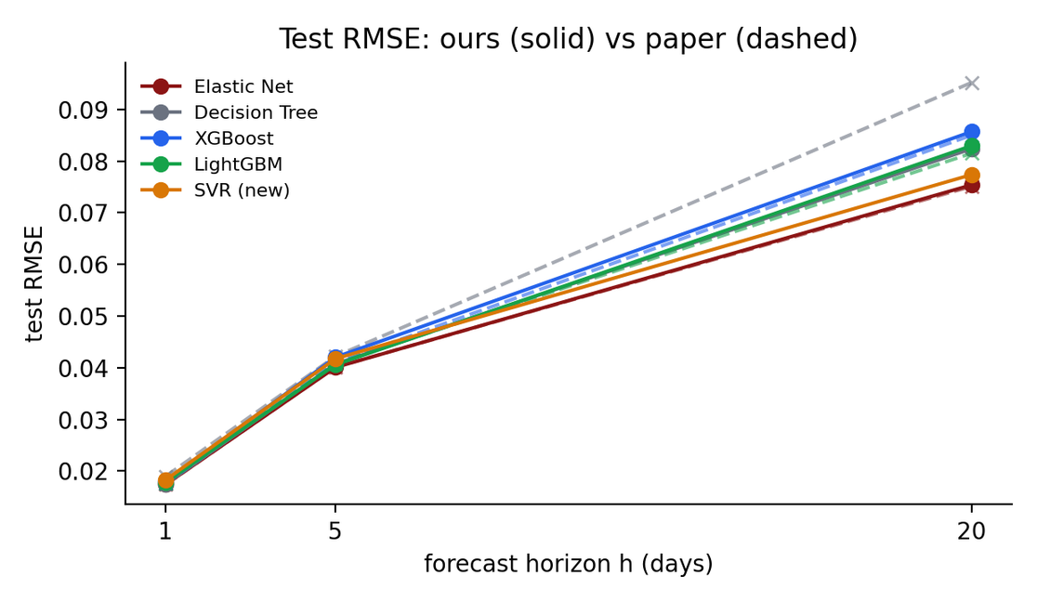
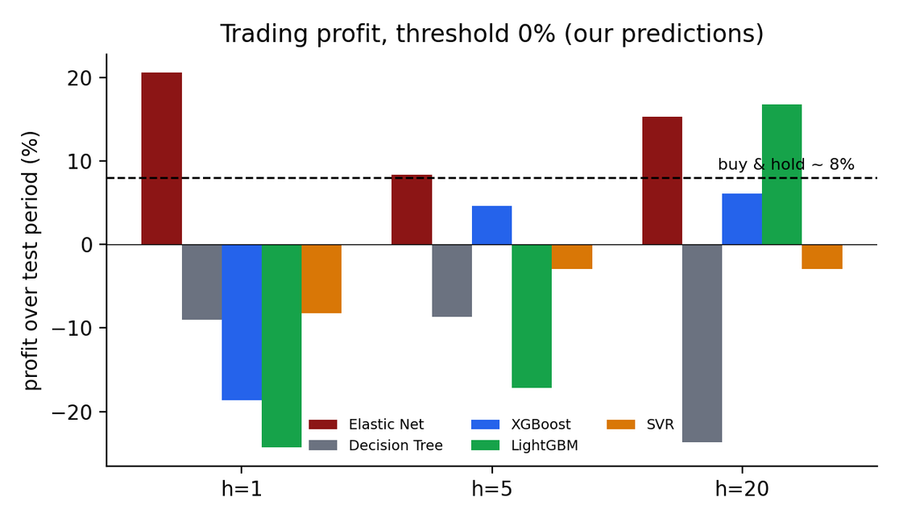
ALL MODELS, SIDE BY SIDE
Error grows with horizon for every model, and Elastic Net stays lowest. Profit at h=1 and h=5 is unstable across models; at h=20 several models beat buy and hold.
UE24CS352A Machine Learning | Mini-Project
Notes:
Left: RMSE vs horizon, ours solid and paper dashed - curves nearly overlap for EN, XGB, LGBM. Right: trading profit at threshold 0 using our predictions in chronological order, dashed line is buy and hold. Only h=20 shows a consistent edge for the best models.
7

Slide 8
CONCLUSIONS
  Prediction results reproduce: Elastic Net is best at h = 1, 5, 20 (within 0.4%).
  New RBF-SVR is competitive, not better: +3 to +5% RMSE vs Elastic Net, second at h = 20.
  Trading claims need care: order-dependent code, h=1,5 unstable; only h=20 gives about 2x buy and hold, before costs.
  Limitations: reduced grids / tuning schedule, only h = 1, 5, 20, one seed, no costs or risk measures.
Notes:
Likely Q&A: Why not shuffle? Time series - sequential split avoids look-ahead. Why zero-fill? Paper's choice; biases effects toward zero. Why SVR C=0.1? Validation picked strongest regularisation - signal weak. Why is DT better than paper? Our smaller grid; untested. Can you trust the profit? Only h=20; costs ignored. Why only h=1,5,20? Poster horizons; compute-limited; code accepts other horizons.
8

Slide 9
THANK YOU
UE24CS352A Machine Learning | Mini-Project
Notes:
Demo: open mini_project.ipynb, show section 3 (Quick demo: all five models on one rolling window, about 1 min, noisy because only 19 test days), then the section 4 and 5 tables and figures. Repo: one notebook + data + saved results + README.
9

