Slide 1


Tree-Based Models in R: From Decision to Boosted Trees

Slide 2
Tree-Based Models in Python: From Decision to Boosted Trees

Slide 3
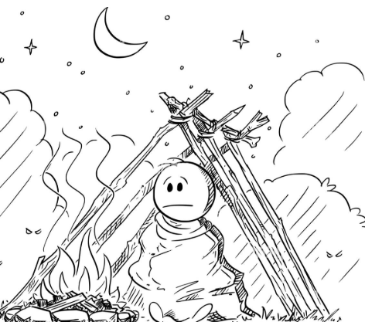
Survival Analysis in R: From Simple Methods to Machine Learning

Slide 4
Survival Analysis in Python: From Simple Methods to Machine Learning

Slide 5
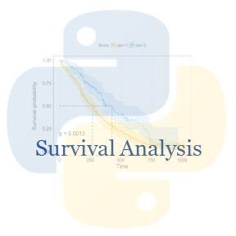
Survival Analysis in Python: From Simple Methods to Machine Learning
Zia Ahmed PhD

Slide 6
Generalized Linear Models (GLMs) in R
Zia Ahmed PhD

Slide 7
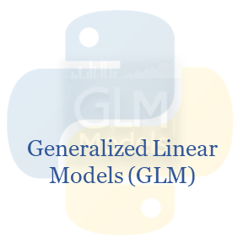
Generalized Linear Models (GLMs) in Python: Theory, Implementation, and Applications
Zia Ahmed PhD

Slide 8
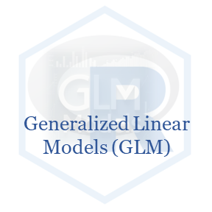
Generalized Linear Models (GLMs) in R: Theory, Implementation, and Applications
Zia Ahmed PhD

Slide 9
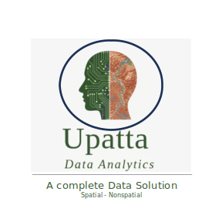
Causal Inference in R: From Theory to Practice

Slide 10
Causal Inference in R Randomized Controlled Trials (RCTs)

Slide 11
Causal Inference in R Directed Acyclic Graphs (DAGs)

Slide 12
Causal Inference in R Temporal Causal Inference

Slide 13
Causal Inference in R Causal Machine Learning

Slide 14
Causal Machine Learning Causal Inference in R Tree-Based Models

Slide 15
Causal Machine Learning Causal Inference in R Meta-Learners

Slide 16
Causal Machine Learning Causal Inference in R Uplift Learners

Slide 17
Causal Machine Learning Causal Inference in R Double/Debiased Machine Learning

Slide 18
Causal Machine Learning Causal Inference in R Deep Causal Learning

Slide 19
Deep Causal Learning Causal Inference in R Treatment Effect Estimators

