Slide 1
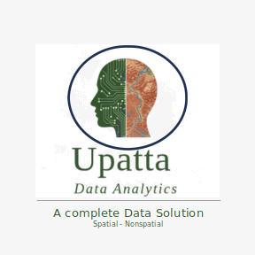
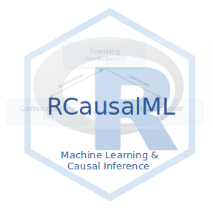
Causal Machine Learning

Slide 2
Causal Inference
Tree-Based Models

Slide 3
Causal Inference
Meta-Learners

Slide 4
Causal Inference
Uplift Learners

Slide 5
Causal Inference
Deep Causal Learning

Slide 6
Causal Inference
Deep Causal Learning
Treatment Effect Estimators

Slide 7
Causal Inference
Deep Causal Learning
Generative Latent-Variable

Slide 8
Causal Inference
Deep Causal Learning
Structural Learning

Slide 9
Causal Inference
Deep Causal Learning
Temporal Causal ML

