Slide 1

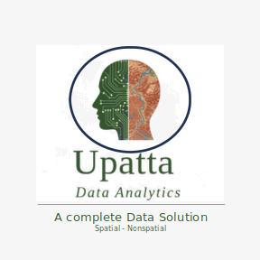
R for Beginners

Slide 2
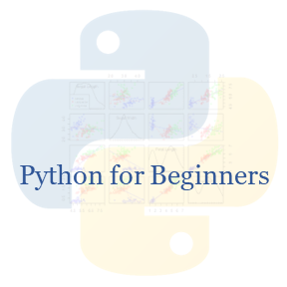
Python for Beginners

Slide 3

Causal Inference:
From Theory to Practice

Slide 4
Causal Inference
Randomized Controlled Trials (RCTs)

Slide 5
Causal Inference
Directed Acyclic Graphs (DAGs)

Slide 6
Causal Inference
Potential Outcomes Framework

Slide 7
Causal Inference
Temporal Causal Inference

Slide 8
Causal Inference
Temporal Causal Inference

Slide 9
Causal Inference
Causal Machine Learning

Slide 10
Causal Machine Learning
Causal Inference
Tree-Based Models

Slide 11
Causal Machine Learning
Causal Inference
Double/Debiased Machine Learning

Slide 12
Causal Machine Learning
Causal Inference
Deep Causal Learning

Slide 13
Causal Machine Learning
Causal Inference
Deep Causal Learning

Slide 14
Deep Causal Learning
Causal Inference
Treatment Effect Estimators

