Slide 1


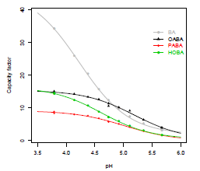

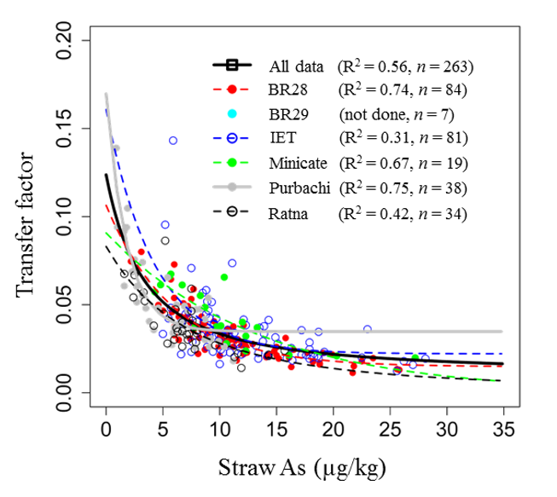
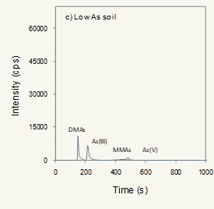
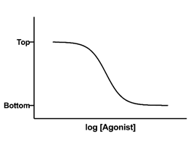
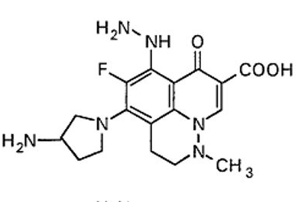
ChemStat-R: Statistics for Chemistry in R

Slide 2
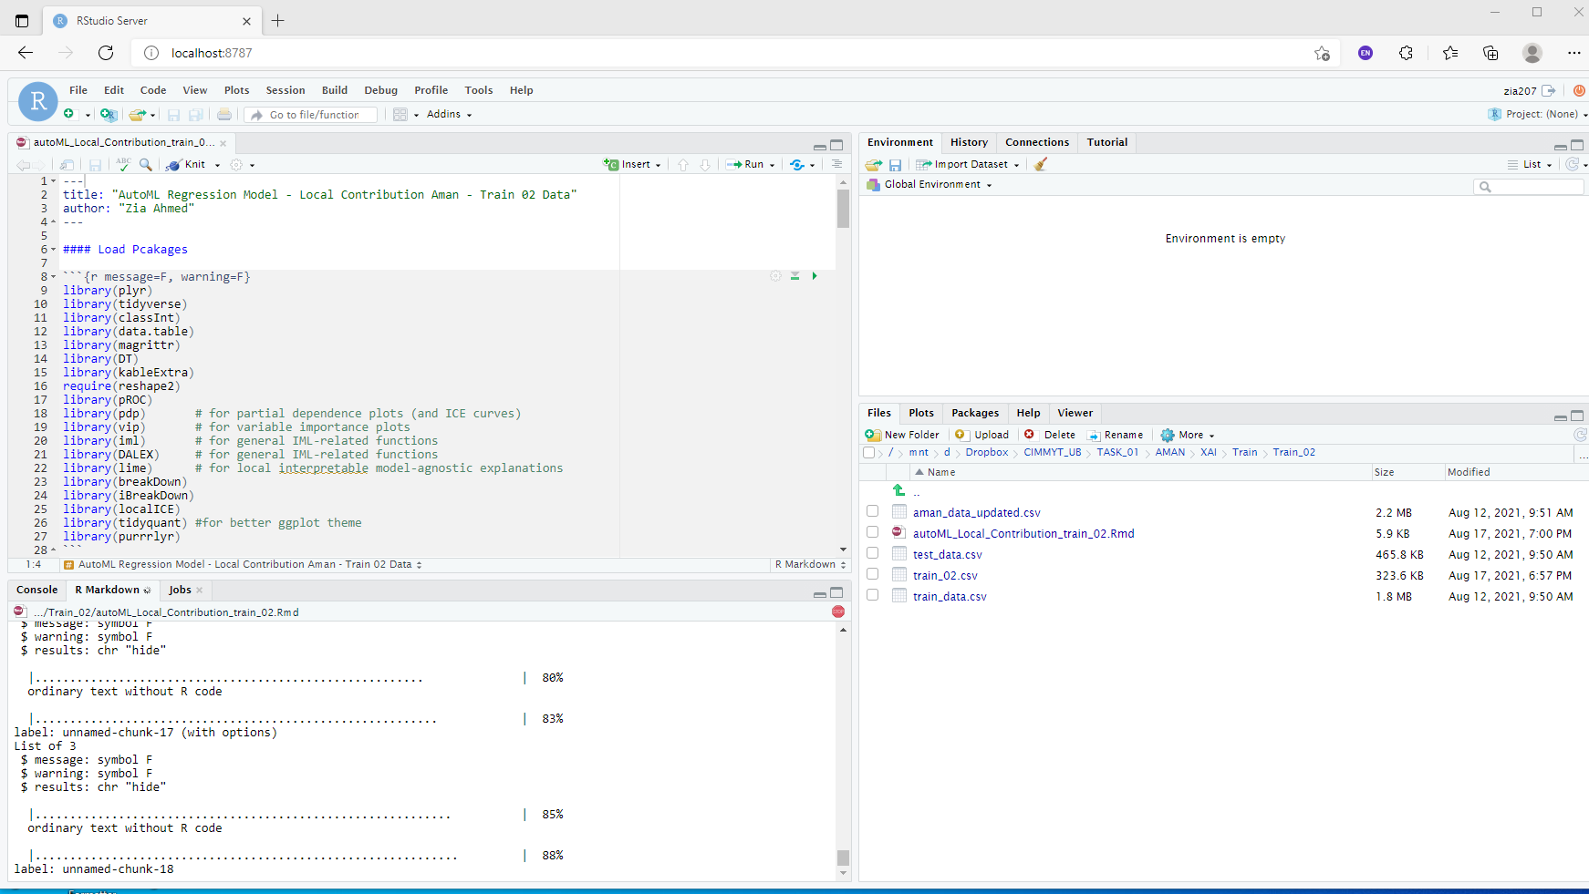
Getting Started with R

Slide 3
Essential of the R Language

Slide 4
Introduction to Using R

Slide 5
R Data Import/Export

Slide 6
Data Wrangling with R

Slide 7
Exploratory Data Analysis

Slide 8
Statistical Test

Slide 9
Analysis of Variance (ANOVA)

Slide 10
Correlation Analysis

Slide 11
Regression Analysis

Slide 12
Nonlinear Regression

Slide 13
Multivariate Statistics with R

Slide 14
Data Visualization with R

Slide 15
Curve Fitting with R

Slide 16
Cheminformatics with R

Slide 17
Getting Started- Cheminformatics

Slide 18
Cheminformatics With ChemmineR

Slide 19
Cheminformatics With rCDK

Slide 20
ICP-MS data Processing and Analysis

