Slide 1



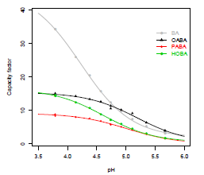
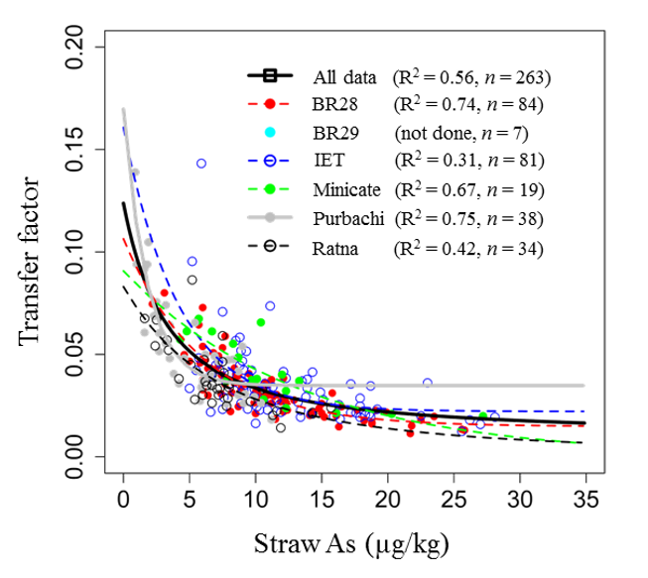
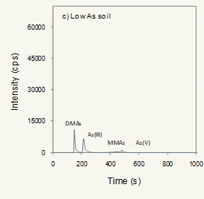
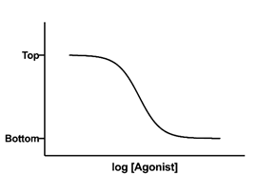
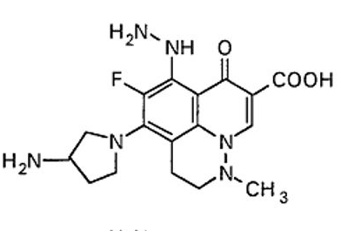
ChemStat-R: Statistics for Chemistry in R

Slide 2
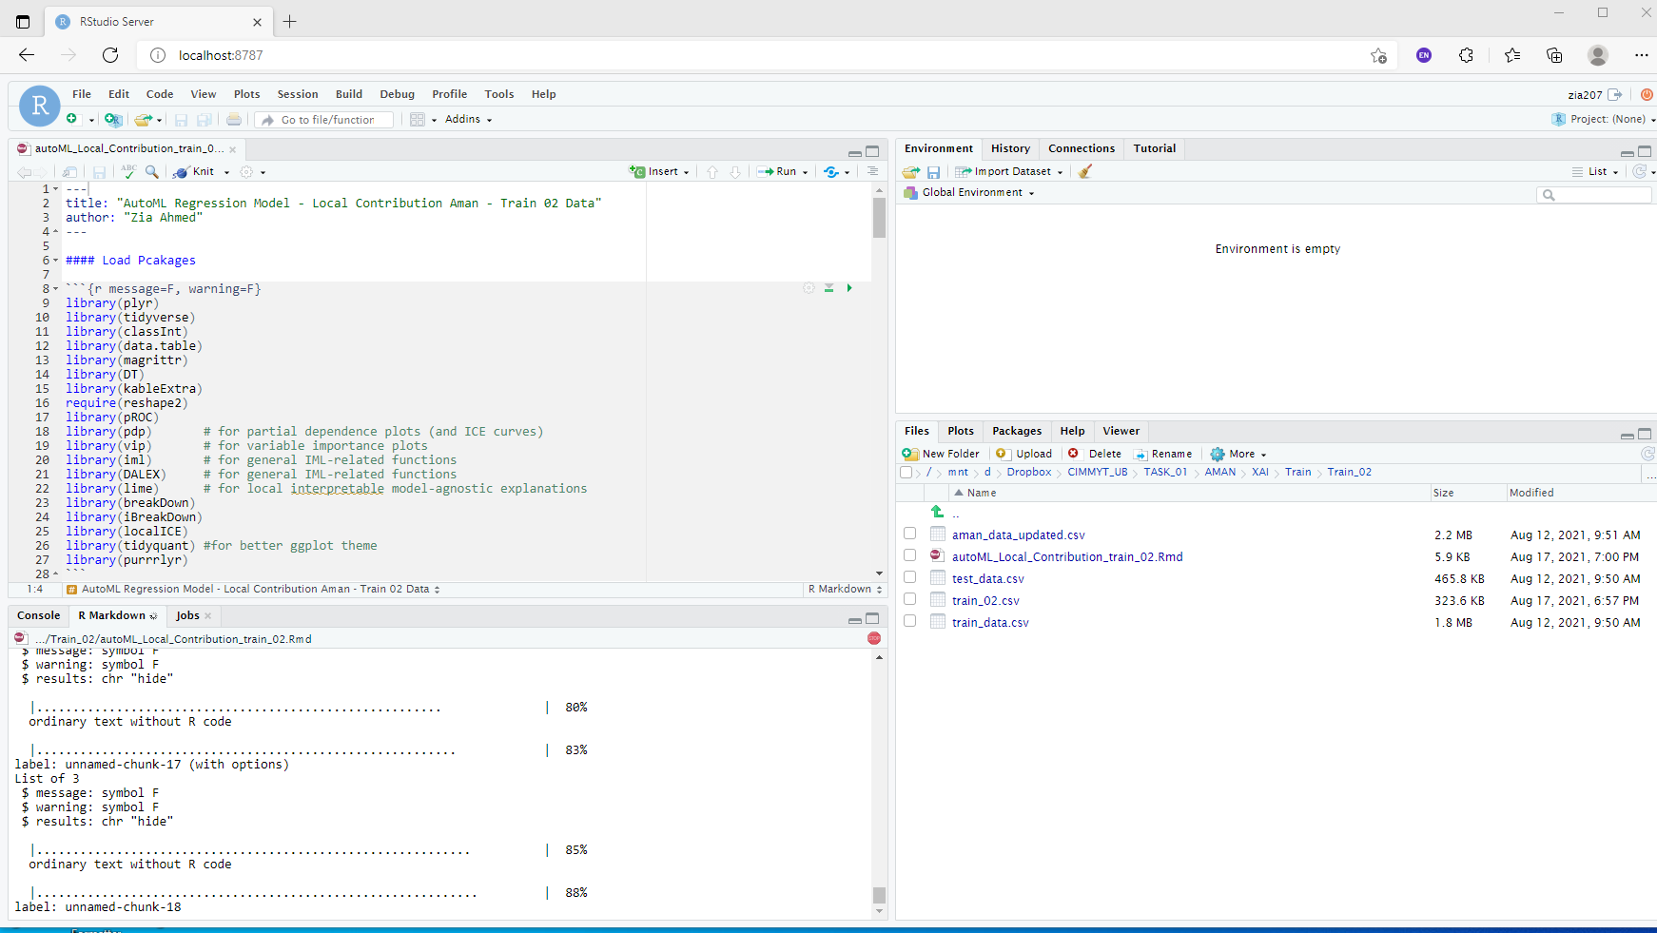
Getting Started with R

Slide 3
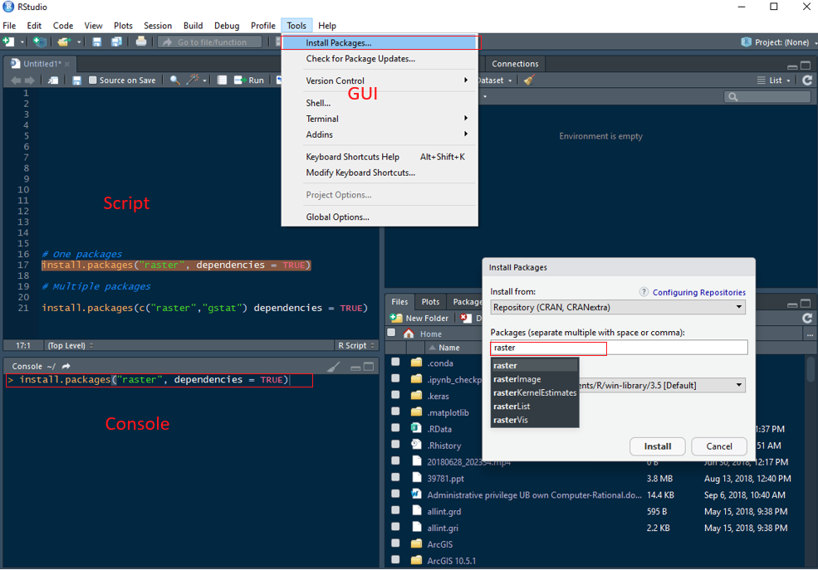
Essential of the R Language

Slide 4
R Data Input and Data Type

Slide 5
Data Wrangling

Slide 6
Data Visualization

Slide 7
Basic Statistics

