Slide 1


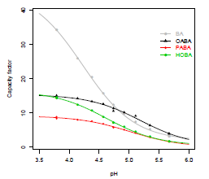

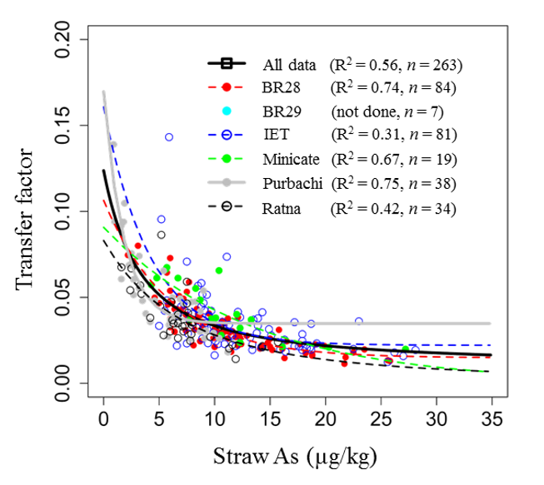
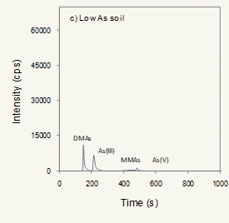
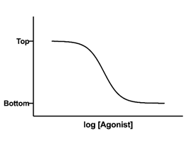
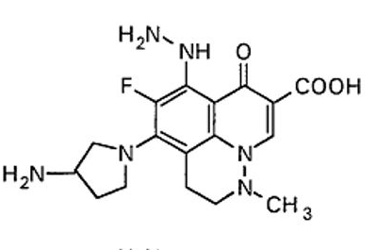
ChemStat-R: Statistics for Chemistry in R

Slide 2
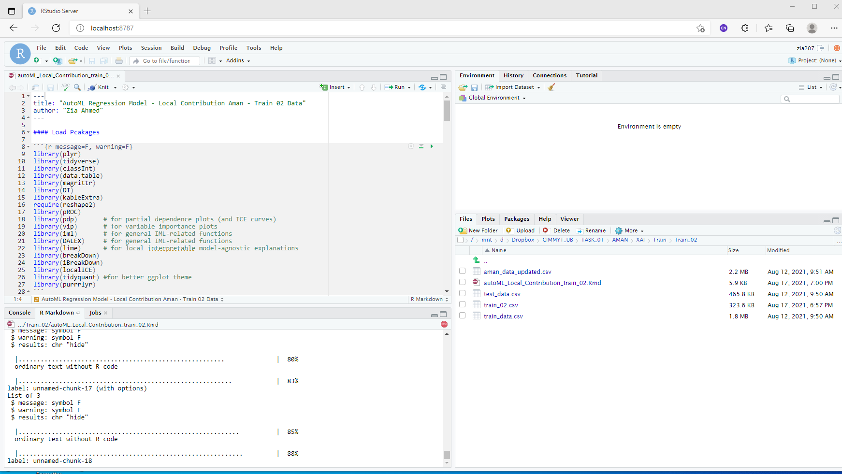
Getting Started with R

Slide 3
Essential of the R Language

Slide 4
Introduction to Using R

Slide 5
R Data Import/Export

Slide 6
Data Wrangling with R

Slide 7
Simple Mathematics with R

Slide 8
Basic Statistics with R

Slide 9
Multivariate Statistics with R

Slide 10
Data Visualization with R

Slide 11
Curve Fitting with R

Slide 12
Cheminformatics with R

Slide 13
Getting Started- Cheminformatics

Slide 14
Cheminformatics With ChemmineR

Slide 15
Cheminformatics With rCDK

Slide 16
ICP-MS data Processing and Analysis

