Slide 1



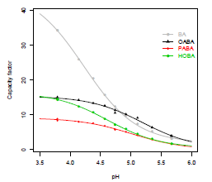
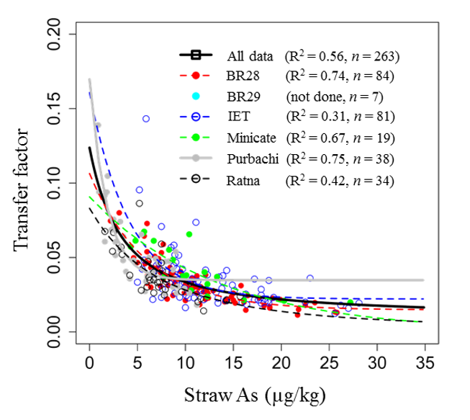
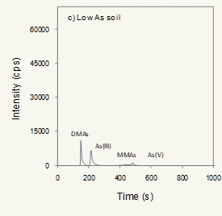
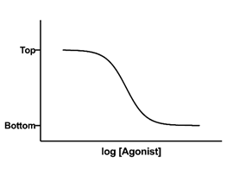
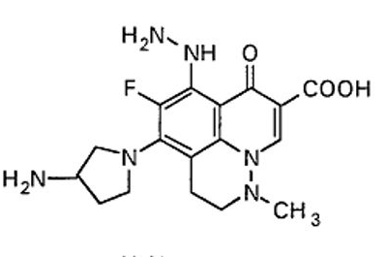
ChemStat-R: Statistics for Chemistry in R

Slide 2
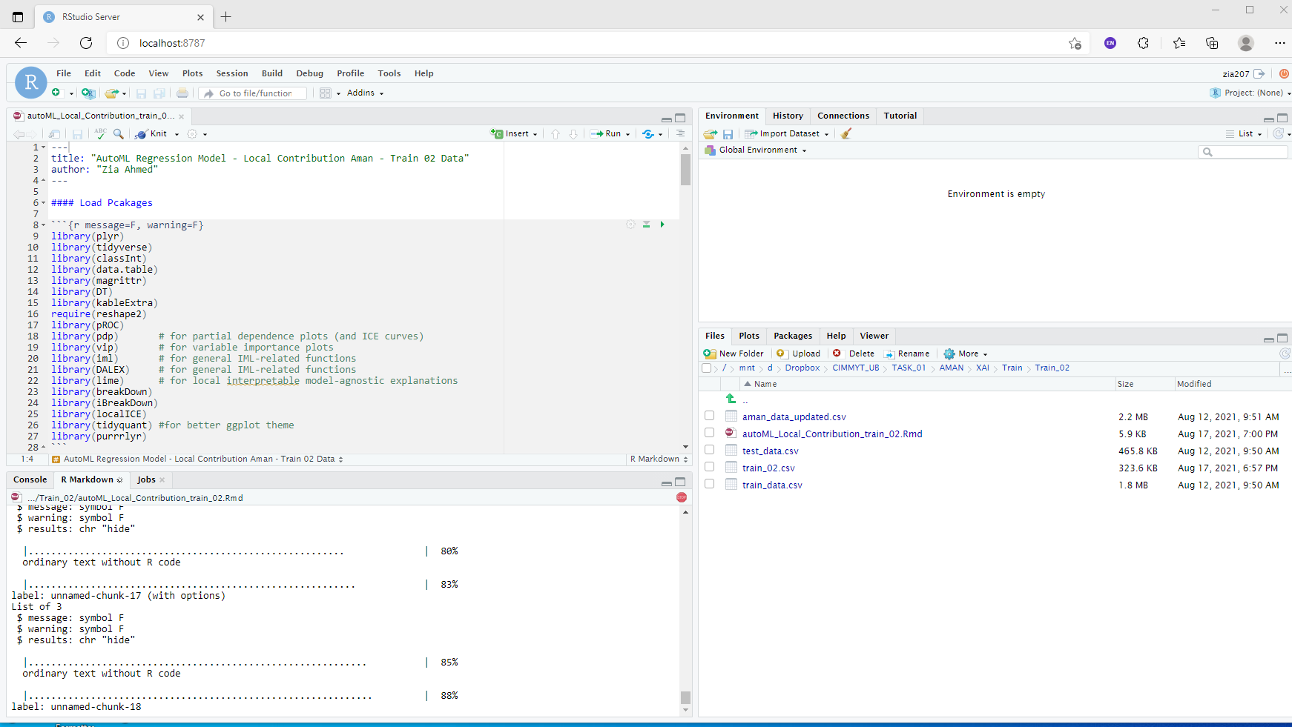
Getting Started with R

Slide 3
Essential of the R Language

Slide 4
Introduction to Using R

Slide 5
Importing/Exporting Data into/From R

Slide 6
Data Visualization

Slide 7
Basic Statistics

Slide 8
Curve Fitting With R

Slide 9
Cheminformatics with R

Slide 10
Getting Started- Cheminformatics

Slide 11
Cheminformatics With ChemmineR

Slide 12
Cheminformatics With rCDK

Slide 13
ICP-MS data Processing and Analysis

