Slide 1

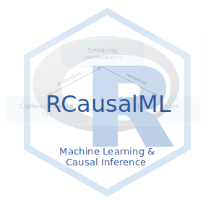
Causal Inference
Tree-Based Models

