Slide 1
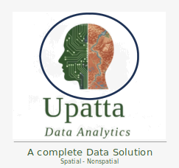

PySpatialStats
Spatial Statistics
Setup and Foundations

Slide 2
PySpatialStats
Spatial Statistics
Point Pattern Analysis

Slide 3
PySpatialStats
Spatial Statistics
Spatial Autocorrelation

Slide 4
PySpatialStats
Spatial Statistics
Spatial Regression

Slide 5
PySpatialStats
Spatial Statistics
Spatial Cluster Analysis

Slide 6
PySpatialStats
Spatial Statistics
Disease Mapping and Bayesian Smoothing

Slide 7
PySpatialStats
Spatial Statistics
Disease Mapping and Bayesian Smoothing

Slide 8
PySpatialStats
Spatial Statistics
Geographically Weighted Models

Slide 9
PySpatialStats
Spatial Statistics
Spatial Interpolation

Slide 10
PySpatialStats
Spatial Statistics
Spatial Sampling and Design

Slide 11
PySpatialStats
Spatial Statistics
Spatio-Temporal Analysis

Slide 12
PySpatialStats
Spatial Statistics
Spatial Sampling and Design

