Slide 1
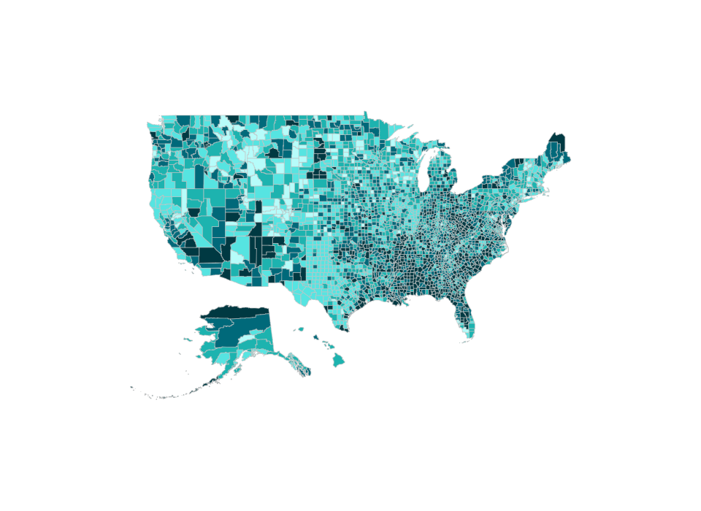


Diagnosed Diabetes, Total, Adults Aged 20+ Years, Age-Adjusted Percentage, U.S. Counties, 2020
Percentage ( Natural Breaks )
3.3 - 6.5
6.6 - 7.4
7.5 - 8.5
8.6 - 10.1
10.2 - 19.5
No Data
Suppressed
Source:
USDSS
Disclaimer: This is a user-generated report. The findings and conclusions are those of the user and do not necessarily represent the views of the CDC.

