Slide 1


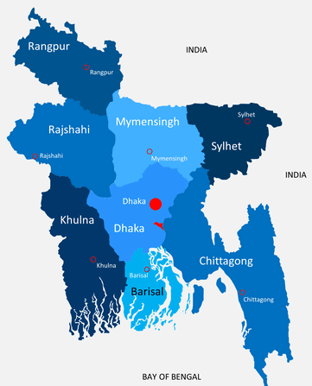
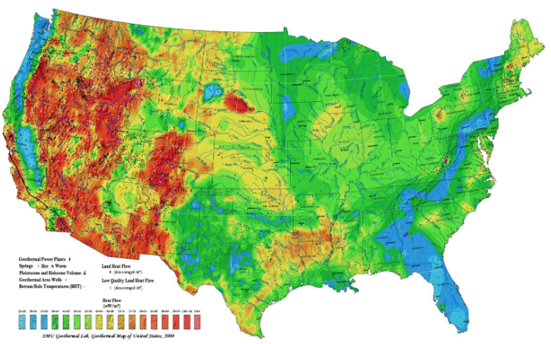

Read and Write Spatial Data in Python
Zia U Ahmed

Slide 2

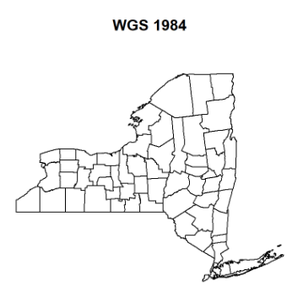
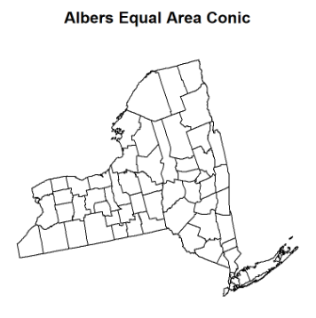
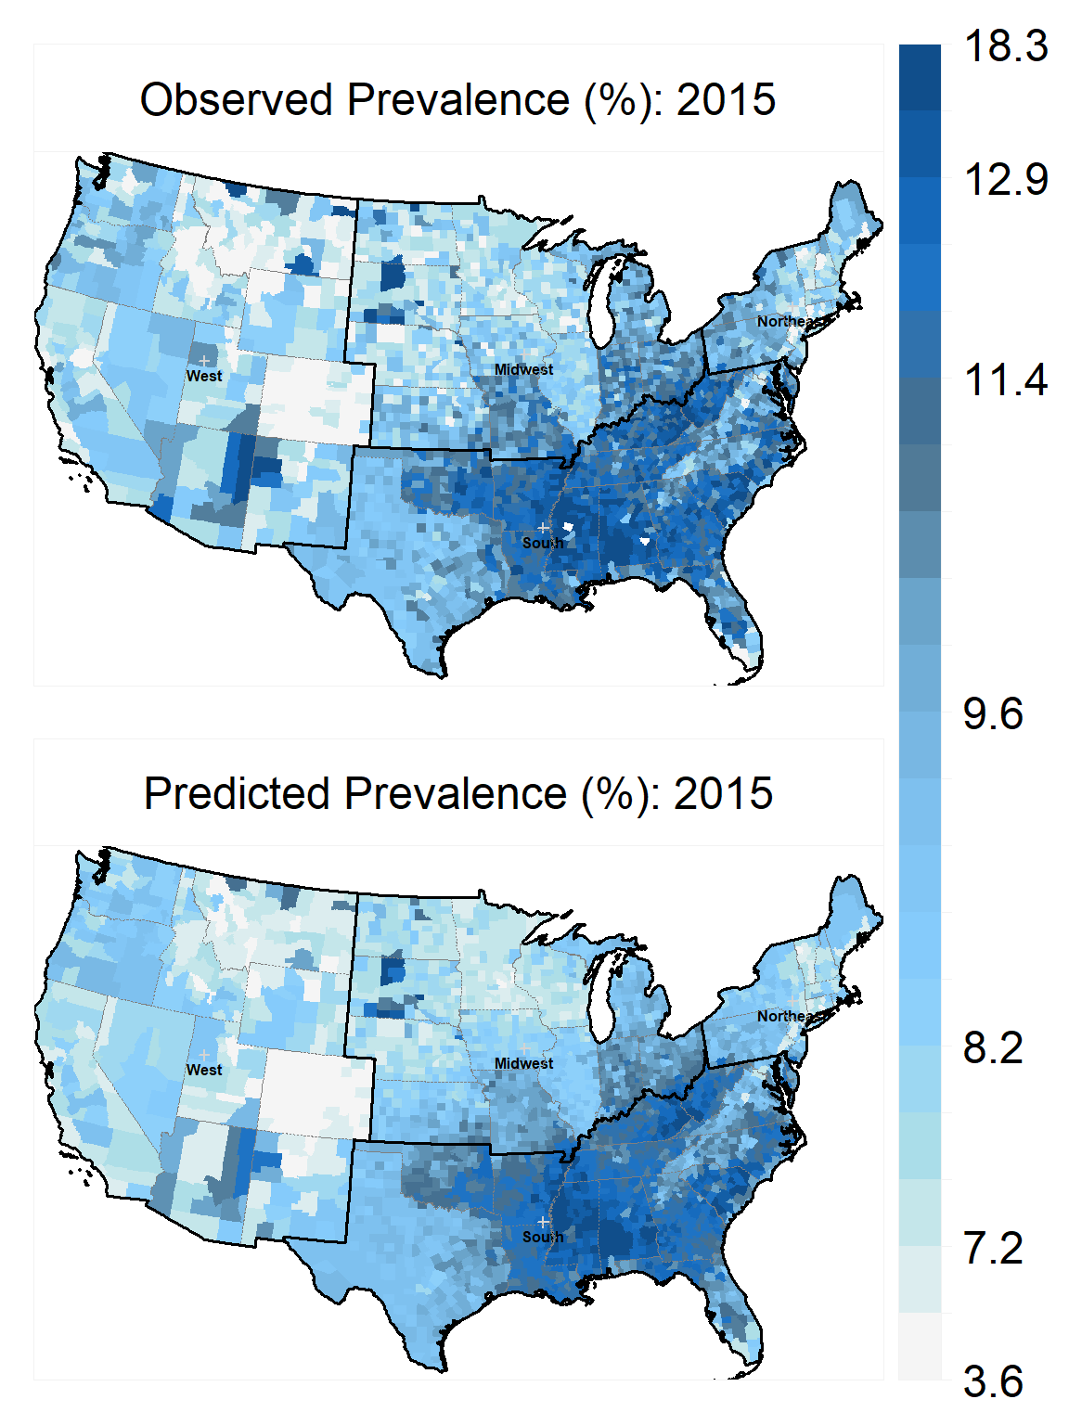
Map Projection and Coordinate Reference Systems
Zia U Ahmed

Slide 3
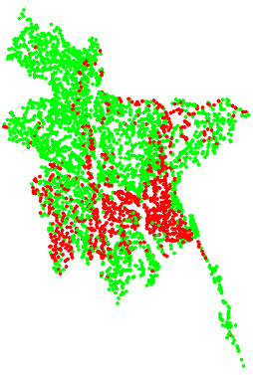
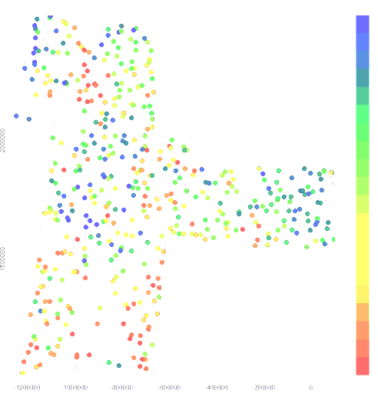
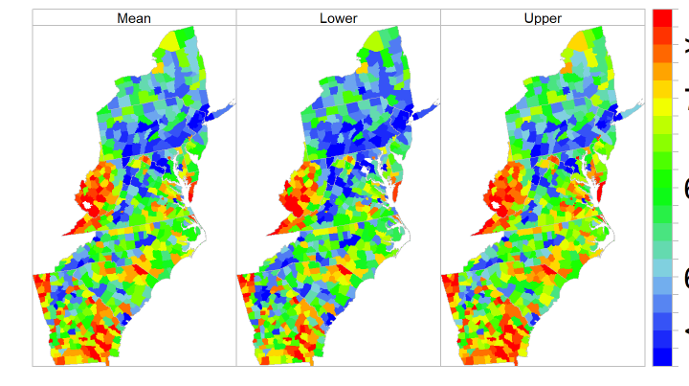
Working With Spatial Vector Data
Zia U Ahmed, University at Buffalo

Slide 4
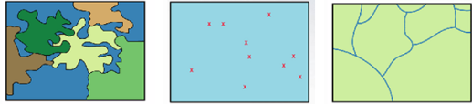
Geo-processing of Vector Data
Zia U Ahmed

Slide 5
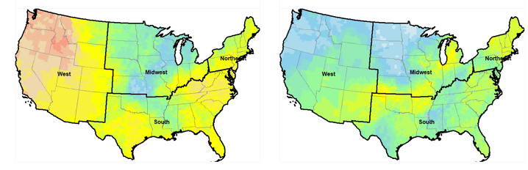
Working with Polygon Data
Zia U Ahmed

Slide 6
Working with Spatial Point Data
Zia U Ahmed

Slide 7
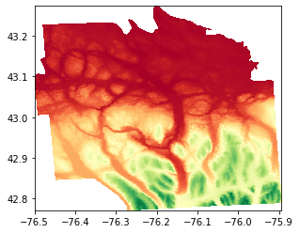
Working with Raster Data
Zia U Ahmed

