Slide 1
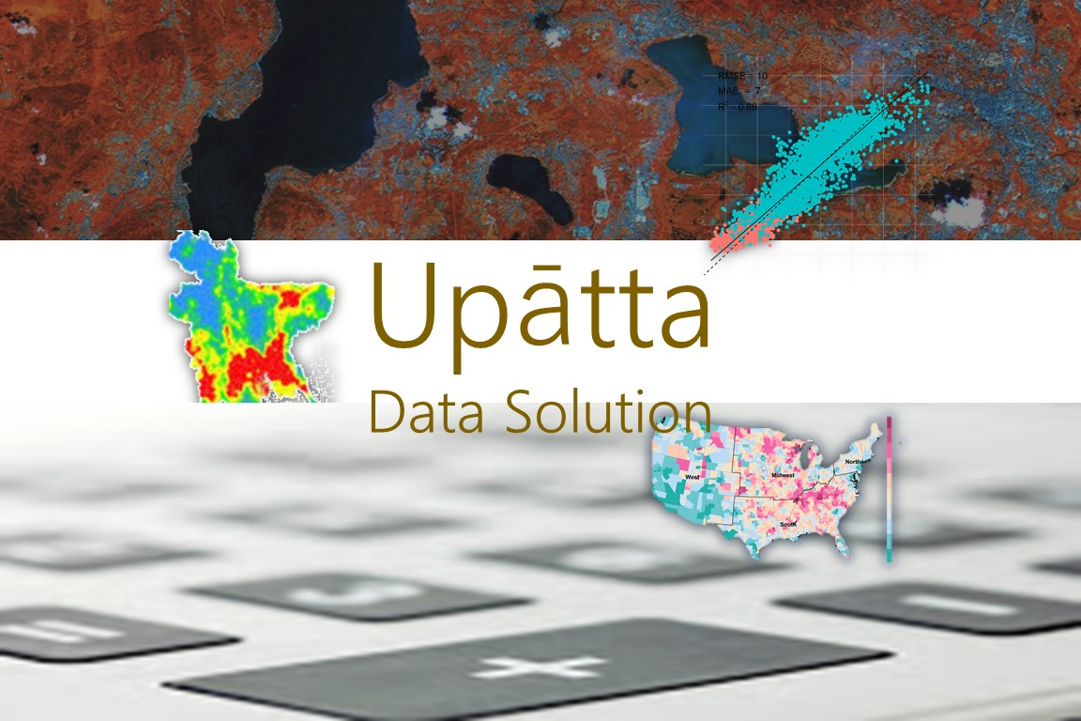

Slide 2
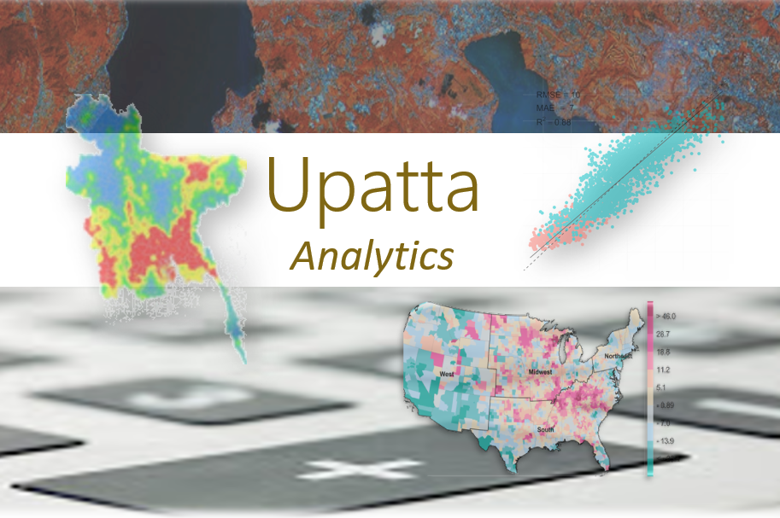

Slide 3



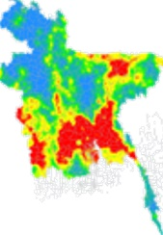
Geospatial Data Science

Slide 4

Geospatial Data Science With Python
Geospatial Data Science With Python

Slide 5
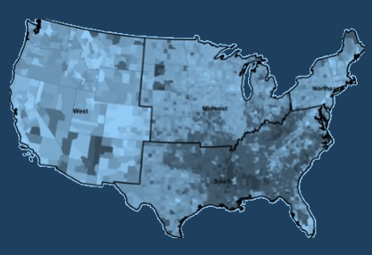

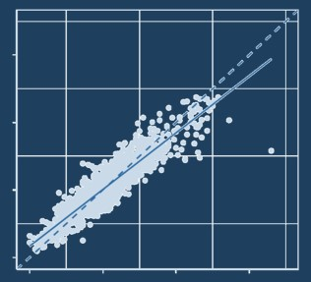
Geospatial Data Science With Python

Slide 6
Getting Started With Python

Slide 7
Geospatial Data Science With Python

Slide 8

