Slide 1
Mini_Project_3_Dashboard
File created on: 10/24/2026 4:07:24 AM
Prepared by: Ziad Bahaa Mokhlef Mohamed
Data Analyst Trainee @ DEPI
Tool: Tableau

Slide 2
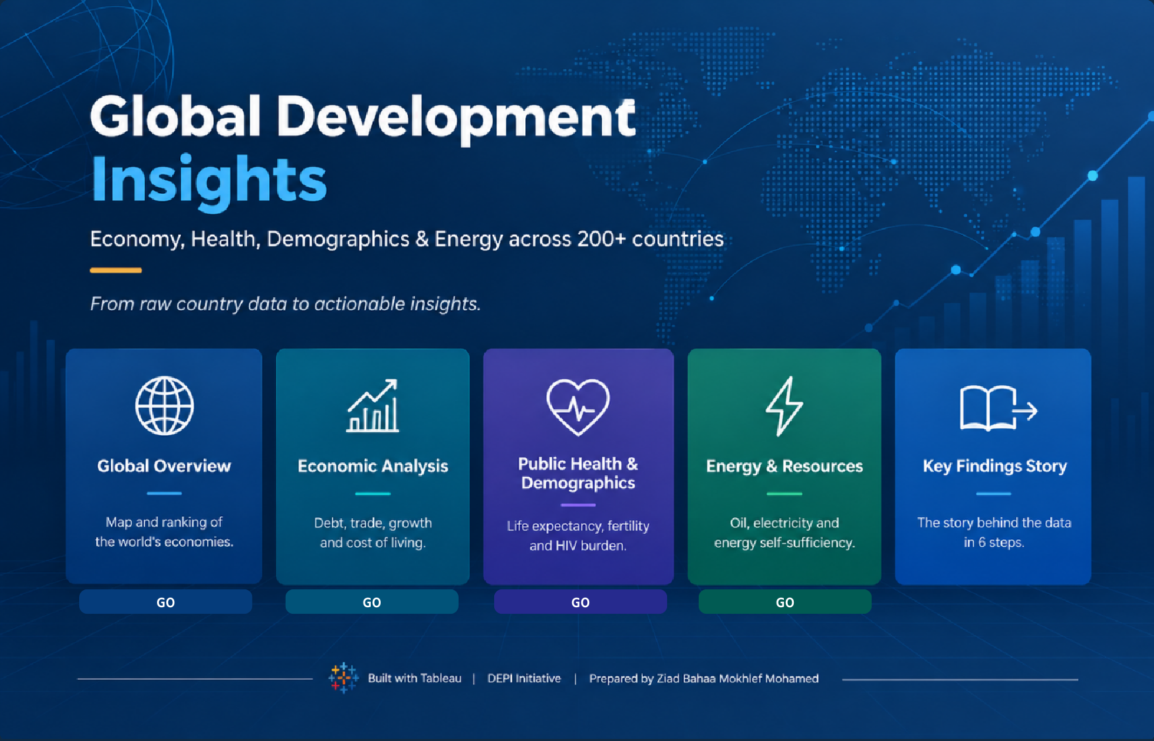

Slide 3
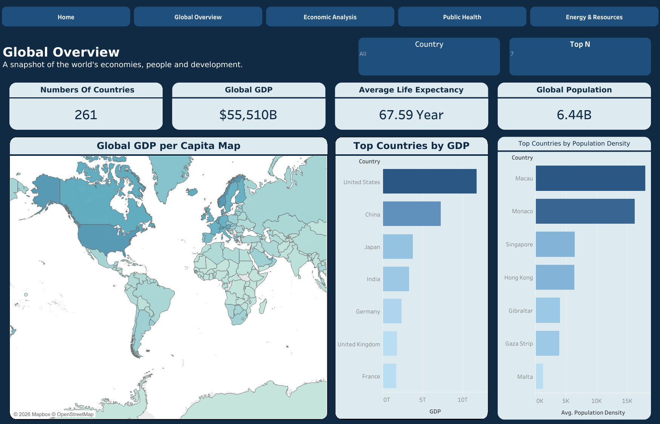

Slide 4
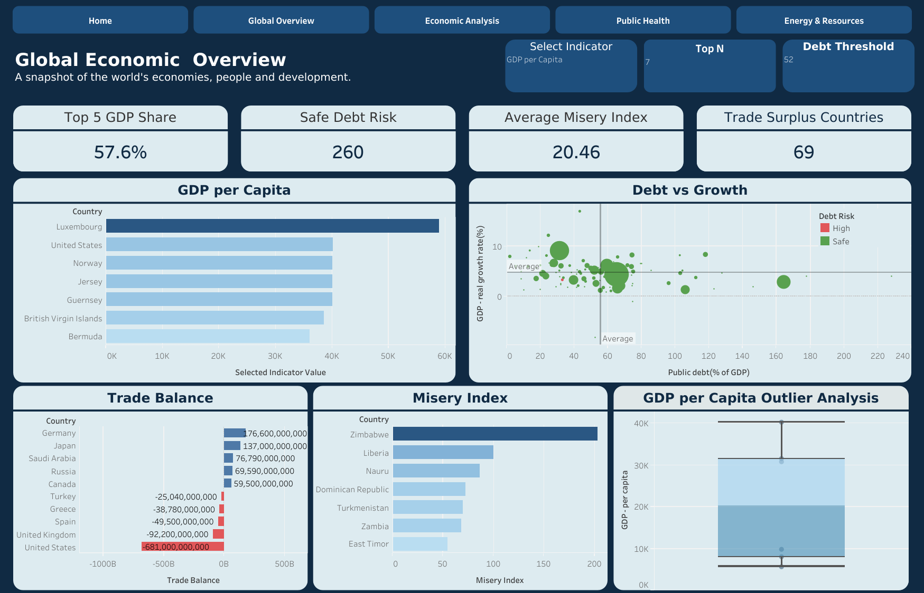

Slide 5
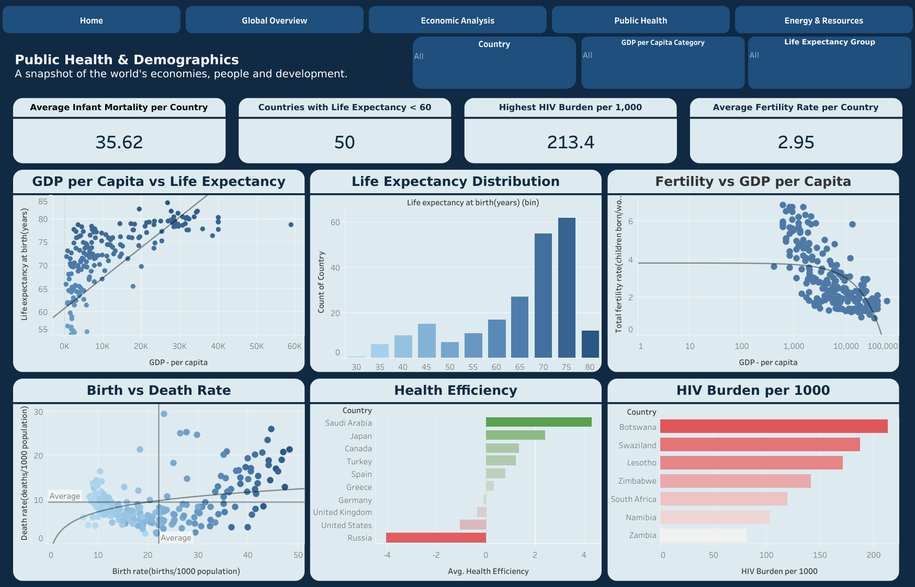

Slide 6
