Slide 1

OCP-CH4 Functional Programming
Why and what is Functional Programming ?

Slide 2
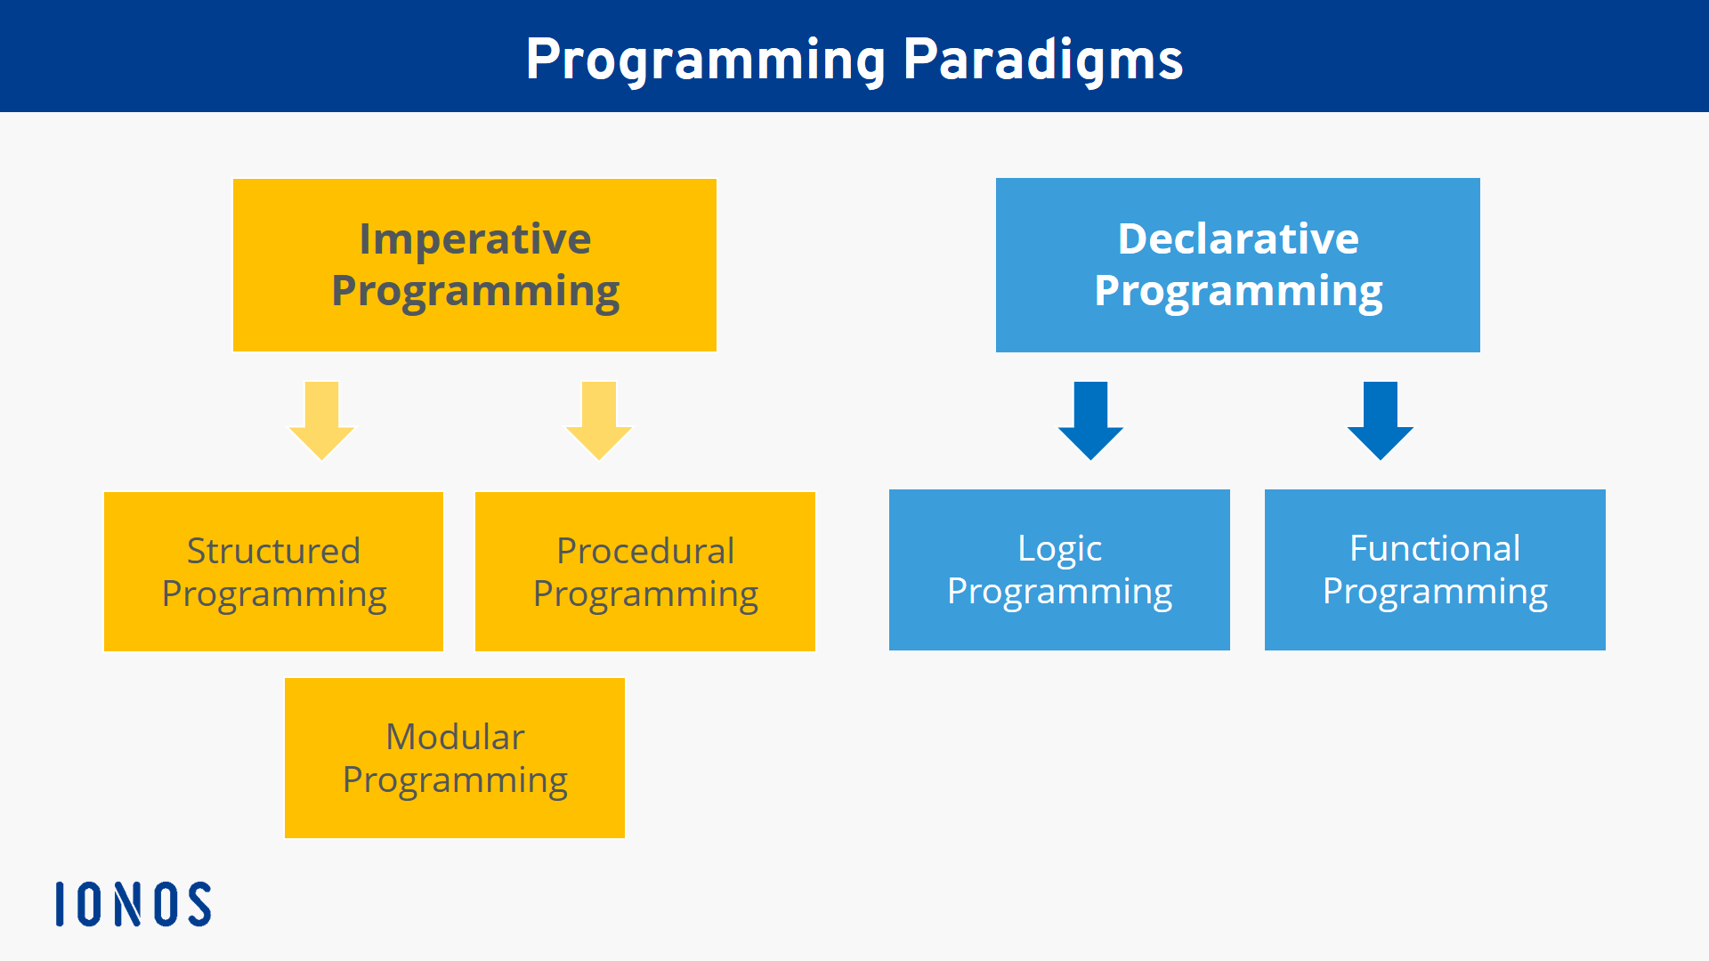
- Functional programming is declarative programming paradigm, meaning that the program logic is expressed without explicitly describing the control flow. It's based on the concept of "pure functions," which produce output based solely on their inputs and have no side effects
- Predictable and Debuggable
- Concurrency and Parallelism
- Modular and Reusable
- Testing

Slide 3

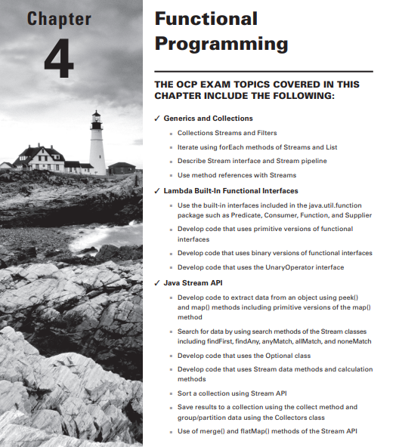
Agenda
- Using Variables in Lambdas
- Working with Built-In Functional Interfaces
- Returning an Optional
- Using Streams
- Working with Primitives
- Working with Advanced Stream Pipeline Concepts
- Summary
- Review Questions

Slide 4
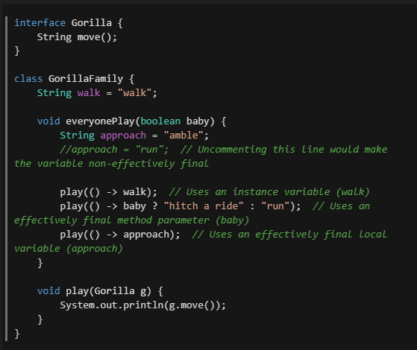
Using Variables in Lambdas
- effectively final variables
- instance variables
- method parameters

Slide 5
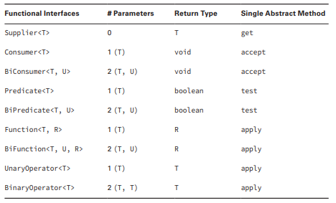
Working with Built-In Functional Interfaces

Slide 6
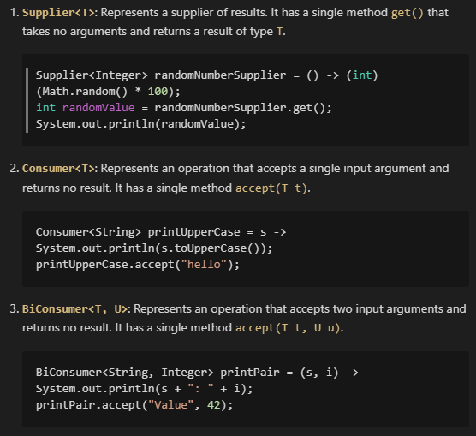
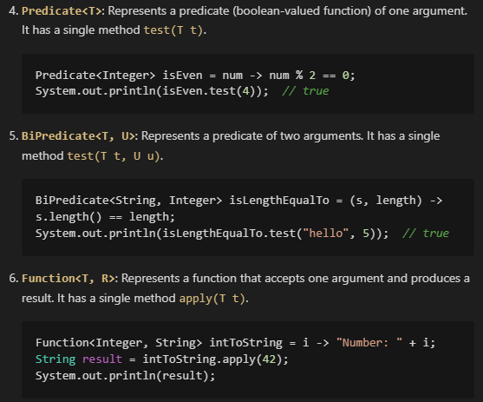
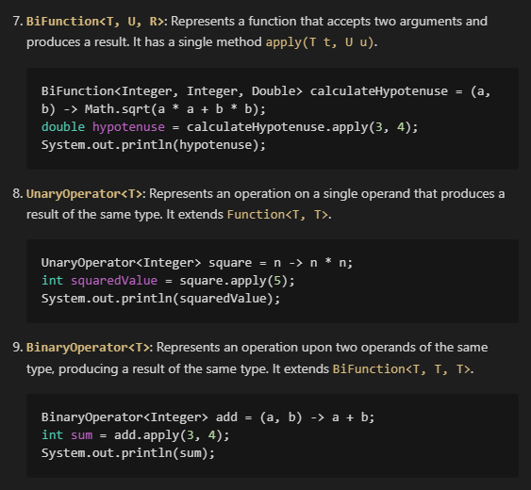

Slide 7
Do we really understand how to deal with Functional Interfaces?
1. Returns a String without taking any parameters ?
2. Returns a Boolean and takes a String ?
3. Returns an Integer and takes two Integers ?

Slide 8
Do we really understand how to deal with Functional Interfaces?
- The `Supplier` functional interface fits this scenario perfectly. It has no parameters and returns a value.
- In this case, the appropriate functional interface is `Function`. Although it's a bit counterintuitive, the `Function` interface is used because it takes one parameter and returns a different type. A `Predicate` wouldn't work since it returns a boolean primitive, not a `Boolean` object.
- you have two valid options: `BinaryOperator` and `BiFunction`. However, the more specific and appropriate choice is `BinaryOperator`, as it is tailored for cases where the input and output types are the same.
1. Returns a String without taking any parameters ?
2. Returns a Boolean and takes a String ?
3. Returns an Integer and takes two Integers ?

Slide 9
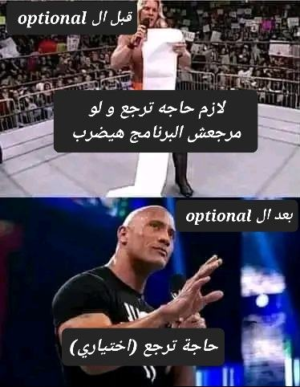
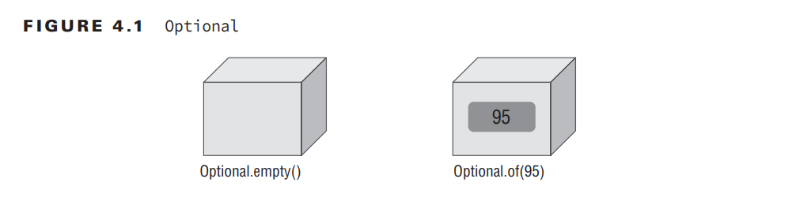
Returning an Optional
Think of an Optional as a box that might have something in it or might instead be empty

Slide 10
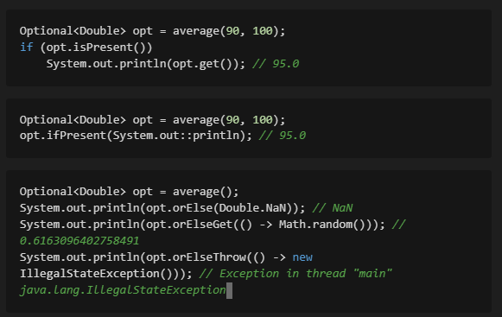
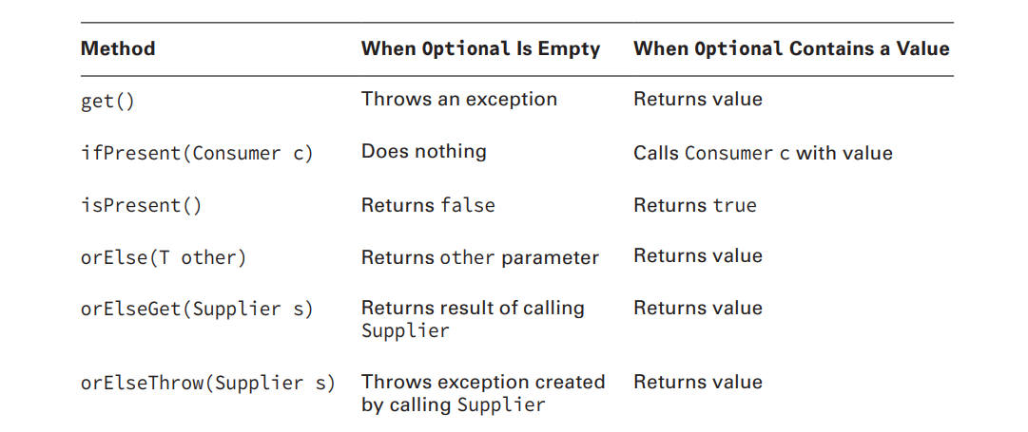
Optional instance methods

Slide 11
Using Streams
What Is a Stream ?
A stream is a sequence of elements supporting sequential and parallel aggregate operations.
Creating a Stream
There are several ways to create a stream. Let's look at some of the most common ways.

Slide 12
Creating a Stream from a Collection

Slide 13
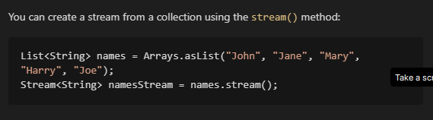
Creating a Stream from a Collection

Slide 14
Creating a Stream from a Collection
Creating a Stream from an Array

Slide 15
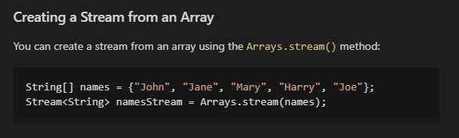
Creating a Stream from a Collection
Creating a Stream from an Array

Slide 16
Creating a Stream from a Collection
Creating a Stream from an Array
Creating a Stream from a Static Factory Method

Slide 17
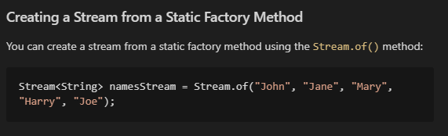
Creating a Stream from a Collection
Creating a Stream from an Array
Creating a Stream from a Static Factory Method

Slide 18
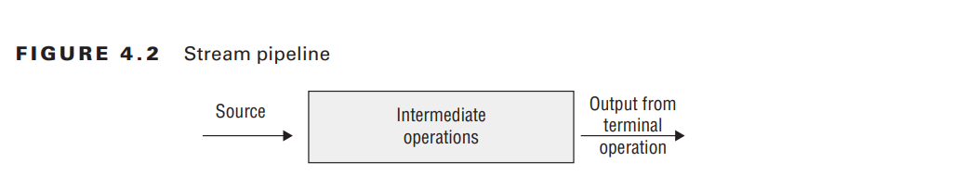
Using Stream Operations
Once you have a stream, you can perform operations on it. There are two types of operations:
- Intermediate operations
- Terminal operations

Slide 19
Intermediate Operations
filter() map()
distinct() flatMap()
limit() sorted()
skip() peek()

Slide 20
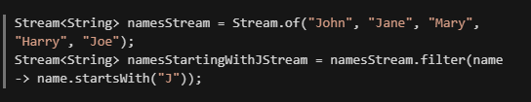
Intermediate Operations
filter()

Slide 21

Intermediate Operations
distinct()

Slide 22

Intermediate Operations
limit()

Slide 23

Intermediate Operations
skip()

Slide 24
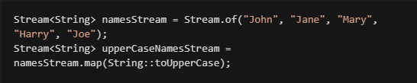
Intermediate Operations
map()

Slide 25
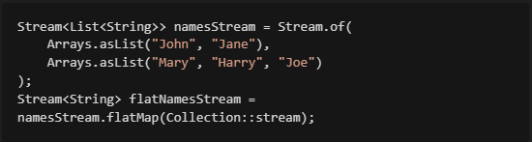
Intermediate Operations
flatMap()

Slide 26

Intermediate Operations
sorted()

Slide 27
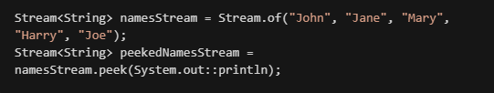
Intermediate Operations
peek()

Slide 28
Terminal Operations
forEach() findFirst()
allMatch() findAny()
anyMatch() count()
noneMatch() Collect()

Slide 29

Terminal Operations
forEach()

Slide 30
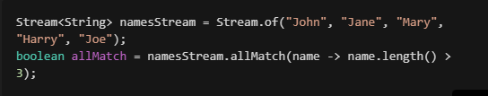
Terminal Operations
allMatch()

Slide 31
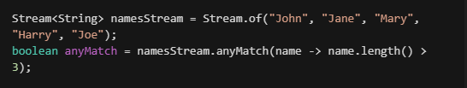
Terminal Operations
anyMatch()

Slide 32
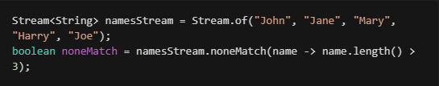
Terminal Operations
noneMatch()

Slide 33

Terminal Operations
findFirst()

Slide 34

Terminal Operations
findAny()

Slide 35

Terminal Operations
count()

Slide 36

Terminal Operations
Collect()

Slide 37
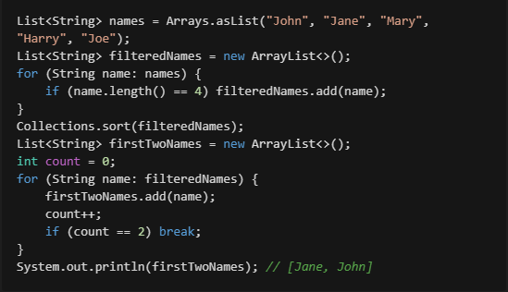
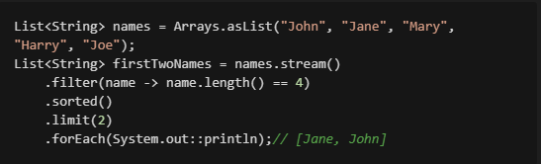
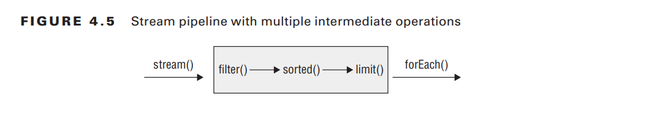
Putting Together the Pipeline of Stream Operations
Streams allow you to use chaining and express what you want to accomplish rather than how to do so. Let’s say that we wanted to get the first two names alphabetically that are four characters long. In Java 7, we’d have to write something like the following:
in Java 8, we can use streams to express what we want to accomplish rather than how to

Slide 38
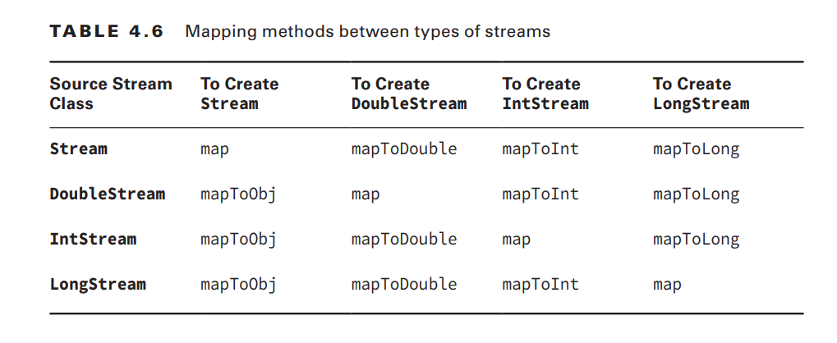
Creating Primitive Streams
IntStream
DoubleStream
LongStream

Slide 39

Using Optional with Primitive Streams

Slide 40
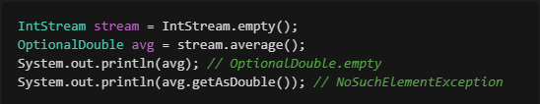
Using Optional with Primitive Streams

Slide 41
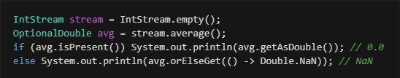
Using Optional with Primitive Streams

Slide 42

Using Optional with Primitive Streams
u’ve learned enough to be able to get the maximum value from a stream of int primitives. If the stream is empty, we want to throw an exception:

Slide 43

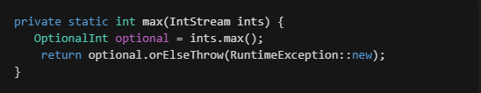
Using Optional with Primitive Streams
u’ve learned enough to be able to get the maximum value from a stream of int primitives. If the stream is empty, we want to throw an exception:

Slide 44
Working with Advanced Stream Pipeline Concepts
- Linking Streams to the Underlying Data
- Chaining Optionals
- Grouping Collectors

Slide 45
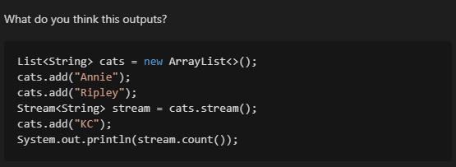
Working with Advanced Stream Pipeline Concepts
- Linking Streams to the Underlying Data
- Chaining Optionals
- Grouping Collectors

Slide 46
Linking Streams to the Underlying Data
The stream is linked to the data source. When we add KC to the list, it is also added to the stream.
When we call count() , we get the number of elements in the stream.
This is the same as the number of elements in the list. The stream is linked to the list.
This is important to know when you are working with streams.
You can’t modify the source while operating on it with a stream.

Slide 47
Chaining Optionals
Suppose that you are given an Optional<Integer> and asked to print the value, but
only if it is a three-digit number. Without functional programming, you could write the

Slide 48
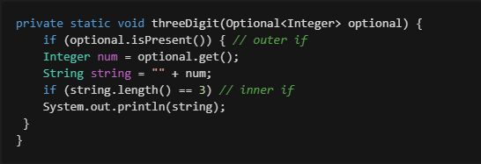
Chaining Optionals
Suppose that you are given an Optional<Integer> and asked to print the value, but
only if it is a three-digit number. Without functional programming, you could write the

Slide 49
Chaining Optionals
This is a lot of code to do something simple. We can do better with functional programming.

Slide 50
Chaining Optionals
This is a lot of code to do something simple. We can do better with functional programming.

Slide 51
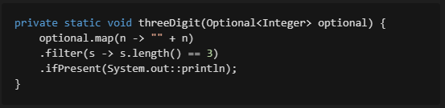
Chaining Optionals
This is a lot of code to do something simple. We can do better with functional programming.

Slide 52
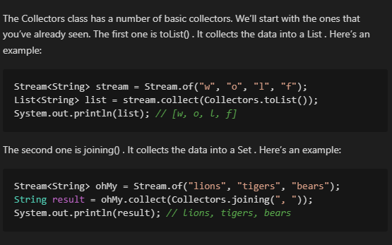
Collecting Using Basic Collectors

Slide 53
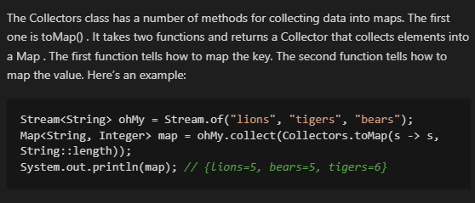
Collecting into Maps

Slide 54
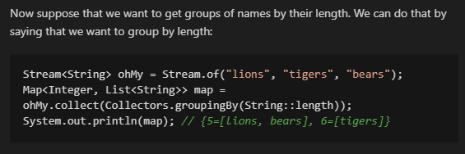
Collecting Using Grouping, Partitioning, and Mapping

Slide 55
Summary

Slide 56
Summary
Lambdas

Slide 57
Summary
Lambdas
Lambdas can reference static variables, instance variables, effectively final parameters, and effectively final local variables.

Slide 58
Summary
Lambdas
Lambdas can reference static variables, instance variables, effectively final parameters, and effectively final local variables.
Functional Interface

Slide 59
Summary
Lambdas
Lambdas can reference static variables, instance variables, effectively final parameters, and effectively final local variables.
Functional Interface
A functional interface has a single abstract method. You must know the functional interfaces: Supplier – Consumer – BiConsumer – Predicate - BiPredicate – Function – BiFunction – UnaryOperator – BinaryOperator

Slide 60
Summary
Lambdas
Lambdas can reference static variables, instance variables, effectively final parameters, and effectively final local variables.
Functional Interface
A functional interface has a single abstract method. You must know the functional interfaces: Supplier – Consumer – BiConsumer – Predicate - BiPredicate – Function – BiFunction – UnaryOperator – BinaryOperator
Optional

Slide 61
Summary
Lambdas
Lambdas can reference static variables, instance variables, effectively final parameters, and effectively final local variables.
Functional Interface
A functional interface has a single abstract method. You must know the functional interfaces: Supplier – Consumer – BiConsumer – Predicate - BiPredicate – Function – BiFunction – UnaryOperator – BinaryOperator
Optional
An Optional can be empty or store a value. You can check if it contains a value with. ifPresent() and get() the value inside.

Slide 62
Summary
Lambdas
Lambdas can reference static variables, instance variables, effectively final parameters, and effectively final local variables.
Functional Interface
A functional interface has a single abstract method. You must know the functional interfaces: Supplier – Consumer – BiConsumer – Predicate - BiPredicate – Function – BiFunction – UnaryOperator – BinaryOperator
Optional
An Optional can be empty or store a value. You can check if it contains a value with. ifPresent() and get() the value inside.
Streams

Slide 63
Summary
Lambdas
Lambdas can reference static variables, instance variables, effectively final parameters, and effectively final local variables.
Functional Interface
A functional interface has a single abstract method. You must know the functional interfaces: Supplier – Consumer – BiConsumer – Predicate - BiPredicate – Function – BiFunction – UnaryOperator – BinaryOperator
Optional
An Optional can be empty or store a value. You can check if it contains a value with. ifPresent() and get() the value inside.
Streams
A stream pipeline has three parts. The source is required, and it creates the data in the stream.
There can be zero or more intermediate operations, which aren’t executed until the terminal operation runs.
Examples of intermediate operations include filter(), flatMap(), and sorted().
Examples of terminal operations include allMatch(), count(), and forEach().

Slide 64
Summary
Lambdas
Lambdas can reference static variables, instance variables, effectively final parameters, and effectively final local variables.
Functional Interface
A functional interface has a single abstract method. You must know the functional interfaces: Supplier – Consumer – BiConsumer – Predicate - BiPredicate – Function – BiFunction – UnaryOperator – BinaryOperator
Optional
An Optional can be empty or store a value. You can check if it contains a value with. ifPresent() and get() the value inside.
Streams
A stream pipeline has three parts. The source is required, and it creates the data in the stream.
There can be zero or more intermediate operations, which aren’t executed until the terminal operation runs.
Examples of intermediate operations include filter(), flatMap(), and sorted().
Examples of terminal operations include allMatch(), count(), and forEach().
Primitive Streams

Slide 65
Summary
Lambdas
Lambdas can reference static variables, instance variables, effectively final parameters, and effectively final local variables.
Functional Interface
A functional interface has a single abstract method. You must know the functional interfaces: Supplier – Consumer – BiConsumer – Predicate - BiPredicate – Function – BiFunction – UnaryOperator – BinaryOperator
Optional
An Optional can be empty or store a value. You can check if it contains a value with. ifPresent() and get() the value inside.
Streams
A stream pipeline has three parts. The source is required, and it creates the data in the stream.
There can be zero or more intermediate operations, which aren’t executed until the terminal operation runs.
Examples of intermediate operations include filter(), flatMap(), and sorted().
Examples of terminal operations include allMatch(), count(), and forEach().
Primitive Streams
There are three primitive streams: DoubleStream, IntStream, and LongStream

Slide 66
Review Questions

Slide 67

Review Questions
1. What is the output of the following?
A. 12112
B. 212
C. 212112
D. java.util.stream.ReferencePipeline$3@4517d9a3
E. The code does not compile.
F. An exception is thrown.
G. The code hangs.

Slide 68
Review Questions
1. What is the output of the following?
solution: D
A. 12112
B. 212
C. 212112
D. java.util.stream.ReferencePipeline$3@4517d9a3
E. The code does not compile.
F. An exception is thrown.
G. The code hangs.

Slide 69
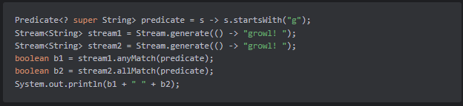
Review Questions
2. What is the output of the following?
A. true false
B. true true
C. java.util.stream.ReferencePipeline$3@4517d9a3
D. The code does not compile.
E. An exception is thrown.
F. The code hangs.

Slide 70
Review Questions
2. What is the output of the following?
Solution: F
A. true false
B. true true
C. java.util.stream.ReferencePipeline$3@4517d9a3
D. The code does not compile.
E. An exception is thrown.
F. The code hangs.

Slide 71
Review Questions
3. Which are true statements about terminal operations in a stream? (Choose all that apply.)
A. At most one terminal operation can exist in a stream pipeline.
B. Terminal operations are a required part of the stream pipeline in order to get a result.
C. Terminal operations have Stream as the return type.
D. The referenced Stream may be used after the calling a terminal operation.
E. The peek() method is an example of a terminal operation.

Slide 72
Review Questions
3. Which are true statements about terminal operations in a stream? (Choose all that apply.)
Solution: A,B
A. At most one terminal operation can exist in a stream pipeline.
B. Terminal operations are a required part of the stream pipeline in order to get a result.
C. Terminal operations have Stream as the return type.
D. The referenced Stream may be used after the calling a terminal operation.
E. The peek() method is an example of a terminal operation.

Slide 73
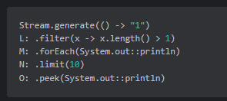
Review Questions
4. Select from the following statements and indicate the order in which they would appear to output 10 lines:
A. L, N
B. L, N, O
C. L, N, M
D. L, N, M, O
E. L, O, M
F. N, M
G. N, O

Slide 74
Review Questions
4. Select from the following statements and indicate the order in which they would appear to output 10 lines:
Solution: F
A. L, N
B. L, N, O
C. L, N, M
D. L, N, M, O
E. L, O, M
F. N, M
G. N, O

Slide 75
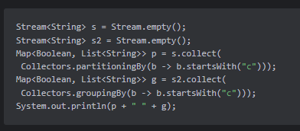
Review Questions
5. What is the output of the following?
A. {} {}
B. {} {false=[], true=[]}
C. {false=[], true=[]} {}
D. {false=[], true=[]} {false=[], true=[]}
E. The code does not compile.
F. An exception is thrown.

Slide 76
Review Questions
5. What is the output of the following?
Solution: C
A. {} {}
B. {} {false=[], true=[]}
C. {false=[], true=[]} {}
D. {false=[], true=[]} {false=[], true=[]}
E. The code does not compile.
F. An exception is thrown.

Slide 77

Thank You ☺
This Is My README to more Details and more examples
If you don't understand some points now, don't worry. With a little experience, you will be familiar with everything

Slide 78
Goodbye, and remember, in Java, we don't say goodbye; we say 'return;' because we'll be back! Happy hacking!
By ziad-ezzat

