Slide 1

SYSTEMS ANALYSIS AND DESIGN
Prof. Mohamed Demerdash
Cairo university- NMA
Code: CS 210
2nd Level 2024/2025

Slide 2
Course Objectives
The primary objective of
systems analysis and design
Discuss the impact of
information technology on
Define an information system
and describe its
is to improve organizational systems.
business strategy and success.
components.
Compare the systems
development life cycle
waterfall model to adaptive models.
Training to use some existing applications
such as
Visio.
Discuss the role of
the information technology Department
and the systems analysts

Slide 3
References
•“Systems Analysis and Design: An Object-Oriented Approach with UML”, Alan Dennis, Barbara Haley Wixom, David Tegarden, 2015, Wiley.
https://www.wiley.com/enus/Systems+Analysis+and+Design%3A+An+Object+Oriented+Approach+with+UML%2C+6th+Edition-p-9781119561217
Course Prerequisites
Course Prerequisites
• Good programming skills (Recommended computer languages: C# , C++, Java)
• Familiar with the computers fundamentals.
• Self-learning skills

Slide 4
System
-It is a group of related and interacting components which work together to achieve a desired purpose or a set of objectives.
-A system takes input, performs processing of data to give some desired outputs.
- Basically, there are three major components in every system. I.e. Input, Processing and Output.
Information System
An information system is an arrangement of people, data, process, interfaces, networks and technology that interact to support and improve both day-to-day operations in a business (sometimes called data process), as well as support the problem-solving and decision-making needs of management (sometimes called information service).
Systems Analysis
System Analysis is the study of business problem domain to recommend improvements and specify the business requirements for the solution.
System design
System design is the specification or construction of a technical, computer-based solution for the business requirements identified in a systems analysis.
System Analysis and Design (SAD) mainly focuses on − (Systems- Processes-Technology)
lOMoARcPSD|7091359

Slide 5
Characteristics of a system
A purpose- A system has a set of objectives to fulfil. This is the overall goal or function of a system.
A system must give priority to the objectives of the organization as a whole as compared to the objectives of a subsystem. Examples of quantifiable objectives:
Increase company productivity by 50% in the next two years
Reduce wastage of papers by 20%
Reduce time taken to process 100 certificates to one day
b. Subsystems- A system is made of several sub systems. A sub system is a part of a bigger system which performs a specific function. Sub systems communicate with each other. They reduce system complexity and enhance understanding of system functional requirements.
c. A Boundary- A system has a boundary within which all of its components are contained and which establishes the limits of a system, separating the system from other systems. The boundary is the line that makes the inside and outside of a system and that sets off the system from its environments.

Slide 6
An Environment- This is everything external to a system that interacts with the system i.e. everything outside the system’s boundary, usually the system interacts with its environment, exchanging, in the case of an information system, data and information.
Interrelated Components- The components are interrelated. This means the dependence of one subsystem on one or more subsystems. The function of one subsystem is tied to the function of others.
Feedback - It monitors the output to check that it conforms to the expected goals and objectives. Variations from the goals or outputs are fed back to the system in order to adjust the system towards the set goals. Feedback may be positive or negative.
Negative Feedback
This is a system that works on the principle of trying to reduce the fluctuations around a set standard. For example if there is credit limit of those customers who have outstanding debts, it restricted them it is known as negative feedback since the action is taken opposite to deviation.
Positive Feedback
It is a system that attempts to increase a detected deviation. It helps the system to adjust but acting in the same direction in which deviation has occurred e.g. If the demand for any product increases and as a result, production is also increased, then it is positive feedback it helps to increase the efficiency of the system.

Slide 7

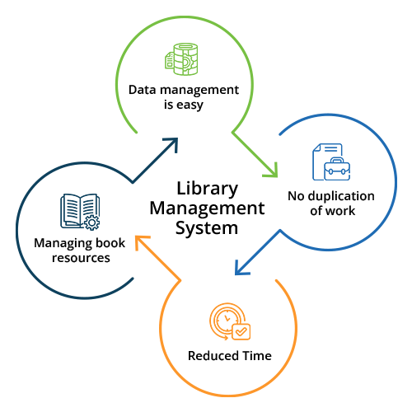
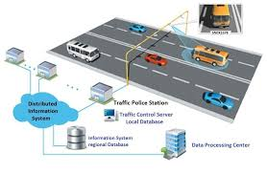
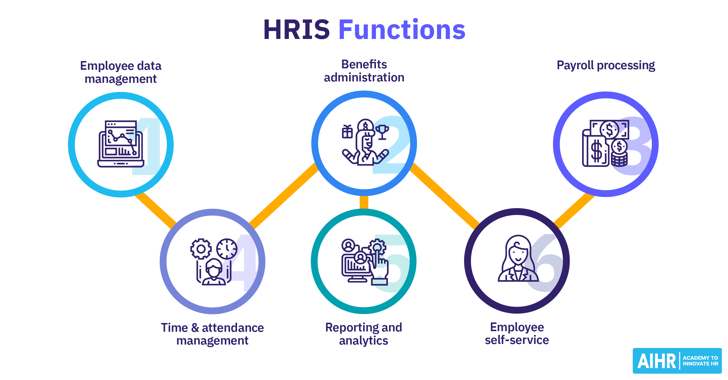
lOMoARcPSD|7091359
Exercises
Think of examples of systems that have positive and negative feedbacks
Constraints of a System
A system must have three basic constraints −
A system must have some structure and behavior which is designed to achieve a predefined objective.
Interconnectivity and interdependence must exist among the system components.
The objectives of the organization have a higher priority than the objectives of its subsystems.
For example, traffic management system, payroll system, automatic library system, human resources information system.

Slide 8
Types of systems
Deterministic Systems (Mechanistic Systems)
- These are the systems that function according to some predetermined procedure and have results and future behavior can be predicted with certainty provided they are working correctly and under control.
- The outputs are known precisely from knowledge of the input. They have predefined rules of obtaining the output or an equation, that defines the input/ output relation in terms of input variables and time. Example include the working of computer program
b. Probabilistic Systems (Stochastic Systems)
These are those whose state and behavior can be predicted only within certain limits, even when they’re under control. Although some of these states in these systems may be predicted from previous states, they can be described only in terms of probable behaviors. They have a lot of uncertainty and include business and economic systems such as a bank giving services to customers. E.g. share price.
Example, the inventory systems, average stock, average demand, average replenishment time may be predicted but exact values of those factors an instance may not be known.
c. Cybernetic system (Self Organizing/ Adaptive)
These are systems that have to adapt to their environments/ react to stimuli they learn from their mistakes, so that they do not always react in the same way to a particular input. Examples are the human body adapts to changes in temperature to keep the body warm or increase the heart beat to cope with some external need, social systems, organizations, plants.

Slide 9
Physical or Abstract Systems
Physical systems are tangible entities. We can touch and feel them.
Physical System may be static or dynamic in nature. For example, desks and chairs are the physical parts of computer center which are static. A programmed computer is a dynamic system in which programs, data, and applications can change according to the user's needs.
Abstract systems are non-physical entities or conceptual that may be formulas, representation or model of a real system.
Open or Closed Systems
An open system must interact with its environment. It receives inputs from and delivers outputs to the outside of the system. For example, an information system which must adapt to the changing environmental conditions.
A closed system does not interact with its environment. It is isolated from environmental influences. A completely closed system is rare in reality.
Adaptive and Non Adaptive System
Adaptive System responds to the change in the environment in a way to improve their performance and to survive. For example, human beings, animals.
Non Adaptive System is the system which does not respond to the environment. For example, machines.
Permanent or Temporary System
Permanent System persists for long time. For example, business policies.
Temporary System is made for specified time and after that they are demolished. For example, A DJ system is set up for a program and it is dissembled after the program.
lOMoARcPSD|7091359

Slide 10
lOMoARcPSD|7091359
Natural and Manufactured System
Natural systems are created by the nature. For example, Solar system, seasonal system.
Manufactured System is the man-made system. For example, Rockets, dams, trains.
Social, Human-Machine, Machine System
Social System is made up of people. For example, social clubs, societies.
In Human-Machine System, both human and machines are involved to perform a particular task. For example, Computer programming.
Machine System is where human interference is neglected. All the tasks are performed by the machine. For example, an autonomous robot.
Man–Made Information Systems
It is an interconnected set of information resources to manage data for particular organization, under Direct Management Control.
This system includes hardware, software, communication, data, and application for producing information according to the need of an organization.
Man-made information systems are divided into three types −
Formal Information System − It is based on the flow of information in the form of memos, instructions, etc., from top level to lower levels of management.
Informal Information System − This is employee based system which solves the day to day work related problems.
Computer Based System − This system is directly dependent on the computer for managing business applications. For example, automatic library system, railway reservation system, banking system, etc.

Slide 11
Systems Models
Schematic Models
A schematic model is a 2-D chart that shows system elements and their linkages.
Different arrows are used to show information flow, material flow, and information feedback.
Flow System Models
A flow system model shows the orderly flow of the material, energy, and information that hold the system together.
Program Evaluation and Review Technique (PERT), for example, is used to abstract a real world system in model form.
Static System Models
They represent one pair of relationships such as activity–time or cost–quantity.
The Gantt chart, for example, gives a static picture of an activity-time relationship.
Dynamic System Models
Business organizations are dynamic systems. A dynamic model approximates the type of organization or application that analysts deal with.
It shows an ongoing, constantly changing status of the system. It consists of −
Inputs that enter the system
The processor through which transformation takes place
The program(s) required for processing
The output(s) that result from processing.

Slide 12
lOMoARcPSD|7091359
Classification of systems
a. Open system
These are systems which interact with the environment. Example: the biological and social system. All business organizations are also open systems since they must have the capacity to adopt in the future of changing competition, changing markets e.t.c. The major components which together constitute the open system are:-
Input – This may take the form of money, materials energy, decisions, information e.t.c
Process- This changes input into desirable output e.g. Changing data to information
Output – This is the systems reason for its existence
Sensor –stimuli, response to the effect of the environment.
Feedback – This is the systems way of monitoring the environment it operates in a way which it permits adjustments to survive and maintain dynamic equilibrium.
Standard – This allows control to be exercised allowing variances to be assessed and action to be where necessary.
Comparator – This is the means by which comparison is made between the standard and actual performance or results.
Effectors – Takes any action to correct any variance or deviation discovered by the comparator.
vii.
b. Closed systems
A closed system is that which does not interact with its environment. The system is not influenced by its environment. (It does not take in from or give to it.) The system behavior occurs because of internal interaction and is more relevant to scientific than social systems. They do not obtain modification from their environments. A computer program is a relatively closed system because it accepts only previously defined outputs. In fact, no system can be a completely closed system for a long time.

Slide 13
lOMoARcPSD|7091359
Differences between open and closed systems
Open
Interacts with the environment constantly
Has infinite scope.
Relevant variables keep on interacting
Flexible and abstract
Closed
Does not interact with the Environment
Limited Scope
Self Contained
Rigid and mathematical

Slide 14
lOMoARcPSD|7091359
2.0 INFORMATION SYSTEMS
Definition: Information System
An information system is an arrangement of people, data, process, interfaces, networks and technology that interact to support and improve both day-to-day operations in a business (sometimes called data process), as well as support the problem-solving and decision-making needs of management (sometimes called information service).
Types of Information Systems
There are different types of information systems distinguished from each other on the basis of what the system does or by technology used to construct the system. The following are some of the classes of information systems.
Transaction Processing Systems (TPS)
Management Information System (MIS)
Decision Support Systems (DSS)
Expert Systems

Slide 15
Transaction Processing Systems (TPS)
TPS automate the handling or transaction, which can be thought of as simple, discrete events in the life of an organization. Data about each transaction are captured. Transaction are verified and accepted or rejected, and validated. Transactions may be moved from process to process in order to handle all aspects of the business activity.
Examples of TPS
Order Entry : This is the TPS which processes customer orders. Orders may arrive by a variety of means: mail, phone, fax etc. In cases of repeat orders, a trigger within the system will be the source.
Inventory: An inventory system monitors the quantity of each product available for sale and helps ensure that the proper amount of stock is maintained. All movement of goods in and out of the store or warehouse will be recorded.
Distribution: This involves ensuring the best mode of transport is selected to deliver goods to the customer on time. Customs clearance, insurance and freight forwarding are the areas of concern here.
Sales Invoicing: The main role of the sales invoicing system is to receive delivery information from the Distribution System and to prepare invoices to be sent to the customer. Discounts are applied where appropriate. In some systems, monthly statements of accounts are also prepared.
Accounts Receivable: As the name implies, this TPS records the amount owed by customers and the payments made. The data comes from the sales invoicing system.
Purchasing: Many companies have central department to handle procurement of its goods and services. The advantages are to gain maximum volume discounts, obtain the lowest price or best deal from various vendors and to achieve standardization where necessary.
Receiving :The role of the receiving system is to record the receipt, inspection, acceptance or rejection of goods. The inspection serves to identify damaged or incomplete goods which must be rejected.
Accounts Payable: This system records the invoices received from vendors determines the optimum time to pay and prepares and prints cheques. Cash forecasting is another important task of the system.
Payroll: This system calculates the salary to be paid to employees, taking into account any relevant deductions (e.g. pension fund) or additions (e.g. allowances). In addition, the payroll system must produce income tax reports and should also keep track of pension fund or union fees which have to be credited to another organization.

Slide 16
lOMoARcPSD|7091359
b. Management Information System (MIS)
MIS takes the relatively raw data available through a TPS and converts them into a meaningful aggregated form that managers need to conduct their responsibilities. It provides the management with the report usually in predetermined, fixed format e.g. detailed Summary.
c. Decision Support Systems (DSS)
DSS are designed to help organizational decision makers make decisions. It provides guidance in identifying problems, finding and evaluating alternative solutions, and selecting of comparing alternatives.
A DSS is composed of a database (which may be extracted from TPS or MIS), mathematical or graphical models of business processes, and a user interface that provides a way for the decision maker, usually a non technical manager, to communicate with DSS.
The System Analysis and Design for a DSS often concentrates on the three main DSS components
Database
model base, and
user dialogue.

Slide 17
Characteristics of DSS
a. DSS offers users flexibility, adaptability and quick response.
DSS operate with little or no assistance from professional programmers.
DSS provide support for decisions and problems whose solutions cannot be specified in advance.
DSS use sophisticated data analysis and modelling tools.
Components of DSS
User Interface- Users interact with a DSS through the user interface. It is important therefore that user interfaces are easy to learn and to use. The method of interfacing may vary with each DSS.
Data Management- A typical DSS will access more than one database. These may contain both internal and external data. Data is extracted from these databases and updated into a DSS database.
Model Management- The Model Management subsystem contains the model base. Models are software programs that support the user in a particular decision making situation.

Slide 18
lOMoARcPSD|7091359
d. Expert Systems
ES attempt to codify and manipulate knowledge rather than information. It provides expert advice by asking users a sequence of questions dependent on prior answers that lead to a conclusion or recommendation. It simulates thinking for those with less knowledge. The focus on developing on ES is acquiring the knowledge of the expert in the particular problem domain knowledge engineers perform knowledge acquisition
Examples:- Physician Diagnostics Tools: LISP, Prolog
In addition, many organizations recognize scientific (technical computing and office automation. There are several other important systems concepts with which systems analysts need to be familiar.

Slide 19
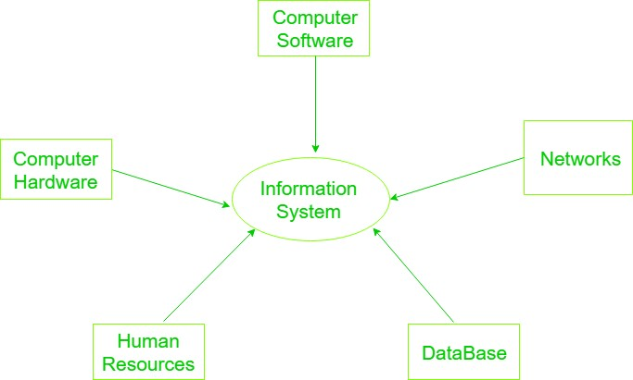
lOMoARcPSD|7091359
Components Of Information System
An Information system is a combination of hardware and software and telecommunication networks that people build to collect, create and distribute useful data, typically in an organisational, It defines the flow of information within the system.

Slide 20
lOMoARcPSD|7091359
1. Computer Hardware:
Physical equipment used for input, output and processing. It consists of input, an output device, operating system, processor, and media devices. This also includes computer peripheral devices.
Computer Software:
The programs/ application program used to control and coordinate the hardware components. It is used for analysing and processing of the data. These programs include a set of instruction used for processing information.
Software is further classified into 3 types: ( 1- System Software 2- Application Software 3- Procedures)
Databases:
Data are the raw facts and figures that are unorganised that are and later processed to generate information. Softwares are used for organising and serving data to the user, managing physical storage of media and virtual resources.
4-Network:
Networks resources refer to the telecommunication networks like the intranet, extranet and the internet.
Networks consists of both the physicals devises such as networks cards, routers, hubs and cables and software such as operating systems, web servers, data servers and application servers.
5. Human Resources:
It is associated with the manpower required to run and manage the system. The end user can be accountants, engineers, salespersons, customers, clerks, or managers etc.

