Slide 1
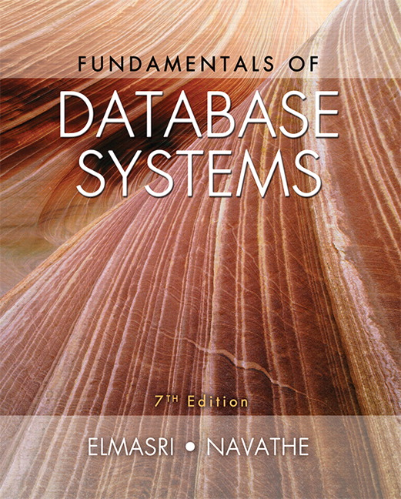

Slide 2
CHAPTER 8
The Relational Algebra and
The Relational Calculus

Slide 3
Chapter Outline
Relational Algebra
  Unary Relational Operations
  Relational Algebra Operations From Set Theory
  Binary Relational Operations
  Additional Relational Operations
  Examples of Queries in Relational Algebra
Relational Calculus
  Tuple Relational Calculus
  Domain Relational Calculus
Example Database Application (COMPANY)

Slide 4
Relational Algebra Overview
Relational algebra is the basic set of operations for the relational model
These operations enable a user to specify basic retrieval requests (or queries)
The result of an operation is a new relation, which may have been formed from one or more input relations
  This property makes the algebra “closed” (all objects in relational algebra are relations)

Slide 5
Relational Algebra Overview (continued)
The algebra operations thus produce new relations
  These can be further manipulated using operations of the same algebra
A sequence of relational algebra operations forms a relational algebra expression
  The result of a relational algebra expression is also a relation that represents the result of a database query (or retrieval request)

Slide 6
Brief History of Origins of Algebra
Muhammad ibn Musa al-Khwarizmi (800-847 CE) – from Morocco wrote a book titled al-jabr about arithmetic of variables
  Book was translated into Latin.
  Its title (al-jabr) gave Algebra its name.
Al-Khwarizmi called variables “shay”
  “Shay” is Arabic for “thing”.
  Spanish transliterated “shay” as “xay” (“x” was “sh” in Spain).
  In time this word was abbreviated as x.
Where does the word Algorithm come from?
  Algorithm originates from “al-Khwarizmi"
  Reference: PBS (http://www.pbs.org/empires/islam/innoalgebra.html)

Slide 7
Relational Algebra Overview
Relational Algebra consists of several groups of operations
  Unary Relational Operations
    SELECT (symbol: σ (sigma))
    PROJECT (symbol: π (pi))
    RENAME (symbol: ρ (rho))
  Relational Algebra Operations From Set Theory
    UNION ( ∪ ), INTERSECTION ( ∩ ), DIFFERENCE (or MINUS, – )
    CARTESIAN PRODUCT ( x )
  Binary Relational Operations
    JOIN (several variations of JOIN exist)
    DIVISION
  Additional Relational Operations
    OUTER JOINS, OUTER UNION
    AGGREGATE FUNCTIONS (These compute summary of information: for example, SUM, COUNT, AVG, MIN, MAX)

Slide 8
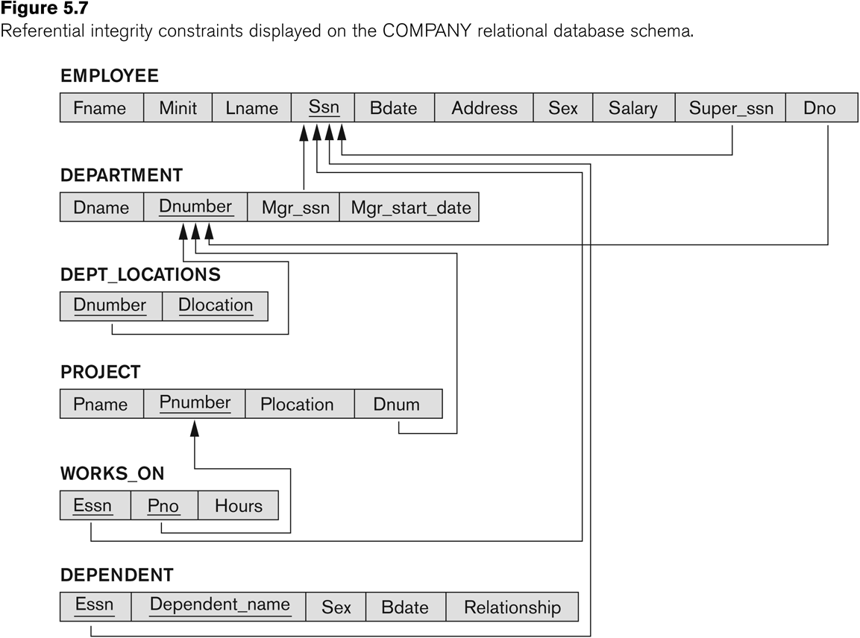
Database State for COMPANY
All examples discussed below refer to the COMPANY database shown here.

Slide 9
Unary Relational Operations: SELECT
The SELECT operation (denoted by σ (sigma)) is used to select a subset of the tuples from a relation based on a selection condition.
  The selection condition acts as a filter
  Keeps only those tuples that satisfy the qualifying condition
  Tuples satisfying the condition are selected whereas the other tuples are discarded (filtered out)
Examples:
  Select the EMPLOYEE tuples whose department number is 4:
σ _{DNO = 4} (EMPLOYEE)
  Select the employee tuples whose salary is greater than $30,000:
σ _{SALARY > 30,000} (EMPLOYEE)

Slide 10
Unary Relational Operations: SELECT
  In general, the select operation is denoted by σ _{<selection condition>}(R) where
    the symbol σ (sigma) is used to denote the select operator
    the selection condition is a Boolean (conditional) expression specified on the attributes of relation R
    tuples that make the condition true are selected
      appear in the result of the operation
    tuples that make the condition false are filtered out
      discarded from the result of the operation

Slide 11
Unary Relational Operations: SELECT (continued)
SELECT Operation Properties
  The SELECT operation σ _{<selection condition>}(R) produces a relation S that has the same schema (same attributes) as R
  SELECT σ is commutative:
    σ _{<condition1>}(σ _{< condition2>} (R)) = σ _{<condition2>} (σ _{< condition1>} (R))
  Because of commutativity property, a cascade (sequence) of SELECT operations may be applied in any order:
    σ_{<cond1>}(σ_{<cond2>} (σ_{<cond3>} (R)) = σ_{<cond2>} (σ_{<cond3>} (σ_{<cond1>} ( R)))
  A cascade of SELECT operations may be replaced by a single selection with a conjunction of all the conditions:
    σ_{<cond1>}(σ_{< cond2>} (σ_{<cond3>}(R)) = σ <cond1> AND < cond2> AND < cond3>(R)))
  The number of tuples in the result of a SELECT is less than (or equal to) the number of tuples in the input relation R

Slide 12
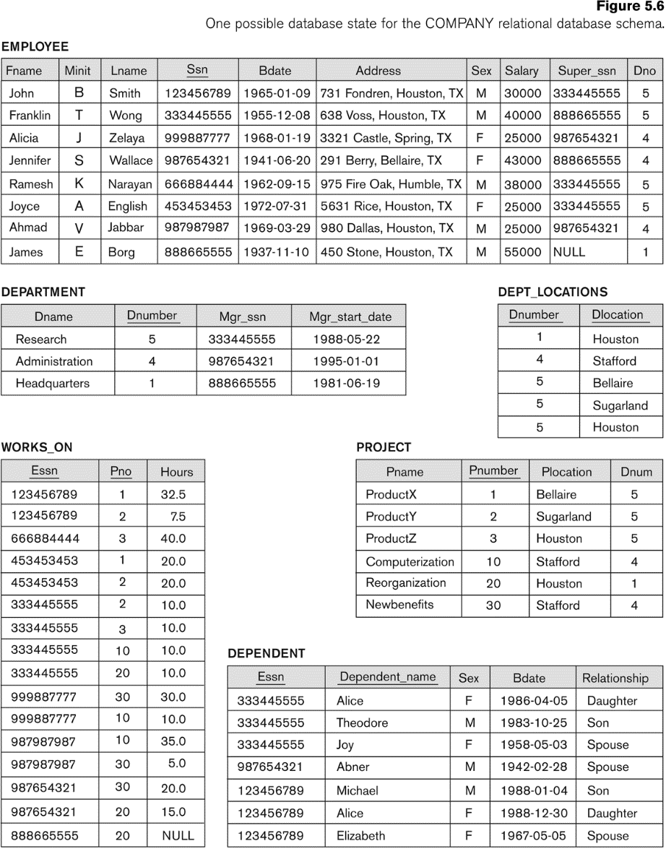
The following query results refer to this database state

Slide 13
Unary Relational Operations: PROJECT
PROJECT Operation is denoted by π (pi)
This operation keeps certain columns (attributes) from a relation and discards the other columns.
  PROJECT creates a vertical partitioning
    The list of specified columns (attributes) is kept in each tuple
    The other attributes in each tuple are discarded
Example: To list each employee’s first and last name and salary, the following is used:
  π_{LNAME, FNAME,SALARY}(EMPLOYEE)

Slide 14
Unary Relational Operations: PROJECT (cont.)
The general form of the project operation is:
π_{<attribute list>}(R)
  π (pi) is the symbol used to represent the project operation
  <attribute list> is the desired list of attributes from relation R.
The project operation removes any duplicate tuples
  This is because the result of the project operation must be a set of tuples
    Mathematical sets do not allow duplicate elements.

Slide 15
Unary Relational Operations: PROJECT (contd.)
PROJECT Operation Properties
  The number of tuples in the result of projection π_{<list>}(R) is always less or equal to the number of tuples in R
    If the list of attributes includes a key of R, then the number of tuples in the result of PROJECT is equal to the number of tuples in R
  PROJECT is not commutative
    π _{<list1>} (π _{<list2>} (R) ) = π _{<list1>} (R) as long as <list2> contains the attributes in <list1>

Slide 16
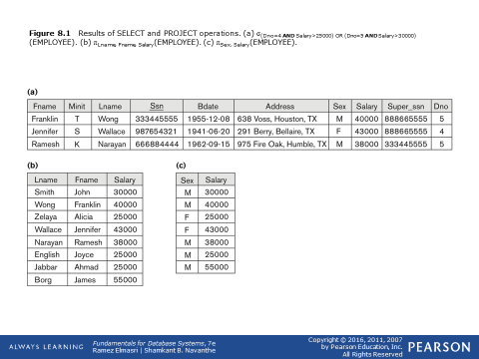
Examples of applying SELECT and PROJECT operations

Slide 17
Relational Algebra Expressions
We may want to apply several relational algebra operations one after the other
  Either we can write the operations as a single relational algebra expression by nesting the operations, or
  We can apply one operation at a time and create intermediate result relations.
In the latter case, we must give names to the relations that hold the intermediate results.

Slide 18
Single expression versus sequence of relational operations (Example)
To retrieve the first name, last name, and salary of all employees who work in department number 5, we must apply a select and a project operation
We can write a single relational algebra expression as follows:
  π_{FNAME, LNAME, SALARY}(σ _{DNO=5}(EMPLOYEE))
OR We can explicitly show the sequence of operations, giving a name to each intermediate relation:
  DEP5_EMPS ← σ _{DNO=5}(EMPLOYEE)
  RESULT ← π _{FNAME, LNAME, SALARY} (DEP5_EMPS)

Slide 19
Unary Relational Operations: RENAME
The RENAME operator is denoted by ρ (rho)
In some cases, we may want to rename the attributes of a relation or the relation name or both
  Useful when a query requires multiple operations
  Necessary in some cases (see JOIN operation later)

Slide 20
Unary Relational Operations: RENAME (continued)
The general RENAME operation ρ can be expressed by any of the following forms:
  ρ_{S (B1, B2, …, Bn )}(R) changes both:
    the relation name to S, and
    the column (attribute) names to B1, B1, …..Bn
  ρ_{S}(R) changes:
    the relation name only to S
  ρ_{(B1, B2, …, Bn )}(R) changes:
    the column (attribute) names only to B1, B1, …..Bn

Slide 21
Unary Relational Operations: RENAME (continued)
For convenience, we also use a shorthand for renaming attributes in an intermediate relation:
  If we write:
    RESULT ← π _{FNAME, LNAME, SALARY} (DEP5_EMPS)
    RESULT will have the same attribute names as DEP5_EMPS (same attributes as EMPLOYEE)
  If we write:
    RESULT (F, M, L, S, B, A, SX, SAL, SU, DNO)← ρ RESULT (F.M.L.S.B,A,SX,SAL,SU, DNO)(DEP5_EMPS)
    The 10 attributes of DEP5_EMPS are renamed to F, M, L, S, B, A, SX, SAL, SU, DNO, respectively
  Note: the ← symbol is an assignment operator

Slide 22
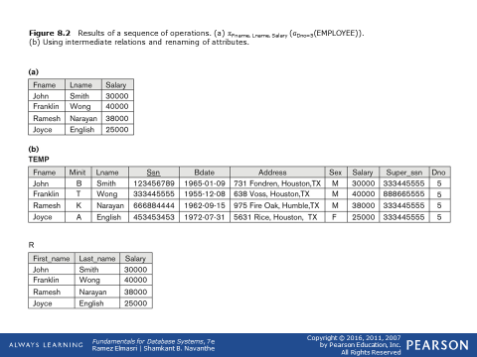
Example of applying multiple operations and RENAME

Slide 23
Relational Algebra Operations from
Set Theory: UNION
UNION Operation
  Binary operation, denoted by ∪
  The result of R ∪ S, is a relation that includes all tuples that are either in R or in S or in both R and S
  Duplicate tuples are eliminated
  The two operand relations R and S must be “type compatible” (or UNION compatible)
    R and S must have same number of attributes
    Each pair of corresponding attributes must be type compatible (have same or compatible domains)

Slide 24
Relational Algebra Operations from
Set Theory: UNION
Example:
  To retrieve the social security numbers of all employees who either work in department 5 (RESULT1 below) or directly supervise an employee who works in department 5 (RESULT2 below)
  We can use the UNION operation as follows:
DEP5_EMPS ← σ_{DNO=5} (EMPLOYEE)
RESULT1 ← π _{SSN}(DEP5_EMPS)
RESULT2(SSN) ← π_{SUPERSSN}(DEP5_EMPS)
RESULT ← RESULT1 ∪ RESULT2
  The union operation produces the tuples that are in either RESULT1 or RESULT2 or both

Slide 25
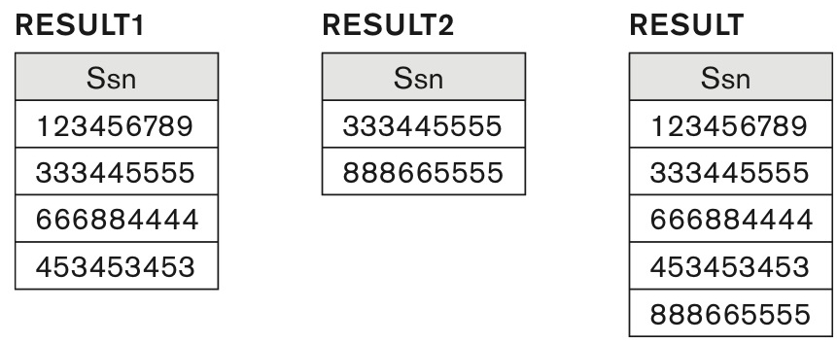
Figure 8.3 Result of the UNION operation RESULT ← RESULT1 ∪ RESULT2.

Slide 26
Relational Algebra Operations from
Set Theory
Type Compatibility of operands is required for the binary set operation UNION ∪, (also for INTERSECTION ∩, and SET DIFFERENCE –, see next slides)
R1(A1, A2, ..., An) and R2(B1, B2, ..., Bn) are type compatible if:
  they have the same number of attributes, and
  the domains of corresponding attributes are type compatible (i.e. dom(Ai)=dom(Bi) for i=1, 2, ..., n).
The resulting relation for R1∪R2 (also for R1∩R2, or R1–R2, see next slides) has the same attribute names as the first operand relation R1 (by convention)

Slide 27
Relational Algebra Operations from Set Theory: INTERSECTION
INTERSECTION is denoted by ∩
The result of the operation R ∩ S, is a relation that includes all tuples that are in both R and S
  The attribute names in the result will be the same as the attribute names in R
The two operand relations R and S must be “type compatible”

Slide 28
Relational Algebra Operations from Set Theory: SET DIFFERENCE (cont.)
SET DIFFERENCE (also called MINUS or EXCEPT) is denoted by –
The result of R – S, is a relation that includes all tuples that are in R but not in S
  The attribute names in the result will be the same as the attribute names in R
The two operand relations R and S must be “type compatible”

Slide 29
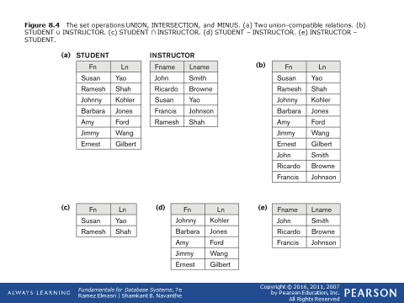
Example to illustrate the result of UNION, INTERSECT, and DIFFERENCE

Slide 30
Some properties of UNION, INTERSECT, and DIFFERENCE
Notice that both union and intersection are commutative operations; that is
  R ∪ S = S ∪ R, and R ∩ S = S ∩ R
Both union and intersection can be treated as n-ary operations applicable to any number of relations as both are associative operations; that is
  R ∪ (S ∪ T) = (R ∪ S) ∪ T
  (R ∩ S) ∩ T = R ∩ (S ∩ T)
The minus operation is not commutative; that is, in general
  R – S ≠ S – R

Slide 31
Relational Algebra Operations from Set Theory: CARTESIAN PRODUCT
CARTESIAN (or CROSS) PRODUCT Operation
  This operation is used to combine tuples from two relations in a combinatorial fashion.
  Denoted by R(A1, A2, . . ., An) x S(B1, B2, . . ., Bm)
  Result is a relation Q with degree n + m attributes:
    Q(A1, A2, . . ., An, B1, B2, . . ., Bm), in that order.
  The resulting relation state has one tuple for each combination of tuples—one from R and one from S.
  Hence, if R has n_{R} tuples (denoted as |R| = n_{R} ), and S has n_{S} tuples, then R x S will have n_{R} * n_{S} tuples.
  The two operands do NOT have to be "type compatible”

Slide 32
Relational Algebra Operations from Set Theory: CARTESIAN PRODUCT (cont.)
Generally, CROSS PRODUCT is not a meaningful operation
  Can become meaningful when followed by other operations
Example (not meaningful):
  FEMALE_EMPS ← σ _{SEX=’F’}(EMPLOYEE)
  EMPNAMES ← π _{FNAME, LNAME, SSN} (FEMALE_EMPS)
  EMP_DEPENDENTS ← EMPNAMES x DEPENDENT
EMP_DEPENDENTS will contain every combination of EMPNAMES and DEPENDENT
  whether or not they are actually related

Slide 33
Relational Algebra Operations from Set Theory: CARTESIAN PRODUCT (cont.)
To keep only combinations where the DEPENDENT is related to the EMPLOYEE, we add a SELECT operation as follows
Example (meaningful):
  FEMALE_EMPS ← σ _{SEX=’F’}(EMPLOYEE)
  EMPNAMES ← π _{FNAME, LNAME, SSN} (FEMALE_EMPS)
  EMP_DEPENDENTS ← EMPNAMES x DEPENDENT
  ACTUAL_DEPS ← σ _{SSN=ESSN}(EMP_DEPENDENTS)
  RESULT ← π _{FNAME, LNAME, DEPENDENT_NAME} (ACTUAL_DEPS)
RESULT will now contain the name of female employees and their dependents

Slide 34
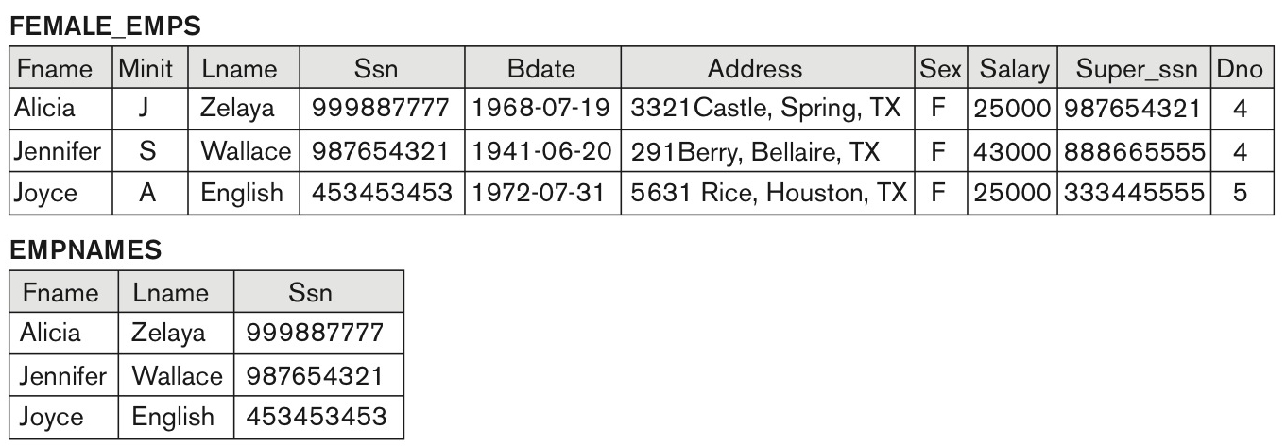
Figure 8.5 The CARTESIAN PRODUCT (CROSS PRODUCT) operation.
continued on next slide

Slide 35
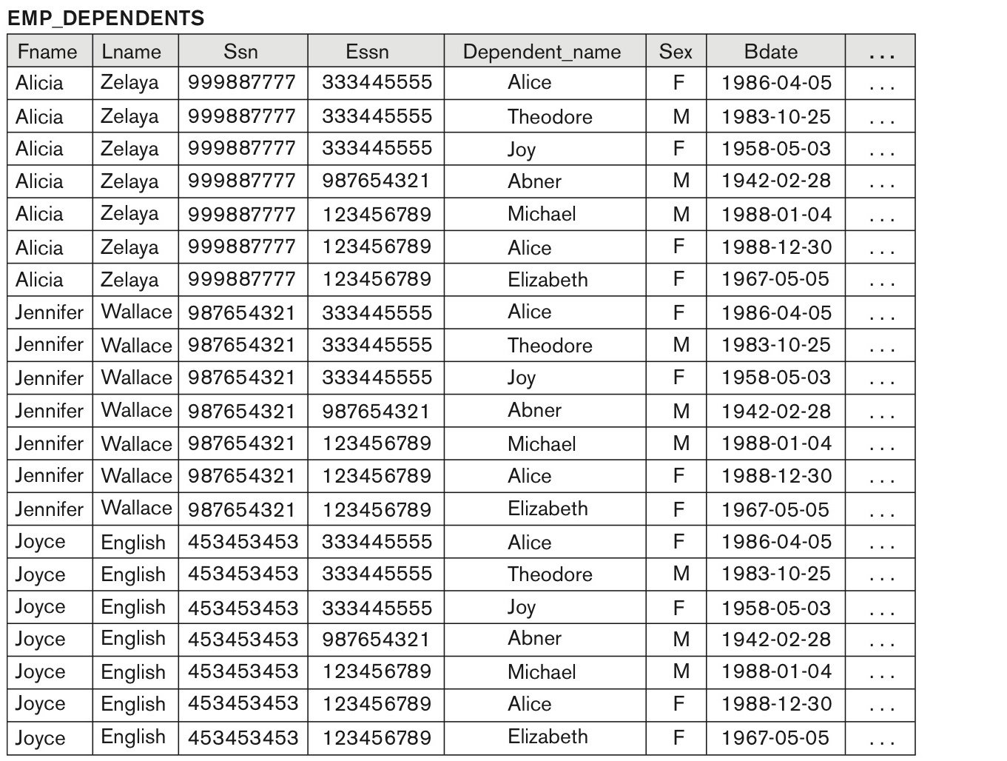
Figure 8.5 (continued) The CARTESIAN PRODUCT (CROSS PRODUCT) operation.
continued on next slide

Slide 36
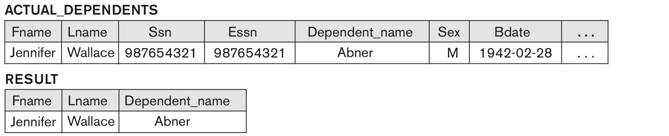
Figure 8.5 (continued) The CARTESIAN PRODUCT (CROSS PRODUCT) operation.

Slide 37
Binary Relational Operations: JOIN
JOIN Operation (denoted by )
  The sequence of CARTESIAN PRODECT followed by SELECT is used quite commonly to identify and select related tuples from two relations
  A special operation, called JOIN combines this sequence into a single operation
  This operation is very important for any relational database with more than a single relation, because it allows us combine related tuples from various relations
  The general form of a join operation on two relations R(A1, A2, . . ., An) and S(B1, B2, . . ., Bm) is:
  R _{<join condition>}S
  where R and S can be any relations that result from general relational algebra expressions.

Slide 38
Binary Relational Operations: JOIN (cont.)
Example: Suppose that we want to retrieve the name of the manager of each department.
  To get the manager’s name, we need to combine each DEPARTMENT tuple with the EMPLOYEE tuple whose SSN value matches the MGRSSN value in the department tuple.
  We do this by using the join operation.
  DEPT_MGR ← DEPARTMENT _{MGRSSN=SSN} EMPLOYEE
MGRSSN=SSN is the join condition
  Combines each department record with the employee who manages the department
  The join condition can also be specified as DEPARTMENT.MGRSSN= EMPLOYEE.SSN

Slide 39
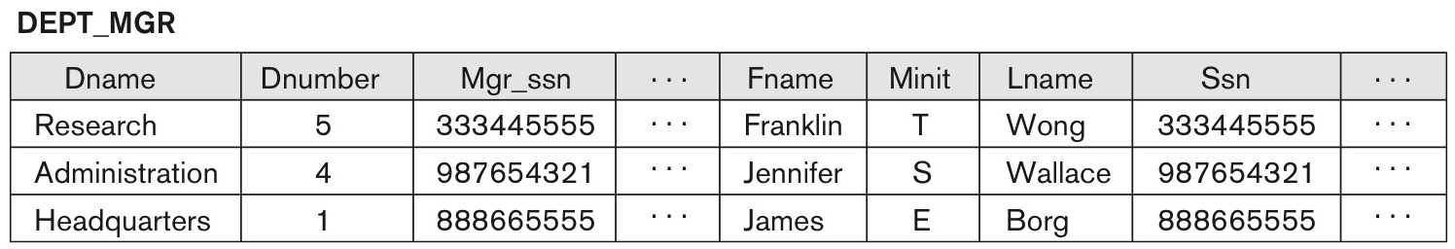
Figure 8.6 Result of the JOIN operation DEPT_MGR ← DEPARTMENT^{|X|} _{Mgr_ssn=Ssn}EMPLOYEE.

Slide 40
Some properties of JOIN
Consider the following JOIN operation:
  R(A1, A2, . . ., An) S(B1, B2, . . ., Bm)
    R.Ai=S.Bj
  Result is a relation Q with degree n + m attributes:
    Q(A1, A2, . . ., An, B1, B2, . . ., Bm), in that order.
  The resulting relation state has one tuple for each combination of tuples—r from R and s from S, but only if they satisfy the join condition r[Ai]=s[Bj]
  Hence, if R has n_{R} tuples, and S has n_{S} tuples, then the join result will generally have less than n_{R} * n_{S} tuples.
  Only related tuples (based on the join condition) will appear in the result

Slide 41
Some properties of JOIN
The general case of JOIN operation is called a Theta-join: R S
    theta
The join condition is called theta
Theta can be any general boolean expression on the attributes of R and S; for example:
  R.Ai<S.Bj AND (R.Ak=S.Bl OR R.Ap<S.Bq)
Most join conditions involve one or more equality conditions “AND”ed together; for example:
  R.Ai=S.Bj AND R.Ak=S.Bl AND R.Ap=S.Bq

Slide 42
Binary Relational Operations: EQUIJOIN
EQUIJOIN Operation
The most common use of join involves join conditions with equality comparisons only
Such a join, where the only comparison operator used is =, is called an EQUIJOIN.
  In the result of an EQUIJOIN we always have one or more pairs of attributes (whose names need not be identical) that have identical values in every tuple.
  The JOIN seen in the previous example was an EQUIJOIN.

Slide 43
Binary Relational Operations:
NATURAL JOIN Operation
NATURAL JOIN Operation
  Another variation of JOIN called NATURAL JOIN — denoted by * — was created to get rid of the second (superfluous) attribute in an EQUIJOIN condition.
    because one of each pair of attributes with identical values is superfluous
  The standard definition of natural join requires that the two join attributes, or each pair of corresponding join attributes, have the same name in both relations
  If this is not the case, a renaming operation is applied first.

Slide 44
Binary Relational Operations NATURAL JOIN (continued)
Example: To apply a natural join on the DNUMBER attributes of DEPARTMENT and DEPT_LOCATIONS, it is sufficient to write:
  DEPT_LOCS ← DEPARTMENT * DEPT_LOCATIONS
Only attribute with the same name is DNUMBER
An implicit join condition is created based on this attribute:
  DEPARTMENT.DNUMBER=DEPT_LOCATIONS.DNUMBER
Another example: Q ← R(A,B,C,D) * S(C,D,E)
  The implicit join condition includes each pair of attributes with the same name, “AND”ed together:
    R.C=S.C AND R.D.S.D
  Result keeps only one attribute of each such pair:
    Q(A,B,C,D,E)

Slide 45
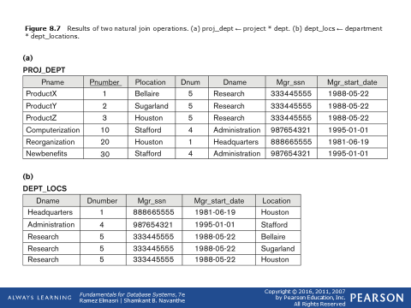
Example of NATURAL JOIN operation

Slide 46
Complete Set of Relational Operations
The set of operations including SELECT σ, PROJECT π , UNION ∪, DIFFERENCE − , RENAME ρ, and CARTESIAN PRODUCT X is called a complete set because any other relational algebra expression can be expressed by a combination of these five operations.
For example:
  R ∩ S = (R ∪ S ) – ((R − S) ∪ (S − R))
  R _{<join condition>}S = σ _{<join condition>} (R X S)

Slide 47
Binary Relational Operations: DIVISION
DIVISION Operation
  The division operation is applied to two relations
  R(Z) ÷ S(X), where X subset Z. Let Y = Z - X (and hence Z = X ∪ Y); that is, let Y be the set of attributes of R that are not attributes of S.
  The result of DIVISION is a relation T(Y) that includes a tuple t if tuples t_{R} appear in R with t_{R} [Y] = t, and with
    t_{R} [X] = t_{s} for every tuple t_{s} in S.
  For a tuple t to appear in the result T of the DIVISION, the values in t must appear in R in combination with every tuple in S.

Slide 48
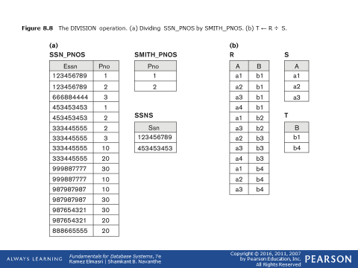
Example of DIVISION

Slide 49
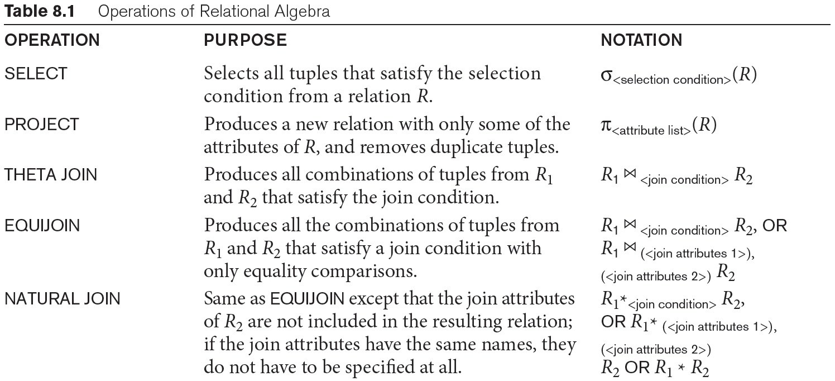
Table 8.1 Operations of Relational Algebra
continued on next slide

Slide 50
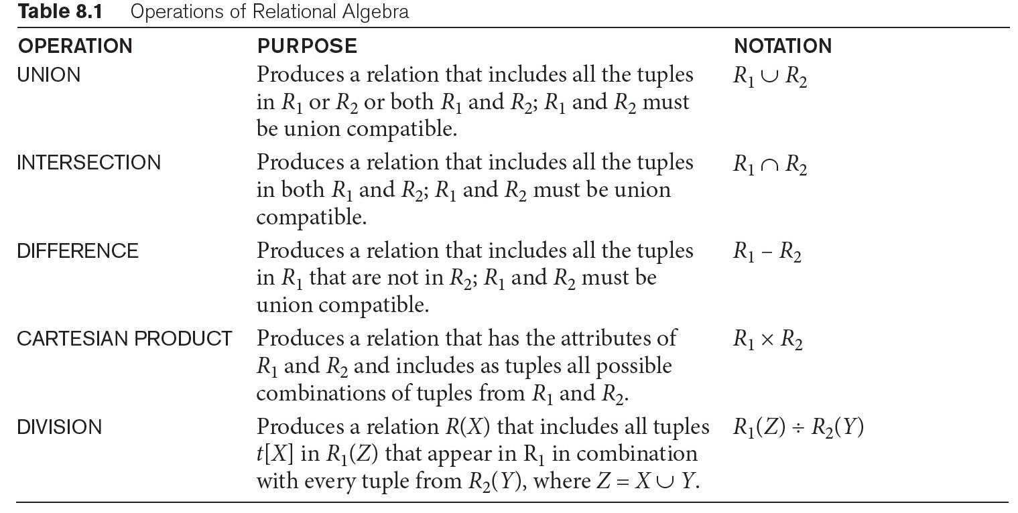
Table 8.1 Operations of Relational Algebra (continued)

Slide 51
Query Tree Notation
Query Tree
  An internal data structure to represent a query
  Standard technique for estimating the work involved in executing the query, the generation of intermediate results, and the optimization of execution
  Nodes stand for operations like selection, projection, join, renaming, division, ….
  Leaf nodes represent base relations
  A tree gives a good visual feel of the complexity of the query and the operations involved
  Algebraic Query Optimization consists of rewriting the query or modifying the query tree into an equivalent tree.
  (see Chapter 15)

Slide 52
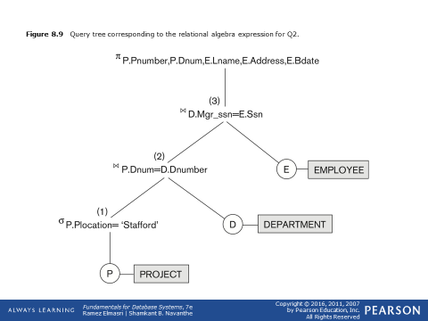
Example of Query Tree

Slide 53
Chapter Summary
Relational Algebra
  Unary Relational Operations
  Relational Algebra Operations From Set Theory
  Binary Relational Operations
  Additional Relational Operations
  Examples of Queries in Relational Algebra

