Slide 1

Dig Into FIRST LEGO League UNEARTHED
Archaeology challenge guide for ages 7–10
Connect real archaeologist work with UNEARTHED robot missions
Use the kid-language prompts to prep your own slides, speeches, or pit displays
Each mission summary is based on FIRST official resources
FIRST LEGO League Game & Season Info, 2025-26 UNEARTHED (firstinspires.org/programs/fll/game-and-season)

Slide 2
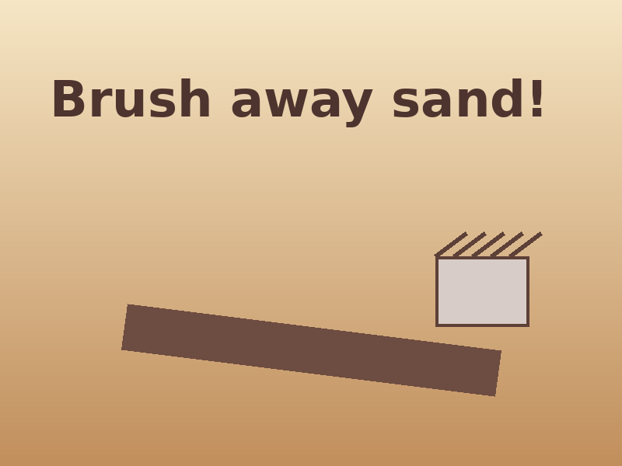
What archaeologists really do
Study past cultures by reading the clues inside material culture—anything people made, used, or changed.
Excavate slowly with brushes, trowels, sieves, and notebooks so nothing breaks or loses its story.
Work in teams: bone experts, soil scientists, artists, and tech helpers all compare notes to solve the puzzle.
Archaeology 101, Archaeological Institute of America (archaeological.org/wp-content/uploads/2019/08/Archaeology-101.pdf)

Slide 3
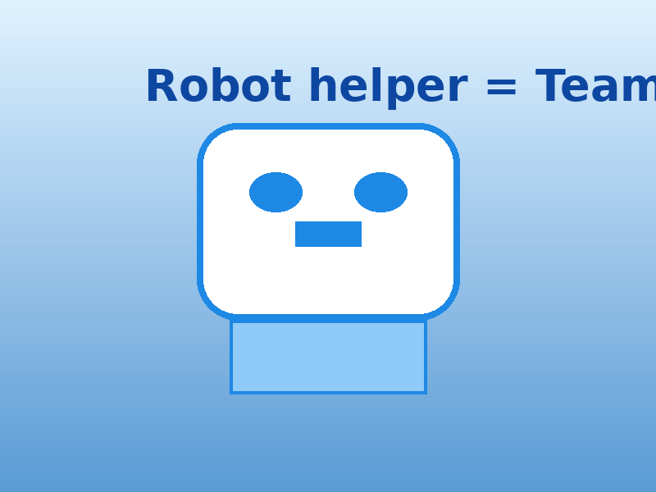
UNEARTHED in kid words
The 2025–26 FIRST LEGO League theme is UNEARTHED™: uncover the past to discover the future.
Every artifact teams reveal has a story about people, inventions, and art.
Robots become the safe tools that let you “dig deeper” using STEM thinking, coding, and teamwork.
FIRST LEGO League Game & Season Info, 2025-26 UNEARTHED (firstinspires.org/programs/fll/game-and-season)

Slide 4
Tools we swap & share
Archaeologist habits to copy
Robot upgrades that help
Brush gently → code slow motor power when touching mission models.
Label finds → program robots to park artifacts neatly for judges.
Sketch layers → use photos, notebooks, or tablets to track each robot run.
Attachment swaps act like brushes, scoops, and lifters.
Sensors = digital measuring tape so you hit the same dig spot every time.
Team roles mirror a dig crew: driver, coder, note taker, reset captain.
Archaeology 101, Archaeological Institute of America (archaeological.org/wp-content/uploads/2019/08/Archaeology-101.pdf) | FIRST LEGO League Game & Season Info, 2025-26 UNEARTHED (firstinspires.org/programs/fll/game-and-season)

Slide 5
Mission map snapshot
01 Surface Brushing 02 Map Reveal 03 Mineshaft Explorer 04 Careful Recovery 05 Who Lived Here? 06 Forge 07 Heavy Lifting 08 Silo
09 What's on Sale? 10 Tip the Scales 11 Angler Artifacts 12 Salvage Operation 13 Statue Rebuild 14 Forum 15 Site Marking
These are official mission titles from the Field Setup Guide.
UNEARTHED Field Setup Guide (firstinspires.blob.core.windows.net/.../fll-challenge-unearthed-field-setup-reference-guide.pdf)

Slide 6
Dig the site (Missions 1–5)
Mission 01 – Surface Brushing: Sweep the loose layer like a dig brush so hidden pieces peek through.
Mission 02 – Map Reveal: Flip or slide the site map to plan where the team explores next.
Mission 03 – Mineshaft Explorer: Send a careful scout into the shaft and guide it back safely.
Mission 04 – Careful Recovery: Lift fragile finds without bumping surrounding structures.
Mission 05 – Who Lived Here?: Collect story tiles that hint at the families who used the site.
Kid-language summaries help you plan stories. Always check the official rulebook for scoring.
UNEARTHED Field Setup Guide (firstinspires.blob.core.windows.net/.../fll-challenge-unearthed-field-setup-reference-guide.pdf)

Slide 7
Build & move (Missions 6–10)
Mission 06 – Forge: Deliver raw material so metal tools can be restored.
Mission 07 – Heavy Lifting: Raise stone blocks with steady power the way pulleys help archaeologists.
Mission 08 – Silo: Store artifacts just like crops in a silo—safe, dry, and labeled.
Mission 09 – What’s on Sale?: Sort market goods to learn what ancient people traded.
Mission 10 – Tip the Scales: Balance weights to compare how heavy different finds are.
UNEARTHED Field Setup Guide (firstinspires.blob.core.windows.net/.../fll-challenge-unearthed-field-setup-reference-guide.pdf)

Slide 8
Share & protect (Missions 11–15)
Mission 11 – Angler Artifacts: Pull treasures from the net without dropping them back into the water.
Mission 12 – Salvage Operation: Rescue pieces from a wreck zone so conservators can clean them.
Mission 13 – Statue Rebuild: Stack statue sections in order so the monument stands again.
Mission 14 – Forum: Bring artifacts to the sharing space where stories get told.
Mission 15 – Site Marking: Plant flags that show exactly where new clues were found.
UNEARTHED Field Setup Guide (firstinspires.blob.core.windows.net/.../fll-challenge-unearthed-field-setup-reference-guide.pdf)

Slide 9
Kid-ready game plan
Before building: read the UNEARTHED description together and circle the history words you want to learn more about.
During robot runs: talk through each move like you are the dig boss explaining what the robot “tool” is doing.
After each mission: take a photo, tape it into a field journal, and write one sentence about the story you uncovered.
FIRST LEGO League Game & Season Info, 2025-26 UNEARTHED (firstinspires.org/programs/fll/game-and-season) | Archaeology 101, Archaeological Institute of America (archaeological.org/wp-content/uploads/2019/08/Archaeology-101.pdf)

Slide 10
Show & tell your discoveries
Explain the problem: “We needed to uncover artifacts without hurting them.”
Describe your solution like an exhibit label: tool name, how it works, and what it revealed.
Connect to people: whose life does the mission remind you of? What future invention could it inspire?
Invite questions: archaeologists and judges love when teams share how they tested, failed, and tried again.
Archaeology 101, Archaeological Institute of America (archaeological.org/wp-content/uploads/2019/08/Archaeology-101.pdf)

Slide 11
Helpful links & downloads
UNEARTHED Game & Season hub: firstinspires.org/programs/fll/game-and-season
Season materials library (rulebook, videos, mission builds): firstinspires.org/resources/library/fll/season-materials
Archaeology 101 mini-book: archaeological.org/wp-content/uploads/2019/08/Archaeology-101.pdf
Field Setup Guide for Mission titles & placement: firstinspires.blob.core.windows.net/fll/challenge/2025-26/fll-challenge-unearthed-field-setup-reference-guide.pdf
All links verified Nov 14, 2025

