Slide 1
.
Pharmacy System
Prepared by :
Ziad Ahmed Mohamed 42010617
Amro Ismail 42010612

Slide 2
.
Agenda
(SRS) Software Requirements Specification.
(DFD) Data Flow Diagram.
(ERD) Entity Relationship Diagram .

Slide 3
.
Introduction :
The following section provides an overview the software requirements specifications (SRS) for the Pharmacy system.

Slide 4
.
Purpose
The purpose of the software is to organize the sales process, manage the pharmacy stock, create offers and manage reports.

Slide 5
.
Product Scope
The software will provide the user with the ability to:
Create receipts for products sold or returned
Put offers on products
Keep detailed record of warehouse stock
Keep detailed record of purchases
Make reports for all the financial affairs

Slide 6
.
References
Interview with Dr. Osama Ismail and Pharmacist at El-Ezaby Pharmacy

Slide 7
.
Overall Description
Product Functions
This will perform four main functions:
Sales: this function creates detailed receipts of products sold to and returned by customers of the pharmacy
Purchases: this function is used to enter the products bought by the pharmacy with details of the purchase i.e. (supplier, expiry date, price in bulk and for user, etc)
Records: this function is used to create records for various financial and managerial affairs such as (warehouse reports, sales reports, expiry reports, etc)
Offers: this function dictates what products have offers on them

Slide 8
.
User Classes and Characteristics
Pharmacy manager: This user has all permissions and accessibility to all features and can create accounts for staff with different permissions, they will be using it mainly for reports
Pharmacist: This user will be mostly using it for sales
Data entry clerk: This user will be using it only for purchases
Accountant: This user will be using it only for reports
Cosmetics executive: This user will be using it only for sales

Slide 9
.
Functional Requirements
Sales Function
Code | Requirements statement | Must/should | Comments
S001 | The function creates receipts with a standard template and accepts input from the keyboard or the barcode scanner | Must | The receipt must include the item/items name, price, quantity, total cost, type of payment and the pharmacist name, it should log the amount paid in the cash drawer and the items should be removed from the warehouse
S002 | Option for home delivery | Must | In case of using this option the receipt should include the delivery guy's name, the customer's home address and phone number
S003 | Option for payment type | Must | It should accept cash payment, visa, or insurance
S004 | Option for making the receipt a return receipt | Must | In case of return, the items should be added to warehouse and cost subtracted from cash drawer

Slide 10
.
Purchases Function
Code | Requirements statement | Must/should | Comments
P001 | Enter purchases | Must | It takes input for purchased products and takes in the product manufacturer, expiry date, price in bulk, price for customer, taxes, profit gained and quantity
P002 | Return purchases | Must | Selected items should be removed from warehouse

Slide 11
.
Offers Function
Code | Requirement Specification | Must/should | Comments | General Comment
OF001 | Discount offer | Must | User should select item and type the discount amount | The offers should be automatically included in the receipt just by scanning the items
OF002 | Free piece/s | Must | User should select item/s and select the free item/s combined with it

Slide 12
.
Reports Function
Code | Requirements statement | Must/should | Comments
R001 | Menu of reports | Must | The menu items are: sales reports-purchases reports-warehouse reports-accounting reports-supplier reports, also, any report is displayed based on the time period chosen (day/week/month/quarter/year) and every report has a "print" option

Slide 13
.
Sales Reports
Code | Requirement Specification | Must/should | Comments
SR001 | Pharmacy sales reports | Must | Report for all sales made
SR002 | Sales comparison (based on selected items) | Must | User must select two items for a comparison report
SR003 | Top and lowest selling items | Must
SR004 | Most and least expensive items | Must
SR005 | Sales comparison of cosmetics and medication | Must
SR006 | Sales comparison of different payments | Must | Compares the sales based on cash, visa and insurance

Slide 14
.
Purchases Reports
Code | Requirement Specification | Must/should | Comments
PR001 | Purchases bought from suppliers | Must
PR002 | Purchases returned | Must

Slide 15
.
Accounting Reports
Code | Requirement Specification | Must/should | Comments
AR001 | Amount in safe | Must
AR002 | Bank Account balance | Must
AR003 | Expenses and Revenues | Must
AR004 | Banking position | Must | Check that must be paid for suppliers with their due dates and amount
AR005 | Profits and losses | Must

Slide 16
.
Supplier Reports
Code | Requirement Specification | Must/should | Comments
SPR001 | Suppliers' credits | Must | How much the pharmacy owes to each supplier

Slide 17
.
Warehouse Reports
Code | Requirement Specification | Must/should | Comments
WR001 | Stock reports | Must | Report of all items in warehouse and their total cost
WR002 | Insufficient items | Must | Items in quantity of 30 or less
WR003 | Expiry Reports | Must | Products that have expired
WR004 | Transactions | Must | Items that have been transferred from the warehouse to the pharmacy or vice versa
WR005 | Product activity | Must | A report for a specific item selected by the user which specifies when the product was bought, sold and transferred and in what quantity

Slide 18
.
Alarm
Code | Requirement statement | Must/should | Comments
A001 | Alarm of insufficient items | Must | When a product reaches a set quantity e.g. 20 pcs the software shows an alarm prompt to the user

Slide 19
.
Nonfunctional Requirements
Usability
Code | Requirement statement | Must/should | Comments
I001 | The software prompts the user to enter username and password | Must
I002 | After logging there's a toolbar that has sales - purchases - reports - offers - create user - exit | Must

Slide 20
.
Performance
Code | Requirements statement | Must/should | Comments
PFM001 | Loading or response time should be under or between 5-10 seconds | Should | Software will be running on medium tier pc e.g. 8th gen core i5 cpu

Slide 21
Portability and compatibility
Code | Requirements statement | Must/should | Comments
PC001 | The software must be compatible with a visa machine, printer, barcode printer, receipt printer and a barcode scanner | Must
PC002 | The software must work on Windows | Must

Slide 22
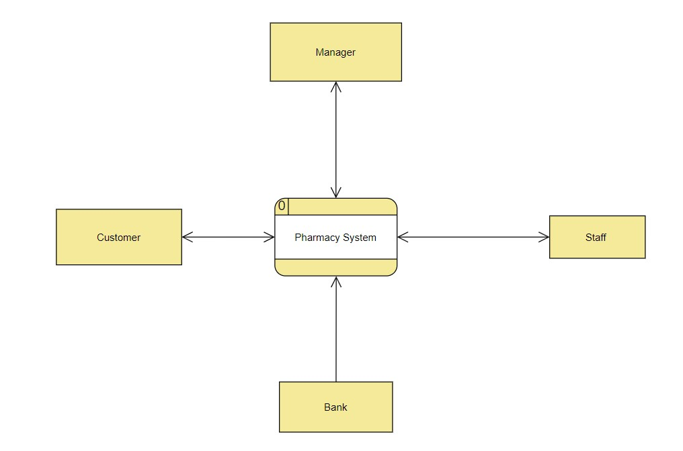
.
Data Flow Diagram

Slide 23
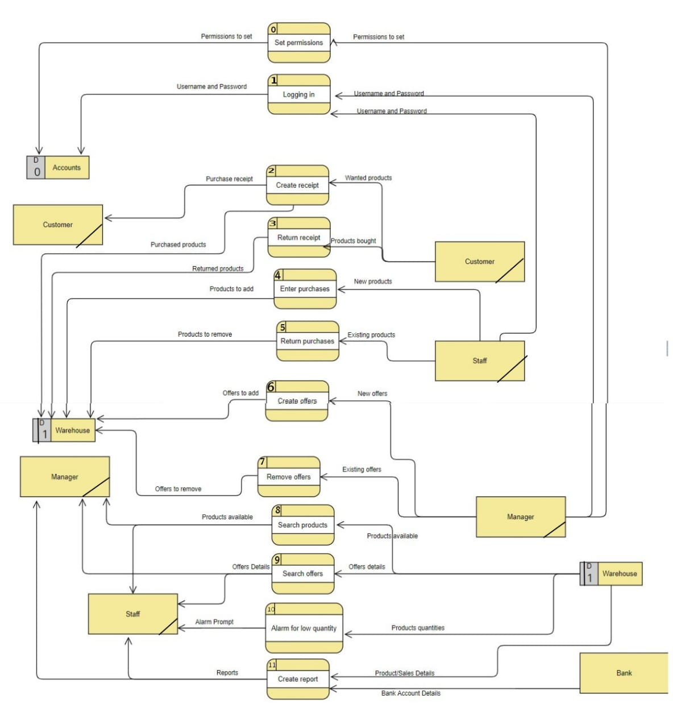
.

Slide 24
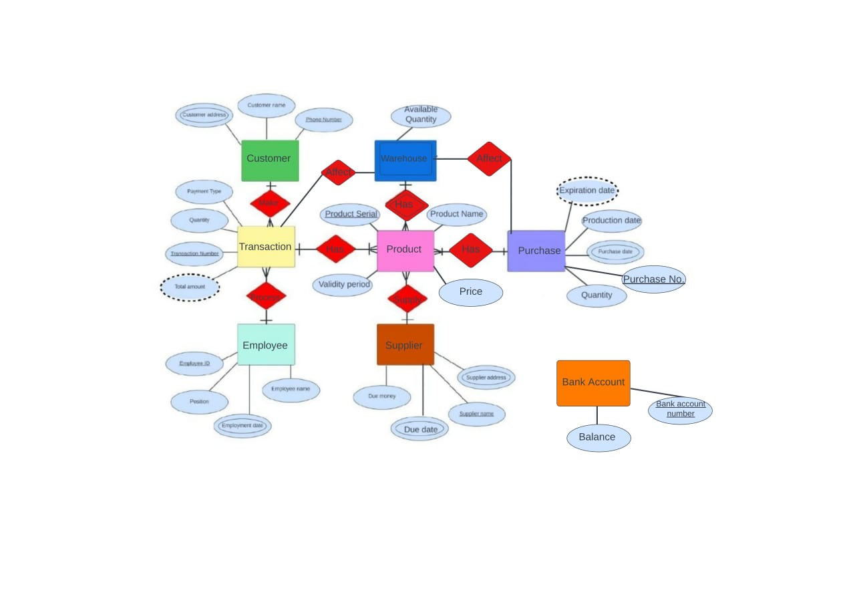
.
Entity Relationship Diagram

