Slide 1
BIG DATA PROJECT
Movie Popularity Prediction Using Big Data and Machine Learning
Apache Spark · scikit-learn · Streamlit
Team: Member 1 · Member 2 · Member 3 · Member 4 · Member 5

Slide 2
PROJECT OVERVIEW
From raw movie metadata to predictions
45,466
44,861
5
5
raw movies (TMDB / MovieLens)
clean movies after Spark processing
regression models compared
interactive dashboard pages
• Clean & transform the data with PySpark
• Explore what drives popularity
• Predict popularity from pre-release information
• Present results in a Streamlit dashboard
2

Slide 3
PROBLEM STATEMENT
Can we estimate a movie's popularity before it is released?
• Studios and platforms need early signals of audience interest
• Input: budget, genres, runtime, release date, language, franchise, production info
• Output: predicted TMDB popularity score (regression)
• Constraint: no post-release information (revenue, votes, ratings) → no data leakage
3

Slide 4
OBJECTIVES
What the project delivers
01
02
03
04
05
Collect
Process
Analyse
Predict
Present
Real dataset with attribution
PySpark cleaning in one notebook
EDA with computed findings
Tuned, evaluated regression models
Professional interactive dashboard
4

Slide 5
SYSTEM ARCHITECTURE
A simple, reproducible pipeline
Raw CSV
PySpark
Parquet
EDA
ML training
Model .pkl
Streamlit
Kaggle / HF mirror
notebook 01
data/processed
notebook 02
notebook 03
models/
local + Cloud
Processed data and the saved model are the only hand-off points; the dashboard never retrains.
5

Slide 6
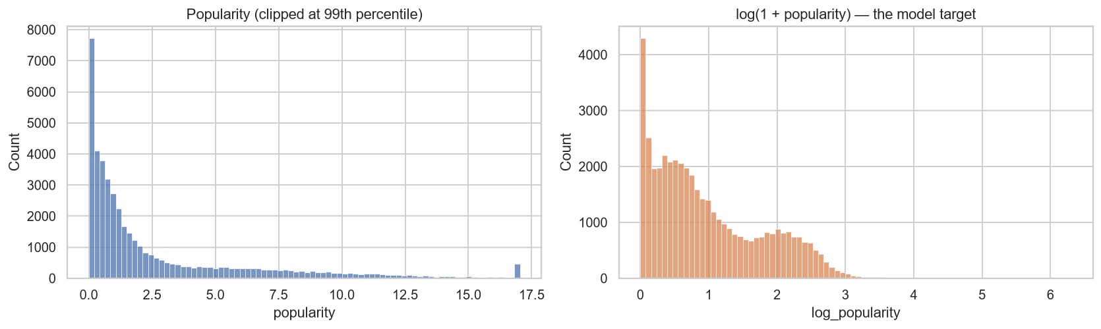
DATASET
The Movies Dataset — R. Banik, Kaggle (CC0)
• movies_metadata.csv — 45,466 movies × 24 columns
• links.csv — MovieLens ↔ TMDB ids
• ratings_small.csv — 100,004 ratings (EDA only)
• Target: TMDB popularity, a 2017 activity snapshot
• Heavily skewed → model log(1 + popularity)
6

Slide 7
DATA PREPROCESSING
Cleaning a messy real-world file
Raw rows
45,466
• 3 malformed rows, 30 duplicate rows removed
• Budget < $1,000 → unknown (81% unknown)
• Invalid runtimes → median imputation (1,756)
• Revenue 0 → null; types fixed with try_cast
Valid numeric id
45,463
De-duplicated
45,433
Released, valid date & title
44,899
Valid popularity
44,861
7

Slide 8
PYSPARK IMPLEMENTATION
Spark does the heavy lifting
DataFrames
Filtering
Parsing
groupBy / agg
multi-line CSV, explicit casting
scope, invalid values
regexp_extract_all on JSON-like strings
genre & yearly statistics
Spark SQL
Joins
Window
Validation
budget tiers, languages, months
ratings ⨝ links ⨝ movies
top movie per year with rank()
asserts on ids, nulls, ranges
8

Slide 9
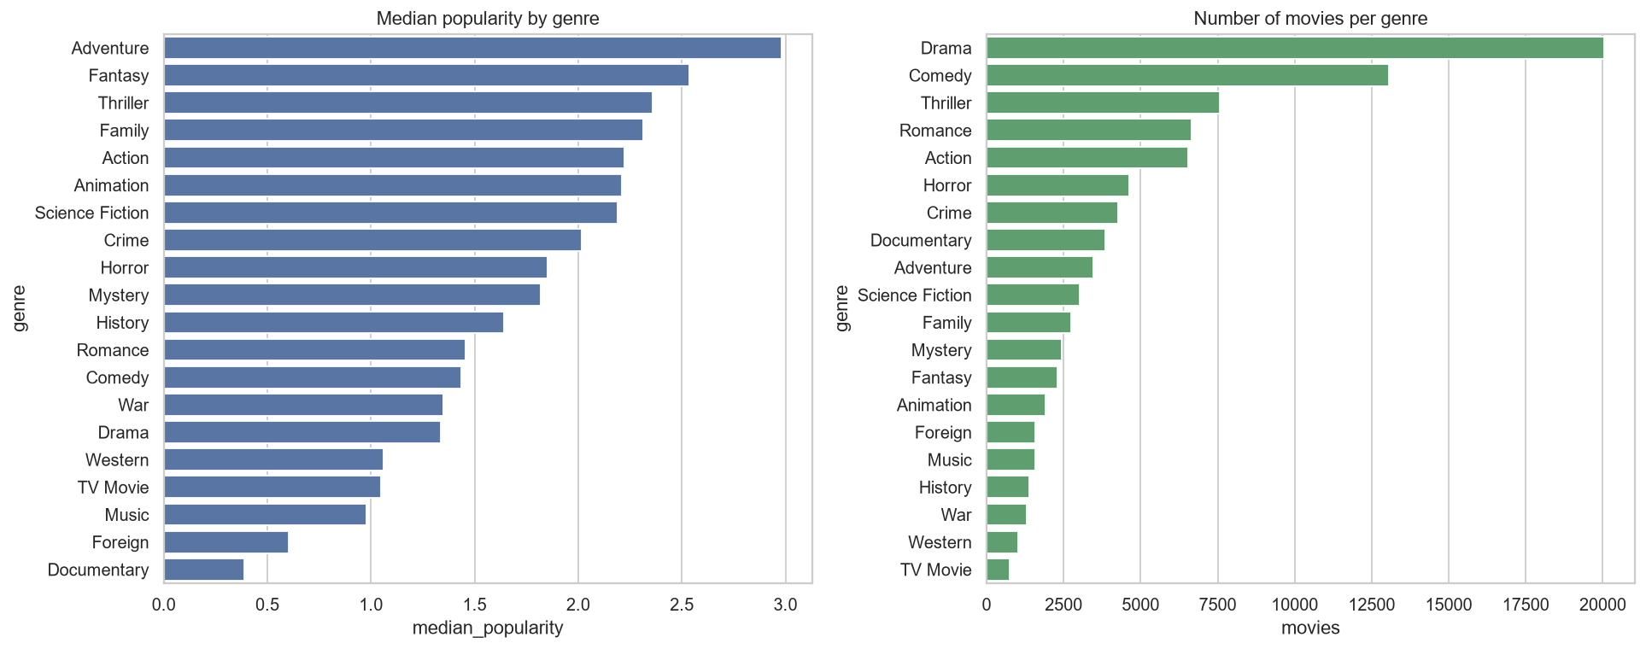
EDA FINDINGS
Budget, franchise and genre matter
• Adventure: highest median popularity; Documentary lowest
• Budget ↔ popularity Spearman 0.60 (known budgets)
• Franchise films: median 3.71 vs 1.03 standalone
• July releases most popular; 53% of films since 2000
• Vote count correlates 0.89 → post-release, excluded
9

Slide 10
MACHINE LEARNING APPROACH
Leakage-free regression pipeline
• 31 pre-release features (log budget, genres, timing, language, production)
• Target: log(1 + popularity); 80/20 split (35,888 / 8,973)
• Pipeline: StandardScaler + OneHotEncoder fitted on training data only
• Models: baseline, Linear Regression, Decision Tree, Random Forest, Gradient Boosting
• 3-fold CV hyper-parameter search; selection by CV RMSE
10

Slide 11
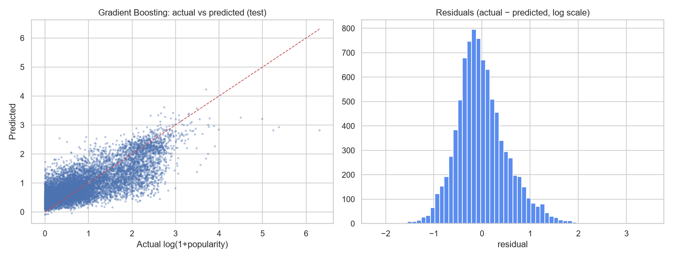
MODEL COMPARISON
Gradient Boosting performs best
Model | MAE (log) | RMSE (log) | R² (log) | R²
Baseline (mean) | 0.667 | 0.801 | -0.000 | -0.026
Linear Regression | 0.444 | 0.566 | 0.500 | 0.161
Decision Tree | 0.434 | 0.561 | 0.509 | 0.176
Random Forest | 0.409 | 0.529 | 0.563 | 0.189
Gradient Boosting | 0.403 | 0.523 | 0.573 | 0.200
Test R² (log) = 0.57 · typical error ≈ ×1.5 · baseline R² = 0
11

Slide 12
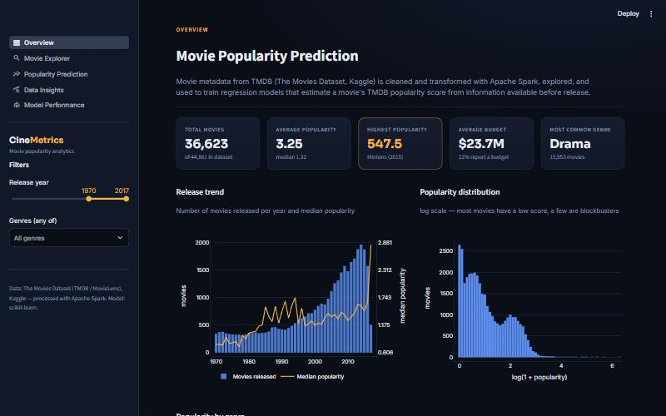
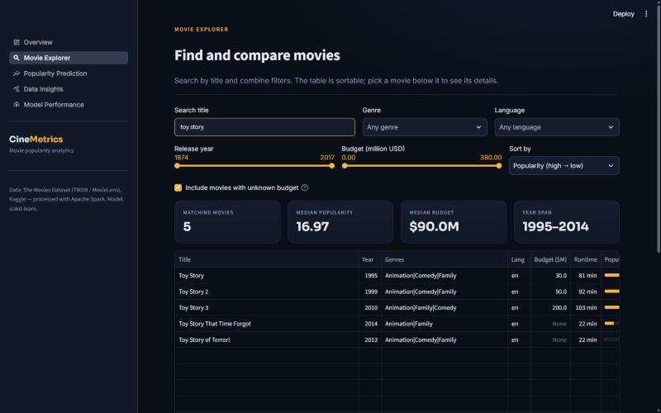
DASHBOARD DEMONSTRATION
CineMetrics — Streamlit + Plotly
Overview · Movie Explorer · Popularity Prediction · Data Insights · Model Performance
12

Slide 13
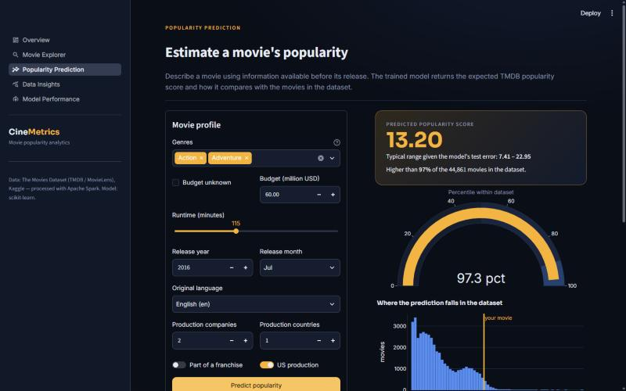
PREDICTION EXAMPLE
$60M action-adventure, July 2016, English
• Predicted popularity ≈ 13.2
• Higher than ~97% of movies
• Range from test error: 7.4 – 23.0
• Same features & order as training
• Comparable movies shown for context
13

Slide 14
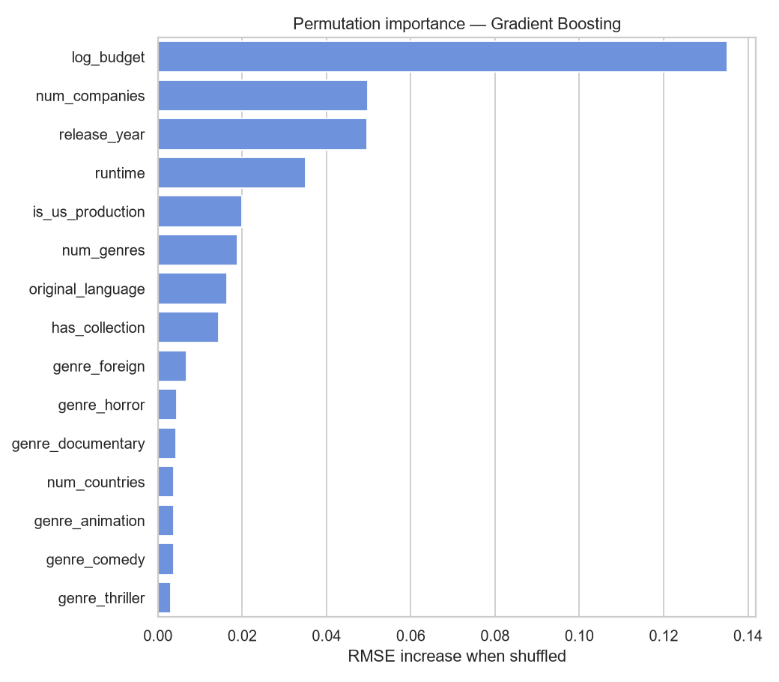
RESULTS & LIMITATIONS
Honest interpretation
• Budget is by far the strongest signal
• Metadata explains ~57% of log-popularity variance
• Popularity is a 2017 snapshot (recency bias)
• 81% of budgets unknown
• No cast, marketing or reviews in the model
14

Slide 15
CONCLUSION
A complete, working Big Data product
• Meaningful Spark pipeline: cleaning, parsing, SQL, joins, windows
• Data-driven EDA with reproducible findings
• Gradient Boosting: best of five models, no leakage
• Deployable dashboard (local & Streamlit Community Cloud)
• Next: cast/crew, keywords, time-based validation
15

Slide 16
TEAM CONTRIBUTIONS
Five members, one integrated pipeline
Member 1
Member 2
Member 3
Member 4
Member 5
Dataset research & collection
PySpark processing (notebook 01)
EDA & visualisation (notebook 02)
ML training & evaluation (notebook 03)
Dashboard, integration & deployment
16

