Slide 1
NeuroText
EEG representation learning for sentence retrieval
Can EEG retrieve sentence meaning
beyond matched negative controls?
ZuCo 1.0 + 2.0 | Statistical ridge · CNN · SSL · frozen LaBraM
Ziad Elsayed | University project
Waveform and transfer findings with validation-only TRT follow-ups.
NEUROTEXT / REVIEW DRAFT / 30 OCT 2026
01
Notes:
Source: docs/research_results/REPORT.md. Original 79-report export retained. Added 18 wider-grid exploratory transfer evaluations, with six original-grid seed42 comparisons kept separate. Report counts are not independent methods or cohorts. Strict cross-release participant independence remains unverified.

Slide 2
Define the prediction task
Fixed-pool retrieval with unseen readers
1. Encode a sentence-length EEG recording.
2. Predict its location in a frozen sentence-embedding space.
3. Rank unique candidate sentences by cosine similarity.
4. Evaluate Recall@1/5/10 and mean reciprocal rank (MRR).
Above random ranking alone is insufficient: real EEG must beat matched controls.
NEUROTEXT / REVIEW DRAFT / 30 OCT 2026
02
Notes:
Source: REPORT.md, Data and methods. The text encoder is frozen MiniLM. MRR averages reciprocal rank of the correct sentence. R@K is the fraction with the correct target in the first K positions. Pool size changes expected random performance.

Slide 3
Data preparation and quality audit
Normal reading · 105 ordered channels · resampled to 200 Hz
ZuCo 1.0
ZuCo 2.0
12 readers
3,356 prepared observations
3,349 after duration QC
18 readers
5,911 prepared observations
5,884 after duration QC
19-channel LaBraM adaptation is a separate cohort: 3,345 / 5,838 observations.
NEUROTEXT / REVIEW DRAFT / 30 OCT 2026
03
Notes:
Source: REPORT.md. ZuCo1: 3356 prepared, 7 duration-QC exclusions, 3349 retained. ZuCo2: 5911 prepared, 27 exclusions, 5884 retained. Missing source slots were separately audited. Original timing/reference/filter histories remain incompletely verified. LaBraM adaptation has different counts: 3345 and 5838, requiring whole seconds.

Slide 4
One shared, memory-conscious implementation
Windows + Colab clients use the same Python package
LOAD
REPRESENT
ALIGN
RANK
Lazy signal arrays
Audited manifests
Statistics / CNN
SSL / frozen LaBraM
Train-only scaling
Validation selection
MiniLM targets
Cosine retrieval
Local hardware: RTX 3050 with 4 GB VRAM; lazy loading limits memory use.
Shared code and documented inputs make weak results inspectable and reproducible.
NEUROTEXT / REVIEW DRAFT / 30 OCT 2026
04
Notes:
Source: REPORT.md and project source modules. Colab compatibility is implemented; actual Colab execution has not been established. Statistical features include per-channel statistics and spectral power. SSL reconstructs masked temporal blocks before alignment. Official LaBraM is frozen and verified, not fine-tuned. Local hardware: RTX 3050, 4 GB VRAM.

Slide 5
Controls make the central comparison
Hold out subjects; fit preprocessing on training observations only
Real EEG: original signals and true sentence pairing.
Gaussian: matched per-channel scale, independently generated noise.
Shuffled: separately trained model with incorrect sentence pairing.
Compare within the same cohort, split, seed and candidate pool.
Single-split differences are descriptive; no statistical significance is claimed.
NEUROTEXT / REVIEW DRAFT / 30 OCT 2026
05
Notes:
Source: REPORT.md. Gaussian noise preserves each observation’s channel standard deviations, so it retains amplitude information and is not uniform random ranking. Shuffled training labels are deranged by sentence class; evaluation labels are true. For SSL, Gaussian covers pretraining and alignment. Shuffled alignment may reuse label-free real-data pretraining. Test inspection during development means this is exploratory research.

Slide 6
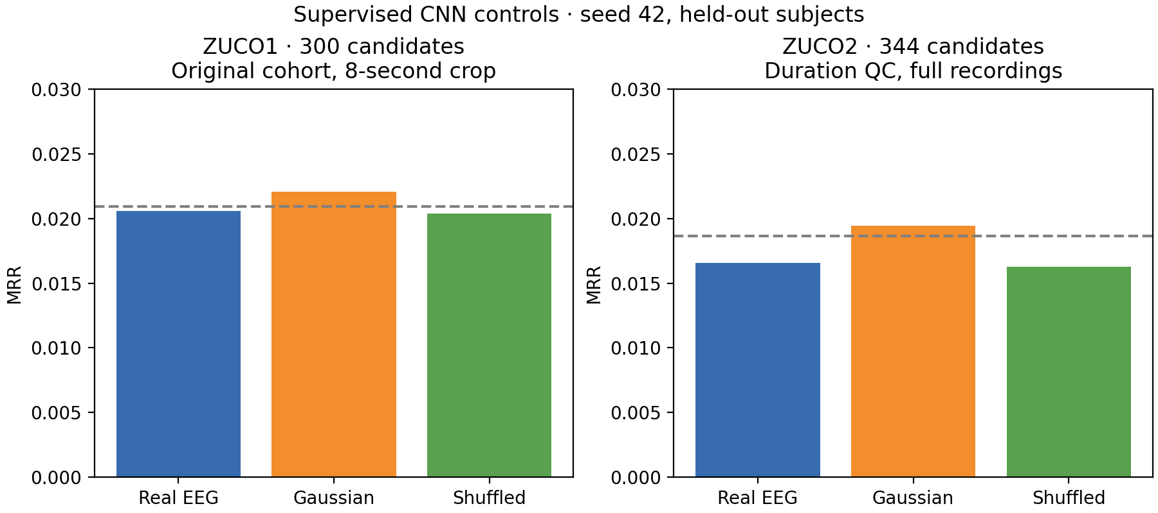
Supervised CNN: Gaussian matches top-1 hits
Seed 42 · ZuCo1: 592 queries / 300 candidates · ZuCo2: 984 / 344
Gaussian MRR exceeds real EEG in both datasets.
NEUROTEXT / REVIEW DRAFT / 30 OCT 2026
06
Notes:
Source: REPORT.md, Supervised CNN negative controls. ZuCo1 uses original cohort and an 8-second center crop; ZuCo2 uses duration QC and full recordings. These are not a controlled cross-dataset comparison. Real and Gaussian top-1 hits: 2 in ZuCo1, 3 in ZuCo2. Dashed lines are uniform random-ranking expectations, not significance thresholds.
Figure: docs/research_results/cnn_controls_mrr.png

Slide 7
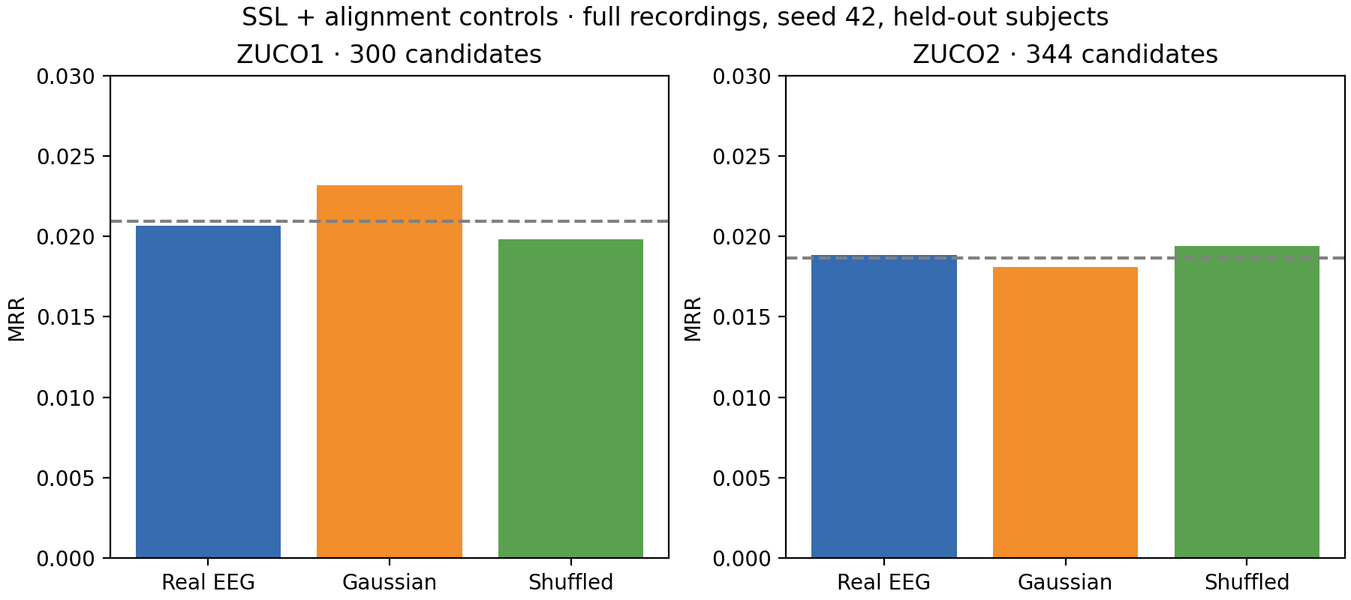
SSL: reconstruction does not establish decoding
Full recordings · duration QC · Gaussian control covers both learned stages
No consistent retrieval advantage for real EEG over the controls.
NEUROTEXT / REVIEW DRAFT / 30 OCT 2026
07
Notes:
Source: REPORT.md, Full-sentence SSL negative controls. Query/candidate counts: 592/300 and 984/344. Real/Gaussian/shuffled MRR: ZuCo1 .020680/.023159/.019842; ZuCo2 .018846/.018117/.019402. Training improvement does not imply generalization. One split; no significance claim.
Figure: docs/research_results/ssl_controls_mrr.png

Slide 8
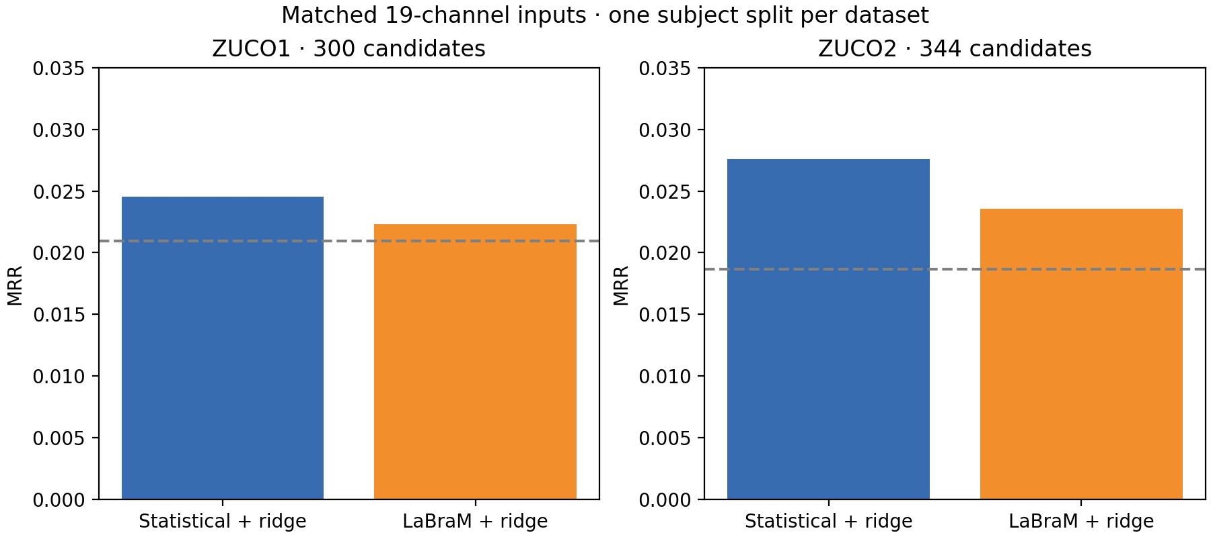
Frozen LaBraM against matched statistical features
Identical adapted signals · 19 mapped electrodes · whole-second support
Statistical features have higher top-1 and MRR on both reported splits.
NEUROTEXT / REVIEW DRAFT / 30 OCT 2026
08
Notes:
Source: REPORT.md, Matched pretrained comparison. Official weights checksum verified. Template-based mapping errors 2.11–9.40 degrees; approximate mapping and unknown upstream reference/filter details limit general conclusions. ZuCo1 592/300; ZuCo2 983/344. ZuCo1 LaBraM Recall@5/10 is higher; do not claim all metrics favor statistics.
Figure: docs/research_results/pretrained_comparison.png

Slide 9
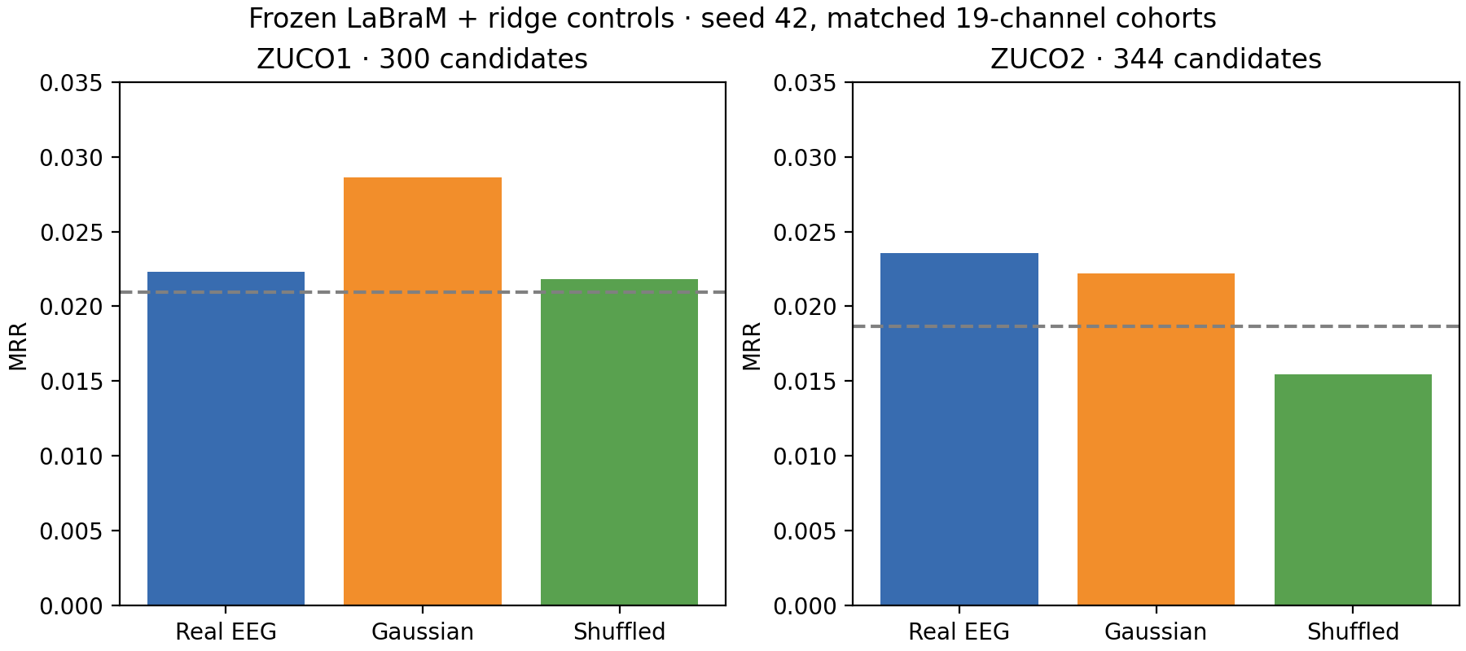
LaBraM controls limit the interpretation
Frozen backbone · separately fit ridge models · same adapted cohort and split
No consistent real-EEG superiority under this exploratory adaptation.
NEUROTEXT / REVIEW DRAFT / 30 OCT 2026
09
Notes:
Source: REPORT.md, Frozen LaBraM ridge negative controls. Gaussian MRR exceeds real in ZuCo1; ZuCo2 real MRR is slightly higher but top-1 has fewer hits (4 versus 5). Duplicate report sets are displayed once when all exported fields agree; this is not independent replication or a general verdict on LaBraM.
Figure: docs/research_results/labram_controls_mrr.png

Slide 10
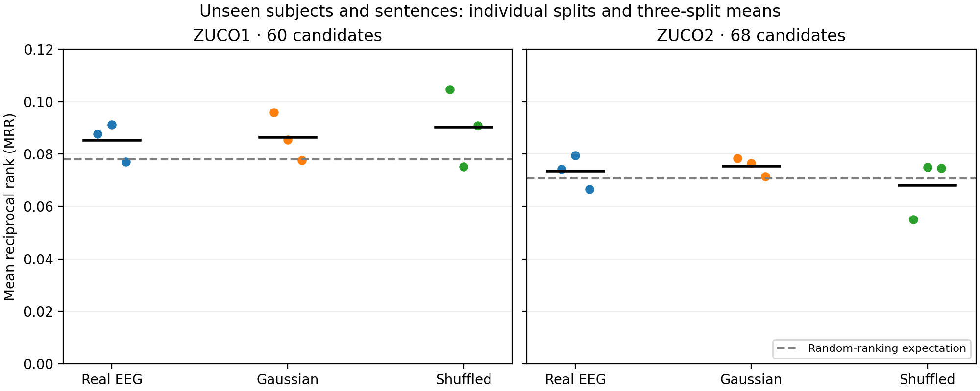
Unseen subjects and unseen sentence content
Ridge · seeds 42, 43, 44 · 60 candidates in ZuCo1 / 68 in ZuCo2
Real EEG exceeds Gaussian MRR on only one of three seeds in each dataset.
NEUROTEXT / REVIEW DRAFT / 30 OCT 2026
10
Notes:
Source: REPORT.md, Unseen subjects and unseen sentence content. Points show individual splits; report SD across splits is not a confidence interval. Splits reuse subjects and stimuli. Real/Gaussian mean MRR: .085268/.086335 in ZuCo1; .073448/.075441 in ZuCo2. Do not compare raw recall percentages against 300/344-candidate experiments.
Figure: docs/research_results/unseen_content_mrr.png

Slide 11
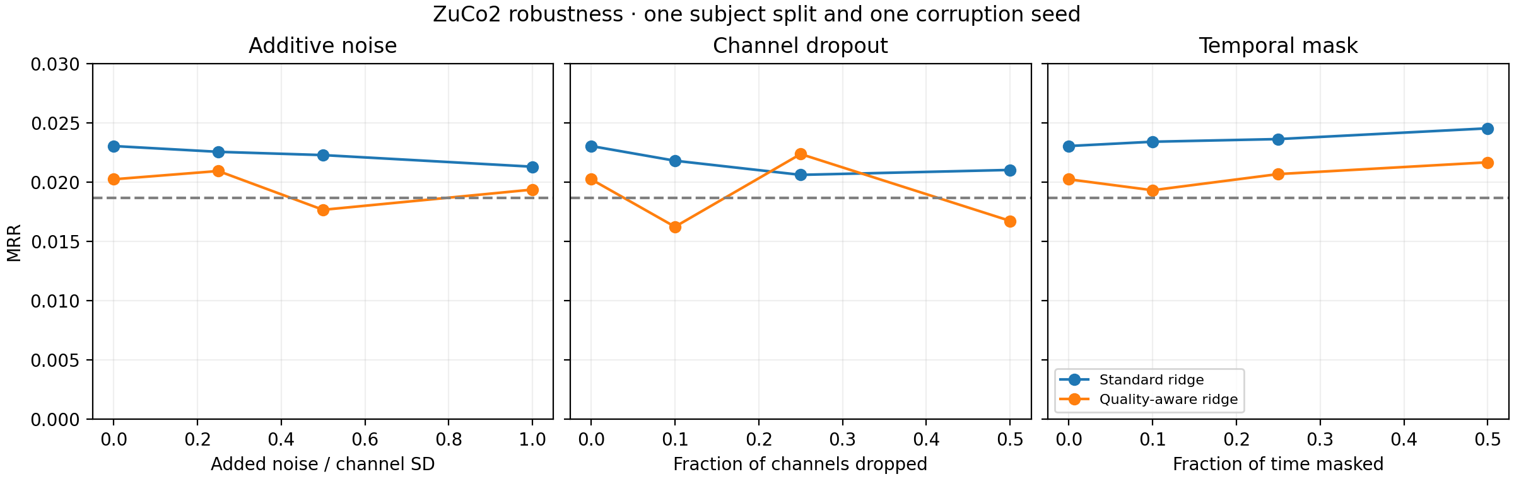
Quality weighting shows no consistent benefit
ZuCo2 ridge · 984 queries / 344 candidates · one split and corruption seed
Quality-aware MRR is lower in 8 of 9 nonzero corruption conditions.
NEUROTEXT / REVIEW DRAFT / 30 OCT 2026
11
Notes:
Source: REPORT.md, Robustness and quality weighting. Clean MRR: standard .023036, quality-aware .020230. Exception: 25% channel dropout. Nonmonotonic curves near chance do not establish beneficial signal removal. Noise, channel dropout and temporal masking have different severity units. No broad robustness claim.
Figure: docs/research_results/quality_robustness_mrr.png

Slide 12
Published work: compare protocols before scores
Generation, classification and retrieval measure different tasks
EEG-to-text papers often report BLEU / ROUGE for language generation.
LaBraM originally reports classification tasks.
Our task reports Recall@K / MRR for a fixed sentence pool.
The original AAAI 2022 repository documents an evaluation correction.
Primary-source protocol review is complete; competitive numerical ranking is unsupported.
NEUROTEXT / REVIEW DRAFT / 30 OCT 2026
12
Notes:
Sources: docs/published_work_comparison.md; docs/research_results/literature_sources.json. Wang and Ji, AAAI 2022: Open Vocabulary EEG-to-Text Decoding and Zero-shot Sentiment Classification. Official repository acknowledges evaluation correction in 2024 and directs readers to NeuSpeech. LaBraM: Jiang, Zhao and Lu, ICLR 2024. Review pins primary source revisions. This project has no protocol-matched numerical paper reproduction. Other limits: small cohorts, montage/reference uncertainty and repeated test inspection during development.

Slide 13
Exploratory transfer uses source-only selection
18 wider-grid evaluations · both directions · seeds 42, 43, 44
Train signal normalization and ridge on source training observations only.
Select alpha by source-validation MRR across seven fixed values.
Compare real EEG with separately trained Gaussian and shuffled controls.
Participant independence across releases remains unresolved.
50 shared texts remain in the target pools; strict transfer is still unexecuted.
NEUROTEXT / REVIEW DRAFT / 30 OCT 2026
13
Notes:
Source: docs/research_results/wider_grid_transfer/summary.json and configurations_and_pools.json. Grid .1,1,10,100,1000,10000,100000. Full recordings, 105 channels, 200 Hz, NR. Source-only validation chooses alpha, first maximum wins ties. No target fitting. All reports use transfer_exploratory and identity_audited:false. Different release labels do not verify different people. Inclusive target pools contain 50 shared texts.

Slide 14
Wider-grid results: ZuCo1 to ZuCo2
5,884 queries · 344 candidates · the same target cohort at every seed
Seed | Condition | Alpha | Source val MRR | Recall@1 | Target MRR
42 | Real | 100 | 0.028249 | 0.340% | 0.018732
42 | Gaussian | 100 | 0.025700 | 0.306% | 0.019507
42 | Shuffled | 100000 | 0.020376 | 0.272% | 0.018177
43 | Real | 1000 | 0.024743 | 0.255% | 0.019005
43 | Gaussian | 0.1 | 0.027825 | 0.493% | 0.020673
43 | Shuffled | 0.1 | 0.027011 | 0.238% | 0.017791
44 | Real | 0.1 | 0.022323 | 0.238% | 0.017851
44 | Gaussian | 10 | 0.020144 | 0.238% | 0.017859
44 | Shuffled | 100 | 0.022480 | 0.238% | 0.018772
Real EEG MRR is below Gaussian MRR on all three seeds.
NEUROTEXT / REVIEW DRAFT / 30 OCT 2026
14
Notes:
Source: docs/research_results/wider_grid_transfer/summary.json and configurations_and_pools.json. All nine seed-level results and source-validation winners are shown.
[{"direction": "zuco1_to_zuco2", "seed": 42, "control": "gaussian", "selected_alpha": 100.0, "validation_mrr": 0.025700484534546597, "recall_at_1": 0.0030591434398368456, "mrr": 0.019507085117496357, "n_queries": 5884, "n_candidates": 344, "shared_source_target_texts": 50, "candidate_pool_sha256": "57bbe847741650bb398d2c6964e8f69282cf968910978ca0173f8cfca6f4cca2", "text_cache_digest": "1faa646a986d32ae67f638487e4d08d038c107a67c2cf31864dea9f151177b29", "train_digest": "684aedf2641e07ec4c58e0d3f5661ad8dd2925634a975a14581bc20210a88868", "val_digest": "77b0e59c8257a6fcb19554588aa307747807aefdbe8af4b8748f17750ae1af4b", "test_digest": "7aabc0b6bf4c8fe0cbeecb4fe38b89cca803a537d3db4806872ea79459cc2726", "protocol": "transfer_exploratory", "identity_audited": false, "report": "C:\\Users\\Asus\\Desktop\\New_trends_AI_project1\\results\\exploratory_regularization_20261029\\0001_ridge_exploratory_zuco1_to_zuco2_gaussian_q0_s42\\evaluation.json"}, {"direction": "zuco1_to_zuco2", "seed": 42, "control": "real", "selected_alpha": 100.0, "validation_mrr": 0.028248771946800456, "recall_at_1": 0.003399048266485384, "mrr": 0.0187324206015878, "n_queries": 5884, "n_candidates": 344, "shared_source_target_texts": 50, "candidate_pool_sha256": "57bbe847741650bb398d2c6964e8f69282cf968910978ca0173f8cfca6f4cca2", "text_cache_digest": "1faa646a986d32ae67f638487e4d08d038c107a67c2cf31864dea9f151177b29", "train_digest": "684aedf2641e07ec4c58e0d3f5661ad8dd2925634a975a14581bc20210a88868", "val_digest": "77b0e59c8257a6fcb19554588aa307747807aefdbe8af4b8748f17750ae1af4b", "test_digest": "7aabc0b6bf4c8fe0cbeecb4fe38b89cca803a537d3db4806872ea79459cc2726", "protocol": "transfer_exploratory", "identity_audited": false, "report": "C:\\Users\\Asus\\Desktop\\New_trends_AI_project1\\results\\exploratory_regularization_20261029\\zuco1_to_zuco2_real\\evaluation.json"}, {"direction": "zuco1_to_zuco2", "seed": 42, "control": "shuffled", "selected_alpha": 100000.0, "validation_mrr": 0.02037593407518129, "recall_at_1": 0.002719238613188307, "mrr": 0.01817680342959089, "n_queries": 5884, "n_candidates": 344, "shared_source_target_texts": 50, "candidate_pool_sha256": "57bbe847741650bb398d2c6964e8f69282cf968910978ca0173f8cfca6f4cca2", "text_cache_digest": "1faa646a986d32ae67f638487e4d08d038c107a67c2cf31864dea9f151177b29", "train_digest": "684aedf2641e07ec4c58e0d3f5661ad8dd2925634a975a14581bc20210a88868", "val_digest": "77b0e59c8257a6fcb19554588aa307747807aefdbe8af4b8748f17750ae1af4b", "test_digest": "7aabc0b6bf4c8fe0cbeecb4fe38b89cca803a537d3db4806872ea79459cc2726", "protocol": "transfer_exploratory", "identity_audited": false, "report": "C:\\Users\\Asus\\Desktop\\New_trends_AI_project1\\results\\exploratory_regularization_20261029\\0002_ridge_exploratory_zuco1_to_zuco2_shuffled_q0_s42\\evaluation.json"}, {"direction": "zuco1_to_zuco2", "seed": 43, "control": "gaussian", "selected_alpha": 0.1, "validation_mrr": 0.027824949339616836, "recall_at_1": 0.004928619986403807, "mrr": 0.020673108690918658, "n_queries": 5884, "n_candidates": 344, "shared_source_target_texts": 50, "candidate_pool_sha256": "57bbe847741650bb398d2c6964e8f69282cf968910978ca0173f8cfca6f4cca2", "text_cache_digest": "1faa646a986d32ae67f638487e4d08d038c107a67c2cf31864dea9f151177b29", "train_digest": "f74b19be3cdc95c743e4f5f116754ad391f1f648930cf5544f798a34cd24ea51", "val_digest": "3eda8a777821b47439001707279fa6d0f64cb59634aeee6fbd12ee672245dc12", "test_digest": "7aabc0b6bf4c8fe0cbeecb4fe38b89cca803a537d3db4806872ea79459cc2726", "protocol": "transfer_exploratory", "identity_audited": false, "report": "C:\\Users\\Asus\\Desktop\\New_trends_AI_project1\\results\\exploratory_wider_seed43_20261029\\0001_ridge_exploratory_zuco1_to_zuco2_gaussian_q0_s43\\evaluation.json"}, {"direction": "zuco1_to_zuco2", "seed": 43, "control": "real", "selected_alpha": 1000.0, "validation_mrr": 0.024742624877177714, "recall_at_1": 0.002549286199864038, "mrr": 0.019005120103991607, "n_queries": 5884, "n_candidates": 344, "shared_source_target_texts": 50, "candidate_pool_sha256": "57bbe847741650bb398d2c6964e8f69282cf968910978ca0173f8cfca6f4cca2", "text_cache_digest": "1faa646a986d32ae67f638487e4d08d038c107a67c2cf31864dea9f151177b29", "train_digest": "f74b19be3cdc95c743e4f5f116754ad391f1f648930cf5544f798a34cd24ea51", "val_digest": "3eda8a777821b47439001707279fa6d0f64cb59634aeee6fbd12ee672245dc12", "test_digest": "7aabc0b6bf4c8fe0cbeecb4fe38b89cca803a537d3db4806872ea79459cc2726", "protocol": "transfer_exploratory", "identity_audited": false, "report": "C:\\Users\\Asus\\Desktop\\New_trends_AI_project1\\results\\exploratory_wider_seed43_20261029\\0000_ridge_exploratory_zuco1_to_zuco2_real_q0_s43\\evaluation.json"}, {"direction": "zuco1_to_zuco2", "seed": 43, "control": "shuffled", "selected_alpha": 0.1, "validation_mrr": 0.027010879607438133, "recall_at_1": 0.002379333786539769, "mrr": 0.017791229500946353, "n_queries": 5884, "n_candidates": 344, "shared_source_target_texts": 50, "candidate_pool_sha256": "57bbe847741650bb398d2c6964e8f69282cf968910978ca0173f8cfca6f4cca2", "text_cache_digest": "1faa646a986d32ae67f638487e4d08d038c107a67c2cf31864dea9f151177b29", "train_digest": "f74b19be3cdc95c743e4f5f116754ad391f1f648930cf5544f798a34cd24ea51", "val_digest": "3eda8a777821b47439001707279fa6d0f64cb59634aeee6fbd12ee672245dc12", "test_digest": "7aabc0b6bf4c8fe0cbeecb4fe38b89cca803a537d3db4806872ea79459cc2726", "protocol": "transfer_exploratory", "identity_audited": false, "report": "C:\\Users\\Asus\\Desktop\\New_trends_AI_project1\\results\\exploratory_wider_seed43_20261029\\0002_ridge_exploratory_zuco1_to_zuco2_shuffled_q0_s43\\evaluation.json"}, {"direction": "zuco1_to_zuco2", "seed": 44, "control": "gaussian", "selected_alpha": 10.0, "validation_mrr": 0.020144315883828066, "recall_at_1": 0.002379333786539769, "mrr": 0.017859127199541008, "n_queries": 5884, "n_candidates": 344, "shared_source_target_texts": 50, "candidate_pool_sha256": "57bbe847741650bb398d2c6964e8f69282cf968910978ca0173f8cfca6f4cca2", "text_cache_digest": "1faa646a986d32ae67f638487e4d08d038c107a67c2cf31864dea9f151177b29", "train_digest": "34866049f75c298077d416692e8bbe0b30044400f6c101a8d0fcb5d77d51724d", "val_digest": "c3d16e54b53fc9fe7a1c74f5557ddd12ee22ff6d99877e5132164c9ca52821a1", "test_digest": "7aabc0b6bf4c8fe0cbeecb4fe38b89cca803a537d3db4806872ea79459cc2726", "protocol": "transfer_exploratory", "identity_audited": false, "report": "C:\\Users\\Asus\\Desktop\\New_trends_AI_project1\\results\\exploratory_wider_seed44_20261029\\0001_ridge_exploratory_zuco1_to_zuco2_gaussian_q0_s44\\evaluation.json"}, {"direction": "zuco1_to_zuco2", "seed": 44, "control": "real", "selected_alpha": 0.1, "validation_mrr": 0.02232285948486181, "recall_at_1": 0.002379333786539769, "mrr": 0.01785082594993825, "n_queries": 5884, "n_candidates": 344, "shared_source_target_texts": 50, "candidate_pool_sha256": "57bbe847741650bb398d2c6964e8f69282cf968910978ca0173f8cfca6f4cca2", "text_cache_digest": "1faa646a986d32ae67f638487e4d08d038c107a67c2cf31864dea9f151177b29", "train_digest": "34866049f75c298077d416692e8bbe0b30044400f6c101a8d0fcb5d77d51724d", "val_digest": "c3d16e54b53fc9fe7a1c74f5557ddd12ee22ff6d99877e5132164c9ca52821a1", "test_digest": "7aabc0b6bf4c8fe0cbeecb4fe38b89cca803a537d3db4806872ea79459cc2726", "protocol": "transfer_exploratory", "identity_audited": false, "report": "C:\\Users\\Asus\\Desktop\\New_trends_AI_project1\\results\\exploratory_wider_seed44_20261029\\0000_ridge_exploratory_zuco1_to_zuco2_real_q0_s44\\evaluation.json"}, {"direction": "zuco1_to_zuco2", "seed": 44, "control": "shuffled", "selected_alpha": 100.0, "validation_mrr": 0.02248035896285381, "recall_at_1": 0.002379333786539769, "mrr": 0.018771661797326745, "n_queries": 5884, "n_candidates": 344, "shared_source_target_texts": 50, "candidate_pool_sha256": "57bbe847741650bb398d2c6964e8f69282cf968910978ca0173f8cfca6f4cca2", "text_cache_digest": "1faa646a986d32ae67f638487e4d08d038c107a67c2cf31864dea9f151177b29", "train_digest": "34866049f75c298077d416692e8bbe0b30044400f6c101a8d0fcb5d77d51724d", "val_digest": "c3d16e54b53fc9fe7a1c74f5557ddd12ee22ff6d99877e5132164c9ca52821a1", "test_digest": "7aabc0b6bf4c8fe0cbeecb4fe38b89cca803a537d3db4806872ea79459cc2726", "protocol": "transfer_exploratory", "identity_audited": false, "report": "C:\\Users\\Asus\\Desktop\\New_trends_AI_project1\\results\\exploratory_wider_seed44_20261029\\0002_ridge_exploratory_zuco1_to_zuco2_shuffled_q0_s44\\evaluation.json"}]

Slide 15
Wider-grid results: ZuCo2 to ZuCo1
3,349 queries · 300 candidates · the same target cohort at every seed
Seed | Condition | Alpha | Source val MRR | Recall@1 | Target MRR
42 | Real | 1000 | 0.026690 | 0.627% | 0.024933
42 | Gaussian | 1000 | 0.024125 | 0.448% | 0.023354
42 | Shuffled | 100000 | 0.019260 | 0.299% | 0.020941
43 | Real | 1000 | 0.024824 | 0.508% | 0.024221
43 | Gaussian | 1 | 0.025861 | 0.358% | 0.022323
43 | Shuffled | 1000 | 0.020172 | 0.388% | 0.021521
44 | Real | 100000 | 0.021306 | 0.388% | 0.021621
44 | Gaussian | 10 | 0.025757 | 0.567% | 0.023748
44 | Shuffled | 1 | 0.016905 | 0.418% | 0.021185
Real EEG MRR exceeds Gaussian on seeds 42 and 43; the sign reverses on seed 44.
NEUROTEXT / REVIEW DRAFT / 30 OCT 2026
15
Notes:
Source: docs/research_results/wider_grid_transfer/summary.json and configurations_and_pools.json. All nine seed-level results and source-validation winners are shown.
[{"direction": "zuco2_to_zuco1", "seed": 42, "control": "gaussian", "selected_alpha": 1000.0, "validation_mrr": 0.02412518880870484, "recall_at_1": 0.004478948939982084, "mrr": 0.023354273502327348, "n_queries": 3349, "n_candidates": 300, "shared_source_target_texts": 50, "candidate_pool_sha256": "33787a9cf7129e1a5c37160ab7bf963ff257743f1c5d81725da62172719f1334", "text_cache_digest": "1faa646a986d32ae67f638487e4d08d038c107a67c2cf31864dea9f151177b29", "train_digest": "fa88a395509406fa30e4fb57ddd55121b7ae3dc4f4f6c99ac05687e369d03233", "val_digest": "75875fd02bf1732ec839ab6312dcf0700f5b5bd9a17724a85e94d2a08116d002", "test_digest": "70c2b6fdd49be951b8c046e73a21b4fbd5f551cdcd040ddd086215e96e38c515", "protocol": "transfer_exploratory", "identity_audited": false, "report": "C:\\Users\\Asus\\Desktop\\New_trends_AI_project1\\results\\exploratory_regularization_20261029\\0004_ridge_exploratory_zuco2_to_zuco1_gaussian_q0_s42\\evaluation.json"}, {"direction": "zuco2_to_zuco1", "seed": 42, "control": "real", "selected_alpha": 1000.0, "validation_mrr": 0.026690071766045365, "recall_at_1": 0.006270528515974918, "mrr": 0.024933392827578994, "n_queries": 3349, "n_candidates": 300, "shared_source_target_texts": 50, "candidate_pool_sha256": "33787a9cf7129e1a5c37160ab7bf963ff257743f1c5d81725da62172719f1334", "text_cache_digest": "1faa646a986d32ae67f638487e4d08d038c107a67c2cf31864dea9f151177b29", "train_digest": "fa88a395509406fa30e4fb57ddd55121b7ae3dc4f4f6c99ac05687e369d03233", "val_digest": "75875fd02bf1732ec839ab6312dcf0700f5b5bd9a17724a85e94d2a08116d002", "test_digest": "70c2b6fdd49be951b8c046e73a21b4fbd5f551cdcd040ddd086215e96e38c515", "protocol": "transfer_exploratory", "identity_audited": false, "report": "C:\\Users\\Asus\\Desktop\\New_trends_AI_project1\\results\\exploratory_regularization_20261029\\0003_ridge_exploratory_zuco2_to_zuco1_real_q0_s42\\evaluation.json"}, {"direction": "zuco2_to_zuco1", "seed": 42, "control": "shuffled", "selected_alpha": 100000.0, "validation_mrr": 0.019260005090146717, "recall_at_1": 0.002985965959988056, "mrr": 0.020941217667641378, "n_queries": 3349, "n_candidates": 300, "shared_source_target_texts": 50, "candidate_pool_sha256": "33787a9cf7129e1a5c37160ab7bf963ff257743f1c5d81725da62172719f1334", "text_cache_digest": "1faa646a986d32ae67f638487e4d08d038c107a67c2cf31864dea9f151177b29", "train_digest": "fa88a395509406fa30e4fb57ddd55121b7ae3dc4f4f6c99ac05687e369d03233", "val_digest": "75875fd02bf1732ec839ab6312dcf0700f5b5bd9a17724a85e94d2a08116d002", "test_digest": "70c2b6fdd49be951b8c046e73a21b4fbd5f551cdcd040ddd086215e96e38c515", "protocol": "transfer_exploratory", "identity_audited": false, "report": "C:\\Users\\Asus\\Desktop\\New_trends_AI_project1\\results\\exploratory_regularization_20261029\\0005_ridge_exploratory_zuco2_to_zuco1_shuffled_q0_s42\\evaluation.json"}, {"direction": "zuco2_to_zuco1", "seed": 43, "control": "gaussian", "selected_alpha": 1.0, "validation_mrr": 0.025860876525447423, "recall_at_1": 0.0035831591519856674, "mrr": 0.022322610256900775, "n_queries": 3349, "n_candidates": 300, "shared_source_target_texts": 50, "candidate_pool_sha256": "33787a9cf7129e1a5c37160ab7bf963ff257743f1c5d81725da62172719f1334", "text_cache_digest": "1faa646a986d32ae67f638487e4d08d038c107a67c2cf31864dea9f151177b29", "train_digest": "51176fee8c90328b31f369e8a24742f61755d3f21083724f3974f6324cfdf41a", "val_digest": "4c3755777863f898de9459c8fce8a508b826ec5ce47c2db3a6302d39e5fed6b0", "test_digest": "70c2b6fdd49be951b8c046e73a21b4fbd5f551cdcd040ddd086215e96e38c515", "protocol": "transfer_exploratory", "identity_audited": false, "report": "C:\\Users\\Asus\\Desktop\\New_trends_AI_project1\\results\\exploratory_wider_seed43_20261029\\0004_ridge_exploratory_zuco2_to_zuco1_gaussian_q0_s43\\evaluation.json"}, {"direction": "zuco2_to_zuco1", "seed": 43, "control": "real", "selected_alpha": 1000.0, "validation_mrr": 0.024823915989668318, "recall_at_1": 0.005076142131979695, "mrr": 0.02422104830672392, "n_queries": 3349, "n_candidates": 300, "shared_source_target_texts": 50, "candidate_pool_sha256": "33787a9cf7129e1a5c37160ab7bf963ff257743f1c5d81725da62172719f1334", "text_cache_digest": "1faa646a986d32ae67f638487e4d08d038c107a67c2cf31864dea9f151177b29", "train_digest": "51176fee8c90328b31f369e8a24742f61755d3f21083724f3974f6324cfdf41a", "val_digest": "4c3755777863f898de9459c8fce8a508b826ec5ce47c2db3a6302d39e5fed6b0", "test_digest": "70c2b6fdd49be951b8c046e73a21b4fbd5f551cdcd040ddd086215e96e38c515", "protocol": "transfer_exploratory", "identity_audited": false, "report": "C:\\Users\\Asus\\Desktop\\New_trends_AI_project1\\results\\exploratory_wider_seed43_20261029\\0003_ridge_exploratory_zuco2_to_zuco1_real_q0_s43\\evaluation.json"}, {"direction": "zuco2_to_zuco1", "seed": 43, "control": "shuffled", "selected_alpha": 1000.0, "validation_mrr": 0.020171569428296832, "recall_at_1": 0.003881755747984473, "mrr": 0.021521174977861095, "n_queries": 3349, "n_candidates": 300, "shared_source_target_texts": 50, "candidate_pool_sha256": "33787a9cf7129e1a5c37160ab7bf963ff257743f1c5d81725da62172719f1334", "text_cache_digest": "1faa646a986d32ae67f638487e4d08d038c107a67c2cf31864dea9f151177b29", "train_digest": "51176fee8c90328b31f369e8a24742f61755d3f21083724f3974f6324cfdf41a", "val_digest": "4c3755777863f898de9459c8fce8a508b826ec5ce47c2db3a6302d39e5fed6b0", "test_digest": "70c2b6fdd49be951b8c046e73a21b4fbd5f551cdcd040ddd086215e96e38c515", "protocol": "transfer_exploratory", "identity_audited": false, "report": "C:\\Users\\Asus\\Desktop\\New_trends_AI_project1\\results\\exploratory_wider_seed43_20261029\\0005_ridge_exploratory_zuco2_to_zuco1_shuffled_q0_s43\\evaluation.json"}, {"direction": "zuco2_to_zuco1", "seed": 44, "control": "gaussian", "selected_alpha": 10.0, "validation_mrr": 0.025757048488592362, "recall_at_1": 0.005673335323977307, "mrr": 0.023748111833794255, "n_queries": 3349, "n_candidates": 300, "shared_source_target_texts": 50, "candidate_pool_sha256": "33787a9cf7129e1a5c37160ab7bf963ff257743f1c5d81725da62172719f1334", "text_cache_digest": "1faa646a986d32ae67f638487e4d08d038c107a67c2cf31864dea9f151177b29", "train_digest": "0996bee1104767b65186650519e447073ef6d01b5b88084fe8f57c5ccb9a018d", "val_digest": "fde7059d217bf55c1a8478d651a5cdff96a0b1d5c0dd60c48741239371ec9fff", "test_digest": "70c2b6fdd49be951b8c046e73a21b4fbd5f551cdcd040ddd086215e96e38c515", "protocol": "transfer_exploratory", "identity_audited": false, "report": "C:\\Users\\Asus\\Desktop\\New_trends_AI_project1\\results\\exploratory_wider_seed44_20261029\\0004_ridge_exploratory_zuco2_to_zuco1_gaussian_q0_s44\\evaluation.json"}, {"direction": "zuco2_to_zuco1", "seed": 44, "control": "real", "selected_alpha": 100000.0, "validation_mrr": 0.021305568487439086, "recall_at_1": 0.003881755747984473, "mrr": 0.021621465845375262, "n_queries": 3349, "n_candidates": 300, "shared_source_target_texts": 50, "candidate_pool_sha256": "33787a9cf7129e1a5c37160ab7bf963ff257743f1c5d81725da62172719f1334", "text_cache_digest": "1faa646a986d32ae67f638487e4d08d038c107a67c2cf31864dea9f151177b29", "train_digest": "0996bee1104767b65186650519e447073ef6d01b5b88084fe8f57c5ccb9a018d", "val_digest": "fde7059d217bf55c1a8478d651a5cdff96a0b1d5c0dd60c48741239371ec9fff", "test_digest": "70c2b6fdd49be951b8c046e73a21b4fbd5f551cdcd040ddd086215e96e38c515", "protocol": "transfer_exploratory", "identity_audited": false, "report": "C:\\Users\\Asus\\Desktop\\New_trends_AI_project1\\results\\exploratory_wider_seed44_20261029\\0003_ridge_exploratory_zuco2_to_zuco1_real_q0_s44\\evaluation.json"}, {"direction": "zuco2_to_zuco1", "seed": 44, "control": "shuffled", "selected_alpha": 1.0, "validation_mrr": 0.016905000897664835, "recall_at_1": 0.0041803523439832785, "mrr": 0.02118536179409562, "n_queries": 3349, "n_candidates": 300, "shared_source_target_texts": 50, "candidate_pool_sha256": "33787a9cf7129e1a5c37160ab7bf963ff257743f1c5d81725da62172719f1334", "text_cache_digest": "1faa646a986d32ae67f638487e4d08d038c107a67c2cf31864dea9f151177b29", "train_digest": "0996bee1104767b65186650519e447073ef6d01b5b88084fe8f57c5ccb9a018d", "val_digest": "fde7059d217bf55c1a8478d651a5cdff96a0b1d5c0dd60c48741239371ec9fff", "test_digest": "70c2b6fdd49be951b8c046e73a21b4fbd5f551cdcd040ddd086215e96e38c515", "protocol": "transfer_exploratory", "identity_audited": false, "report": "C:\\Users\\Asus\\Desktop\\New_trends_AI_project1\\results\\exploratory_wider_seed44_20261029\\0005_ridge_exploratory_zuco2_to_zuco1_shuffled_q0_s44\\evaluation.json"}]

Slide 16
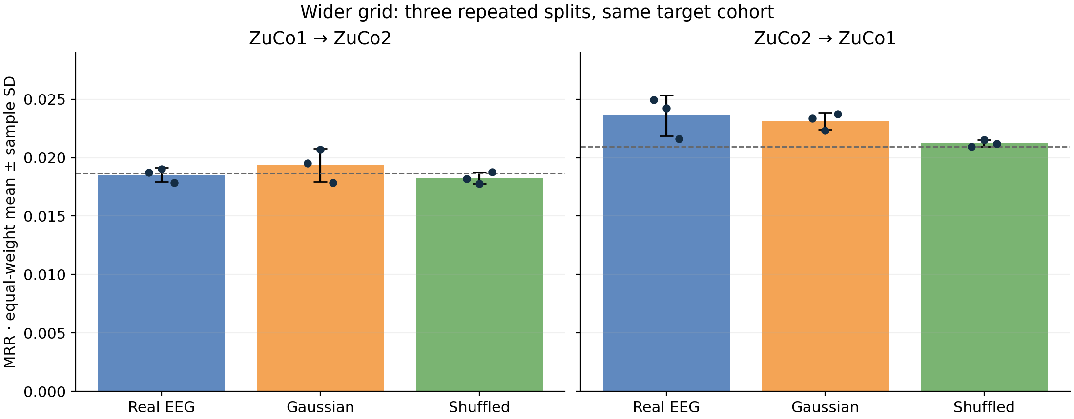
Wider-grid means remain close to controls
Equal-weight seed means · sample SD · individual seed points
Repeated splits reuse target participants and queries; SD is descriptive.
NEUROTEXT / REVIEW DRAFT / 30 OCT 2026
16
Notes:
Source: docs/research_results/wider_grid_transfer/summary.json and configurations_and_pools.json. Mean MRR ± sample SD: forward real .018529±.000603, Gaussian .019346±.001414, shuffled .018247±.000494; reverse .023592±.001743, .023142±.000736, .021216±.000291. SD uses ddof=1 across seeds. It is not a CI or standard error. Dashed lines are uniform ranking expectations, not significance thresholds. Gaussian preserves amplitude and duration.

Slide 17
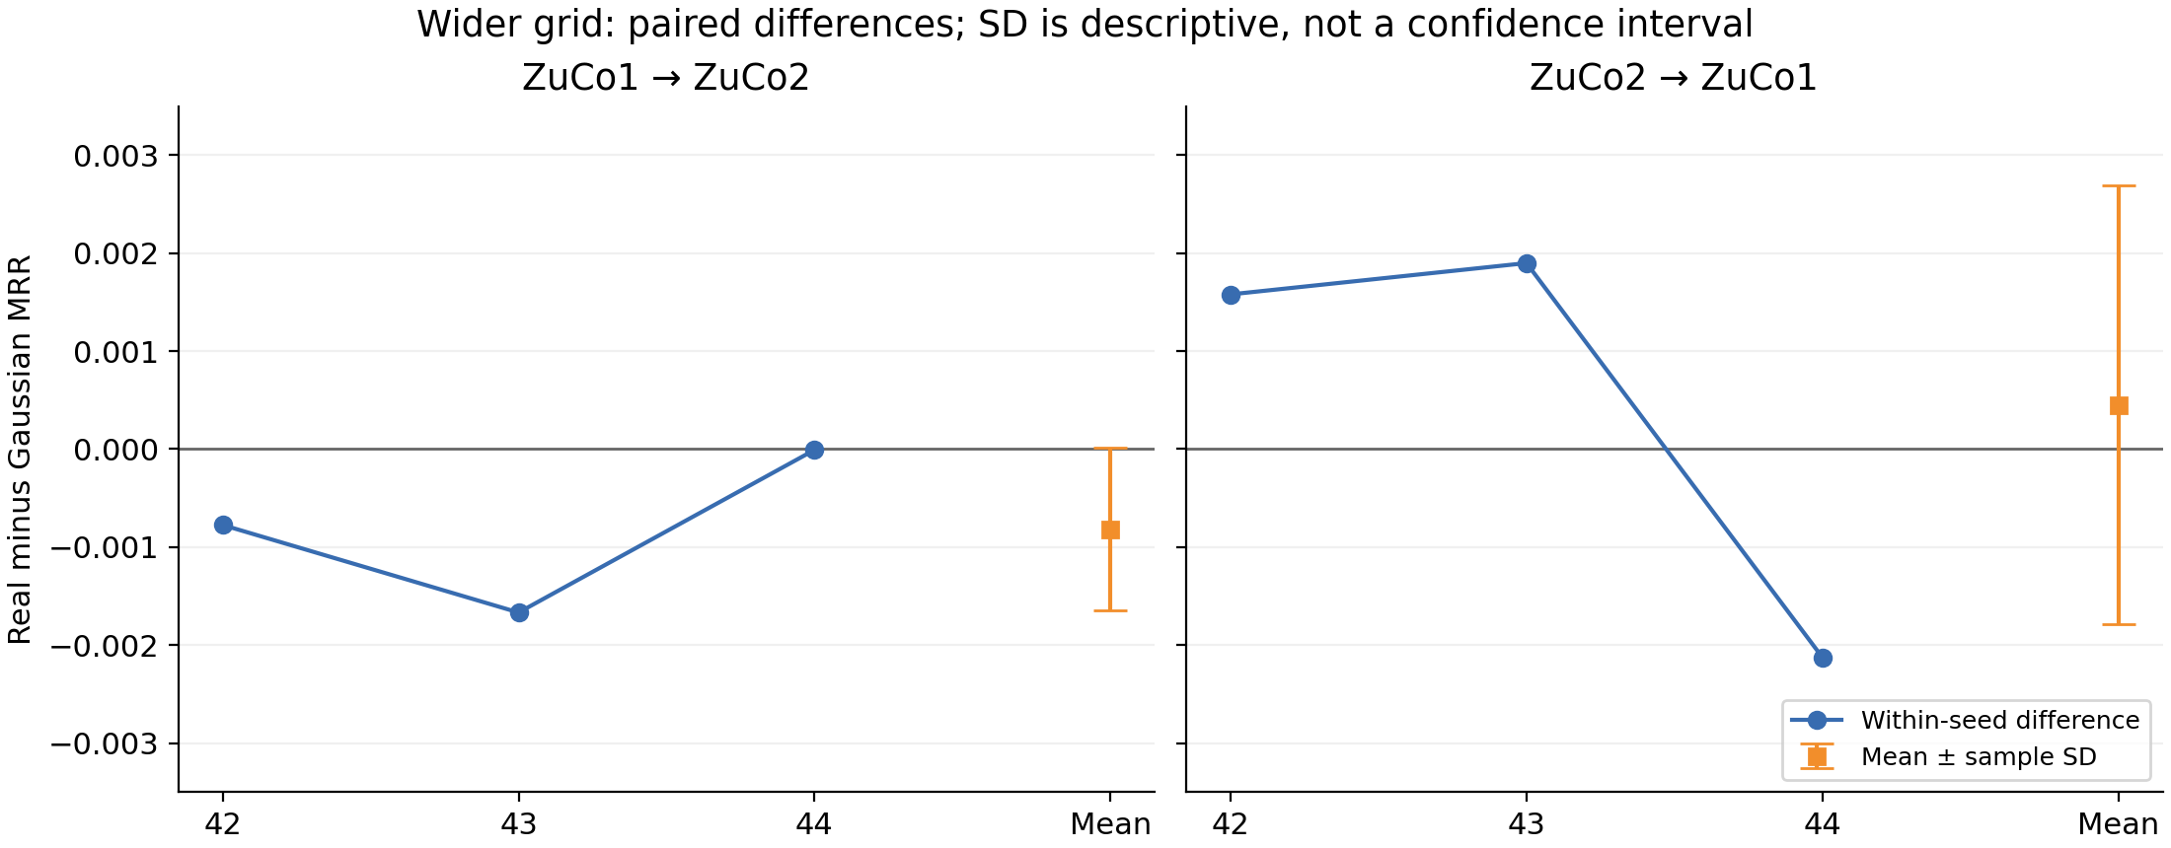
Real-minus-Gaussian differences change by seed
Pair within direction and seed before calculating mean and sample SD
Forward ΔMRR −0.000817 ± 0.000831; reverse +0.000450 ± 0.002237.
NEUROTEXT / REVIEW DRAFT / 30 OCT 2026
17
Notes:
Source: docs/research_results/wider_grid_transfer/summary.json and configurations_and_pools.json. Forward paired MRR differences: -.000774665, -.001667989, -.000008301. Reverse: +.001579119, +.001898438, -.002126646. Positive reverse differences in 2/3 seeds; forward 0/3. Same target cohorts and overlapping source splits. No independent-cohort or significance claim. Mean ΔRecall@1 pp: forward -.067981±.148161; reverse +.049766±.198815.

Slide 18
Original and wider grids are separate experiments
Seed 42 only · original grid ends at 100 · wider grid ends at 100,000
Direction | Condition | Original α / MRR | Wider α / MRR
1 to 2 | Real | 100 / 0.018732 | 100 / 0.018732
1 to 2 | Gaussian | 100 / 0.019507 | 100 / 0.019507
1 to 2 | Shuffled | 1 / 0.019001 | 100000 / 0.018177
2 to 1 | Real | 10 / 0.022941 | 1000 / 0.024933
2 to 1 | Gaussian | 100 / 0.024007 | 1000 / 0.023354
2 to 1 | Shuffled | 10 / 0.021036 | 100000 / 0.020941
Only the wider grid has seeds 42–44; do not pool the grids as extra repeats.
NEUROTEXT / REVIEW DRAFT / 30 OCT 2026
18
Notes:
Source: docs/research_results/wider_grid_transfer/original_grid_seed42.csv and summary.json. Original grid [.1,1,10,100], wider grid [.1,1,10,100,1000,10000,100000]. Original grid has only seed42 transfer; no three-seed grid-effect claim. Reverse real R1 .328% to .627% at seed42. Keep separate from original 79-report within-dataset export. No target score selected alpha.

Slide 19
Archive and recorded software validation
139 passed · 2 optional skips · 0 deselected
Full configs, candidate keys, split digests and evaluation JSON are archived.
Two official-weight tests skip because EEG_LABRAM_CACHE is unset.
Integration skip: no network download during unit tests.
Extraction skip: optional official weights on synthetic fixtures.
The previously excluded 513 MiB MATLAB test was included and passed.
Recorded validation is preserved; consolidation launches no experiments.
NEUROTEXT / REVIEW DRAFT / 30 OCT 2026
19
Notes:
Source: docs/research_results/wider_grid_transfer/summary.json and configurations_and_pools.json. Recorded command: .venv/Scripts/python.exe -m pytest -q -rs. 139 passed, 2 skipped, 0 deselected, two existing short-signal matplotlib warnings. Exact skips: tests/test_storage_and_pretrained.py::test_official_pretrained_weights_on_synthetic_input (optional official-weight integration; no network download during unit tests) and ::test_pretrained_cache_extraction (optional official-weight extraction on synthetic fixtures). EEG_LABRAM_CACHE unset. tests/test_mat5_streaming.py::test_file_above_old_limit_without_full_materialization was included and passed. Archive: archive_manifest.json, runs.csv, condition_summary.csv, paired_differences.csv, difference_summary.csv, configs/, implementation/, evaluations/.

Slide 20
These configurations do not show reliable retrieval
Matched controls and repeated splits limit the interpretation
These configurations do not demonstrate reliable retrieval beyond controls.
Forward real MRR trails Gaussian on all three seeds.
Reverse differences change sign, with only a small positive mean.
Participant independence remains unresolved; strict transfer is unexecuted.
The findings do not establish that EEG contains no semantic information.
NEUROTEXT / REVIEW DRAFT / 30 OCT 2026
20
Notes:
Source: docs/research_results/wider_grid_transfer/summary.json and configurations_and_pools.json. Conclusion concerns these tested configurations, not all EEG decoding. Same target participants and queries at every seed, overlapping source splits, shared sentences, source timing/reference uncertainties and exploratory test inspection limit inference. Original 79-row export and original-grid transfer remain separate. No new experiments were run during consolidation. Independent identity evidence and protocol-matched paper reproduction remain unresolved.

Slide 21
Validation-only TRT spectral pilot
TRT pools eight 105-channel word vectors into sentence features.
The cohort has 2,245 training observations and 512 validation queries.
All validation scores rank the same 298 sentence candidates.
Counts and missingness require explicit structural controls.
Gaze-assisted source features retain timing and preprocessing limitations.
NEUROTEXT / REVIEW DRAFT / 30 OCT 2026
21
Notes:
Source: results/spectral_trt_pilot_v1_20261030/plan.json and feature_view.json. TRT values are Hilbert-envelope amplitudes. Durations are sample counts at 500 Hz. No word text or sentence identity input. Unchanged targets, no punctuation repair. No new exclusions. One all-missing training observation retained. Test features not extracted. Reused validation cohort, not a new held-out test.

Slide 22
Validation-only pilot favors structural controls
Condition | Val R@1 | Val R@5 | Val R@10 | Val MRR
Real TRT | 12.305% | 32.227% | 41.406% | 0.226986
Matched Gaussian | 10.742% | 23.633% | 28.906% | 0.177208
Class shuffled | 0.391% | 2.148% | 3.711% | 0.022676
Count / duration | 17.773% | 40.625% | 51.367% | 0.292012
Zero / missingness | 16.406% | 40.234% | 52.344% | 0.281028
Sentence ridge | 0.586% | 2.734% | 4.102% | 0.026320
Count / duration validation MRR 0.292012 uses no measured TRT amplitudes.
NEUROTEXT / REVIEW DRAFT / 30 OCT 2026
22
Notes:
Source: results/spectral_trt_pilot_v1_20261030/validation_summary.json. All table scores are validation only, not test. Each condition selected one of 28 settings (two imputers, two scalers, seven alphas). The structural 62-feature count/duration baseline has a train-derived count basis. Real-minus-count MRR -0.065026; real-minus-zero/missingness -0.054043. All six models share observations and 298 candidates. Large gains above old sentence features do not establish EEG information.

Slide 23
Validation-only incremental comparison
All three models share 62 structural features and one frozen transform.
Combined models append 840 real or matched Gaussian TRT values.
Both combined models search 196 settings, including zero EEG weight.
Post-scaling weights preserve an exact structural-only candidate.
196 settings = 2 EEG imputers x 2 EEG scalers x 7 alphas x 7 weights
NEUROTEXT / REVIEW DRAFT / 30 OCT 2026
23
Notes:
Source: results/trt_incremental_v1_20261030/plan.json and structural_preprocessing_frozen.json. Identical raw and transformed structural blocks; training-fit structural imputation/scaling selected using structural-only validation and then frozen. Structural-only searches 28 settings. EEG weights [0,.01,.03,.1,.3,1,3] after scaling. Alphas [.1,1,10,100,1000,10000,100000]. Ascending weight wins ties. Validation MRR selects. Both combined searches have identical 196 setting tuples. Repeated use of validation across investigations creates selection optimism.

Slide 24
Validation-only incremental results
Model | Val R@1 | Val R@5 | Val R@10 | Val MRR | EEG weight
Structure | 17.773% | 40.625% | 51.367% | 0.292012 | 0
Structure + real | 17.383% | 41.016% | 51.562% | 0.292310 | 0.01
Structure + Gaussian | 17.773% | 40.820% | 51.172% | 0.292156 | 0.01
Val delta MRR: real - structure +0.000299, real - Gaussian +0.000154
NEUROTEXT / REVIEW DRAFT / 30 OCT 2026
24
Notes:
Source: results/trt_incremental_v1_20261030/validation_summary.json and differences.json. Validation-only selected models, 2245 training observations, 512 validation queries, 298 candidates. All alpha10. Both selected EEG weight .01, not zero, but gains are tiny. Structure median/std, real EEG median/std, Gaussian EEG mean/robust IQR. Zero EEG candidates exactly reproduce structural path. These scores are selection results after 196 settings, not independent test estimates.

Slide 25
Validation-only reader effects change sign
Reader | Queries | Val real - structure MRR | Val real - Gaussian MRR
ZJS | 216 | -0.003530 | -0.004365
ZKW | 296 | +0.003092 | +0.003452
Real TRT loses two Recall@1 hits overall despite the small pooled MRR increase.
NEUROTEXT / REVIEW DRAFT / 30 OCT 2026
25
Notes:
Source: results/trt_incremental_v1_20261030/differences.json. Validation-only per-reader changes: ZJS216 real-structure -.003530047, real-Gaussian -.004364868. ZKW296 +.003092387 and +.003452321. Same two readers and one previously reused split, not independent cohorts. Do not pool these as replicated neural effects.

Slide 26
Validation-only results show no consistent EEG gain
The structural baseline retrieves sentence classes from reading structure.
Real TRT adds no consistent benefit across both validation readers.
The 196-setting search and repeated validation use limit inference.
Further tuning and test evaluation are stopped.
Every new score is validation-only. No test features were extracted.
NEUROTEXT / REVIEW DRAFT / 30 OCT 2026
26
Notes:
Sources: docs/research_results/REPORT.md and the spectral/incremental archives. Separate structural retrieval from incremental EEG information. Full observation/candidate identity and hashes preserved. No confidence interval or significance claim from word observations or repeated validation use. Prior experiment files, target cache, datasets and checkpoints unchanged. No new fitting, tuning or model evaluation during consolidation. Structural baseline appears in both studies and is not an independent repeat. Historical waveform and transfer findings remain separate.

Slide 27
Later pilots: what changed after 30 October
SAVED RESULTS ONLY / No training or evaluation ran for this update / No test-set use
Study | Change tested | Scope | Supported finding
Ordered-word ridge | Four word-position bins vs. mean | CV, then reused validation | One extra hit; controls stronger
Relative amplitude | Channel-relative features, two heads | Training CV | Zero EEG weight selected
Full-sequence GRU | All ordered word steps | Training CV | Gate failed; far below structure
GRU retrieval loss | Full-candidate cross entropy | Training CV | Predictions spread; no better retrieval
Word pretraining | Exported-word targets first | Training CV | No gain over fresh training
N-way analysis | Smaller random candidate pools | Replayed training CV | Real EEG near chance, below missingness
Training CV and reused validation are development scores, not untouched confirmation.
NEUROTEXT / REVIEW DRAFT / 05 NOV 2026
27
Notes:
Later studies from the REPORT.md tables and each archive under docs/research_results. Every score here is a development score. Word-order used training CV selection and one evaluation on reused outer validation. Amplitude, GRU, loss-only and word-pretraining pilots did not evaluate outer validation. None used the test set.

Slide 28
Ordered-word ridge does not beat its controls
REUSED OUTER VALIDATION / ZuCo1 seed 42 / 512 queries / 298 candidates / alpha chosen on training readers
Condition | R@1 | R@5 | R@10 | MRR
Mean real EEG | 0.195% | 1.758% | 3.320% | 0.019783
Ordered real EEG | 0.391% | 1.367% | 4.102% | 0.022452
Matched Gaussian | 0.781% | 1.953% | 4.102% | 0.026921
Word-order shuffled | 0.586% | 1.172% | 4.688% | 0.024464
Class shuffled | 0.000% | 2.148% | 3.516% | 0.019378
Missingness only | 17.578% | 40.625% | 51.758% | 0.291229
Structure only | 17.578% | 40.430% | 51.367% | 0.291369
Order adds one top-1 hit over the mean; Gaussian and order-shuffled score higher on R@1 and MRR.
NEUROTEXT / REVIEW DRAFT / 05 NOV 2026
28
Notes:
Source: evidence_review_v1_20261101/outer_validation.csv. Training-fitted 16-component word PCA with mean or four position bins. Source word order is displayed order, not fixation chronology. Missingness and structure use annotation-derived information and are not EEG decoding. Chance Recall@1 is 1/298.

Slide 29
Relative amplitudes: both heads select zero EEG weight
TRAINING-READER CV ONLY / 8 readers / 2,245 observations / 300 candidates
Condition | Embedding R@1 | Embedding MRR | Known-class R@1 | Known-class MRR
EEG only | 0.355% | 0.020519 | 0.357% | 0.019292
Gaussian only | 0.696% | 0.025876 | 0.395% | 0.022132
Structure only | 16.113% | 0.280271 | 20.909% | 0.400506
Structure + real EEG | 16.113% | 0.280271 | 20.909% | 0.400506
Structure + Gaussian | 16.113% | 0.280271 | 20.909% | 0.400506
Combined models equal structure alone. The 20.909% known-class score is structure, not EEG.
NEUROTEXT / REVIEW DRAFT / 05 NOV 2026
29
Notes:
Source: evidence_review_v1_20261101/training_cv.csv and amplitude_audit_v1_20261101/training_summary.json. Settings were selected on the same readers, so scores are optimistic. Known-class is closed-set classification of repeated sentences. The reduced reader amplitude spread is an observation, not proof of subject alignment.

Slide 30
GRU: the loss change spreads predictions, not retrieval
TRAINING-READER CV ONLY / 8 readers / 2,245 observations / 300 candidates / epoch 8
Condition | Cosine R@1 | Cosine MRR | Cross-entropy R@1 | Cross-entropy MRR
Real EEG | 0.542% | 0.023048 | 0.529% | 0.020781
Mean EEG | 0.401% | 0.022454 | 0.363% | 0.019303
Matched Gaussian | 0.404% | 0.021327 | 0.261% | 0.018486
Class shuffled | 0.358% | 0.021432 | 0.174% | 0.020120
Word-order shuffled | 0.441% | 0.022068 | 0.265% | 0.018809
Missingness only | 0.358% | 0.021191 | 0.449% | 0.023184
Structure only | 16.113% | 0.280271 | 16.113% | 0.280271
Distinct top-1 choices rise from 6.375 to 53 per reader; real beats Gaussian in only 3/8 readers.
NEUROTEXT / REVIEW DRAFT / 05 NOV 2026
30
Notes:
Source: evidence_review_v1_20261101/training_cv.csv, gru_retrieval_loss_v1_20261101/prediction_concentration.json and baseline_prediction_audit/summary.json. Real beats Gaussian on Recall@1 in 3/8 readers under both objectives. Chance Recall@1 is 1/300. Both pilots failed their descriptive gate, which is a stopping rule, not a significance test.

Slide 31
Word pretraining adds no sentence-retrieval gain
TRAINING-READER CV ONLY / 8 readers / 2,245 observations / 300 candidates / sentence scores
Condition | R@1 | R@5 | R@10 | MRR
Pretrained real EEG | 0.395% | 1.382% | 2.986% | 0.020149
Fresh, same sentence updates | 0.529% | 1.553% | 2.903% | 0.021318
Fresh, equal total updates | 0.348% | 1.579% | 2.890% | 0.019855
Pretrained Gaussian | 0.216% | 1.023% | 2.295% | 0.017447
Pretrained class shuffled | 0.578% | 1.824% | 3.720% | 0.023627
Pretrained missingness | 0.898% | 2.846% | 5.086% | 0.030513
Structure only | 16.113% | 40.287% | 52.053% | 0.280271
Real EEG beats fresh same-sentence training in 0/8 readers and missingness in 0/8 readers.
NEUROTEXT / REVIEW DRAFT / 05 NOV 2026
31
Notes:
Source: evidence_review_v1_20261101/training_cv.csv and participant_metrics.csv. Fixed stages of 128 word updates and 256 sentence updates; only the projection transfers. Equal update counts do not match FLOPs or sequence exposure. Counts are descriptive, not significance tests.

Slide 32
Word-task scores are a separate quantity
WORD CLASSES, NOT SENTENCES / Training-reader CV / Macro across 8 readers / Text is a target only
Condition | R@1 | R@5 | R@10 | MRR
Pretrained real EEG | 3.008% | 10.046% | 15.943% | 0.068325
Pretrained Gaussian | 3.002% | 9.727% | 15.503% | 0.067224
Pretrained missingness | 3.333% | 14.504% | 21.836% | 0.088084
Pretrained class shuffled | 0.067% | 0.199% | 0.324% | 0.003046
Missingness alone scores higher overall; only 1/8 readers favor real EEG on word Recall@1.
NEUROTEXT / REVIEW DRAFT / 05 NOV 2026
32
Notes:
Source: evidence_review_v1_20261101/word_task_macro.json and word_task.csv. These are word-class scores, not sentence accuracy. Frequent words and gaze-derived missingness can support them without demonstrated EEG language information. Reader folds repeat sentence classes, so no unseen-word claim follows.

Slide 33
Smaller candidate pools change difficulty, not the model
EXPECTED ACCURACY / Replayed training-reader CV / Uniform random distractors / Not a new cohort
N | Real EEG | Gaussian | Class shuffled | Missingness | Structure | Chance
2 | 49.21% | 49.20% | 50.23% | 53.83% | 90.44% | 50.00%
5 | 19.53% | 18.81% | 20.26% | 23.77% | 75.06% | 20.00%
10 | 9.71% | 8.80% | 10.27% | 12.83% | 62.81% | 10.00%
20 | 4.74% | 4.05% | 5.28% | 7.03% | 51.36% | 5.00%
50 | 1.81% | 1.42% | 2.29% | 3.24% | 37.88% | 2.00%
100 | 0.89% | 0.65% | 1.27% | 1.87% | 28.53% | 1.00%
300 | 0.39% | 0.22% | 0.58% | 0.90% | 16.11% | 0.33%
Two-way real EEG is 49.21%, below 50% chance. Structure's 90.44% is annotation-derived, not EEG.
NEUROTEXT / REVIEW DRAFT / 05 NOV 2026
33
Notes:
Source: nway_word_pretrain_v1_20261101/summary.csv. Exact expectations from frozen models, averaged within reader then across readers. Ties with the target count as misses. Compare each column with chance and with controls at the same N. Random distractors do not control sentence length.

Slide 34
Project brief: what the evidence covers
Coverage of the seven brief steps / Done means executed and reported, not that decoding succeeded
Brief step | Evidence | Status
1. Data and splits | ZuCo 1.0 and 2.0 prepared; QC cohorts 3,349 and 5,884; reader-disjoint train, validation and test. | Done
2. Preprocessing | 105 ordered channels, 200 Hz, train-fit normalizers; upstream session processing is inherited. | Done
3. Representations | Frozen adapted LaBraM, ZuCo reconstruction SSL, supervised CNN, statistical baselines; no useful gain. | Done
4. Decoding and noise control | Fixed-pool sentence retrieval; Gaussian and shuffled controls; controlled negative result. | Done
5. Quality and robustness | ZuCo2 ridge only, one split and corruption seed; quality weighting lower in 8 of 9 conditions. | Partial
6. New subjects and datasets | Unseen readers tested; cross-release transfer exploratory; strict transfer not run. | Partial
7. Evaluation and analysis | Methods compared on clean data; degraded conditions cover ridge only; limitations documented. | Partial
Open items: strict transfer, and degraded-condition coverage beyond ZuCo2 ridge.
NEUROTEXT / REVIEW DRAFT / 05 NOV 2026
34
Notes:
Steps come from the project brief. Quality source: docs/research_results/retrieval.csv, where the only corrupted-input rows are ZuCo2 ridge runs: additive noise, channel dropout and temporal masking at three nonzero severities. Clean MRR: standard 0.023036, quality-aware 0.020230. Strict transfer needs participant-identity evidence.

Slide 35
Current conclusion: a controlled negative result
All scopes considered / Scores from different scopes are not ranked against each other
Supported
Reproducible pipeline with matched controls and verified source pairing.
Strong retrieval from annotation-derived counts and durations, separate from EEG.
Not supported
A useful, consistent EEG gain beyond the strongest controls.
Verified participant-independent transfer between ZuCo releases.
One validated final accuracy.
Needed
A revised, falsifiable hypothesis with a frozen plan.
Independent readers and stimuli for generalization claims.
Untouched evaluation, not more tuning on this development history.
This does not show that EEG lacks language information; these configurations did not establish it.
NEUROTEXT / REVIEW DRAFT / 05 NOV 2026
35
Notes:
Consistent with REPORT.md and evidence_review_v1_20261101/SUPERVISOR_NOTE.md. One seed, short budgets and minimal architectures cannot rule out every representation. Experiments remain stopped until a new task is scoped explicitly.

