Slide 1
NeuroText
EEG representation learning for sentence retrieval
Can EEG retrieve sentence meaning
beyond matched negative controls?
ZuCo 1.0 + 2.0 | Statistical ridge · CNN · SSL · frozen LaBraM
Ziad Elsayed | University project
18 wider-grid exploratory transfer evaluations; participant independence unresolved.
NEUROTEXT / REVIEW DRAFT / 29 OCT 2026
01
Notes:
Source: docs/research_results/REPORT.md. Original 79-report export retained. Added 18 wider-grid exploratory transfer evaluations, with six original-grid seed42 comparisons kept separate. Report counts are not independent methods or cohorts. Strict cross-release participant independence remains unverified.

Slide 2
Define the prediction task
Fixed-pool retrieval with unseen readers
1. Encode a sentence-length EEG recording.
2. Predict its location in a frozen sentence-embedding space.
3. Rank unique candidate sentences by cosine similarity.
4. Evaluate Recall@1/5/10 and mean reciprocal rank (MRR).
Above random ranking alone is insufficient: real EEG must beat matched controls.
NEUROTEXT / REVIEW DRAFT / 29 OCT 2026
02
Notes:
Source: REPORT.md, Data and methods. The text encoder is frozen MiniLM. MRR averages reciprocal rank of the correct sentence. R@K is the fraction with the correct target in the first K positions. Pool size changes expected random performance.

Slide 3
Data preparation and quality audit
Normal reading · 105 ordered channels · resampled to 200 Hz
ZuCo 1.0
ZuCo 2.0
12 readers
3,356 prepared observations
3,349 after duration QC
18 readers
5,911 prepared observations
5,884 after duration QC
19-channel LaBraM adaptation is a separate cohort: 3,345 / 5,838 observations.
NEUROTEXT / REVIEW DRAFT / 29 OCT 2026
03
Notes:
Source: REPORT.md. ZuCo1: 3356 prepared, 7 duration-QC exclusions, 3349 retained. ZuCo2: 5911 prepared, 27 exclusions, 5884 retained. Missing source slots were separately audited. Original timing/reference/filter histories remain incompletely verified. LaBraM adaptation has different counts: 3345 and 5838, requiring whole seconds.

Slide 4
One shared, memory-conscious implementation
Windows + Colab clients use the same Python package
LOAD
REPRESENT
ALIGN
RANK
Lazy signal arrays
Audited manifests
Statistics / CNN
SSL / frozen LaBraM
Train-only scaling
Validation selection
MiniLM targets
Cosine retrieval
Local hardware: RTX 3050 with 4 GB VRAM; lazy loading limits memory use.
Shared code and documented inputs make weak results inspectable and reproducible.
NEUROTEXT / REVIEW DRAFT / 29 OCT 2026
04
Notes:
Source: REPORT.md and project source modules. Colab compatibility is implemented; actual Colab execution has not been established. Statistical features include per-channel statistics and spectral power. SSL reconstructs masked temporal blocks before alignment. Official LaBraM is frozen and verified, not fine-tuned. Local hardware: RTX 3050, 4 GB VRAM.

Slide 5
Controls make the central comparison
Hold out subjects; fit preprocessing on training observations only
Real EEG: original signals and true sentence pairing.
Gaussian: matched per-channel scale, independently generated noise.
Shuffled: separately trained model with incorrect sentence pairing.
Compare within the same cohort, split, seed and candidate pool.
Single-split differences are descriptive; no statistical significance is claimed.
NEUROTEXT / REVIEW DRAFT / 29 OCT 2026
05
Notes:
Source: REPORT.md. Gaussian noise preserves each observation’s channel standard deviations, so it retains amplitude information and is not uniform random ranking. Shuffled training labels are deranged by sentence class; evaluation labels are true. For SSL, Gaussian covers pretraining and alignment. Shuffled alignment may reuse label-free real-data pretraining. Test inspection during development means this is exploratory research.

Slide 6
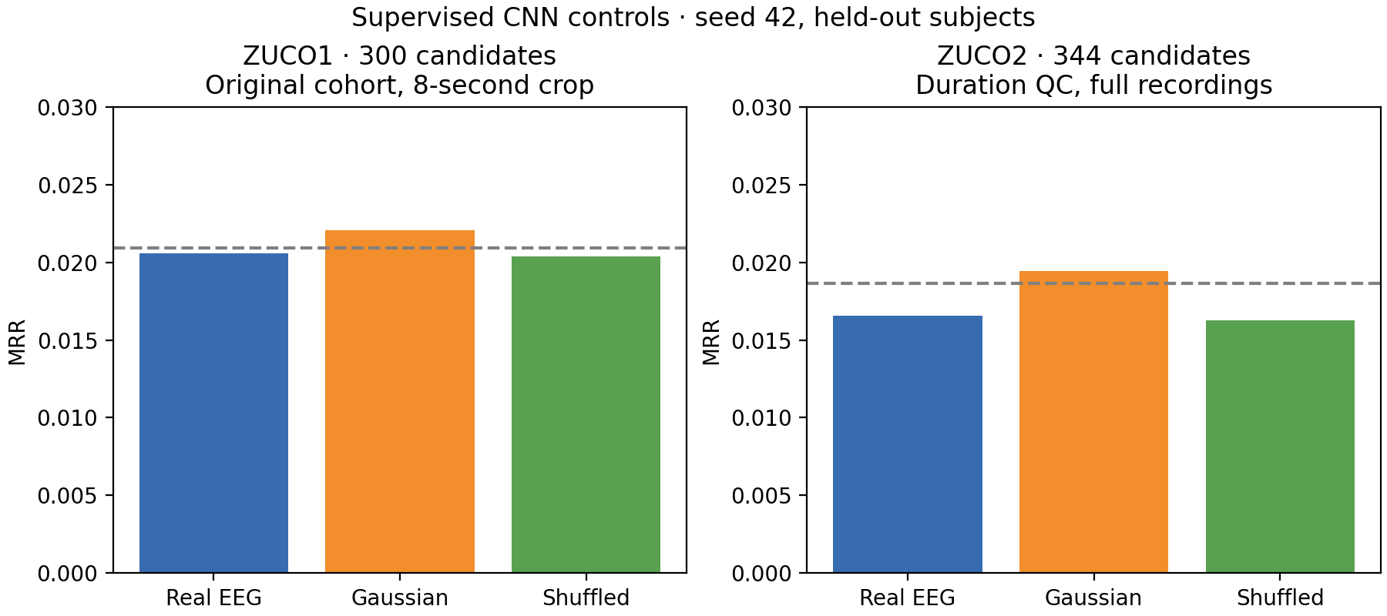
Supervised CNN: Gaussian matches top-1 hits
Seed 42 · ZuCo1: 592 queries / 300 candidates · ZuCo2: 984 / 344
Gaussian MRR exceeds real EEG in both datasets.
NEUROTEXT / REVIEW DRAFT / 29 OCT 2026
06
Notes:
Source: REPORT.md, Supervised CNN negative controls. ZuCo1 uses original cohort and an 8-second center crop; ZuCo2 uses duration QC and full recordings. These are not a controlled cross-dataset comparison. Real and Gaussian top-1 hits: 2 in ZuCo1, 3 in ZuCo2. Dashed lines are uniform random-ranking expectations, not significance thresholds.
Figure: docs/research_results/cnn_controls_mrr.png

Slide 7
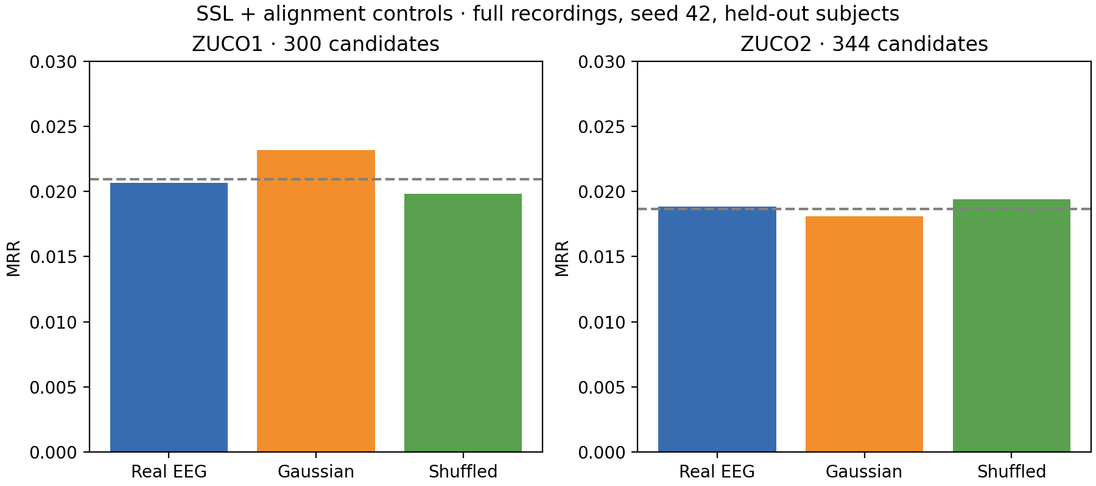
SSL: reconstruction does not establish decoding
Full recordings · duration QC · Gaussian control covers both learned stages
No consistent retrieval advantage for real EEG over the controls.
NEUROTEXT / REVIEW DRAFT / 29 OCT 2026
07
Notes:
Source: REPORT.md, Full-sentence SSL negative controls. Query/candidate counts: 592/300 and 984/344. Real/Gaussian/shuffled MRR: ZuCo1 .020680/.023159/.019842; ZuCo2 .018846/.018117/.019402. Training improvement does not imply generalization. One split; no significance claim.
Figure: docs/research_results/ssl_controls_mrr.png

Slide 8
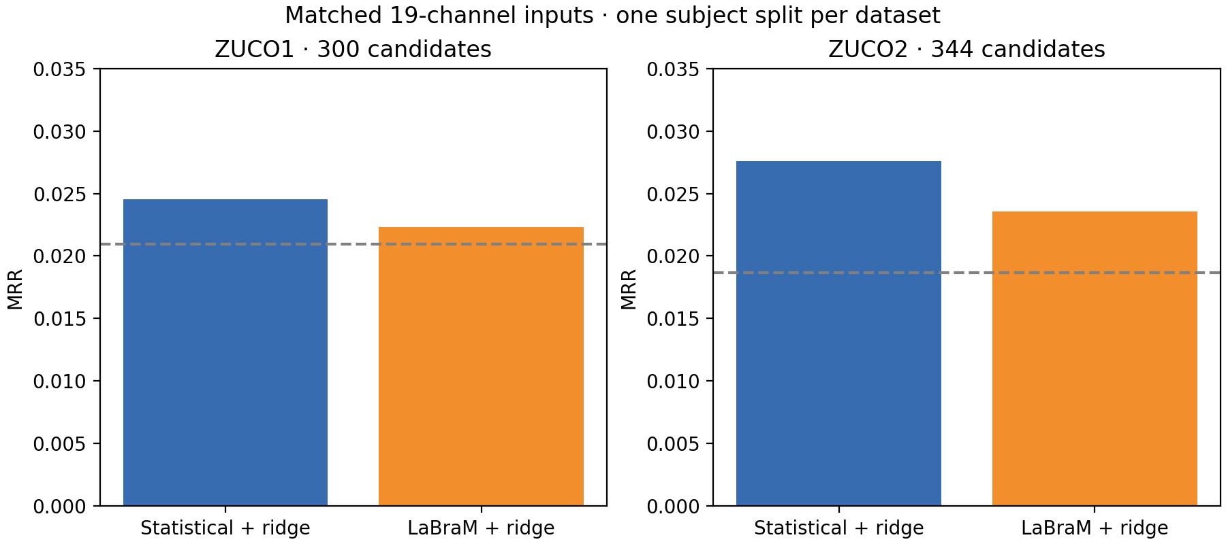
Frozen LaBraM against matched statistical features
Identical adapted signals · 19 mapped electrodes · whole-second support
Statistical features have higher top-1 and MRR on both reported splits.
NEUROTEXT / REVIEW DRAFT / 29 OCT 2026
08
Notes:
Source: REPORT.md, Matched pretrained comparison. Official weights checksum verified. Template-based mapping errors 2.11–9.40 degrees; approximate mapping and unknown upstream reference/filter details limit general conclusions. ZuCo1 592/300; ZuCo2 983/344. ZuCo1 LaBraM Recall@5/10 is higher; do not claim all metrics favor statistics.
Figure: docs/research_results/pretrained_comparison.png

Slide 9
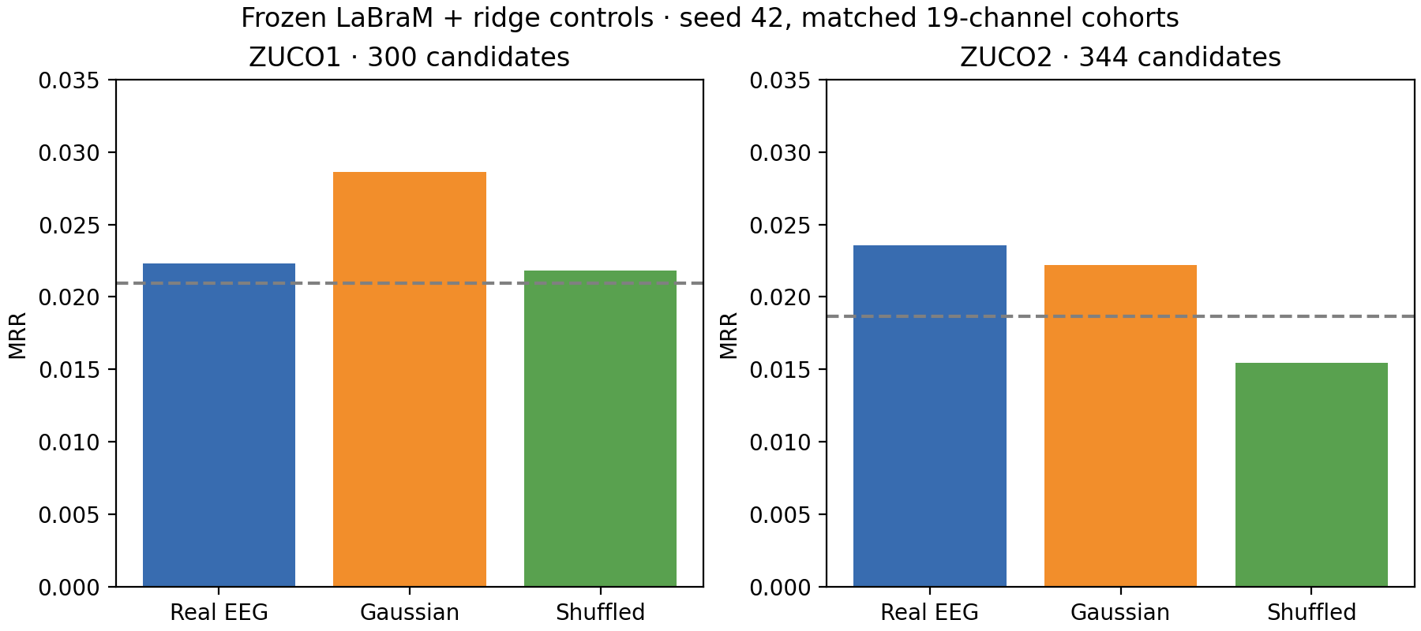
LaBraM controls limit the interpretation
Frozen backbone · separately fit ridge models · same adapted cohort and split
No consistent real-EEG superiority under this exploratory adaptation.
NEUROTEXT / REVIEW DRAFT / 29 OCT 2026
09
Notes:
Source: REPORT.md, Frozen LaBraM ridge negative controls. Gaussian MRR exceeds real in ZuCo1; ZuCo2 real MRR is slightly higher but top-1 has fewer hits (4 versus 5). Duplicate report sets are displayed once when all exported fields agree; this is not independent replication or a general verdict on LaBraM.
Figure: docs/research_results/labram_controls_mrr.png

Slide 10
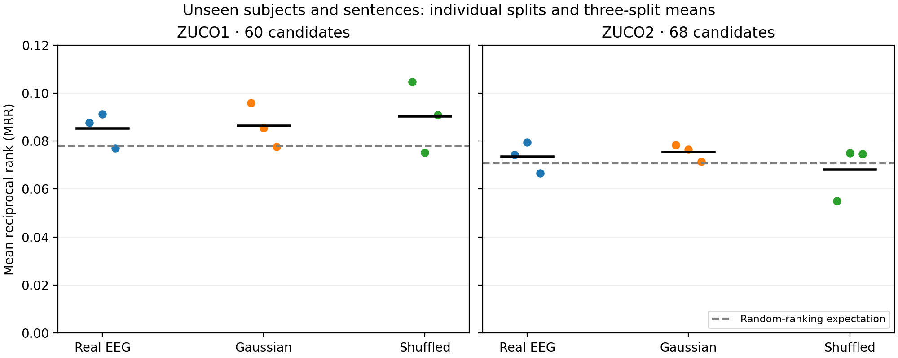
Unseen subjects and unseen sentence content
Ridge · seeds 42, 43, 44 · 60 candidates in ZuCo1 / 68 in ZuCo2
Real EEG exceeds Gaussian MRR on only one of three seeds in each dataset.
NEUROTEXT / REVIEW DRAFT / 29 OCT 2026
10
Notes:
Source: REPORT.md, Unseen subjects and unseen sentence content. Points show individual splits; report SD across splits is not a confidence interval. Splits reuse subjects and stimuli. Real/Gaussian mean MRR: .085268/.086335 in ZuCo1; .073448/.075441 in ZuCo2. Do not compare raw recall percentages against 300/344-candidate experiments.
Figure: docs/research_results/unseen_content_mrr.png

Slide 11
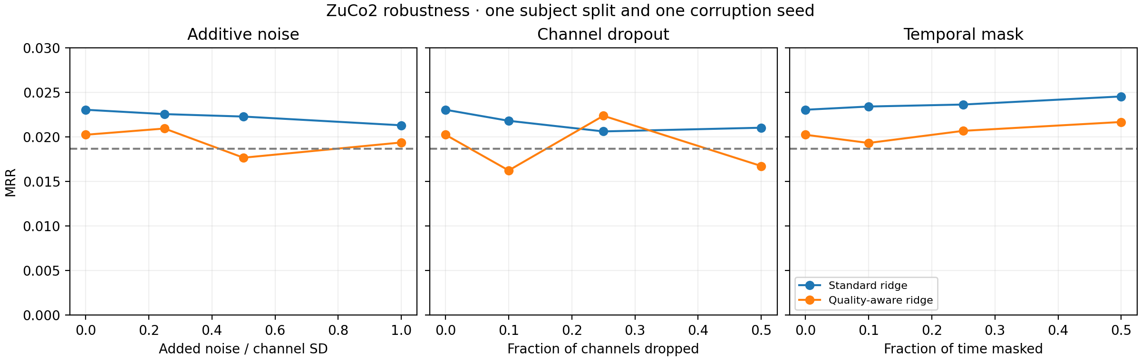
Quality weighting shows no consistent benefit
ZuCo2 ridge · 984 queries / 344 candidates · one split and corruption seed
Quality-aware MRR is lower in 8 of 9 nonzero corruption conditions.
NEUROTEXT / REVIEW DRAFT / 29 OCT 2026
11
Notes:
Source: REPORT.md, Robustness and quality weighting. Clean MRR: standard .023036, quality-aware .020230. Exception: 25% channel dropout. Nonmonotonic curves near chance do not establish beneficial signal removal. Noise, channel dropout and temporal masking have different severity units. No broad robustness claim.
Figure: docs/research_results/quality_robustness_mrr.png

Slide 12
Published work: compare protocols before scores
Generation, classification and retrieval measure different tasks
EEG-to-text papers often report BLEU / ROUGE for language generation.
LaBraM originally reports classification tasks.
Our task reports Recall@K / MRR for a fixed sentence pool.
The original AAAI 2022 repository documents an evaluation correction.
Primary-source protocol review is complete; competitive numerical ranking is unsupported.
NEUROTEXT / REVIEW DRAFT / 29 OCT 2026
12
Notes:
Sources: docs/published_work_comparison.md; docs/research_results/literature_sources.json. Wang and Ji, AAAI 2022: Open Vocabulary EEG-to-Text Decoding and Zero-shot Sentiment Classification. Official repository acknowledges evaluation correction in 2024 and directs readers to NeuSpeech. LaBraM: Jiang, Zhao and Lu, ICLR 2024. Review pins primary source revisions. This project has no protocol-matched numerical paper reproduction. Other limits: small cohorts, montage/reference uncertainty and repeated test inspection during development.

Slide 13
Exploratory transfer uses source-only selection
18 wider-grid evaluations · both directions · seeds 42, 43, 44
Train signal normalization and ridge on source training observations only.
Select alpha by source-validation MRR across seven fixed values.
Compare real EEG with separately trained Gaussian and shuffled controls.
Participant independence across releases remains unresolved.
50 shared texts remain in the target pools; strict transfer is still unexecuted.
NEUROTEXT / REVIEW DRAFT / 29 OCT 2026
13
Notes:
Source: docs/research_results/wider_grid_transfer/summary.json and configurations_and_pools.json. Grid .1,1,10,100,1000,10000,100000. Full recordings, 105 channels, 200 Hz, NR. Source-only validation chooses alpha, first maximum wins ties. No target fitting. All reports use transfer_exploratory and identity_audited:false. Different release labels do not verify different people. Inclusive target pools contain 50 shared texts.

Slide 14
Wider-grid results: ZuCo1 to ZuCo2
5,884 queries · 344 candidates · the same target cohort at every seed
Seed | Condition | Alpha | Source val MRR | Recall@1 | Target MRR
42 | Real | 100 | 0.028249 | 0.340% | 0.018732
42 | Gaussian | 100 | 0.025700 | 0.306% | 0.019507
42 | Shuffled | 100000 | 0.020376 | 0.272% | 0.018177
43 | Real | 1000 | 0.024743 | 0.255% | 0.019005
43 | Gaussian | 0.1 | 0.027825 | 0.493% | 0.020673
43 | Shuffled | 0.1 | 0.027011 | 0.238% | 0.017791
44 | Real | 0.1 | 0.022323 | 0.238% | 0.017851
44 | Gaussian | 10 | 0.020144 | 0.238% | 0.017859
44 | Shuffled | 100 | 0.022480 | 0.238% | 0.018772
Real EEG MRR is below Gaussian MRR on all three seeds.
NEUROTEXT / REVIEW DRAFT / 29 OCT 2026
14
Notes:
Source: docs/research_results/wider_grid_transfer/summary.json and configurations_and_pools.json. All nine seed-level results and source-validation winners are shown.
[{"direction": "zuco1_to_zuco2", "seed": 42, "control": "gaussian", "selected_alpha": 100.0, "validation_mrr": 0.025700484534546597, "recall_at_1": 0.0030591434398368456, "mrr": 0.019507085117496357, "n_queries": 5884, "n_candidates": 344, "shared_source_target_texts": 50, "candidate_pool_sha256": "57bbe847741650bb398d2c6964e8f69282cf968910978ca0173f8cfca6f4cca2", "text_cache_digest": "1faa646a986d32ae67f638487e4d08d038c107a67c2cf31864dea9f151177b29", "train_digest": "684aedf2641e07ec4c58e0d3f5661ad8dd2925634a975a14581bc20210a88868", "val_digest": "77b0e59c8257a6fcb19554588aa307747807aefdbe8af4b8748f17750ae1af4b", "test_digest": "7aabc0b6bf4c8fe0cbeecb4fe38b89cca803a537d3db4806872ea79459cc2726", "protocol": "transfer_exploratory", "identity_audited": false, "report": "C:\\Users\\Asus\\Desktop\\New_trends_AI_project1\\results\\exploratory_regularization_20261029\\0001_ridge_exploratory_zuco1_to_zuco2_gaussian_q0_s42\\evaluation.json"}, {"direction": "zuco1_to_zuco2", "seed": 42, "control": "real", "selected_alpha": 100.0, "validation_mrr": 0.028248771946800456, "recall_at_1": 0.003399048266485384, "mrr": 0.0187324206015878, "n_queries": 5884, "n_candidates": 344, "shared_source_target_texts": 50, "candidate_pool_sha256": "57bbe847741650bb398d2c6964e8f69282cf968910978ca0173f8cfca6f4cca2", "text_cache_digest": "1faa646a986d32ae67f638487e4d08d038c107a67c2cf31864dea9f151177b29", "train_digest": "684aedf2641e07ec4c58e0d3f5661ad8dd2925634a975a14581bc20210a88868", "val_digest": "77b0e59c8257a6fcb19554588aa307747807aefdbe8af4b8748f17750ae1af4b", "test_digest": "7aabc0b6bf4c8fe0cbeecb4fe38b89cca803a537d3db4806872ea79459cc2726", "protocol": "transfer_exploratory", "identity_audited": false, "report": "C:\\Users\\Asus\\Desktop\\New_trends_AI_project1\\results\\exploratory_regularization_20261029\\zuco1_to_zuco2_real\\evaluation.json"}, {"direction": "zuco1_to_zuco2", "seed": 42, "control": "shuffled", "selected_alpha": 100000.0, "validation_mrr": 0.02037593407518129, "recall_at_1": 0.002719238613188307, "mrr": 0.01817680342959089, "n_queries": 5884, "n_candidates": 344, "shared_source_target_texts": 50, "candidate_pool_sha256": "57bbe847741650bb398d2c6964e8f69282cf968910978ca0173f8cfca6f4cca2", "text_cache_digest": "1faa646a986d32ae67f638487e4d08d038c107a67c2cf31864dea9f151177b29", "train_digest": "684aedf2641e07ec4c58e0d3f5661ad8dd2925634a975a14581bc20210a88868", "val_digest": "77b0e59c8257a6fcb19554588aa307747807aefdbe8af4b8748f17750ae1af4b", "test_digest": "7aabc0b6bf4c8fe0cbeecb4fe38b89cca803a537d3db4806872ea79459cc2726", "protocol": "transfer_exploratory", "identity_audited": false, "report": "C:\\Users\\Asus\\Desktop\\New_trends_AI_project1\\results\\exploratory_regularization_20261029\\0002_ridge_exploratory_zuco1_to_zuco2_shuffled_q0_s42\\evaluation.json"}, {"direction": "zuco1_to_zuco2", "seed": 43, "control": "gaussian", "selected_alpha": 0.1, "validation_mrr": 0.027824949339616836, "recall_at_1": 0.004928619986403807, "mrr": 0.020673108690918658, "n_queries": 5884, "n_candidates": 344, "shared_source_target_texts": 50, "candidate_pool_sha256": "57bbe847741650bb398d2c6964e8f69282cf968910978ca0173f8cfca6f4cca2", "text_cache_digest": "1faa646a986d32ae67f638487e4d08d038c107a67c2cf31864dea9f151177b29", "train_digest": "f74b19be3cdc95c743e4f5f116754ad391f1f648930cf5544f798a34cd24ea51", "val_digest": "3eda8a777821b47439001707279fa6d0f64cb59634aeee6fbd12ee672245dc12", "test_digest": "7aabc0b6bf4c8fe0cbeecb4fe38b89cca803a537d3db4806872ea79459cc2726", "protocol": "transfer_exploratory", "identity_audited": false, "report": "C:\\Users\\Asus\\Desktop\\New_trends_AI_project1\\results\\exploratory_wider_seed43_20261029\\0001_ridge_exploratory_zuco1_to_zuco2_gaussian_q0_s43\\evaluation.json"}, {"direction": "zuco1_to_zuco2", "seed": 43, "control": "real", "selected_alpha": 1000.0, "validation_mrr": 0.024742624877177714, "recall_at_1": 0.002549286199864038, "mrr": 0.019005120103991607, "n_queries": 5884, "n_candidates": 344, "shared_source_target_texts": 50, "candidate_pool_sha256": "57bbe847741650bb398d2c6964e8f69282cf968910978ca0173f8cfca6f4cca2", "text_cache_digest": "1faa646a986d32ae67f638487e4d08d038c107a67c2cf31864dea9f151177b29", "train_digest": "f74b19be3cdc95c743e4f5f116754ad391f1f648930cf5544f798a34cd24ea51", "val_digest": "3eda8a777821b47439001707279fa6d0f64cb59634aeee6fbd12ee672245dc12", "test_digest": "7aabc0b6bf4c8fe0cbeecb4fe38b89cca803a537d3db4806872ea79459cc2726", "protocol": "transfer_exploratory", "identity_audited": false, "report": "C:\\Users\\Asus\\Desktop\\New_trends_AI_project1\\results\\exploratory_wider_seed43_20261029\\0000_ridge_exploratory_zuco1_to_zuco2_real_q0_s43\\evaluation.json"}, {"direction": "zuco1_to_zuco2", "seed": 43, "control": "shuffled", "selected_alpha": 0.1, "validation_mrr": 0.027010879607438133, "recall_at_1": 0.002379333786539769, "mrr": 0.017791229500946353, "n_queries": 5884, "n_candidates": 344, "shared_source_target_texts": 50, "candidate_pool_sha256": "57bbe847741650bb398d2c6964e8f69282cf968910978ca0173f8cfca6f4cca2", "text_cache_digest": "1faa646a986d32ae67f638487e4d08d038c107a67c2cf31864dea9f151177b29", "train_digest": "f74b19be3cdc95c743e4f5f116754ad391f1f648930cf5544f798a34cd24ea51", "val_digest": "3eda8a777821b47439001707279fa6d0f64cb59634aeee6fbd12ee672245dc12", "test_digest": "7aabc0b6bf4c8fe0cbeecb4fe38b89cca803a537d3db4806872ea79459cc2726", "protocol": "transfer_exploratory", "identity_audited": false, "report": "C:\\Users\\Asus\\Desktop\\New_trends_AI_project1\\results\\exploratory_wider_seed43_20261029\\0002_ridge_exploratory_zuco1_to_zuco2_shuffled_q0_s43\\evaluation.json"}, {"direction": "zuco1_to_zuco2", "seed": 44, "control": "gaussian", "selected_alpha": 10.0, "validation_mrr": 0.020144315883828066, "recall_at_1": 0.002379333786539769, "mrr": 0.017859127199541008, "n_queries": 5884, "n_candidates": 344, "shared_source_target_texts": 50, "candidate_pool_sha256": "57bbe847741650bb398d2c6964e8f69282cf968910978ca0173f8cfca6f4cca2", "text_cache_digest": "1faa646a986d32ae67f638487e4d08d038c107a67c2cf31864dea9f151177b29", "train_digest": "34866049f75c298077d416692e8bbe0b30044400f6c101a8d0fcb5d77d51724d", "val_digest": "c3d16e54b53fc9fe7a1c74f5557ddd12ee22ff6d99877e5132164c9ca52821a1", "test_digest": "7aabc0b6bf4c8fe0cbeecb4fe38b89cca803a537d3db4806872ea79459cc2726", "protocol": "transfer_exploratory", "identity_audited": false, "report": "C:\\Users\\Asus\\Desktop\\New_trends_AI_project1\\results\\exploratory_wider_seed44_20261029\\0001_ridge_exploratory_zuco1_to_zuco2_gaussian_q0_s44\\evaluation.json"}, {"direction": "zuco1_to_zuco2", "seed": 44, "control": "real", "selected_alpha": 0.1, "validation_mrr": 0.02232285948486181, "recall_at_1": 0.002379333786539769, "mrr": 0.01785082594993825, "n_queries": 5884, "n_candidates": 344, "shared_source_target_texts": 50, "candidate_pool_sha256": "57bbe847741650bb398d2c6964e8f69282cf968910978ca0173f8cfca6f4cca2", "text_cache_digest": "1faa646a986d32ae67f638487e4d08d038c107a67c2cf31864dea9f151177b29", "train_digest": "34866049f75c298077d416692e8bbe0b30044400f6c101a8d0fcb5d77d51724d", "val_digest": "c3d16e54b53fc9fe7a1c74f5557ddd12ee22ff6d99877e5132164c9ca52821a1", "test_digest": "7aabc0b6bf4c8fe0cbeecb4fe38b89cca803a537d3db4806872ea79459cc2726", "protocol": "transfer_exploratory", "identity_audited": false, "report": "C:\\Users\\Asus\\Desktop\\New_trends_AI_project1\\results\\exploratory_wider_seed44_20261029\\0000_ridge_exploratory_zuco1_to_zuco2_real_q0_s44\\evaluation.json"}, {"direction": "zuco1_to_zuco2", "seed": 44, "control": "shuffled", "selected_alpha": 100.0, "validation_mrr": 0.02248035896285381, "recall_at_1": 0.002379333786539769, "mrr": 0.018771661797326745, "n_queries": 5884, "n_candidates": 344, "shared_source_target_texts": 50, "candidate_pool_sha256": "57bbe847741650bb398d2c6964e8f69282cf968910978ca0173f8cfca6f4cca2", "text_cache_digest": "1faa646a986d32ae67f638487e4d08d038c107a67c2cf31864dea9f151177b29", "train_digest": "34866049f75c298077d416692e8bbe0b30044400f6c101a8d0fcb5d77d51724d", "val_digest": "c3d16e54b53fc9fe7a1c74f5557ddd12ee22ff6d99877e5132164c9ca52821a1", "test_digest": "7aabc0b6bf4c8fe0cbeecb4fe38b89cca803a537d3db4806872ea79459cc2726", "protocol": "transfer_exploratory", "identity_audited": false, "report": "C:\\Users\\Asus\\Desktop\\New_trends_AI_project1\\results\\exploratory_wider_seed44_20261029\\0002_ridge_exploratory_zuco1_to_zuco2_shuffled_q0_s44\\evaluation.json"}]

Slide 15
Wider-grid results: ZuCo2 to ZuCo1
3,349 queries · 300 candidates · the same target cohort at every seed
Seed | Condition | Alpha | Source val MRR | Recall@1 | Target MRR
42 | Real | 1000 | 0.026690 | 0.627% | 0.024933
42 | Gaussian | 1000 | 0.024125 | 0.448% | 0.023354
42 | Shuffled | 100000 | 0.019260 | 0.299% | 0.020941
43 | Real | 1000 | 0.024824 | 0.508% | 0.024221
43 | Gaussian | 1 | 0.025861 | 0.358% | 0.022323
43 | Shuffled | 1000 | 0.020172 | 0.388% | 0.021521
44 | Real | 100000 | 0.021306 | 0.388% | 0.021621
44 | Gaussian | 10 | 0.025757 | 0.567% | 0.023748
44 | Shuffled | 1 | 0.016905 | 0.418% | 0.021185
Real EEG MRR exceeds Gaussian on seeds 42 and 43; the sign reverses on seed 44.
NEUROTEXT / REVIEW DRAFT / 29 OCT 2026
15
Notes:
Source: docs/research_results/wider_grid_transfer/summary.json and configurations_and_pools.json. All nine seed-level results and source-validation winners are shown.
[{"direction": "zuco2_to_zuco1", "seed": 42, "control": "gaussian", "selected_alpha": 1000.0, "validation_mrr": 0.02412518880870484, "recall_at_1": 0.004478948939982084, "mrr": 0.023354273502327348, "n_queries": 3349, "n_candidates": 300, "shared_source_target_texts": 50, "candidate_pool_sha256": "33787a9cf7129e1a5c37160ab7bf963ff257743f1c5d81725da62172719f1334", "text_cache_digest": "1faa646a986d32ae67f638487e4d08d038c107a67c2cf31864dea9f151177b29", "train_digest": "fa88a395509406fa30e4fb57ddd55121b7ae3dc4f4f6c99ac05687e369d03233", "val_digest": "75875fd02bf1732ec839ab6312dcf0700f5b5bd9a17724a85e94d2a08116d002", "test_digest": "70c2b6fdd49be951b8c046e73a21b4fbd5f551cdcd040ddd086215e96e38c515", "protocol": "transfer_exploratory", "identity_audited": false, "report": "C:\\Users\\Asus\\Desktop\\New_trends_AI_project1\\results\\exploratory_regularization_20261029\\0004_ridge_exploratory_zuco2_to_zuco1_gaussian_q0_s42\\evaluation.json"}, {"direction": "zuco2_to_zuco1", "seed": 42, "control": "real", "selected_alpha": 1000.0, "validation_mrr": 0.026690071766045365, "recall_at_1": 0.006270528515974918, "mrr": 0.024933392827578994, "n_queries": 3349, "n_candidates": 300, "shared_source_target_texts": 50, "candidate_pool_sha256": "33787a9cf7129e1a5c37160ab7bf963ff257743f1c5d81725da62172719f1334", "text_cache_digest": "1faa646a986d32ae67f638487e4d08d038c107a67c2cf31864dea9f151177b29", "train_digest": "fa88a395509406fa30e4fb57ddd55121b7ae3dc4f4f6c99ac05687e369d03233", "val_digest": "75875fd02bf1732ec839ab6312dcf0700f5b5bd9a17724a85e94d2a08116d002", "test_digest": "70c2b6fdd49be951b8c046e73a21b4fbd5f551cdcd040ddd086215e96e38c515", "protocol": "transfer_exploratory", "identity_audited": false, "report": "C:\\Users\\Asus\\Desktop\\New_trends_AI_project1\\results\\exploratory_regularization_20261029\\0003_ridge_exploratory_zuco2_to_zuco1_real_q0_s42\\evaluation.json"}, {"direction": "zuco2_to_zuco1", "seed": 42, "control": "shuffled", "selected_alpha": 100000.0, "validation_mrr": 0.019260005090146717, "recall_at_1": 0.002985965959988056, "mrr": 0.020941217667641378, "n_queries": 3349, "n_candidates": 300, "shared_source_target_texts": 50, "candidate_pool_sha256": "33787a9cf7129e1a5c37160ab7bf963ff257743f1c5d81725da62172719f1334", "text_cache_digest": "1faa646a986d32ae67f638487e4d08d038c107a67c2cf31864dea9f151177b29", "train_digest": "fa88a395509406fa30e4fb57ddd55121b7ae3dc4f4f6c99ac05687e369d03233", "val_digest": "75875fd02bf1732ec839ab6312dcf0700f5b5bd9a17724a85e94d2a08116d002", "test_digest": "70c2b6fdd49be951b8c046e73a21b4fbd5f551cdcd040ddd086215e96e38c515", "protocol": "transfer_exploratory", "identity_audited": false, "report": "C:\\Users\\Asus\\Desktop\\New_trends_AI_project1\\results\\exploratory_regularization_20261029\\0005_ridge_exploratory_zuco2_to_zuco1_shuffled_q0_s42\\evaluation.json"}, {"direction": "zuco2_to_zuco1", "seed": 43, "control": "gaussian", "selected_alpha": 1.0, "validation_mrr": 0.025860876525447423, "recall_at_1": 0.0035831591519856674, "mrr": 0.022322610256900775, "n_queries": 3349, "n_candidates": 300, "shared_source_target_texts": 50, "candidate_pool_sha256": "33787a9cf7129e1a5c37160ab7bf963ff257743f1c5d81725da62172719f1334", "text_cache_digest": "1faa646a986d32ae67f638487e4d08d038c107a67c2cf31864dea9f151177b29", "train_digest": "51176fee8c90328b31f369e8a24742f61755d3f21083724f3974f6324cfdf41a", "val_digest": "4c3755777863f898de9459c8fce8a508b826ec5ce47c2db3a6302d39e5fed6b0", "test_digest": "70c2b6fdd49be951b8c046e73a21b4fbd5f551cdcd040ddd086215e96e38c515", "protocol": "transfer_exploratory", "identity_audited": false, "report": "C:\\Users\\Asus\\Desktop\\New_trends_AI_project1\\results\\exploratory_wider_seed43_20261029\\0004_ridge_exploratory_zuco2_to_zuco1_gaussian_q0_s43\\evaluation.json"}, {"direction": "zuco2_to_zuco1", "seed": 43, "control": "real", "selected_alpha": 1000.0, "validation_mrr": 0.024823915989668318, "recall_at_1": 0.005076142131979695, "mrr": 0.02422104830672392, "n_queries": 3349, "n_candidates": 300, "shared_source_target_texts": 50, "candidate_pool_sha256": "33787a9cf7129e1a5c37160ab7bf963ff257743f1c5d81725da62172719f1334", "text_cache_digest": "1faa646a986d32ae67f638487e4d08d038c107a67c2cf31864dea9f151177b29", "train_digest": "51176fee8c90328b31f369e8a24742f61755d3f21083724f3974f6324cfdf41a", "val_digest": "4c3755777863f898de9459c8fce8a508b826ec5ce47c2db3a6302d39e5fed6b0", "test_digest": "70c2b6fdd49be951b8c046e73a21b4fbd5f551cdcd040ddd086215e96e38c515", "protocol": "transfer_exploratory", "identity_audited": false, "report": "C:\\Users\\Asus\\Desktop\\New_trends_AI_project1\\results\\exploratory_wider_seed43_20261029\\0003_ridge_exploratory_zuco2_to_zuco1_real_q0_s43\\evaluation.json"}, {"direction": "zuco2_to_zuco1", "seed": 43, "control": "shuffled", "selected_alpha": 1000.0, "validation_mrr": 0.020171569428296832, "recall_at_1": 0.003881755747984473, "mrr": 0.021521174977861095, "n_queries": 3349, "n_candidates": 300, "shared_source_target_texts": 50, "candidate_pool_sha256": "33787a9cf7129e1a5c37160ab7bf963ff257743f1c5d81725da62172719f1334", "text_cache_digest": "1faa646a986d32ae67f638487e4d08d038c107a67c2cf31864dea9f151177b29", "train_digest": "51176fee8c90328b31f369e8a24742f61755d3f21083724f3974f6324cfdf41a", "val_digest": "4c3755777863f898de9459c8fce8a508b826ec5ce47c2db3a6302d39e5fed6b0", "test_digest": "70c2b6fdd49be951b8c046e73a21b4fbd5f551cdcd040ddd086215e96e38c515", "protocol": "transfer_exploratory", "identity_audited": false, "report": "C:\\Users\\Asus\\Desktop\\New_trends_AI_project1\\results\\exploratory_wider_seed43_20261029\\0005_ridge_exploratory_zuco2_to_zuco1_shuffled_q0_s43\\evaluation.json"}, {"direction": "zuco2_to_zuco1", "seed": 44, "control": "gaussian", "selected_alpha": 10.0, "validation_mrr": 0.025757048488592362, "recall_at_1": 0.005673335323977307, "mrr": 0.023748111833794255, "n_queries": 3349, "n_candidates": 300, "shared_source_target_texts": 50, "candidate_pool_sha256": "33787a9cf7129e1a5c37160ab7bf963ff257743f1c5d81725da62172719f1334", "text_cache_digest": "1faa646a986d32ae67f638487e4d08d038c107a67c2cf31864dea9f151177b29", "train_digest": "0996bee1104767b65186650519e447073ef6d01b5b88084fe8f57c5ccb9a018d", "val_digest": "fde7059d217bf55c1a8478d651a5cdff96a0b1d5c0dd60c48741239371ec9fff", "test_digest": "70c2b6fdd49be951b8c046e73a21b4fbd5f551cdcd040ddd086215e96e38c515", "protocol": "transfer_exploratory", "identity_audited": false, "report": "C:\\Users\\Asus\\Desktop\\New_trends_AI_project1\\results\\exploratory_wider_seed44_20261029\\0004_ridge_exploratory_zuco2_to_zuco1_gaussian_q0_s44\\evaluation.json"}, {"direction": "zuco2_to_zuco1", "seed": 44, "control": "real", "selected_alpha": 100000.0, "validation_mrr": 0.021305568487439086, "recall_at_1": 0.003881755747984473, "mrr": 0.021621465845375262, "n_queries": 3349, "n_candidates": 300, "shared_source_target_texts": 50, "candidate_pool_sha256": "33787a9cf7129e1a5c37160ab7bf963ff257743f1c5d81725da62172719f1334", "text_cache_digest": "1faa646a986d32ae67f638487e4d08d038c107a67c2cf31864dea9f151177b29", "train_digest": "0996bee1104767b65186650519e447073ef6d01b5b88084fe8f57c5ccb9a018d", "val_digest": "fde7059d217bf55c1a8478d651a5cdff96a0b1d5c0dd60c48741239371ec9fff", "test_digest": "70c2b6fdd49be951b8c046e73a21b4fbd5f551cdcd040ddd086215e96e38c515", "protocol": "transfer_exploratory", "identity_audited": false, "report": "C:\\Users\\Asus\\Desktop\\New_trends_AI_project1\\results\\exploratory_wider_seed44_20261029\\0003_ridge_exploratory_zuco2_to_zuco1_real_q0_s44\\evaluation.json"}, {"direction": "zuco2_to_zuco1", "seed": 44, "control": "shuffled", "selected_alpha": 1.0, "validation_mrr": 0.016905000897664835, "recall_at_1": 0.0041803523439832785, "mrr": 0.02118536179409562, "n_queries": 3349, "n_candidates": 300, "shared_source_target_texts": 50, "candidate_pool_sha256": "33787a9cf7129e1a5c37160ab7bf963ff257743f1c5d81725da62172719f1334", "text_cache_digest": "1faa646a986d32ae67f638487e4d08d038c107a67c2cf31864dea9f151177b29", "train_digest": "0996bee1104767b65186650519e447073ef6d01b5b88084fe8f57c5ccb9a018d", "val_digest": "fde7059d217bf55c1a8478d651a5cdff96a0b1d5c0dd60c48741239371ec9fff", "test_digest": "70c2b6fdd49be951b8c046e73a21b4fbd5f551cdcd040ddd086215e96e38c515", "protocol": "transfer_exploratory", "identity_audited": false, "report": "C:\\Users\\Asus\\Desktop\\New_trends_AI_project1\\results\\exploratory_wider_seed44_20261029\\0005_ridge_exploratory_zuco2_to_zuco1_shuffled_q0_s44\\evaluation.json"}]

Slide 16
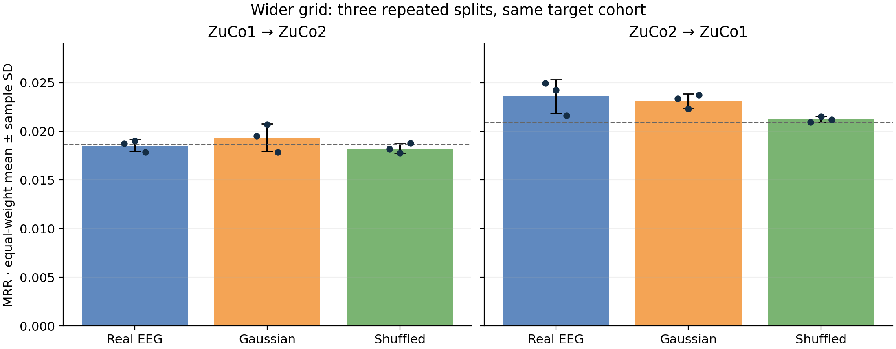
Wider-grid means remain close to controls
Equal-weight seed means · sample SD · individual seed points
Repeated splits reuse target participants and queries; SD is descriptive.
NEUROTEXT / REVIEW DRAFT / 29 OCT 2026
16
Notes:
Source: docs/research_results/wider_grid_transfer/summary.json and configurations_and_pools.json. Mean MRR ± sample SD: forward real .018529±.000603, Gaussian .019346±.001414, shuffled .018247±.000494; reverse .023592±.001743, .023142±.000736, .021216±.000291. SD uses ddof=1 across seeds. It is not a CI or standard error. Dashed lines are uniform ranking expectations, not significance thresholds. Gaussian preserves amplitude and duration.

Slide 17
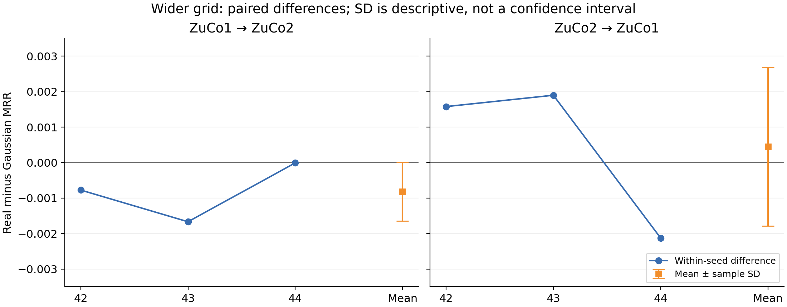
Real-minus-Gaussian differences change by seed
Pair within direction and seed before calculating mean and sample SD
Forward ΔMRR −0.000817 ± 0.000831; reverse +0.000450 ± 0.002237.
NEUROTEXT / REVIEW DRAFT / 29 OCT 2026
17
Notes:
Source: docs/research_results/wider_grid_transfer/summary.json and configurations_and_pools.json. Forward paired MRR differences: -.000774665, -.001667989, -.000008301. Reverse: +.001579119, +.001898438, -.002126646. Positive reverse differences in 2/3 seeds; forward 0/3. Same target cohorts and overlapping source splits. No independent-cohort or significance claim. Mean ΔRecall@1 pp: forward -.067981±.148161; reverse +.049766±.198815.

Slide 18
Original and wider grids are separate experiments
Seed 42 only · original grid ends at 100 · wider grid ends at 100,000
Direction | Condition | Original α / MRR | Wider α / MRR
1 to 2 | Real | 100 / 0.018732 | 100 / 0.018732
1 to 2 | Gaussian | 100 / 0.019507 | 100 / 0.019507
1 to 2 | Shuffled | 1 / 0.019001 | 100000 / 0.018177
2 to 1 | Real | 10 / 0.022941 | 1000 / 0.024933
2 to 1 | Gaussian | 100 / 0.024007 | 1000 / 0.023354
2 to 1 | Shuffled | 10 / 0.021036 | 100000 / 0.020941
Only the wider grid has seeds 42–44; do not pool the grids as extra repeats.
NEUROTEXT / REVIEW DRAFT / 29 OCT 2026
18
Notes:
Source: docs/research_results/wider_grid_transfer/original_grid_seed42.csv and summary.json. Original grid [.1,1,10,100], wider grid [.1,1,10,100,1000,10000,100000]. Original grid has only seed42 transfer; no three-seed grid-effect claim. Reverse real R1 .328% to .627% at seed42. Keep separate from original 79-report within-dataset export. No target score selected alpha.

Slide 19
Archive and recorded software validation
139 passed · 2 optional skips · 0 deselected
Full configs, candidate keys, split digests and evaluation JSON are archived.
Two official-weight tests skip because EEG_LABRAM_CACHE is unset.
Integration skip: no network download during unit tests.
Extraction skip: optional official weights on synthetic fixtures.
The previously excluded 513 MiB MATLAB test was included and passed.
Recorded validation is preserved; consolidation launches no experiments.
NEUROTEXT / REVIEW DRAFT / 29 OCT 2026
19
Notes:
Source: docs/research_results/wider_grid_transfer/summary.json and configurations_and_pools.json. Recorded command: .venv/Scripts/python.exe -m pytest -q -rs. 139 passed, 2 skipped, 0 deselected, two existing short-signal matplotlib warnings. Exact skips: tests/test_storage_and_pretrained.py::test_official_pretrained_weights_on_synthetic_input (optional official-weight integration; no network download during unit tests) and ::test_pretrained_cache_extraction (optional official-weight extraction on synthetic fixtures). EEG_LABRAM_CACHE unset. tests/test_mat5_streaming.py::test_file_above_old_limit_without_full_materialization was included and passed. Archive: archive_manifest.json, runs.csv, condition_summary.csv, paired_differences.csv, difference_summary.csv, configs/, implementation/, evaluations/.

Slide 20
These configurations do not show reliable retrieval
Matched controls and repeated splits limit the interpretation
These configurations do not demonstrate reliable retrieval beyond controls.
Forward real MRR trails Gaussian on all three seeds.
Reverse differences change sign, with only a small positive mean.
Participant independence remains unresolved; strict transfer is unexecuted.
The findings do not establish that EEG contains no semantic information.
NEUROTEXT / REVIEW DRAFT / 29 OCT 2026
20
Notes:
Source: docs/research_results/wider_grid_transfer/summary.json and configurations_and_pools.json. Conclusion concerns these tested configurations, not all EEG decoding. Same target participants and queries at every seed, overlapping source splits, shared sentences, source timing/reference uncertainties and exploratory test inspection limit inference. Original 79-row export and original-grid transfer remain separate. No new experiments were run during consolidation. Independent identity evidence and protocol-matched paper reproduction remain unresolved.

