Slide 1
NeuroText
EEG representation learning for sentence retrieval
Can EEG retrieve sentence meaning
beyond matched negative controls?
ZuCo 1.0 + 2.0 | Statistical ridge · CNN · SSL · frozen LaBraM
Ziad Elsayed | University project
Executed within-dataset results; strict cross-dataset evaluation remains pending.
NEUROTEXT / REVIEW DRAFT / 29 OCT 2026
01
Notes:
Present as a draft based on Windows RTX 3050 execution. This deck is not a completed cross-dataset study. Source: docs/research_results/REPORT.md and retrieval.csv (79 reports).

Slide 2
Define the prediction task
Fixed-pool retrieval with unseen readers
1. Encode a sentence-length EEG recording.
2. Predict its location in a frozen sentence-embedding space.
3. Rank unique candidate sentences by cosine similarity.
4. Evaluate Recall@1/5/10 and mean reciprocal rank (MRR).
Above random ranking alone is insufficient: real EEG must beat matched controls.
NEUROTEXT / REVIEW DRAFT / 29 OCT 2026
02
Notes:
Source: REPORT.md, Data and methods. The text encoder is frozen MiniLM. MRR averages reciprocal rank of the correct sentence. R@K is the fraction with the correct target in the first K positions. Pool size changes expected random performance.

Slide 3
Data preparation and quality audit
Normal reading · 105 ordered channels · resampled to 200 Hz
ZuCo 1.0
ZuCo 2.0
12 readers
3,356 prepared observations
3,349 after duration QC
18 readers
5,911 prepared observations
5,884 after duration QC
19-channel LaBraM adaptation is a separate cohort: 3,345 / 5,838 observations.
NEUROTEXT / REVIEW DRAFT / 29 OCT 2026
03
Notes:
Source: REPORT.md. ZuCo1: 3356 prepared, 7 duration-QC exclusions, 3349 retained. ZuCo2: 5911 prepared, 27 exclusions, 5884 retained. Missing source slots were separately audited. Original timing/reference/filter histories remain incompletely verified. LaBraM adaptation has different counts: 3345 and 5838, requiring whole seconds.

Slide 4
One shared, memory-conscious implementation
Windows + Colab clients use the same Python package
LOAD
REPRESENT
ALIGN
RANK
Lazy signal arrays
Audited manifests
Statistics / CNN
SSL / frozen LaBraM
Train-only scaling
Validation selection
MiniLM targets
Cosine retrieval
Local hardware: RTX 3050 with 4 GB VRAM; lazy loading limits memory use.
Shared code and documented inputs make weak results inspectable and reproducible.
NEUROTEXT / REVIEW DRAFT / 29 OCT 2026
04
Notes:
Source: REPORT.md and project source modules. Colab compatibility is implemented; actual Colab execution has not been established. Statistical features include per-channel statistics and spectral power. SSL reconstructs masked temporal blocks before alignment. Official LaBraM is frozen and verified, not fine-tuned. Local hardware: RTX 3050, 4 GB VRAM.

Slide 5
Controls make the central comparison
Hold out subjects; fit preprocessing on training observations only
Real EEG: original signals and true sentence pairing.
Gaussian: matched per-channel scale, independently generated noise.
Shuffled: separately trained model with incorrect sentence pairing.
Compare within the same cohort, split, seed and candidate pool.
Single-split differences are descriptive; no statistical significance is claimed.
NEUROTEXT / REVIEW DRAFT / 29 OCT 2026
05
Notes:
Source: REPORT.md. Gaussian noise preserves each observation’s channel standard deviations, so it retains amplitude information and is not uniform random ranking. Shuffled training labels are deranged by sentence class; evaluation labels are true. For SSL, Gaussian covers pretraining and alignment. Shuffled alignment may reuse label-free real-data pretraining. Test inspection during development means this is exploratory research.

Slide 6
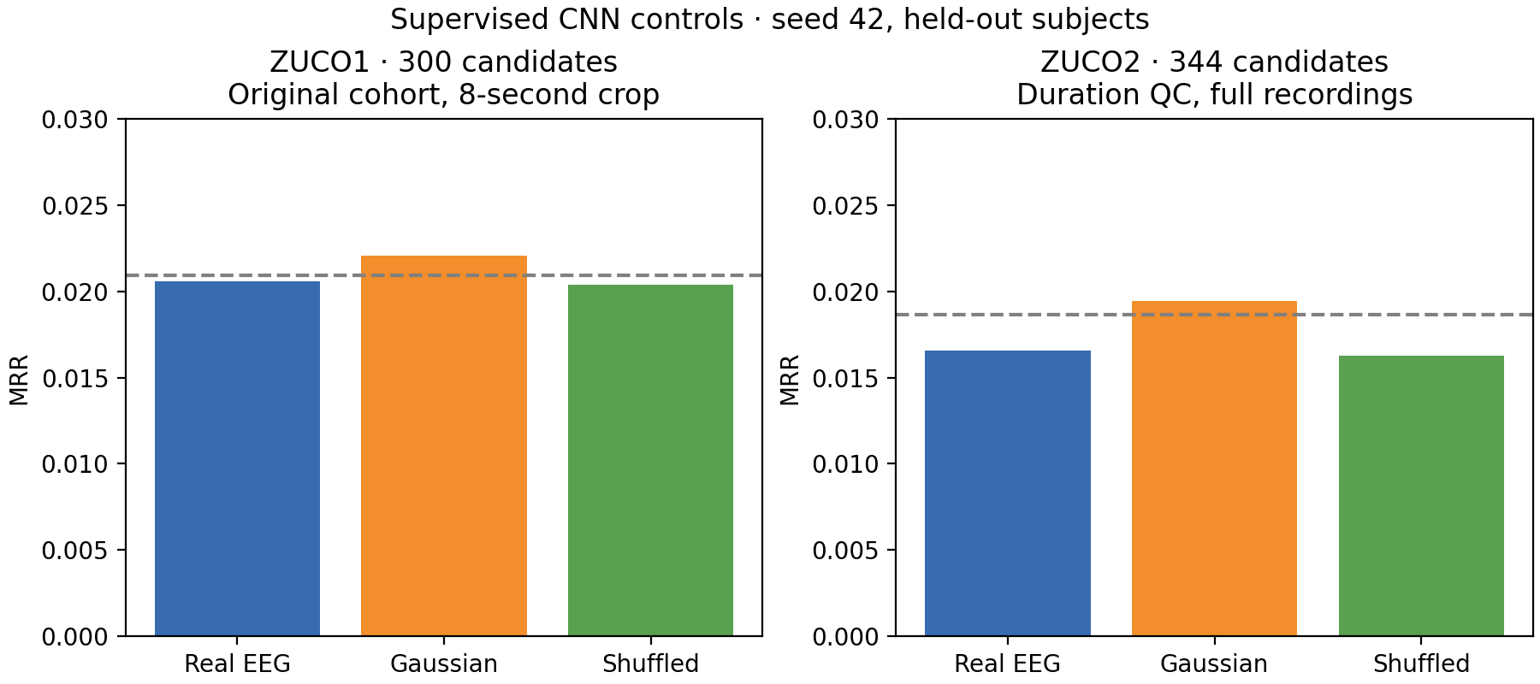
Supervised CNN: Gaussian matches top-1 hits
Seed 42 · ZuCo1: 592 queries / 300 candidates · ZuCo2: 984 / 344
Gaussian MRR exceeds real EEG in both datasets.
NEUROTEXT / REVIEW DRAFT / 29 OCT 2026
06
Notes:
Source: REPORT.md, Supervised CNN negative controls. ZuCo1 uses original cohort and an 8-second center crop; ZuCo2 uses duration QC and full recordings. These are not a controlled cross-dataset comparison. Real and Gaussian top-1 hits: 2 in ZuCo1, 3 in ZuCo2. Dashed lines are uniform random-ranking expectations, not significance thresholds.
Figure: docs/research_results/cnn_controls_mrr.png

Slide 7
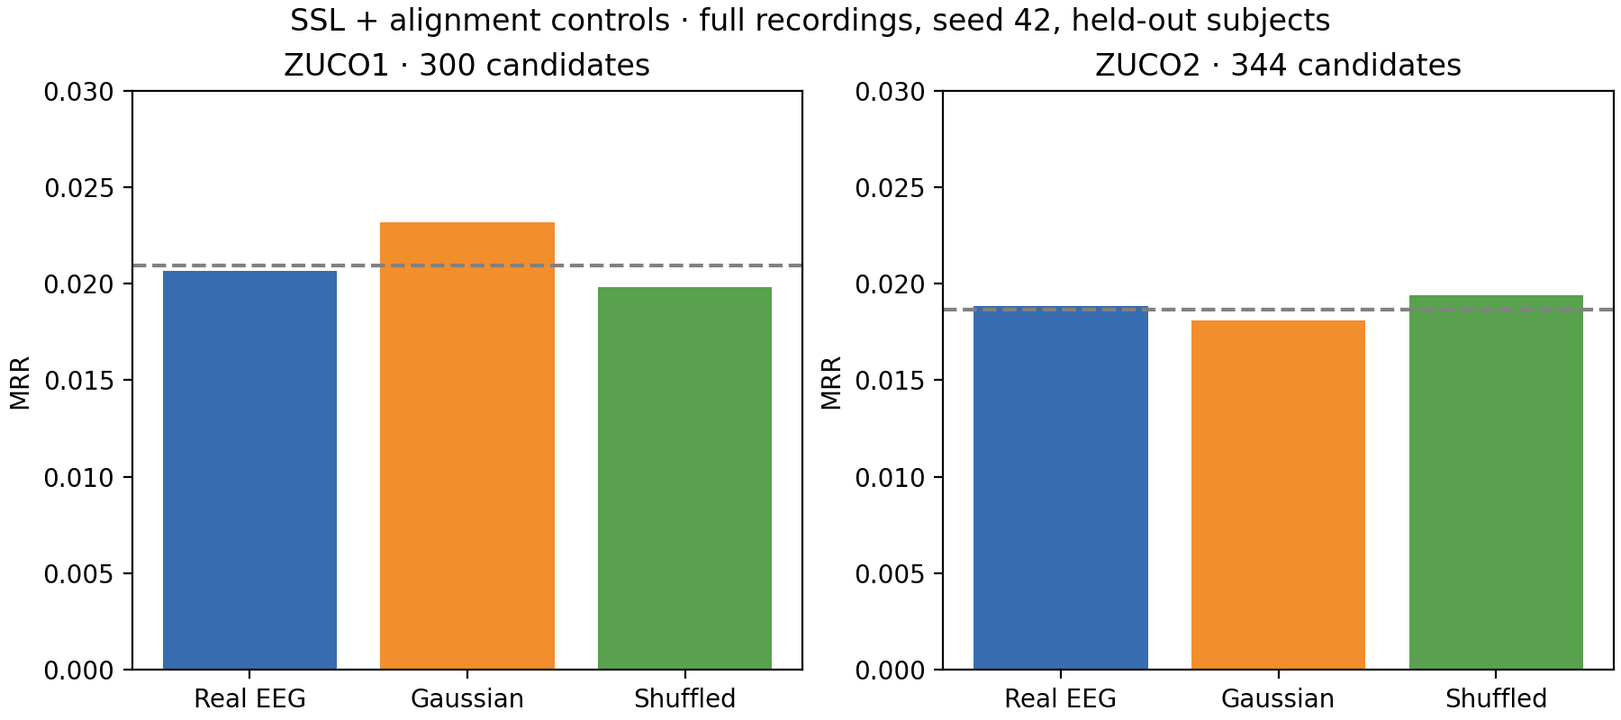
SSL: reconstruction does not establish decoding
Full recordings · duration QC · Gaussian control covers both learned stages
No consistent retrieval advantage for real EEG over the controls.
NEUROTEXT / REVIEW DRAFT / 29 OCT 2026
07
Notes:
Source: REPORT.md, Full-sentence SSL negative controls. Query/candidate counts: 592/300 and 984/344. Real/Gaussian/shuffled MRR: ZuCo1 .020680/.023159/.019842; ZuCo2 .018846/.018117/.019402. Training improvement does not imply generalization. One split; no significance claim.
Figure: docs/research_results/ssl_controls_mrr.png

Slide 8
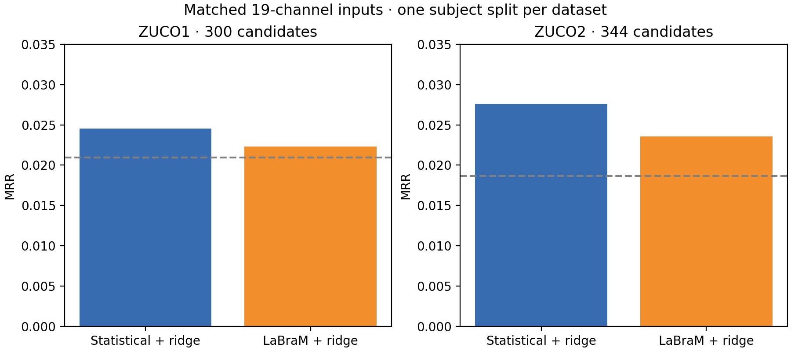
Frozen LaBraM against matched statistical features
Identical adapted signals · 19 mapped electrodes · whole-second support
Statistical features have higher top-1 and MRR on both reported splits.
NEUROTEXT / REVIEW DRAFT / 29 OCT 2026
08
Notes:
Source: REPORT.md, Matched pretrained comparison. Official weights checksum verified. Template-based mapping errors 2.11–9.40 degrees; approximate mapping and unknown upstream reference/filter details limit general conclusions. ZuCo1 592/300; ZuCo2 983/344. ZuCo1 LaBraM Recall@5/10 is higher; do not claim all metrics favor statistics.
Figure: docs/research_results/pretrained_comparison.png

Slide 9
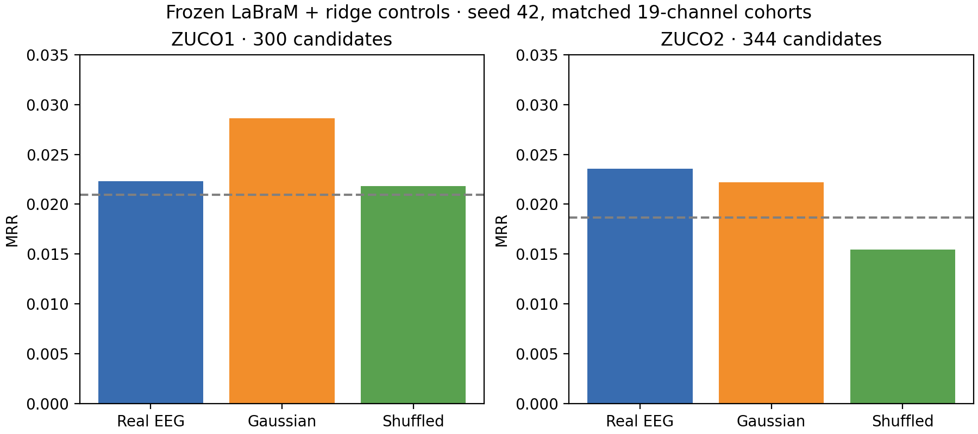
LaBraM controls limit the interpretation
Frozen backbone · separately fit ridge models · same adapted cohort and split
No consistent real-EEG superiority under this exploratory adaptation.
NEUROTEXT / REVIEW DRAFT / 29 OCT 2026
09
Notes:
Source: REPORT.md, Frozen LaBraM ridge negative controls. Gaussian MRR exceeds real in ZuCo1; ZuCo2 real MRR is slightly higher but top-1 has fewer hits (4 versus 5). Duplicate report sets are displayed once when all exported fields agree; this is not independent replication or a general verdict on LaBraM.
Figure: docs/research_results/labram_controls_mrr.png

Slide 10
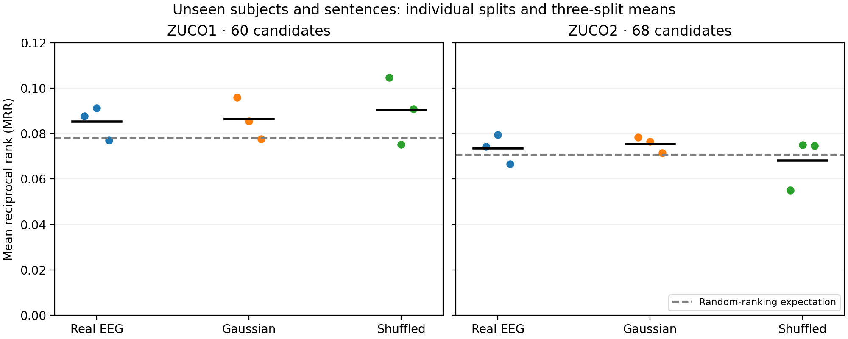
Unseen subjects and unseen sentence content
Ridge · seeds 42, 43, 44 · 60 candidates in ZuCo1 / 68 in ZuCo2
Real EEG exceeds Gaussian MRR on only one of three seeds in each dataset.
NEUROTEXT / REVIEW DRAFT / 29 OCT 2026
10
Notes:
Source: REPORT.md, Unseen subjects and unseen sentence content. Points show individual splits; report SD across splits is not a confidence interval. Splits reuse subjects and stimuli. Real/Gaussian mean MRR: .085268/.086335 in ZuCo1; .073448/.075441 in ZuCo2. Do not compare raw recall percentages against 300/344-candidate experiments.
Figure: docs/research_results/unseen_content_mrr.png

Slide 11
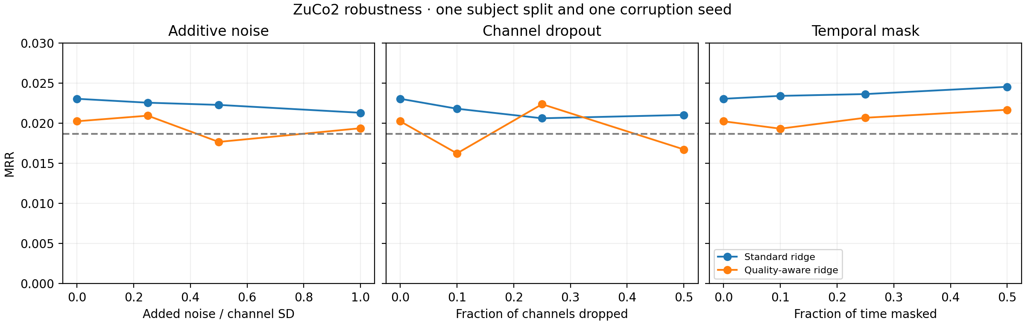
Quality weighting shows no consistent benefit
ZuCo2 ridge · 984 queries / 344 candidates · one split and corruption seed
Quality-aware MRR is lower in 8 of 9 nonzero corruption conditions.
NEUROTEXT / REVIEW DRAFT / 29 OCT 2026
11
Notes:
Source: REPORT.md, Robustness and quality weighting. Clean MRR: standard .023036, quality-aware .020230. Exception: 25% channel dropout. Nonmonotonic curves near chance do not establish beneficial signal removal. Noise, channel dropout and temporal masking have different severity units. No broad robustness claim.
Figure: docs/research_results/quality_robustness_mrr.png

Slide 12
Published work: compare protocols before scores
Generation, classification and retrieval measure different tasks
EEG-to-text papers often report BLEU / ROUGE for language generation.
LaBraM originally reports classification tasks.
Our task reports Recall@K / MRR for a fixed sentence pool.
The original AAAI 2022 repository documents an evaluation correction.
Primary-source protocol review is complete; competitive numerical ranking is unsupported.
NEUROTEXT / REVIEW DRAFT / 29 OCT 2026
12
Notes:
Sources: docs/published_work_comparison.md; docs/research_results/literature_sources.json. Wang and Ji, AAAI 2022: Open Vocabulary EEG-to-Text Decoding and Zero-shot Sentiment Classification. Official repository acknowledges evaluation correction in 2024 and directs readers to NeuSpeech. LaBraM: Jiang, Zhao and Lu, ICLR 2024. Review pins primary source revisions. This project has no protocol-matched numerical paper reproduction. Other limits: small cohorts, montage/reference uncertainty and repeated test inspection during development.

Slide 13
Cross-dataset transfer: prepared, not executed
Both directions remain pending participant identity evidence
Prepared: 9,233 signal references and 594 shared sentence targets.
Directions: ZuCo1 → ZuCo2 and ZuCo2 → ZuCo1.
Pending: verify whether the same people appear in both releases.
Then: reconcile identities and fit / select models on the source only.
Preparation is successful; it is not an executed transfer result.
NEUROTEXT / REVIEW DRAFT / 29 OCT 2026
13
Notes:
Source: user execution transcript, transfer_plan_20261029_213051/plan.json summary. 9233 observations; 594 unique targets; text cache rebuilt at MiniLM revision 1110a243fdf4706b3f48f1d95db1a4f5529b4d41. The summary has been supplied, not the full plan JSON. No EEG copies or training. Maintainer inquiry was sent by the user; no response supplied. Different dataset ID prefixes do not establish participant independence. Existing selected NR manifests have 50 shared canonical texts; transfer must disclose overlap. Original signals and completed results are preserved.

Slide 14
Conclusion and remaining work
A reproducible negative result with explicit limits
Finding: tested representations do not show reliable retrieval beyond controls.
Contribution: modular pipeline, audited data, matched controls and clear limits.
Remaining: identity evidence, strict transfer experiments and final review.
Archive: original evaluation JSON, configs, splits and checkpoints.
These findings do not establish that EEG contains no semantic information.
NEUROTEXT / REVIEW DRAFT / 29 OCT 2026
14
Notes:
Sources: REPORT.md; archived retrieval.csv, 79 executed evaluation reports including duplicates and robustness conditions, not 79 independent methods. Software validation 121 passed; synthetic tests verify software and do not prove scientific accuracy. Remaining: independent identity evidence, strict transfer in both directions, original JSON/config/checkpoint audit and final submission review.

