Slide 1
M110: Python Programming Meeting #1 Algorithms Flowcharts & Pseudocodes
Prepared by Dr. Ahmad Mikati

Slide 2
Contents
Introduction
1.1 Algorithm
1.2 Flowcharts
1.3 Pseudocodes
Summary

Slide 3
Introduction
Throughout history, man has thought of ever more elegant ways of reducing the amount of labor needed to do things.
A computer has immense potential for saving time/energy, as most (computational) tasks that are repetitive or can be generalized can be done by a computer.
For a computer to perform a desired task, a method for carrying out some sequence of events, resulting in accomplishing the task, must be described to the computer.
An algorithm.

Slide 4
Introduction
Good, logical programming is developed through good pre-code planning and organization (Algorithm) using:
Pseudocode
Flowcharts
In this tutorial, you will learn two different ways of laying out a computer algorithm independent of programming language

Slide 5
Algorithm
An algorithm is an ordered set of unambiguous steps that describes a process.
An algorithm can be implemented in more than one programming language.
Examples from real life:
Recipes
Project directions - chemistry lab, writing prompt
Instruction manual

Slide 6
Algorithm
Characteristics of an Algorithm
An algorithm should have the following characteristics:
Unambiguous − Algorithm should be clear and unambiguous. Each of its steps (or phases), and their inputs/outputs should be clear and must lead to only one meaning.
Input − An algorithm should have 0 or more well-defined inputs.
Output − An algorithm should have 1 or more well-defined outputs and should match the desired output.
Finiteness − Algorithms must terminate after a finite number of steps.
Feasibility − Should be feasible with the available resources.
Independent − An algorithm should have step-by-step directions, which should be independent of any programming code.

Slide 7
Algorithm
How to Write an Algorithm
1. Define the problem: State the problem you are trying to solve in clear and concise terms.
2. List the inputs (information needed to solve the problem) and the outputs (what the algorithm will produce as a result)
3. Describe the steps needed to convert or manipulate the inputs to produce the outputs. Start at a high level first and keep refining the steps until they are effectively computable operations.
4. Test the algorithm: choose data sets and verify that your algorithm works!

Slide 8
Programming Tools
Algorithms are implemented using programming languages.
Programs are written in a programming language such as Java or Python, which is then converted into machine code for the computer to run.
Algorithms can be designed using flowcharts or pseudocodes.
Flowchart - Graphically depicts the logical steps to carry out a task and shows how the steps relate to each other.
Pseudocode - Uses English-like phrases to outline the program.

Slide 9
Flowcharts
Flowcharting is a tool developed in the computer industry, for showing the operation of an algorithm.
A flowchart is a diagram made up of shapes (boxes, diamonds,…) connected by arrows:
Each shape represents a step in the process.
Arrows show the order in which they occur.

Slide 10
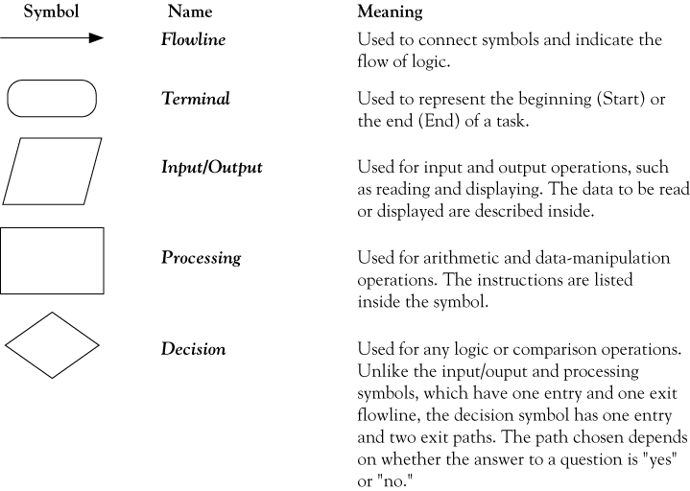
Flowchart symbols

Slide 11
Flowcharts
General Rules for flowcharting
All boxes of the flowchart are connected with Arrows (Not lines).
Flowchart symbols have an entry point on the top of the symbol with no other entry points. The exit point for all flowchart symbols is on the bottom except for the Decision symbol.
The Decision symbol has two exit points; these can be on the sides or the bottom and one side.
Generally, a flowchart will flow from top to bottom. However, an upward flow can be shown as long as it does not exceed 3 symbols.
Connectors are used to connect breaks in the flowchart. Examples are:
From one page to another page.
From the bottom of the page to the top of the same page.
An upward flow of more then 3 symbols
Subroutines and Interrupt programs have their own and independent flowcharts.
All flow charts start and end with a Terminal symbol.

Slide 12
Pseudocode
Pseudocode is one of the tools that can be used to write a preliminary plan that can be developed into a computer program.
Pseudocode is a generic way of describing an algorithm without use of any specific programming language syntax.
It is pseudo code, it cannot be executed on a real computer, but it models and resembles real programming code and is written at roughly the same level of detail.
In the algorithm design, the steps of the algorithm are written in free English text, and they may be as long as needed to describe the particular operation.
Many languages, such as Pascal, Python, have a syntax that is almost identical to pseudocode and hence make the transition from design to coding extremely easy.

Slide 13
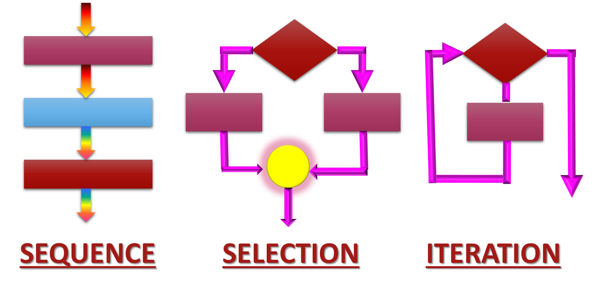
Statement structures
Sequence – follow instructions from one line to the next without skipping over any lines
Decision - if the answer to a question is “Yes” then one group of instructions is executed. If the answer is “No,” then another is executed
Looping – a series of instructions are executed over and over

Slide 14
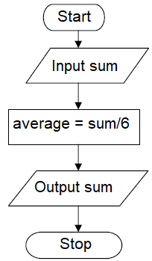
The Sequence Structure
The sequence structure is a case where the steps in an algorithm are constructed in such a way that, no condition step is required.
For example, suppose you are required to design an algorithm for finding the average of six numbers, and the sum of the numbers is given.
The pseudocode and its corresponding flowchart will be as follows:
Start
Use variables sum, average
Input sum
average = sum / 6
Output the average
Stop

Slide 15
The Sequence Structure
The following pseudo-code describes an algorithm which will accept two numbers from the keyboard and calculate the sum and product Printing the answer on the monitor screen.
Start
Use variables sum, product, number1, number2
Input number1, number2
sum = number1 + number2
print sum
product = number1 * number2
print product
Stop

Slide 16
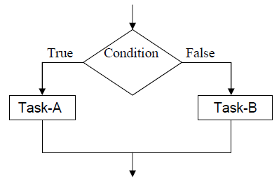
The Decision Structure
The decision (selection) structure is case where in the algorithm, one has to make a choice of two alternatives by making decision depending on a given condition.
Selection structures are also called case selection structures when there are two or more alternatives to choose from.
In pseudocode form we get
IF condition is true
task A
ELSE
task-B

Slide 17
The Decision Structure
Example:
Write an algorithm of a program that reads from the user an integer and displays on the screen a message if this integer is odd or even.
Solution:
Start
Use variable: number
Input number
IF number mod 2 = 0
print (“The number is even”)
ELSE
print (“The number is odd”)
Stop

Slide 18
The Decision Structure
Example:
Write an algorithm to do the following:
Read from the user two values representing the height and base of a triangle.
Check if the user entered positive values (i.e. greater than 0), then calculate and print the area of the triangle. Otherwise, print a message that the values should be positive and do not calculate that area.
The area of triangle is calculated as: ½ (base)(height)

Slide 19
The Decision Structure
Solution:
Start
Use variable: base, height, area
Input base
Input height
IF base >0 and height >0
area = ½ (base)(height)
print (area)
ELSE
print (“You should enter positive numbers”)
Stop

Slide 20
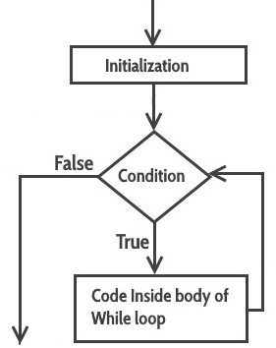
Repetition
Repetition or Iteration Structure
Any program instruction that repeats some statement or sequence of statements several times is called an iteration or a loop.
The commands used to create iterations or loops are all based on logical tests.
The repetition structure can be done with the while loop.
The While loop: is used to repeat a statement or a set of statements as long as a condition is true.
The pseudocode syntax and flowchart of the while loop are:
WHILE (condition)
A statement or block of statements
ENDWHILE

Slide 21
Repetition
Example:
Write the pseudocode for reading the values of 6 test scores and finding their sum.
Solution 1: (impractical!)
a) Pseudocode
1. Start
2. sum = 0
3. Get the 1st testscore
4. Add first testscore to sum
5. Get the 2nd testscore
6. Add to sum
7. Get the 3rd testscore
8. Add to sum
9. Get the 4th testscore
10. Add to sum
11. Get the 5th testscore
12. Add to sum
13. Get the 6th testscore
14. Add to sum
15. Output the sum
16. Stop
Notice that there are repeated steps in the solution.
You should use a loop.

Slide 22
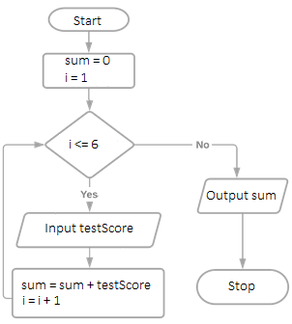

Repetition
Solution 2:
a) Pseudocode
b) Flowchart
Start
Use variable: testScore, sum, i
sum= 0
i = 1
WHILE( i<=6)
Input testScore
sum = sum + testScore
i = i + 1
ENDWHILE
Output sum
Stop

Slide 23
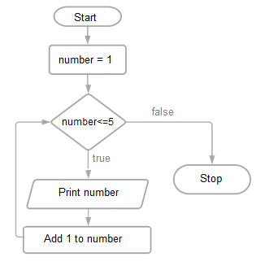
Repetition
Example:
Write a pseudo-code and a flowchart for a program that prints the numbers from 1 to 5.
Solution:
a) Pseudocode
b) Flowchart
Use variable: number
number = 1
WHILE number <= 5
Print number
Add 1 to number
ENDWHILE

Slide 24
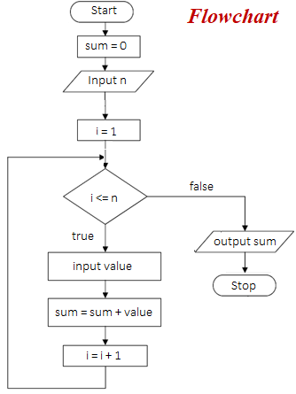
Repetition
Example:
Design a pseudocode and the corresponding flowchart for finding the sum of n numbers, where n is a value to read from the user.
Solution:
Pseudocode
Start
Use variable: value, sum, n, i
sum = 0
i = 1
Input n
WHILE (i <= n)
Input value
sum = sum + value
i= i+1
ENDWHILE
Output sum
Stop

Slide 25
Extra Examples on Pseudocodes and Flowcharts

Slide 26
Example 1
Write a pseudocode to print out each character typed at a keyboard until the character ‘q’ is entered. (i.e., The program reads characters and print them until ‘q’ in entered).
Problem explanation:
This is an example of sentinel-controlled repetition (indefinite repetition) because the number of repetitions is not known before the loop begins executing.
A special value called a sentinel value can be used to indicate “end of data entry” or a “condition of termination”.
A sentinel value must be chosen that cannot be confused with an acceptable input value.

Slide 27
Example 1- Solution
Pseudocode
Use variable: letter
Print “Type in a character or ‘q’ to stop”
Input letter
WHILE letter <> ‘q’
Print letter
Print “Type in a character or ‘q’ to stop”
Input letter
ENDWHILE

Slide 28
Example 2
Design a pseudocode that will output the square of any number input until the number input is zero.
Solution:
Use variable: number, square
Print “Type in a number or zero to stop”
Input number
WHILE number <> 0
square = number * number
Print square
Print “Type in a number or zero to stop”
Input number
ENDWHILE

Slide 29
Example 3
Design the pseudocode and flowchart for a program that reads the grades of several students in a class and calculates the grade-point average for the class. The total number of students is unknown, and the program should stop reading grades when the user enters -1.

Slide 30
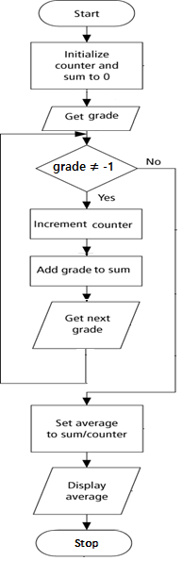
Example 3- Solution
Pseudocode
Start
Use variable: counter , grade, sum, average
Initialize counter to 0
Initialize sum to 0
Print “Type in a grade or -1 to stop”
Input grade
WHILE grade ≠ -1
Add the Grade to the Sum
Increment the Counter
Print “Type in a grade or -1 to stop”
Input grade
ENDWHILE
Average = Sum / Counter
Print Average
Stop
Flowchart

Slide 31
Summary
Laying out an algorithm using flowcharts and pseudo-code
Learning basic elements of algorithms:
Input
Output
Decision-Making
Repetition
Processes

Slide 32
Extra Exercises
Write an algorithm (pseudocode or a flowchart) to do the following:
Read two numbers from the user. Check if the user entered values greater than Zero, then display the sum of both numbers; otherwise display the multiplication of both numbers. Print “Finish”.
Read from the user a student’s grades in TMA, MTA and final exam. The program should calculate the total grade and displays in the screen if the student passed or not. A student passes a course if the total grade is 50 or more.
Read three scores (quiz, midterm, and final). Calculate the total score and determine and print the grade based on the following rules:
if the total score >= 90 → grade=A
if the total score >= 70 and <90 → grade=B
if the total score>=50 and <70 → grade=C
if the total score<50 → grade=F

Slide 33
Extra Exercises
Print all odd numbers from 1 to 100.
Print all even numbers from 1 to 100.
Prompts the user to enter 10 positive numbers. Find and print the biggest number entered by the user.
Prompt the user to enter positive numbers (0 to stop). find and print the smallest number entered by the user.
Read from the user 10 words. Count and print the number of words that start with character ‘a’.
Read from the user words (“finish” to stop). Count and print the number of words that start with character ‘a’.
Print the multiplication table for 6:
1 x 6 = 6
2 x 6 = 12
3 x 6 = 18
…
12 x 6 = 72

