Slide 1

Glove For Deaf
AMIT Graduation Project ‘69

Slide 2
Team Member
1 . Ziad Mohammed Fathi : zizo.alprnc.90@gmail.com
2 . Mahmoud Maher AbdElbary : mmah2371@gmail.com
3 .Ebram Solimam : ebramsolimam@gmail.com

Slide 3
Detalis
Making a glove to read the hand signs of deaf people to know are they saying by displaying the sentence on LCD.
There are 7 signs needed to be considered, they are: “I love you”, “You”, “I watch you”, “I really love you”, “I wish you good life”, “That is fantastic” and “Good job”.
We need to save the sentences in an EEPROM, we used the internal one to store in it our signs.
We also need to display on the LCD on both lines due to the long sentences.

Slide 4
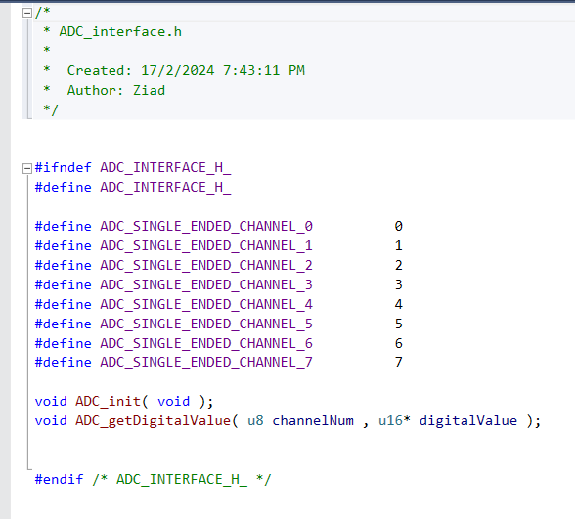
1 . ADC

Slide 5
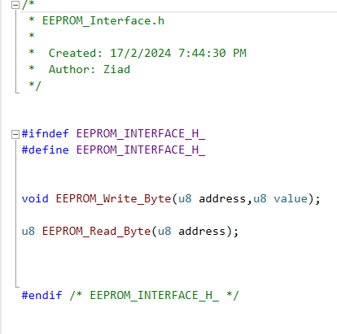
2 . EEPROM

Slide 6
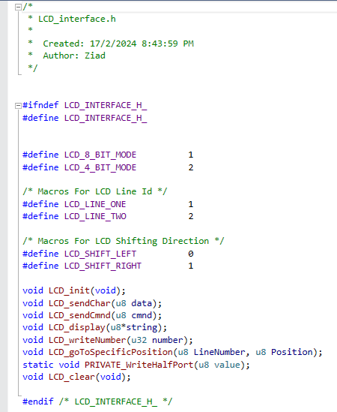
3 . LCD

Slide 7
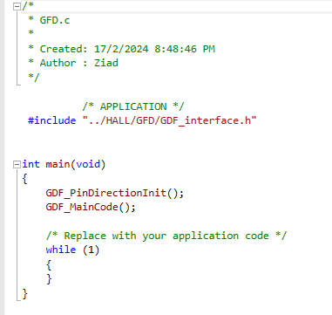
Main Functions

Slide 8
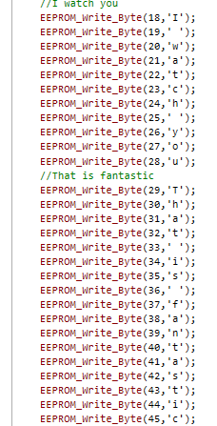
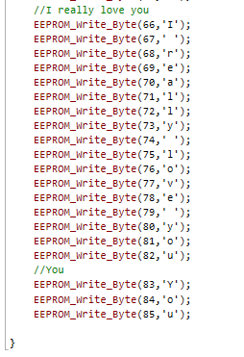
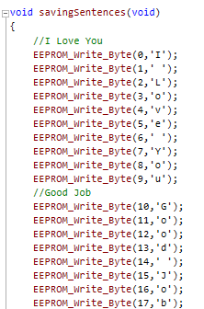
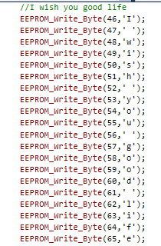
Main Project Code
Saving sentences in EEPROM

Slide 9
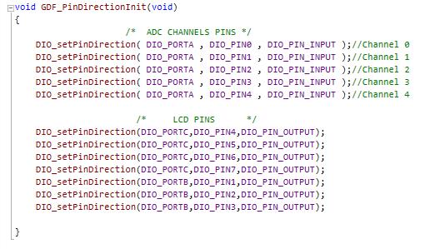
Setting Pins

Slide 10
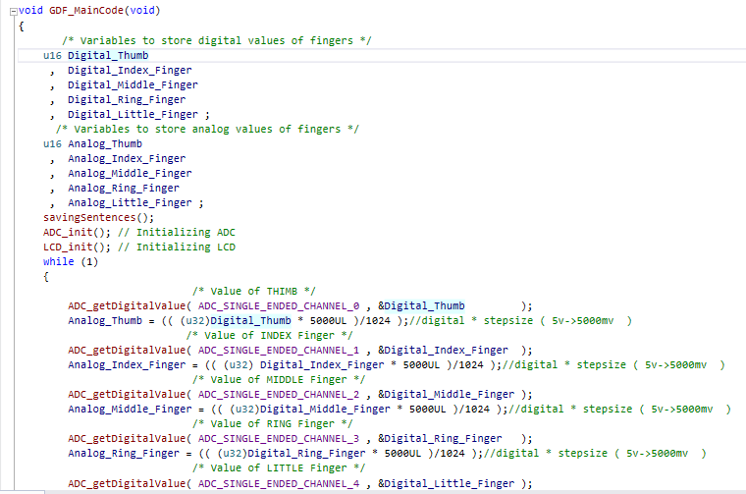
Main Code

Slide 11
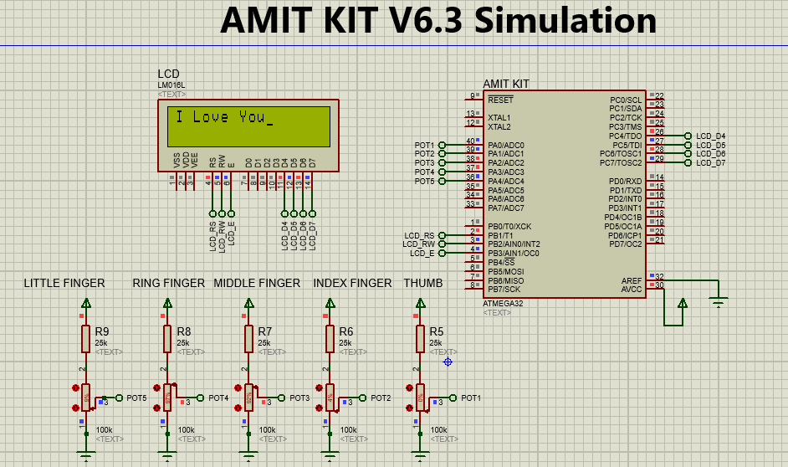
Simulation

Slide 12


