Slide 1


Robotics Corner
Getting Started with ROS2!

Slide 2


Agenda
ROS2 Environment Setup
Python Or C++?!
Hierarchy
Nodes and Topics
Publisher and Subscriber with C++

Slide 3


1 ROS2 Environment setup
After installing ROS2 Version
How to make sure it is installed correctly?!
List all distros installed

Slide 4
1 ROS2 Environment setup
What is sourcing, why it is necessary ?!
A- Sourcing is necessary to be able to use ROS2 commands in terminal (to make the terminal familiar with specific ROS Distro)
>> source /opt/ros/foxy/setup.bash In every terminal ??
~/.bashrc

Slide 5

1 ROS2 Environment setup
Can we have multiple ROS distros on the same local device?
If yes, can we have multiple of them active? Environment variable conflict !!

Slide 6
1 ROS2 Environment setup
1
Restrict communication and hide my ROS processes
ROS_LOCALHOST_ONLY
0
Make my ROS Processes visible to different devices on the same network
How to set the variable and connect with different devices?
>>export <VAR>=<Value>
Don't forget to export in ~/.bashrc if needed and use >>echo <VAR>

Slide 7

1 ROS2 Environment setup
Network
1
2
Ip1: 192.168.1.X
Ip2: 192.168.1.Y
1-Set the ROS_DOMAIN_ID 2-Ping

Slide 8
2
Python or C++?!
 | Python | C++
Pros | -Faster to build -No need for compilation -easier to learn | -Faster to run -Error detection early stage -Used in industry
Cons | -Slower in runtime due to compilation while running | -More complex than python

Slide 9
3 ROS2 Hierarchy
What is Colcon ?
What is a ROS Workspace ?
What is a ROS Package ?

Slide 10
3 ROS2 Hierarchy
What is Colcon ?
What is a ROS Workspace ?
What is a ROS Package ?
Colcon is a building tool that helps us speed up the process
colcon build Vs
colcon build --symlink-install
Compiling Source Code
Organizing Output
Resolving dependencies

Slide 11
3 ROS2 Hierarchy
What is Colcon ?
What is a ROS Workspace ?
What is a ROS Package ?
ROS Workspace is a directory structure that contains some different folders inside it, some for the source code (src/), some for intermediate files generated during the building process (build/), some for compiled and installed files (executables, libraries, etc..) which is found at (install/), and folder contains information for the building process at (log/)
ros2_ws/
src/
build/
install/
log/

Slide 12
3 ROS2 Hierarchy
What is Colcon ?
What is a ROS Workspace ?
What is a ROS Package ?
Organizational unit for ROS2 code, but where it is located?!
ros2_ws/
src/
build/
install/
log/
my_pkg/

Slide 13
3 ROS2 Hierarchy
What is Colcon ?
What is a ROS Workspace ?
What is a ROS Package ?
ros2_ws/
How to build ?
src/
build/
install/
log/
my_pkg/
CMakeLists.txt include/my_pkg/ package.xml src/
^{Python based} ros2 pkg create --build-type ament_python <package_name>
C++ based
ros2 pkg create --build-type ament_cmake <package_name>

Slide 14
3 ROS2 Hierarchy
What is Colcon ?
What is a ROS Workspace ?
What is a ROS Package ?
ros2_ws/
src/
build/
install/
log/
CMakeLists.txt include/my_pkg/ package.xml src/
how to build the code within the package
containing the public headers for the package meta information about the package
containing the source code for the package
my_pkg/

Slide 15
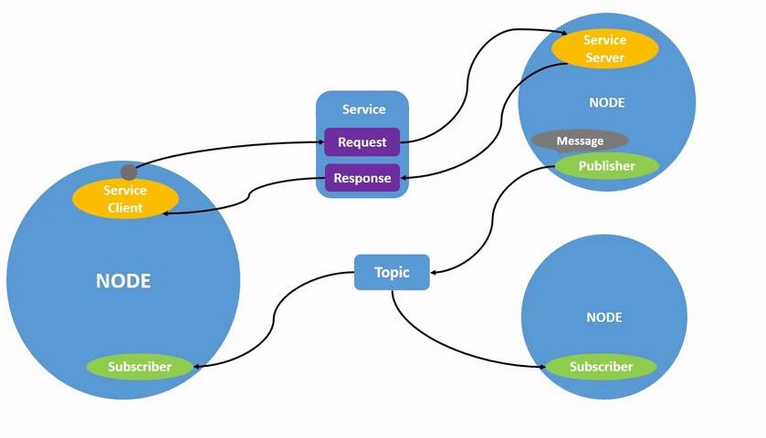
4 Nodes and Topics
What is a ROS2 Node?!
ROS2 Node is single, modular purpose executable process
What could a ROS2 Node possibly do?
Send and receive data from other nodes via Topics, Services, Actions, and Parameters
What type of data
Publishing sensory data like (Lidar Scan), Publish a binary value to represent the status of proximity single point sensor, etc..
Listen to the sensory data and publish a control action, controller parameter based on input sensory data, etc..

Slide 16
4 Nodes and Topics
What is a ROS2 Node?!
ROS2 Node is single, modular purpose executable process
What could a ROS2 Node possibly do?
Send and receive data from other nodes via Topics, Services, Actions, and Parameters
What type of data
Publishing sensory data like (Lidar Scan), Publish a binary value to represent the status of proximity single point sensor, etc..
Listen to the sensory data and publish a control action, controller parameter based on input sensory data, etc..

Slide 17
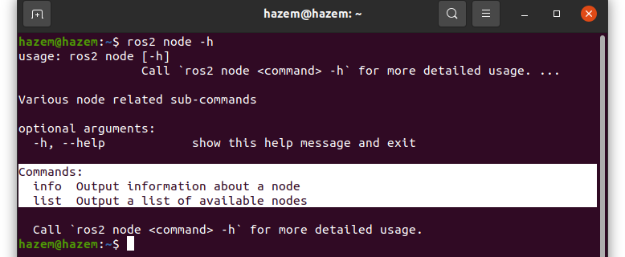
4 Nodes and Topics
How can we use ROS2 Node related commands?!
To get more details on a ROS2 command in general we can use –h
How can we run ROS2 executable Node?!
>> ros2 run <pkgName> <execName> <Argv>

Slide 18
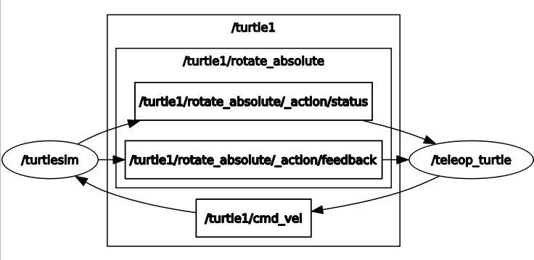
4 Nodes and Topics
What is a ROS2 Topic?!
ROS2 Topic is a distributer which handles the communication between nodes, with specified msg type, having a certain number of publishers and a certain number of subscribers.

Slide 19
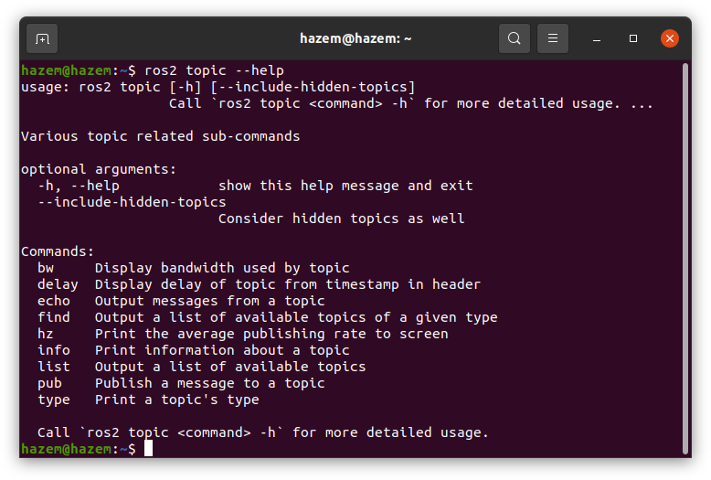
4 Nodes and Topics
How can we use ROS2 Topic related commands?!
To get more details on a ROS2 command in general we can use –h or --help

Slide 20
Publisher and Subscriber with C++
5
Steps of making a node in ROS2 using C++
Locate/Create a package
Create a .cpp file to contain the source code 3- Write down the node source code
Add dependencies
Edit CMakeLists.txt
Build
Source
Run and test the node

Slide 21
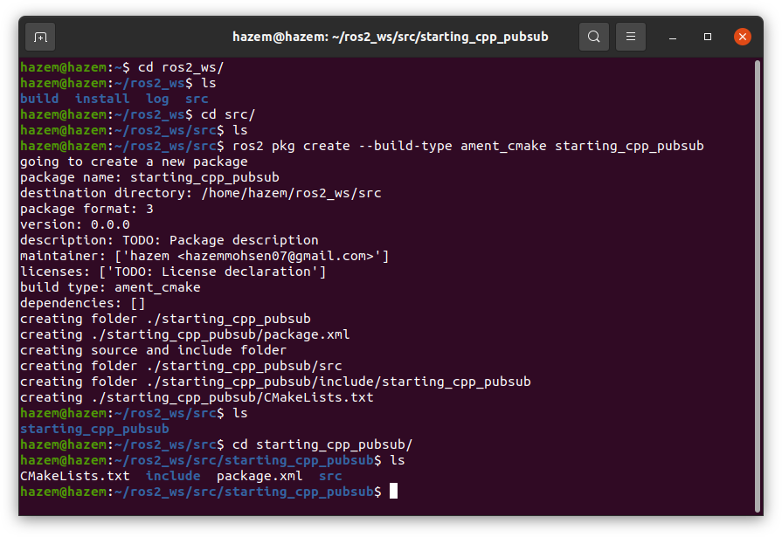
Publisher and Subscriber with C++
5
Steps of making a node in ROS2 using C++
1- Locate/Create a package

Slide 22
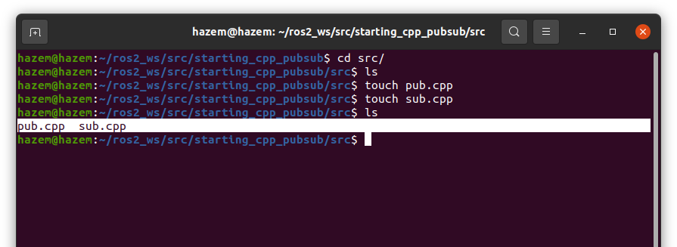
Publisher and Subscriber with C++
5
Steps of making a node in ROS2 using C++
2- Create a .cpp file to contain the source code

Slide 23
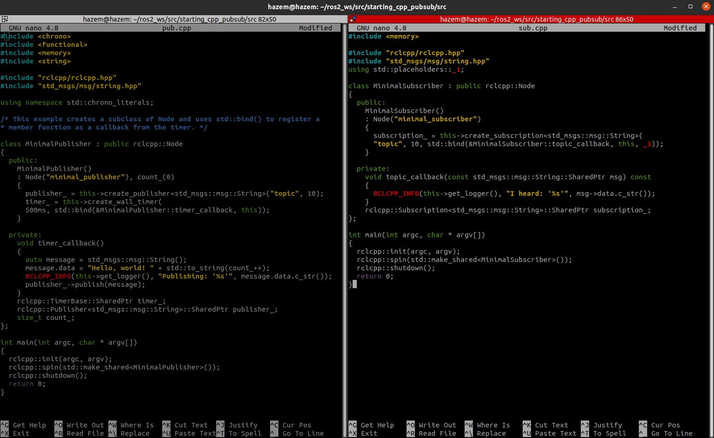
5
Publisher and Subscriber with C++
Steps of making a node in ROS2 using C++
3- Write down the node source code
?
In a minute..

Slide 24
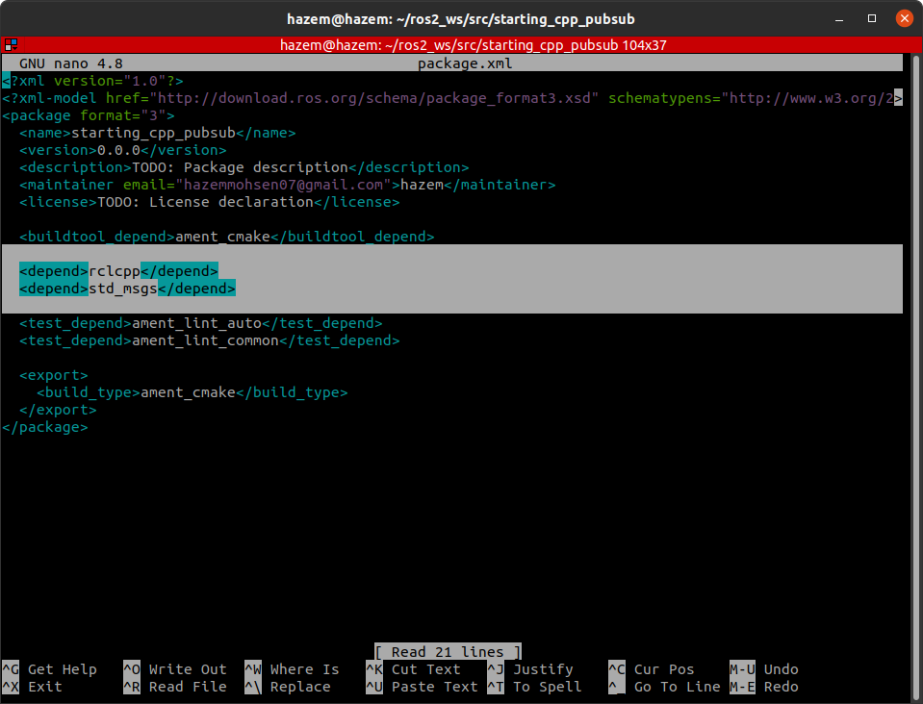
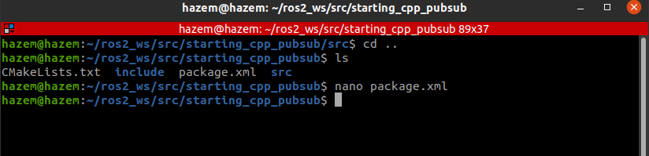
5
Publisher and Subscriber with C++
Steps of making a node in ROS2 using C++
4- Add dependencies

Slide 25
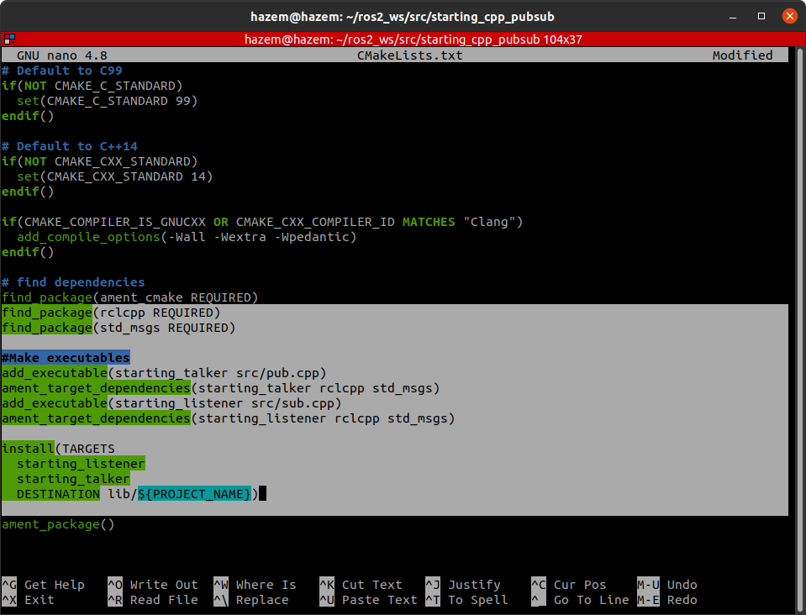
Publisher and Subscriber with C++
5
Steps of making a node in ROS2 using C++
5- Edit CMakeLists.txt
A- Add Packages to be found find_packages(<depPkgName> REǪUIRED)
B- Make the nodes executable add_executable(<execName>, <pathInsideSrc>)
ament_target_dependencies(<execName> <depPkg1> … <depPkgN> install (TARGETS
<execName1>
...
<execNameN>
DESTINATION lib/${PROJECT_NAME})

Slide 26
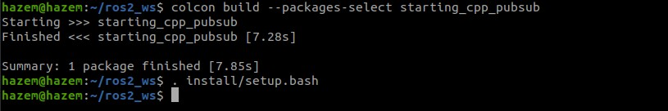
Publisher and Subscriber with C++
5
Steps of making a node in ROS2 using C++
6/7- Build and Source
Could be sourced in
~/.bashrc if needed
To speed up the building process if there are many packages inside the workspace

Slide 27
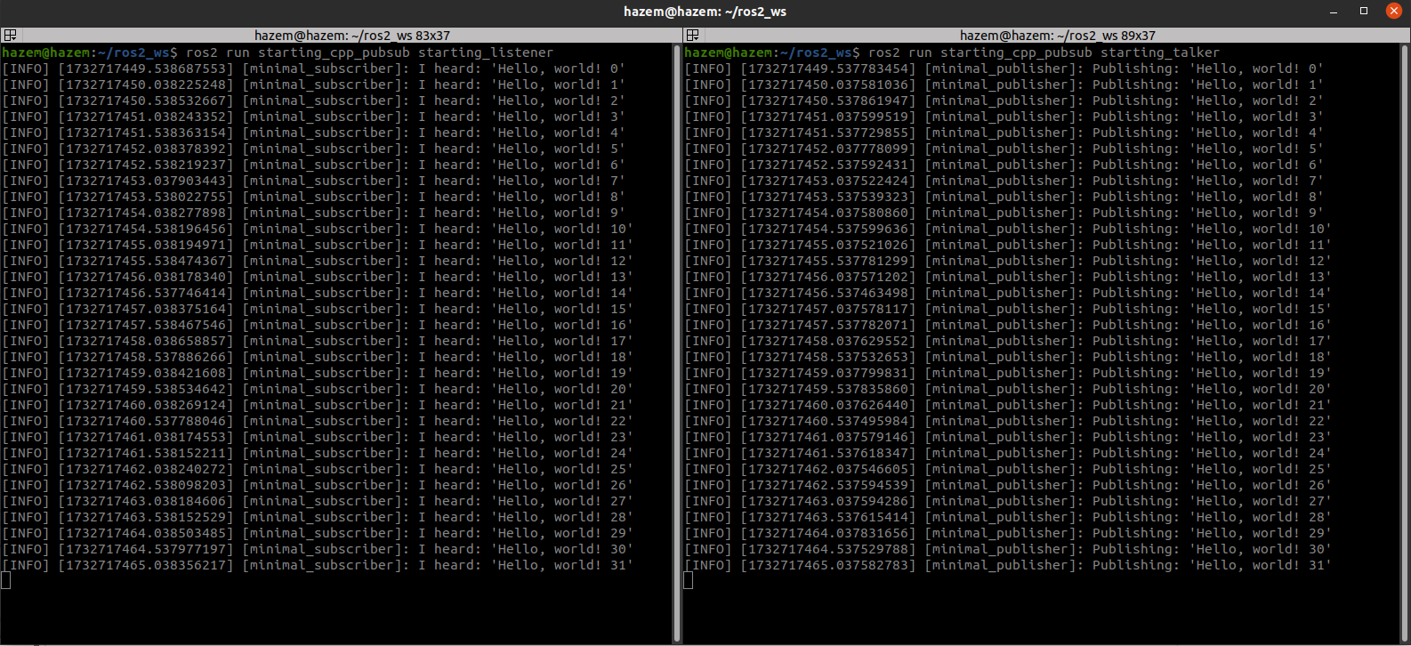
5
Publisher and Subscriber with C++
Steps of making a node in ROS2 using C++
8- Run!

Slide 28

Publisher and Subscriber with C++
5
Code explanation and source code chunks for ROS2 Node in C++
1- Standard C++ includes
Provides timing utilities
Allow functions to be used as a callback
To use smart pointers
Supports string manipulations

Slide 29

Publisher and Subscriber with C++
5
Code explanation and source code chunks for ROS2 Node in C++
2- ROS includes
To handle nodes
Providing msg type used

Slide 30
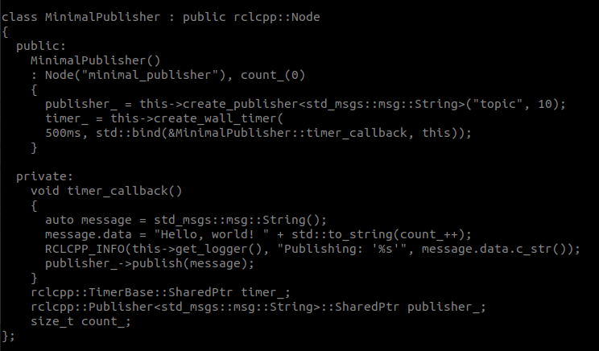
Publisher and Subscriber with C++
5
Code explanation and source code chunks for ROS2 Node in C++
3- Class definition
Constructor to initialize node, making a publisher instance, setting up a timer to be followed
Defines the callback function that iteratively publishes a message
Defining member variables

Slide 31
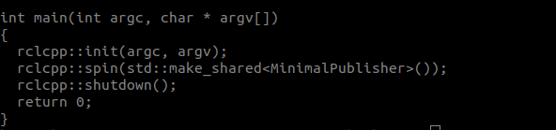
Publisher and Subscriber with C++
5
Code explanation and source code chunks for ROS2 Node in C++
4- main loop
Initializing Node
Keeps the node running until killed manually
Shut down node

