Slide 1
Industrial Robotic Arm - 5 DOF
Hand controlled Using MPU6050
Supervisor: Dr. Mohammed Magdy
Eng. Soha Magdy
Eng. Esraa Salem
Team Members:
1. Duaa Mohamed Ibrahim
2. Rowan Ebrahim Desouky
3. Asmaa Osama Eid
4. Rozan Mahmoud Ahmed
5. Zohir Raafat Hassan
6. Ziad Mohammed Fathy
7. Abdelrahman Said
8. Abdelrahman Ashraf Saad
GitHub Repository:
[Link to GitHub Repository: https://github.com/ziadmohamed0/RoboticProjects.git]

Slide 2





Our Project
Aim & Objectives
Motivation
Methodology
Researching
Future Recommendations

Slide 3
Aim & Objectives
Aim
To design and develop a cost-effective, reliable, and highly versatile industrial robotic arm with 5 DOF.
Objectives:
Integrate advanced hardware and software for seamless functionality.
Ensure precise movement and orientation using MPU6050 (IMU) and servo motors.
Enable wireless communication and real-time monitoring.

Slide 4
Motivation
Automation
Increased demand for automation in manufacturing and industrial processes.
Efficiency
Improve productivity and efficiency in repetitive tasks.
Safety
Enhance workplace safety by minimizing human involvement in hazardous operations.
Financial
Need for cost-effective and efficient robotic solutions.
For US
Development of hands-on expertise in robotics for team members.
Understanding the concept of the Robotics like The kinematics , Actuators & its calculations And the practical implementation of the project

Slide 5
Methodology
Hardware Development:
Microcontrollers: ESP8266, ESP32, and STM32.
Sensors: MPU6050 (IMU) and IR sensor.
Servo motors and PCA9685 driver.
Integration and Testing:
Assembling components.
Testing movement accuracy and sensor responsiveness.
Prototype Design (matlab&solidworks)
Material PLA
Components
Kinematics
Denavit-Hartenberg (D-H) parameter table.
Forward and inverse kinematics calculations.
Homogeneous transformation matrices.
Software Development:
Coding for wireless communication between ESP modules.
Mapping sensor data to servo angles for accurate control.

Slide 6
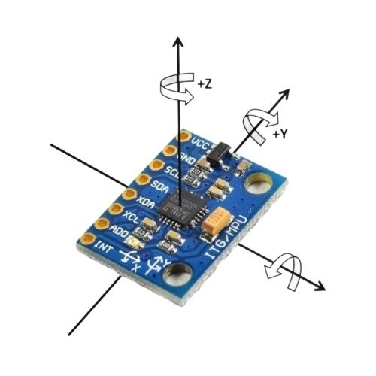
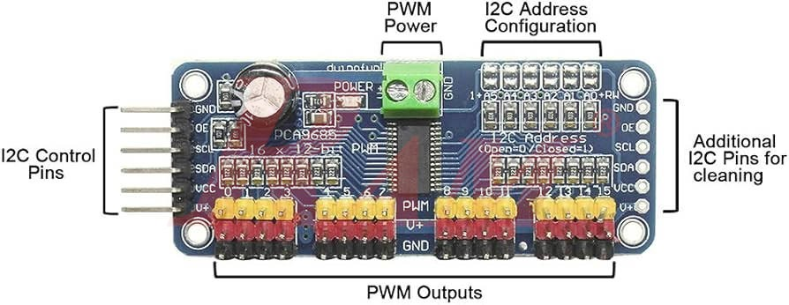
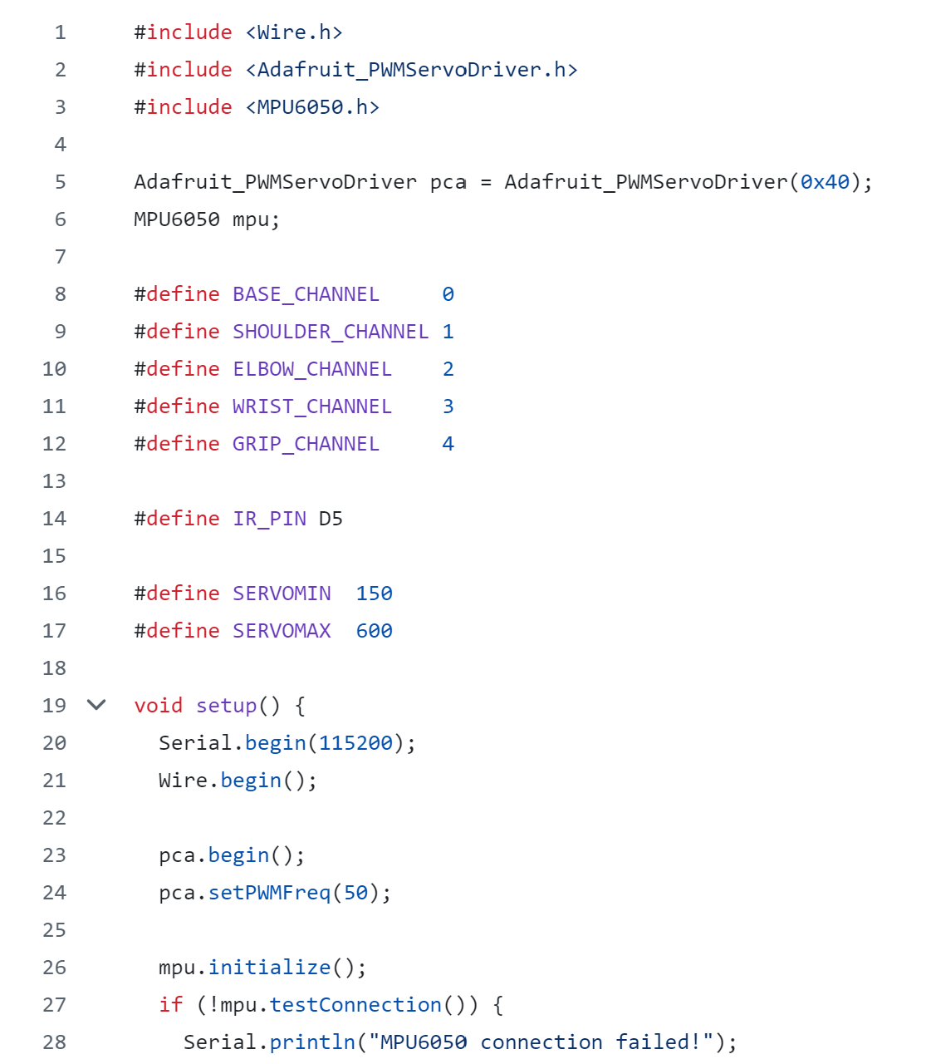
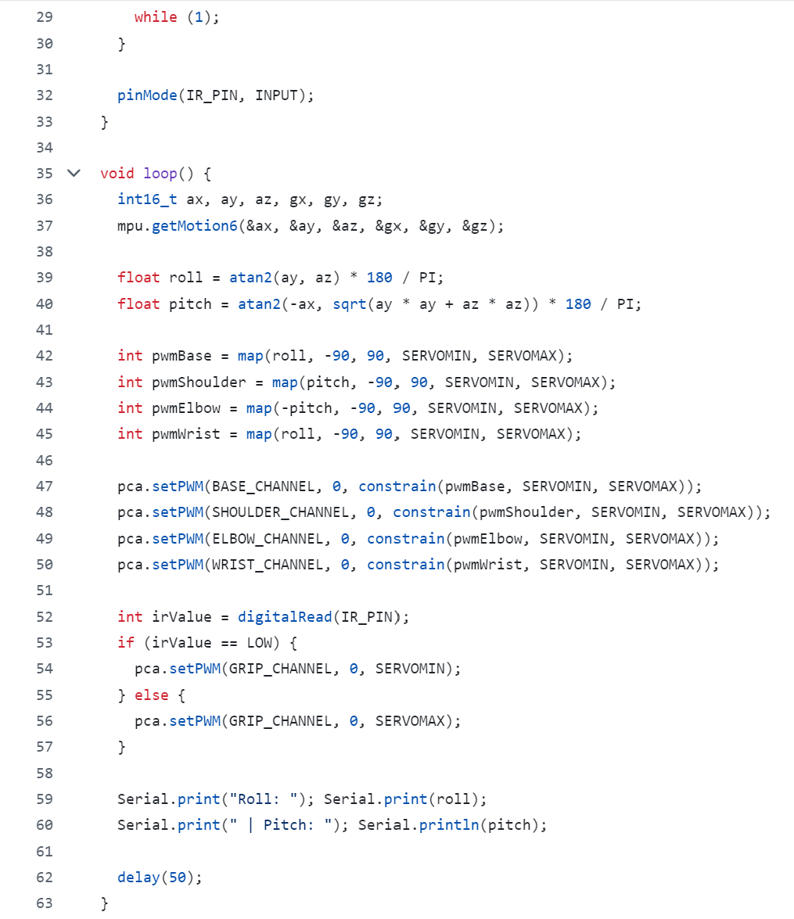
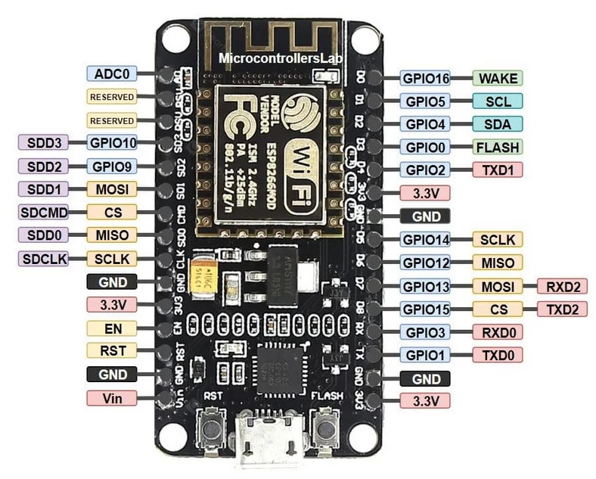
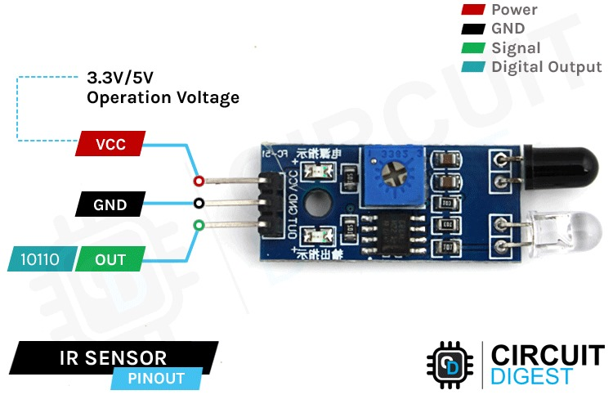
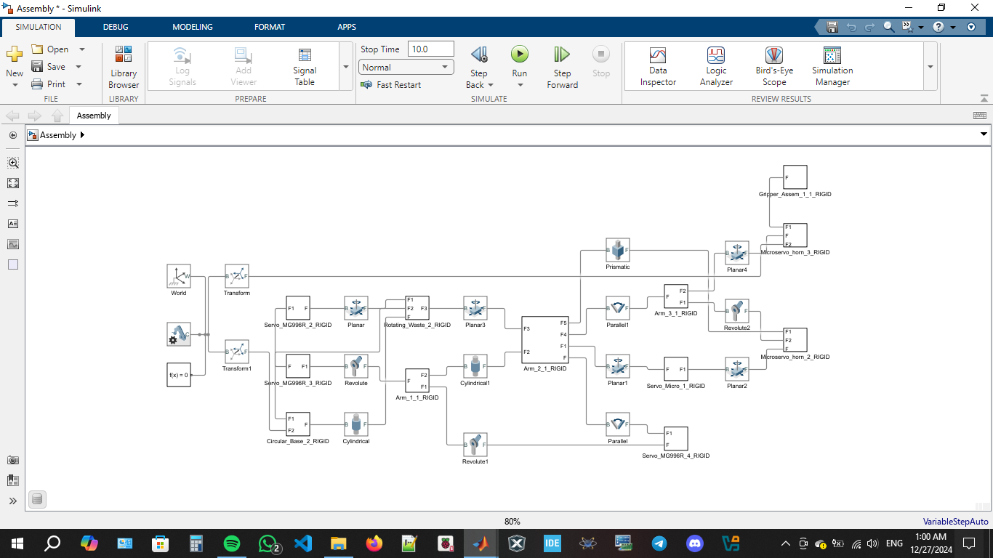
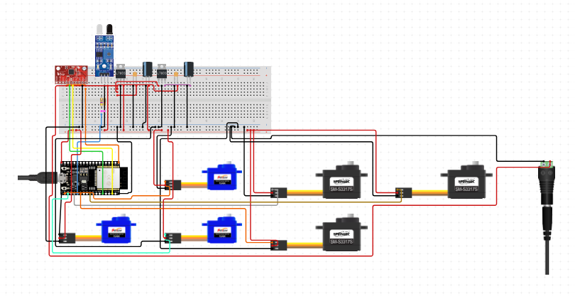
Hardware Development
MPU 6050 PCA9685 driver
ESP8266 IR Sensor
Software Development

Slide 7
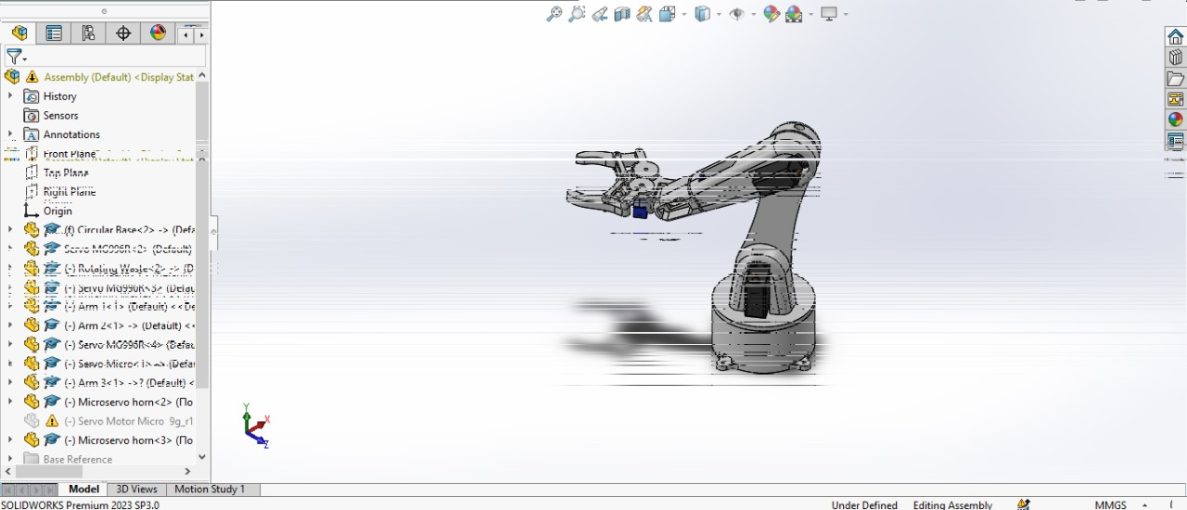
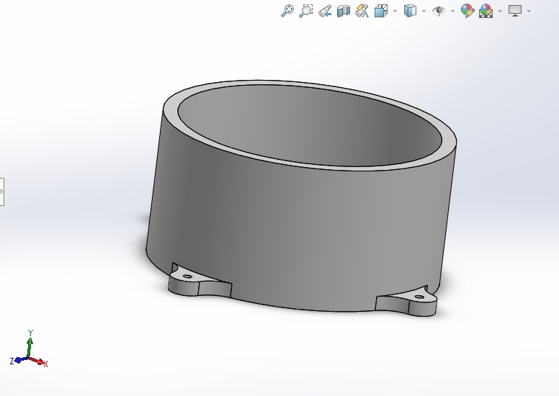
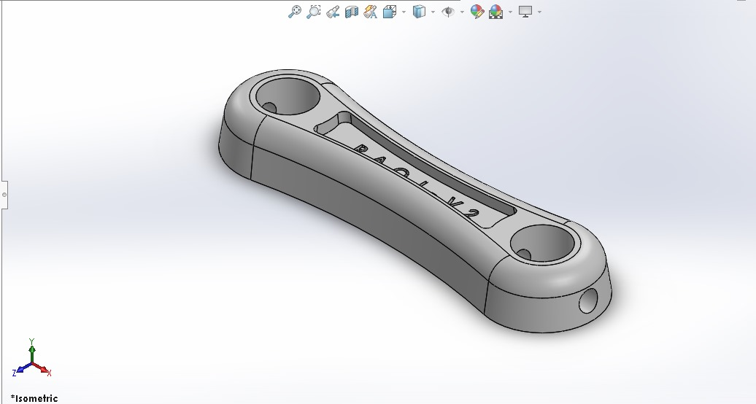
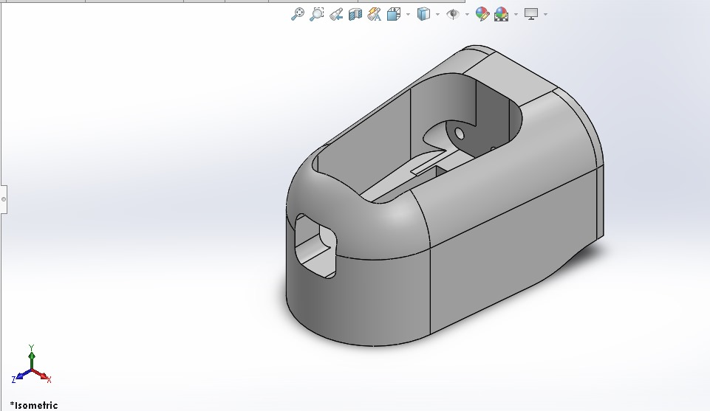
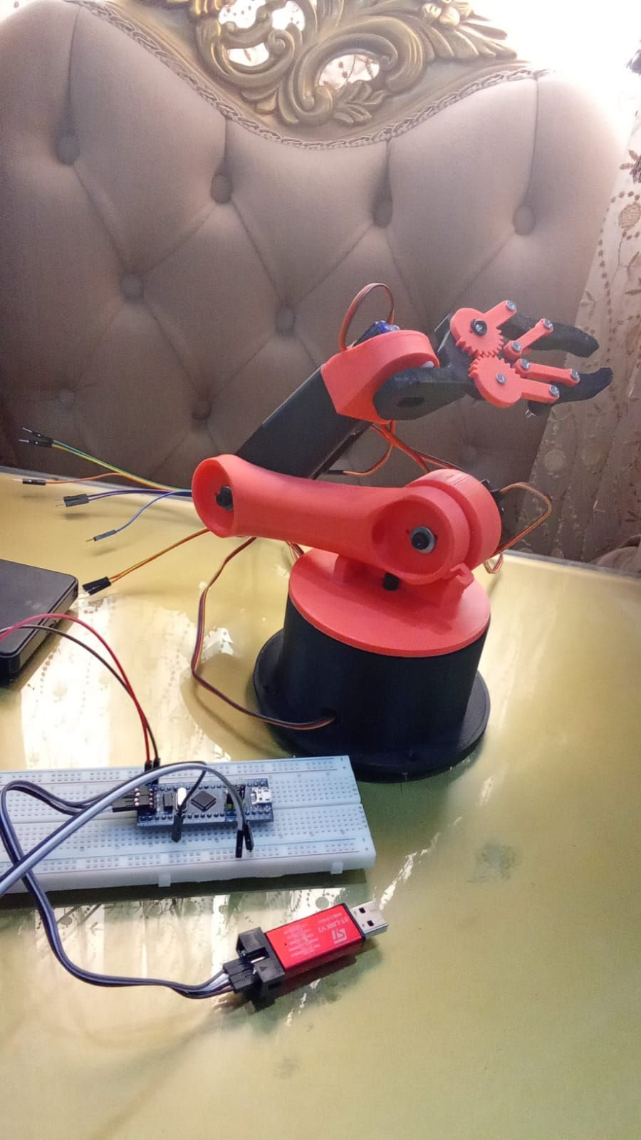
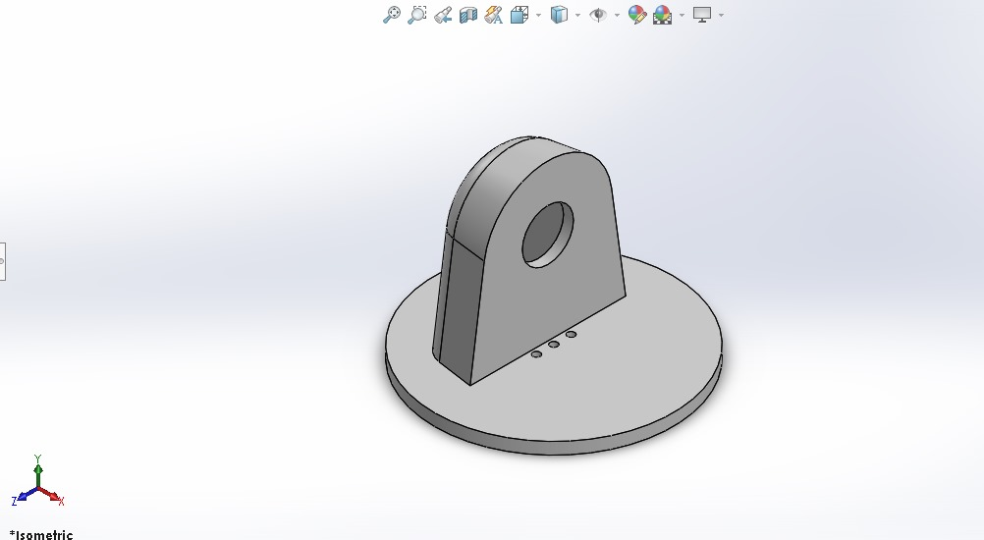
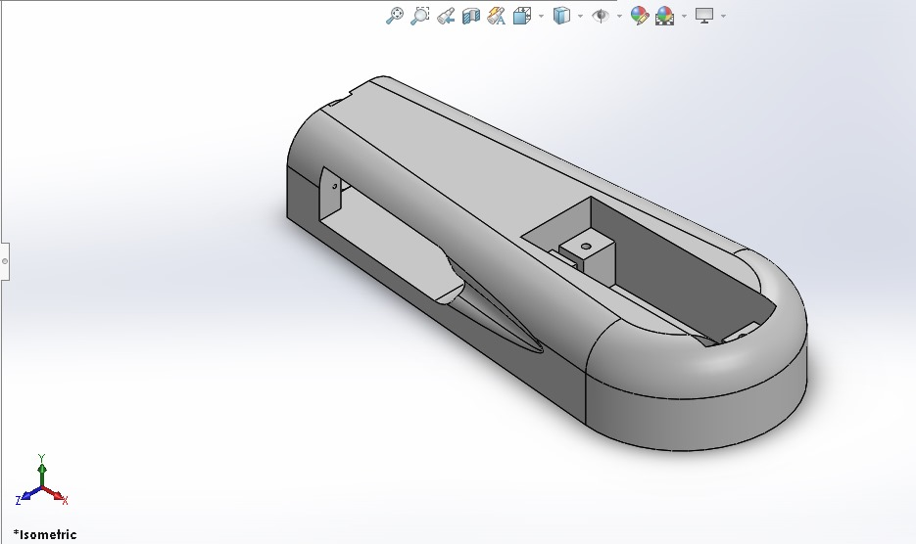
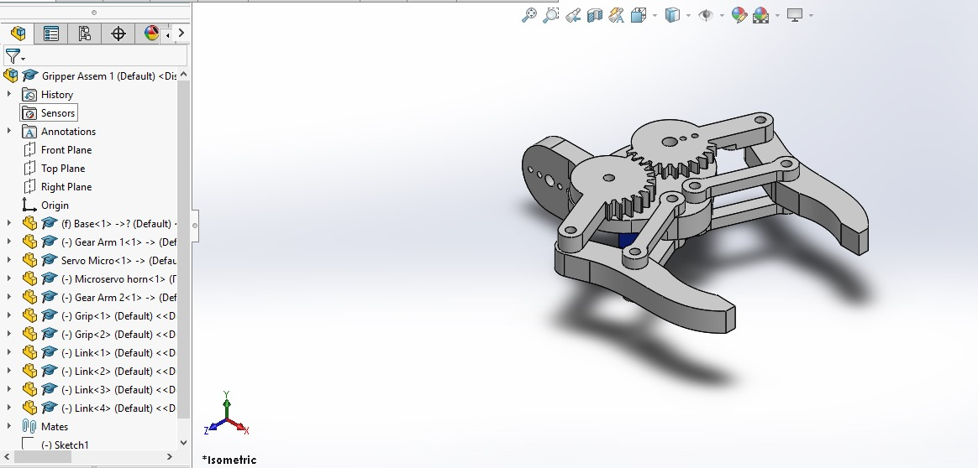
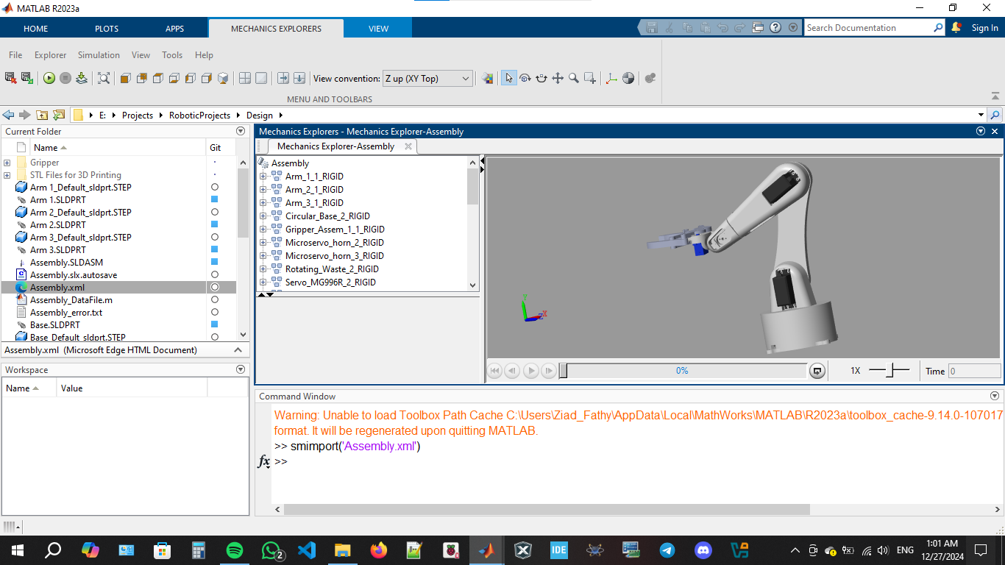
Prototype Design
(matlab&solidworks)

Slide 8
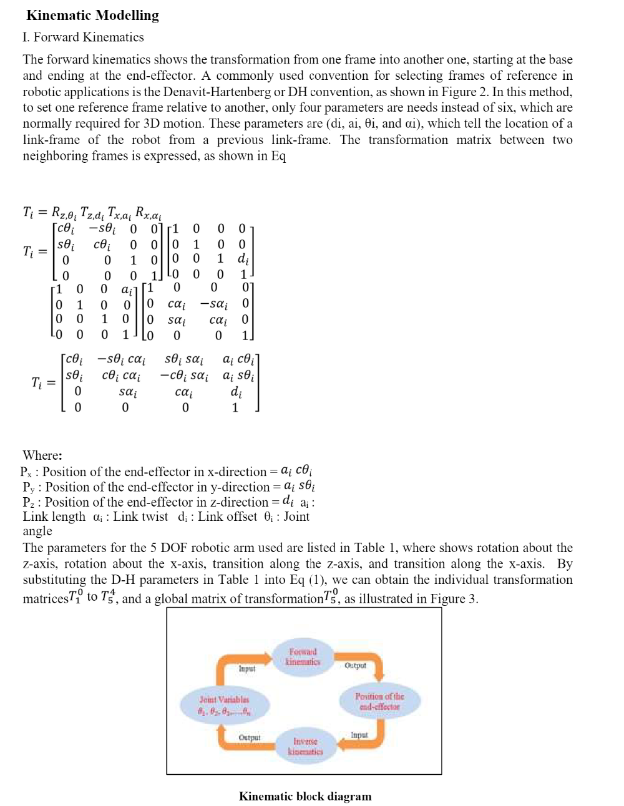
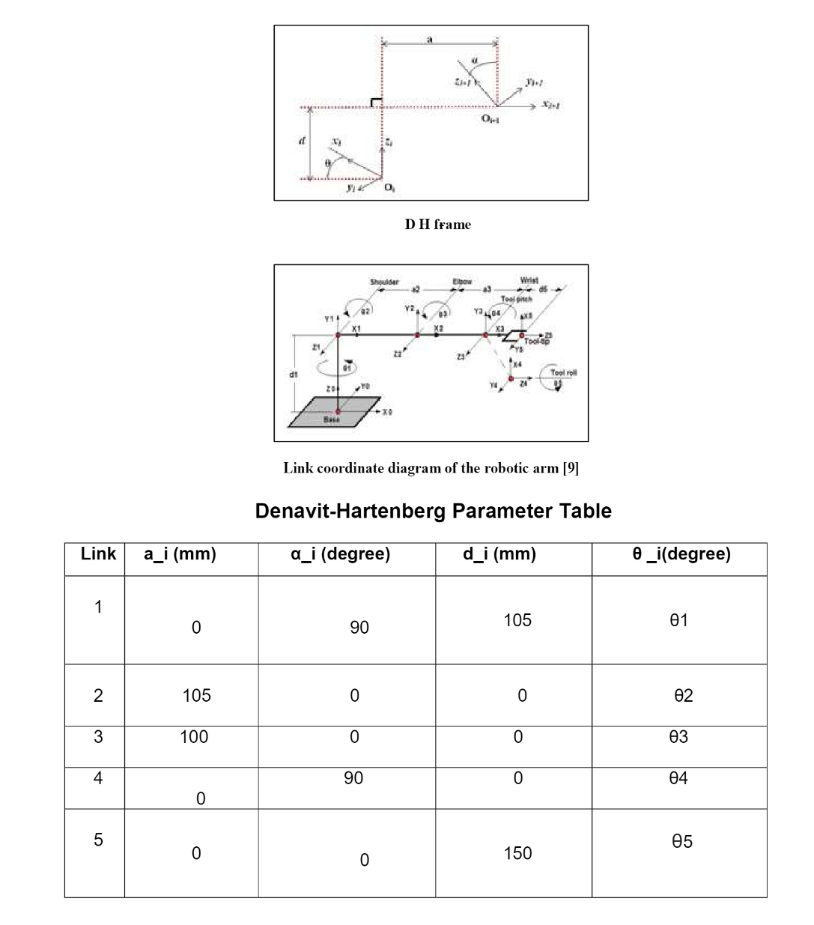
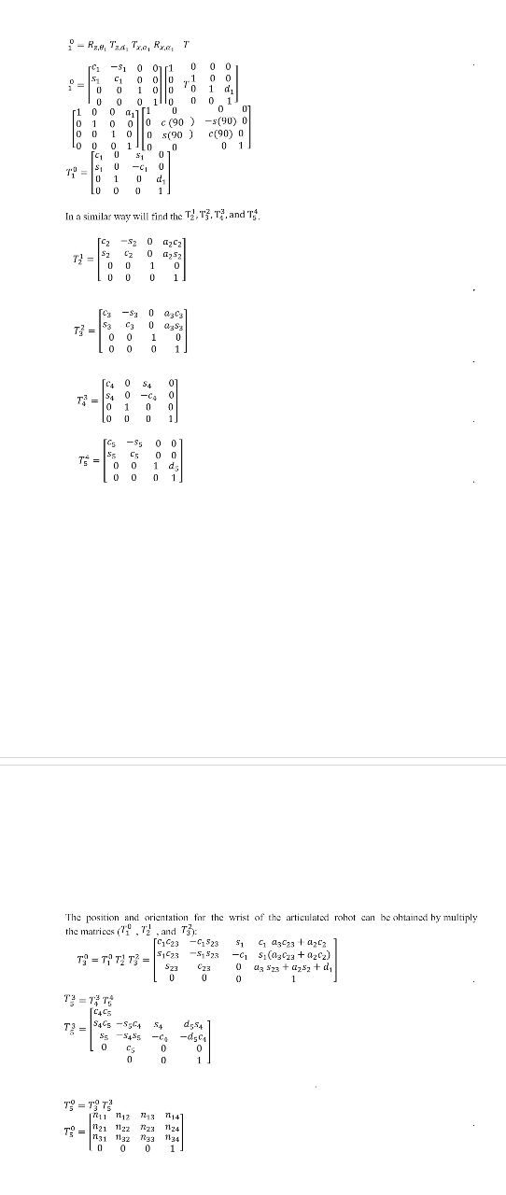
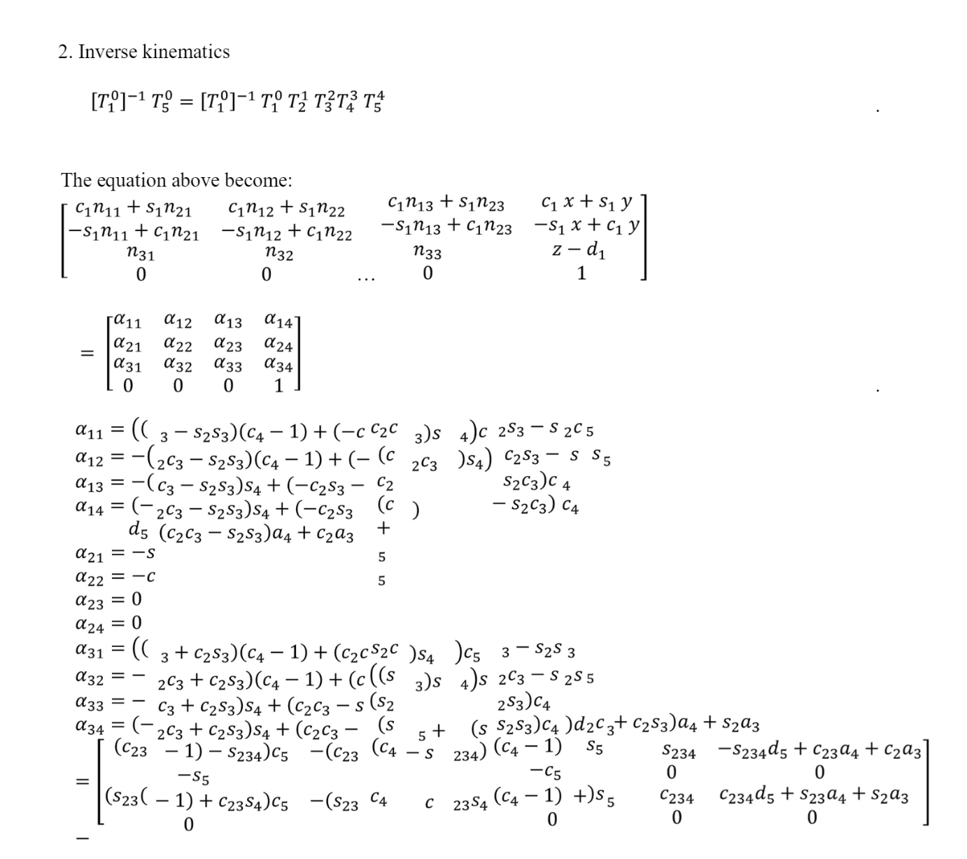
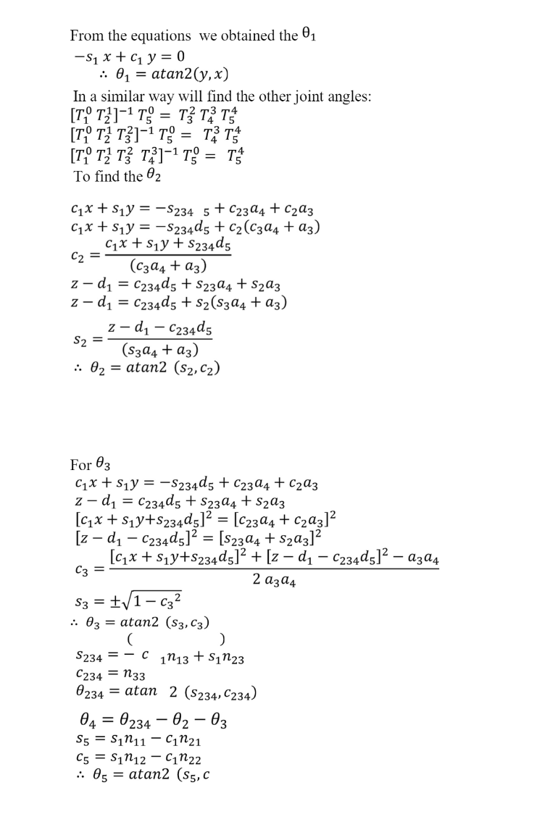
Kinematics

Slide 9
Researching
Understanding Existing Solutions:
Studied advanced robotic systems .
Identified design principles and performance gaps for improvement.
2. Selecting Components:
Researched microcontrollers (ESP8266, ESP32, STM32), MPU6050 sensor, PCA9685 driver.
Ensured compatibility, efficiency, and optimal performance.
3. Exploring Kinematic Models:
Derived movement equations through forward and inverse kinematics.
Applied Denavit-Hartenberg (D-H) parameters for joint positioning.
4. Optimizing Communication Protocols:
Evaluated Wi-Fi for real-time, reliable data transfer using ESP modules.
5. Innovating Design:
Integrated real-time orientation sensing and IR-based gripper control.
Used sustainable, lightweight materials for the prototype.

Slide 10
Future Recommendations
Increase the degrees of freedom for more complex tasks.
Upgrade power systems for higher payload capacity.
Incorporate AI for autonomous decision-making.
Improve design to reduce energy consumption.

