Slide 1
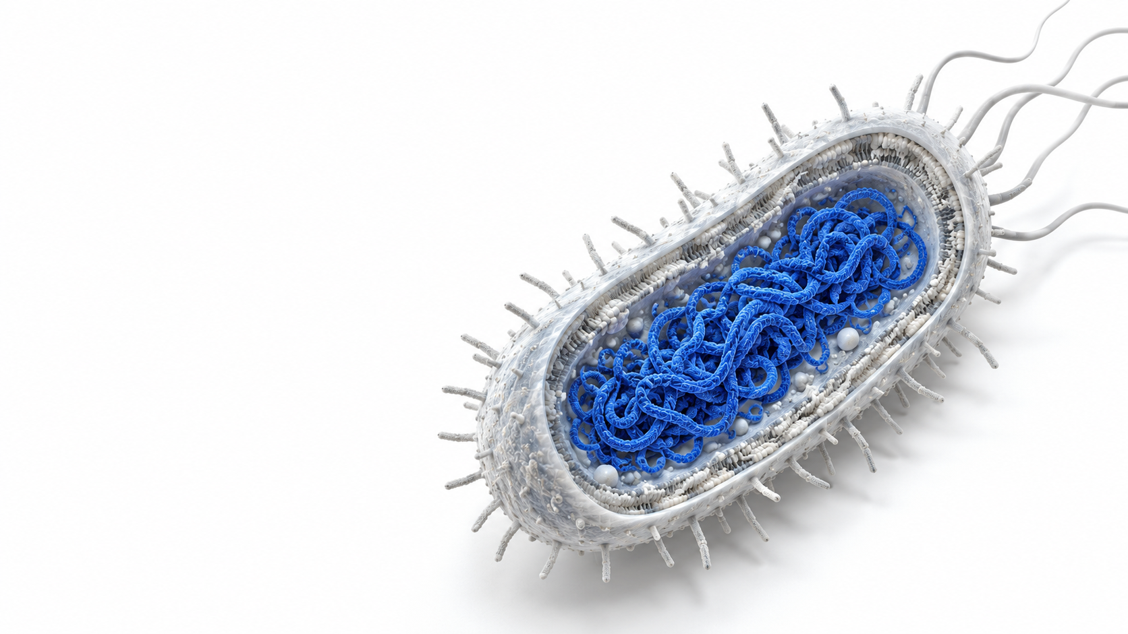
BIOINFORMATICS PROJECT
E. coli
Variant analysis
Three samples compared with
the REL606 reference genome
Ziad
Read evidence, variant comparison
and predicted coding effects
01
Notes:
TIMING: 20 seconds. Planned interval 0:00 to 0:20.
Introduce the analysis as a comparison of three paired-end samples with REL606. The cutaway is generated conceptual art, not a laboratory image. The analysis targets candidate small variants and read-level evidence.
SOURCE: Original project report and uploaded BAM/VCF/QC/IGV files, with shared_variants_gene_summary.tsv and shared_variants_protein_effects.tsv. Values preserved from the verified project analysis.

Slide 2
STUDY DESIGN
Three samples. One reference.
Sample | Read pairs
SRR2584863 | 175,000
SRR2584866 | 175,000
SRR2589044 | 175,000
4,629,812
reference bases
CP000819.1
E. coli B strain REL606
Provided FASTQs are pretrimmed subsets. Two files per sample: R1 and R2.
02
Notes:
TIMING: 45 seconds. Planned interval 0:20 to 1:05.
Each sample contains 175000 pairs, or 350000 primary reads. We used supplied trimmed subsets, not all reads in the original study. REL606 is the same reference for every sample and the later GFF annotation.
SOURCE: Original project report and uploaded BAM/VCF/QC/IGV files, with shared_variants_gene_summary.tsv and shared_variants_protein_effects.tsv. Values preserved from the verified project analysis.

Slide 3
METHODS
The analysis workflow
01
02
03
Reads and reference
Alignment
Variant calling
FASTQ + REL606 FASTA
BWA-MEM + SAMtools
BCFtools, haploid model
FastQC / MultiQC
Indexed, duplicate-marked BAM
Raw VCF with DP and AD
04
05
06
Filtering
Comparison
Interpretation
QUAL ≥ 30; sample DP ≥ 5
Normalization + exact alleles
IGV + GFF + codon checks
Filtered, indexed VCF
Shared and unique call sets
Read evidence and predictions
03
Notes:
TIMING: 50 seconds. Planned interval 1:05 to 1:55.
Walk through the dependency order. QC does not modify reads. All three samples followed the alignment and calling workflow. Normalization precedes exact-allele comparison. Gene annotation and coding-effect predictions were an extension for the six shared variants.
SOURCE: Original project report and uploaded BAM/VCF/QC/IGV files, with shared_variants_gene_summary.tsv and shared_variants_protein_effects.tsv. Values preserved from the verified project analysis.

Slide 4
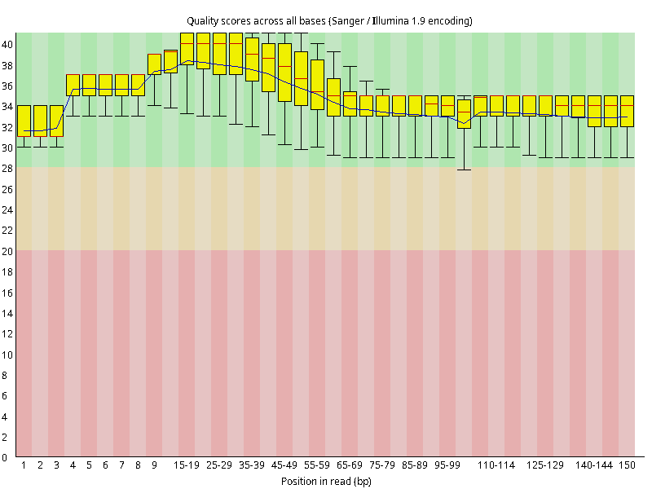
QUALITY CONTROL
Read quality before alignment
6 input files
PASS
Base quality
Adapter content
WARN
GC content
Read length distribution
FastQC example: SRR2584863 R2. Composition flags remain documented in the report.
04
Notes:
TIMING: 50 seconds. Planned interval 1:55 to 2:45.
Six FastQC reports were combined using MultiQC. Base quality and adapter content passed. GC and length distributions triggered warnings, and composition failures occurred in some reads. These flags require contextual interpretation. We did not run another trimming step.
SOURCE: Original project report and uploaded BAM/VCF/QC/IGV files, with shared_variants_gene_summary.tsv and shared_variants_protein_effects.tsv. Values preserved from the verified project analysis.

Slide 5
ALIGNMENT
BAM preparation preserves the read evidence
01
02
03
Align
Convert
Group mates
bwa mem
samtools view
collate + fixmate -m
04
05
06
Sort
Mark duplicates
Index
samtools sort
samtools markdup
samtools index
quickcheck checks the header and file end. Duplicate records remain in the final BAM.
05
Notes:
TIMING: 55 seconds. Planned interval 2:45 to 3:40.
The actual sequence was SAM to BAM, collate, fixmate -m, coordinate sort, markdup and indexing. Markdup flagged duplicates, rather than removing their records. Fixmate adds mate information needed by markdup. The basic quickcheck does not validate every record.
SOURCE: Original project report and uploaded BAM/VCF/QC/IGV files, with shared_variants_gene_summary.tsv and shared_variants_protein_effects.tsv. Values preserved from the verified project analysis.

Slide 6
ALIGNMENT RESULTS
High mapping rates coexist with uneven coverage
Sample | Mapped
4863 | 99.96%
4866 | 99.98%
9044 | 99.94%
≈10×
mean genome depth
Covered genome: 99.79%, 93.02%, 99.81%. Mapped percentages refer to primary reads.
06
Notes:
TIMING: 60 seconds. Planned interval 3:40 to 4:40.
Report the exact coverage and mapping metrics. Mean depths were 9.89791, 9.95870 and 9.96615. Genome coverage was lower for 4866 even though its mapping rate was highest. Mapping percentage and fraction of reference covered measure different things.
SOURCE: Original project report and uploaded BAM/VCF/QC/IGV files, with shared_variants_gene_summary.tsv and shared_variants_protein_effects.tsv. Values preserved from the verified project analysis.

Slide 7
VARIANT CALLING
A haploid call model and explicit filters
30
bcftools mpileup
-f "$REFERENCE"
-a FORMAT/DP,FORMAT/AD
-Ou "$BAM" |
bcftools call --ploidy 1
-mv -Oz -o "$RAW_VCF"
minimum site QUAL
5
minimum sample DP
Exclude missing genotypes
VCFtools --max-missing 1
07
Notes:
TIMING: 65 seconds. Planned interval 4:40 to 5:45.
Call variants using BCFtools mpileup and call --ploidy 1. Record DP and AD. VCFtools uses site QUAL at least 30 and genotype FORMAT/DP at least 5. Genotypes failing depth become missing, then max-missing 1 excludes those sites. Filtering does not prove every retained call correct.
SOURCE: Original project report and uploaded BAM/VCF/QC/IGV files, with shared_variants_gene_summary.tsv and shared_variants_protein_effects.tsv. Values preserved from the verified project analysis.

Slide 8
VARIANT COUNTS
SRR2584866 has the largest retained call set
Sample | SNPs | Ins. | Del.
4863 | 18 | 3 | 1
4866 | 614 | 57 | 39
9044 | 6 | 1 | 1
22 / 710 / 8
filtered records
08
Notes:
TIMING: 75 seconds. Planned interval 5:45 to 7:00.
Counts are records in the VCF call sets, not numbers of affected genes. Raw records were 28, 792 and 12. Filtered records were 22, 710 and 8, with the displayed SNP and indel counts. Larger counts alone do not establish mutation rates or selection.
SOURCE: Original project report and uploaded BAM/VCF/QC/IGV files, with shared_variants_gene_summary.tsv and shared_variants_protein_effects.tsv. Values preserved from the verified project analysis.

Slide 9
COMPARISON
Six exact alleles are shared by all samples
6
Position | REF | ALT | Gene
648692 | C | T | mrdB
1331794 | C | A | topA
1733343 | G | A | pykF
3481820 | A | G | malT
4100183 | A | G | hslU
4431393 | TGG | T | ytfN
shared variants
Pairwise overlap
4863 / 4866: 19
4863 / 9044: 6
4866 / 9044: 6
bcftools norm + isec -c none. Unique filtered records: 3 / 691 / 2.
09
Notes:
TIMING: 65 seconds. Planned interval 7:00 to 8:05.
We normalized indels against the same reference before exact REF and ALT matching. Six calls were common to all three samples: five SNPs and one GG deletion. Pairwise overlaps include those six shared calls. Unique filtered-call counts were 3, 691 and 2, conditional on coverage and filtering.
SOURCE: Original project report and uploaded BAM/VCF/QC/IGV files, with shared_variants_gene_summary.tsv and shared_variants_protein_effects.tsv. Values preserved from the verified project analysis.

Slide 10
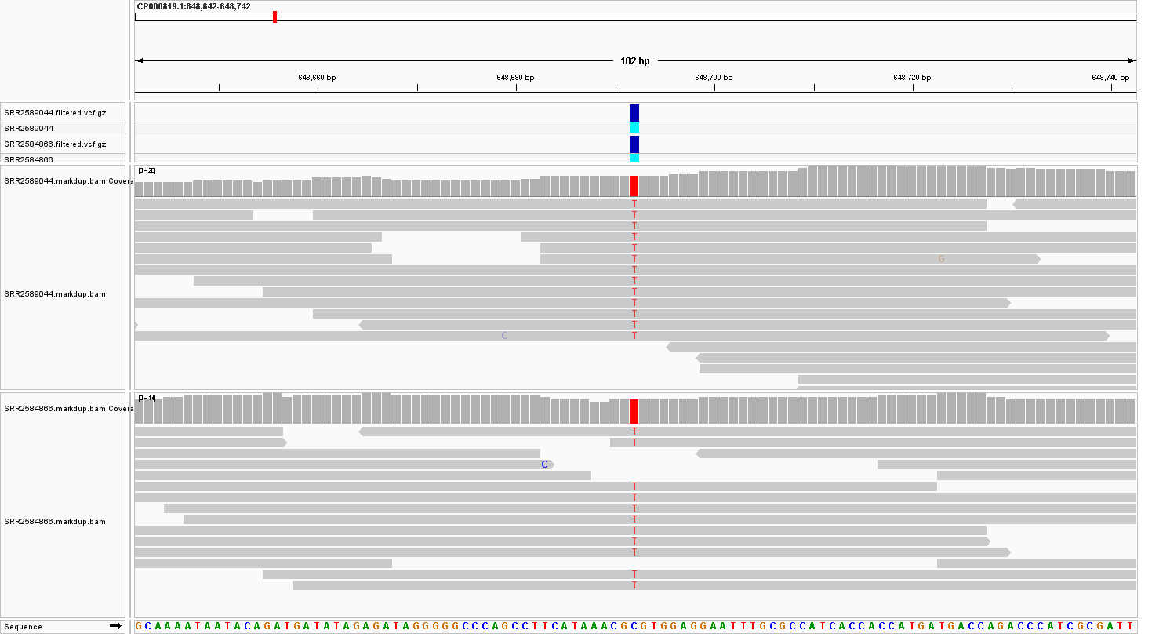
IGV EVIDENCE
Shared SNP: C to T at 648692
C → T
Same allele
in all three
filtered VCFs
Original IGV evidence. Review read support alongside the VCF call.
10
Notes:
TIMING: 60 seconds. Planned interval 8:05 to 9:05.
Use the actual IGV screenshot. The locus is CP000819.1:648692. The exact C-to-T call is shared across the three filtered files. The screenshot supports read-level review. It does not establish functional change or fixation across all cells.
SOURCE: Original project report and uploaded BAM/VCF/QC/IGV files, with shared_variants_gene_summary.tsv and shared_variants_protein_effects.tsv. Values preserved from the verified project analysis.

Slide 11
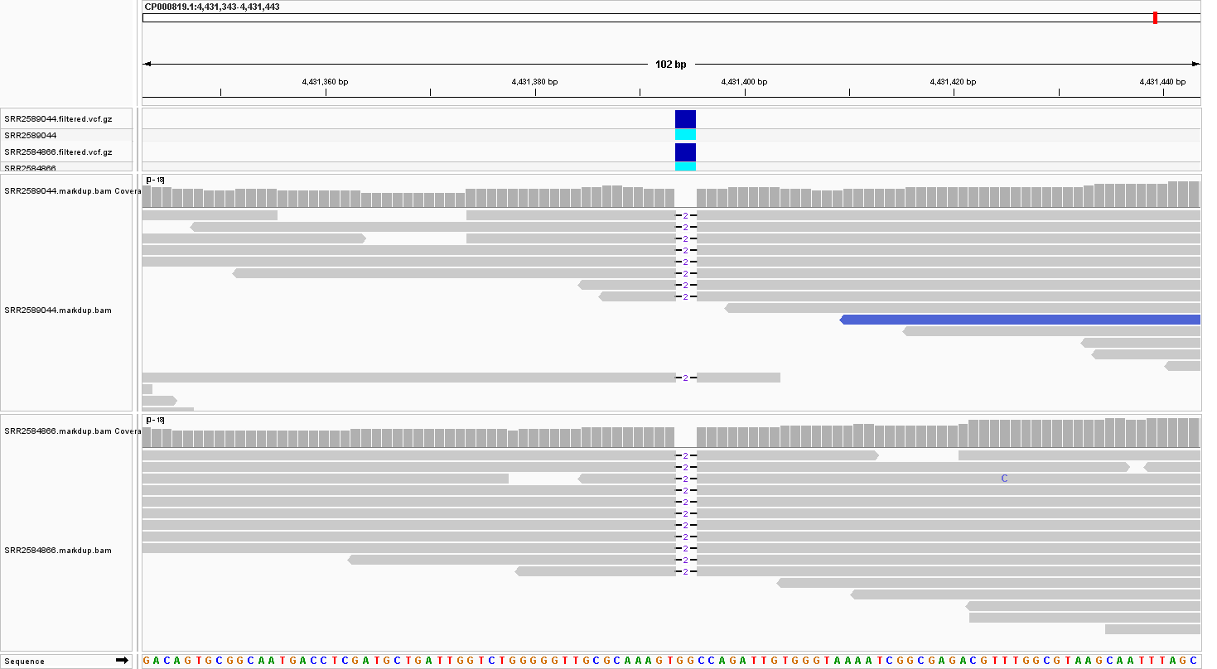
IGV EVIDENCE
Shared deletion: TGG to T at 4431393
−2 bp
GG deleted
4431394–
4431395
T at 4431393 is the VCF anchor. Deleted bases lie inside the annotated ytfN CDS.
11
Notes:
TIMING: 60 seconds. Planned interval 9:05 to 10:05.
Explain the anchor explicitly. TGG to T removes GG at 4431394 and 4431395, while keeping the T at 4431393. The deleted bases fall inside the annotated ytfN CDS. The frameshift prediction follows from the sequence and frame analysis described later.
SOURCE: Original project report and uploaded BAM/VCF/QC/IGV files, with shared_variants_gene_summary.tsv and shared_variants_protein_effects.tsv. Values preserved from the verified project analysis.

Slide 12
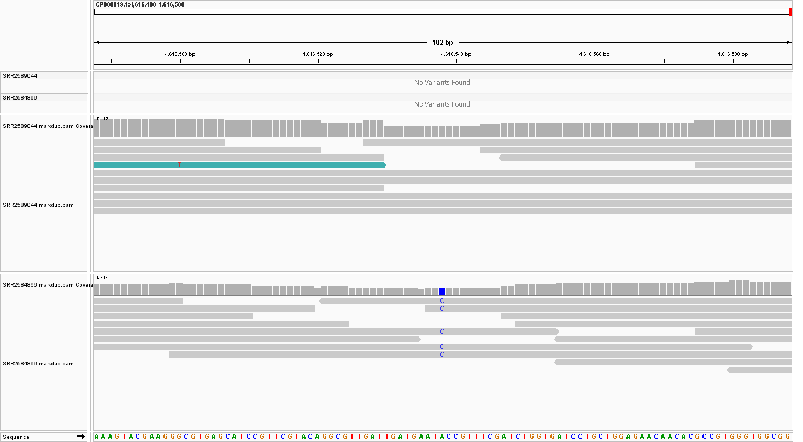
FILTER SENSITIVITY
A depth filter changes apparent uniqueness
4616538 A → C
DP 9
SRR2584863: retained
DP 4
SRR2584866: excluded
The alternate call exists in the raw 4866 VCF. Filtered absence is conditional.
12
Notes:
TIMING: 65 seconds. Planned interval 10:05 to 11:10.
The 4616538 A-to-C call was retained in 4863 with DP 9 and AD 0,9. In 4866 it had DP 4 and AD 0,4 in the raw VCF, below the minimum depth. The example shows why filtered absence cannot be treated as biological absence.
SOURCE: Original project report and uploaded BAM/VCF/QC/IGV files, with shared_variants_gene_summary.tsv and shared_variants_protein_effects.tsv. Values preserved from the verified project analysis.

Slide 13
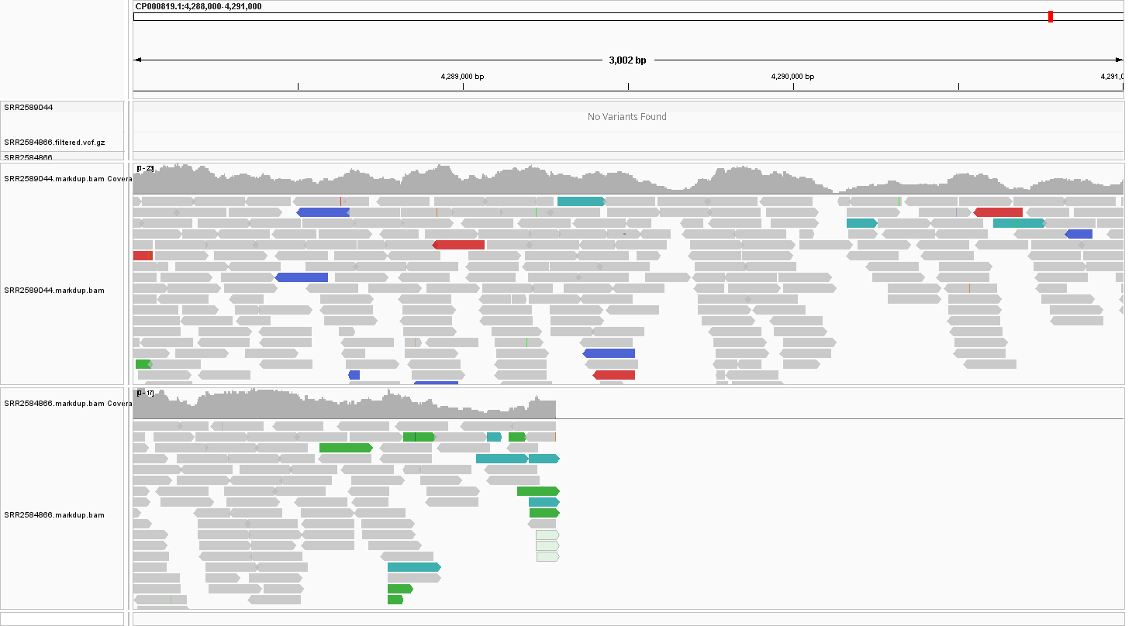
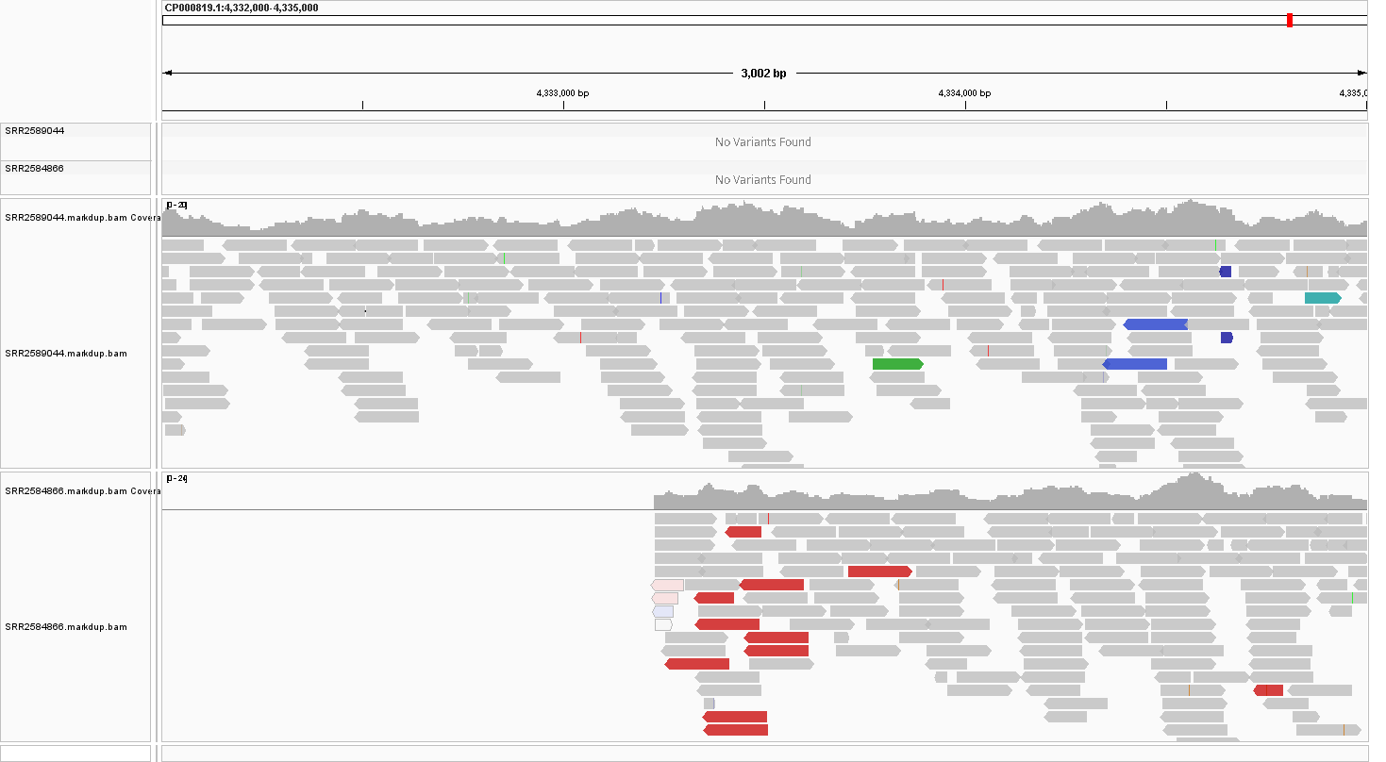
COVERAGE INVESTIGATION
A 43,944-base coverage gap needs investigation
Left boundary
Right boundary
4,289,284–4,333,227
SRR2584866, CP000819.1. Zero depth under SAMtools depth settings is not proof of deletion.
13
Notes:
TIMING: 75 seconds. Planned interval 11:10 to 12:25.
SAMtools depth -aa identified a contiguous zero-depth interval in 4866 from 4289284 to 4333227 inclusive. The length is end minus start plus one. Inspect both boundary screenshots. These data motivated a possible structural-change hypothesis, but no confirmed deletion junction was established. Keep it separate from small VCF deletions.
SOURCE: Original project report and uploaded BAM/VCF/QC/IGV files, with shared_variants_gene_summary.tsv and shared_variants_protein_effects.tsv. Values preserved from the verified project analysis.

Slide 14
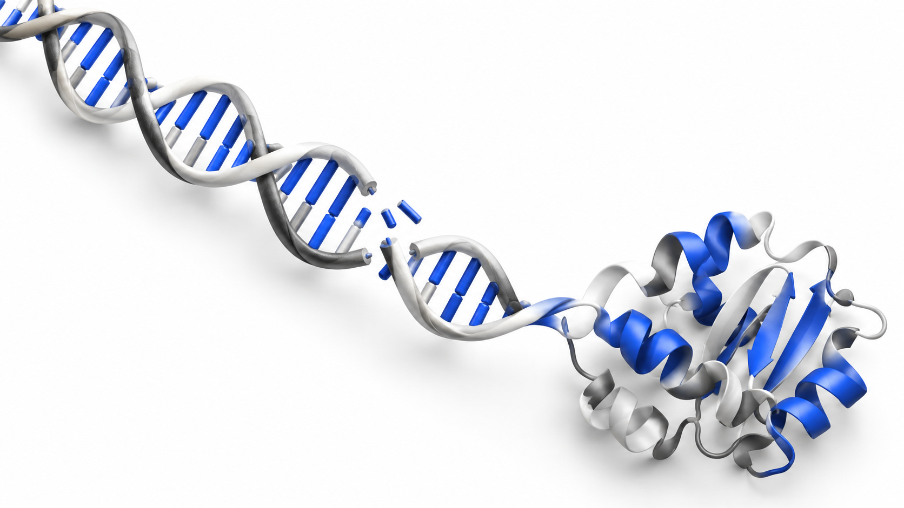
CODING CONSEQUENCES
Predicted effects of the six shared variants
Gene | Codon | Protein change
mrdB | CGC → CAC | p.Arg69His
topA | ACG → AAG | p.Thr792Lys
pykF | GAT → AAT | p.Asp127Asn
malT | ACC → GCC | p.Thr46Ala
hslU | TCT → CCT | p.Ser350Pro
ytfN | GGC → CCA* | p.Gly1176ProfsTer5
5 missense
1 frameshift
* First altered codon. Predictions treat each variant separately. Functional effects remain untested.
14
Notes:
TIMING: 90 seconds. Planned interval 12:25 to 13:55.
Map the six shared variants with the matching NCBI GFF and retrieve reference codons using SAMtools faidx. Negative-strand genes mrdB and hslU require reverse complements. Five SNPs predict amino-acid substitutions. The two-base ytfN deletion predicts p.Gly1176ProfsTer5. Each prediction is isolated against the reference CDS; complete sample protein haplotypes were not reconstructed. The molecular image is generated conceptual art.
SOURCE: Original project report and uploaded BAM/VCF/QC/IGV files, with shared_variants_gene_summary.tsv and shared_variants_protein_effects.tsv. Values preserved from the verified project analysis.

Slide 15
CONCLUSIONS
What this analysis establishes
22 / 710 / 8
filtered variant records
Six shared alleles
One large coverage gap
with predicted coding effects
requiring further validation
15
Notes:
TIMING: 65 seconds. Planned interval 13:55 to 15:00.
Close with the verified results and the boundaries of inference. We delivered indexed BAM and VCF files, QC reports, comparison and annotation tables, and IGV evidence. The study supports candidate sequence differences, not experimentally proven adaptation mechanisms, selection, or function.
SOURCE: Original project report and uploaded BAM/VCF/QC/IGV files, with shared_variants_gene_summary.tsv and shared_variants_protein_effects.tsv. Values preserved from the verified project analysis.

Slide 16
BACKUP
Complete workflow reference
01
Inputs
07
Group mates
13
Call
FASTQ / FASTA
collate
mpileup / call
02
QC
08
Mate tags
14
Filter
FastQC / MultiQC
fixmate -m
QUAL 30 / DP 5
03
Reference index
09
Sort
15
VCF index
BWA / faidx
samtools sort
view -Oz / index
04
Alignment
10
Duplicate flags
16
Compare
bwa mem
markdup
norm / isec
05
Convert
11
BAM index
17
Annotate
samtools view
samtools index
GFF / faidx
06
Basic check
12
Metrics
18
Evidence
quickcheck
flagstat / coverage
IGV / report
16
Notes:
BACKUP SLIDE: outside the planned 15-minute talk.
Backup reference showing the complete dependency order. Apply sample alignment and variant-analysis stages to all three accessions. This is a native editable diagram, not a generated data figure.
SOURCE: Original project report and uploaded BAM/VCF/QC/IGV files, with shared_variants_gene_summary.tsv and shared_variants_protein_effects.tsv. Values preserved from the verified project analysis.

Slide 17
BACKUP
Calling and filtering commands
bcftools mpileup -f "$REFERENCE" \
-a FORMAT/DP,FORMAT/AD -Ou "$BAM" | \
bcftools call --ploidy 1 -mv -Oz -o "$RAW_VCF"
vcftools --gzvcf "$RAW_VCF" \
--minQ 30 --minDP 5 --max-missing 1 \
--recode --recode-INFO-all --out "$PREFIX"
REFERENCE, BAM, RAW_VCF and PREFIX identify the corresponding per-sample paths.
17
Notes:
BACKUP SLIDE: outside the planned 15-minute talk.
Use this slide only for methods questions. The complete command examples, output files and explanations appear in the report and detailed learning guide.
SOURCE: Original project report and uploaded BAM/VCF/QC/IGV files, with shared_variants_gene_summary.tsv and shared_variants_protein_effects.tsv. Values preserved from the verified project analysis.

Slide 18
BACKUP
How the ytfN deletion changes the reading frame
Reference, from codon 1176
GGC CAG ATT GTG GGT
After deleting the first GG
CCA GAT TGT GGG TAA
Pro Asp Cys Gly STOP
Predicted p.Gly1176ProfsTer5. The fifth altered codon is a stop at residue 1180.
18
Notes:
BACKUP SLIDE: outside the planned 15-minute talk.
The variant TGG to T retains its anchor and deletes GG. The first deleted base is at coding offset 3525 in a continuous positive-strand phase-zero CDS. The shifted sequence produces Pro Asp Cys Gly STOP, giving p.Gly1176ProfsTer5. This is a sequence consequence, not proof of functional knockout.
SOURCE: Original project report and uploaded BAM/VCF/QC/IGV files, with shared_variants_gene_summary.tsv and shared_variants_protein_effects.tsv. Values preserved from the verified project analysis.

Slide 19
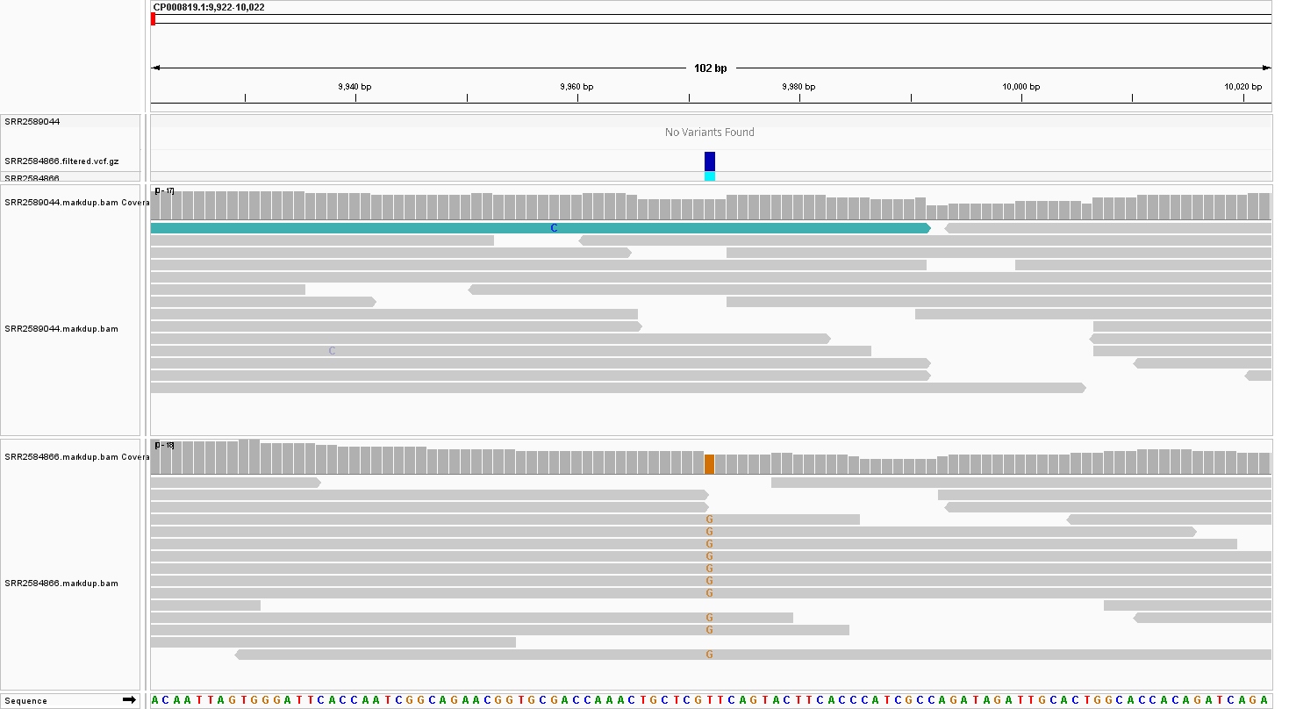
BACKUP
SNP comparison at position 9972
T → G
4863 raw DP: 4
Fails DP ≥ 5
A second example of threshold-dependent differences in filtered call sets.
19
Notes:
BACKUP SLIDE: outside the planned 15-minute talk.
This actual IGV comparison shows 4866 and 9044. The raw 4863 call at 9972 had depth four and failed the minimum-depth filter.
SOURCE: Original project report and uploaded BAM/VCF/QC/IGV files, with shared_variants_gene_summary.tsv and shared_variants_protein_effects.tsv. Values preserved from the verified project analysis.

