Slide 1






Book
Recommendation
System
BRS
Explore New Worlds

Slide 2

Overview
Introduction
Problem Statement
How the System Works
System Design
Benefits
Conclusion

Slide 3




Introduction
What is BRS?
It’s a system designed to suggest books based on user preferences.
Our system allows users to input a book title and recommends similar books.
The Importance
Helps readers discover books that align with their tastes.
Enhances user experience by reducing the time spent searching for books.

Slide 4




Problem Statment
Overwhelmed
Personalization
Time
The vast number of available books makes it difficult for readers to choose.
Popular books dominate, leaving hidden gems unnoticed
Most platforms suggest books that don’t cater to individual tastes.
Users receive recommendations based on general popularity, not personal preferences.
Manual searches are time-consuming
Users must sort through numerous reviews, lists, and categories.
Finding a suitable match can be frustrating, often causing users to abandon their search.

Slide 5

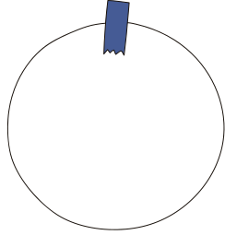



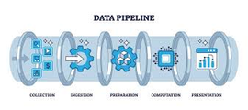

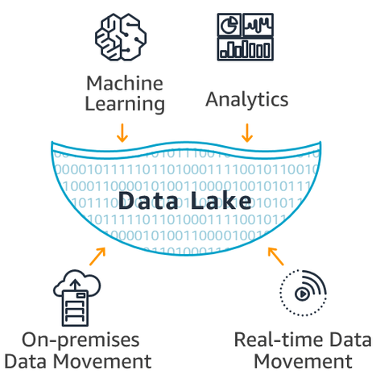





Data Cycle
Pipeline
Google Drive
Data Lake
Central repository for data from Google Drive.
Ingested via Azure Data Factory pipeline.
Supports personalized book recommendations and user engagement.
Website Database
Preprocessing
Handled null values and removed duplicates.
Created new tables and features for the ML model.
Enhanced data quality for improved recommendation accuracy.
Model
Training
BRS

Slide 6

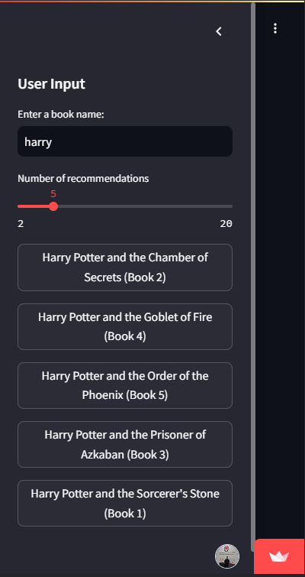





Beneifts
Auto-completion
Customizable Recommendations
Book Covers
Friendly UI

Slide 7
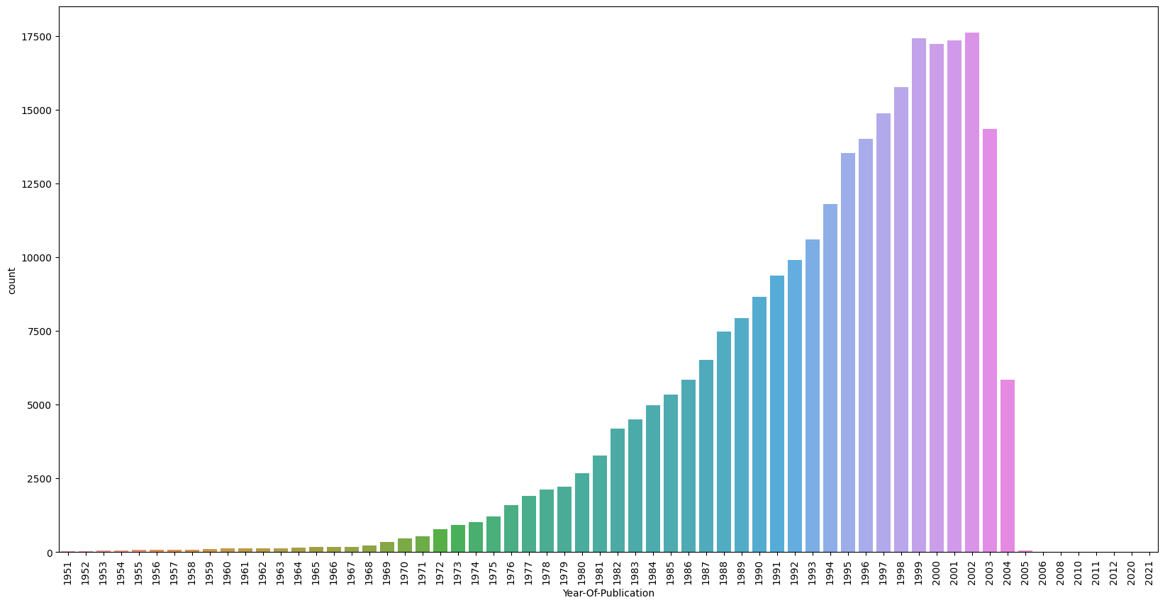

Slide 8
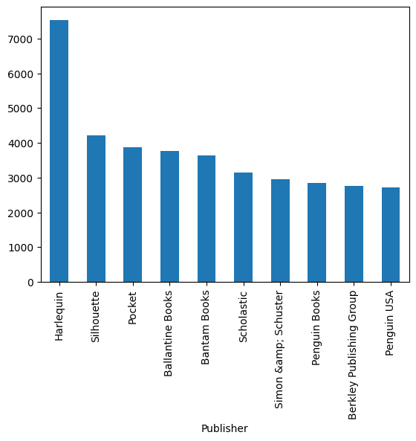
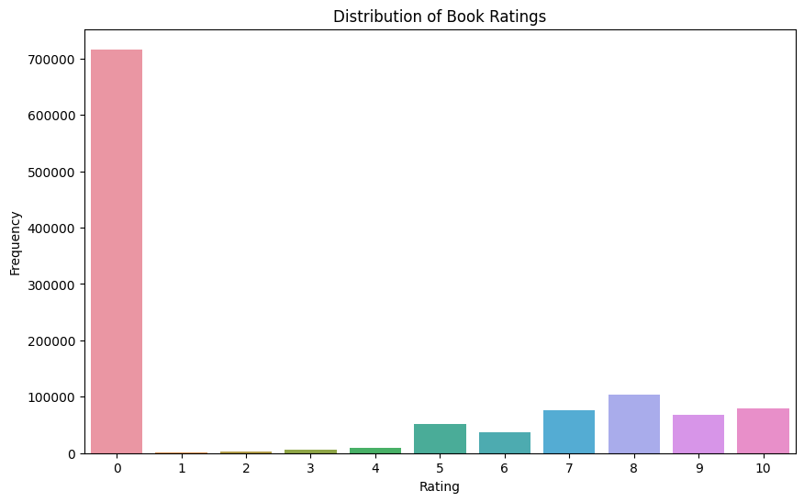

Slide 9
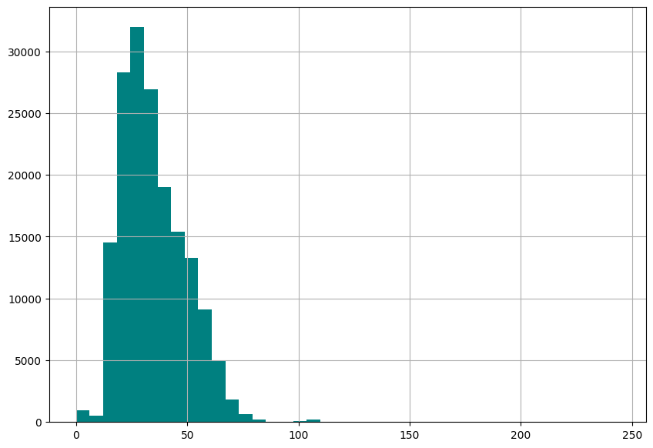
AGE DISTRIBUTION

Slide 10
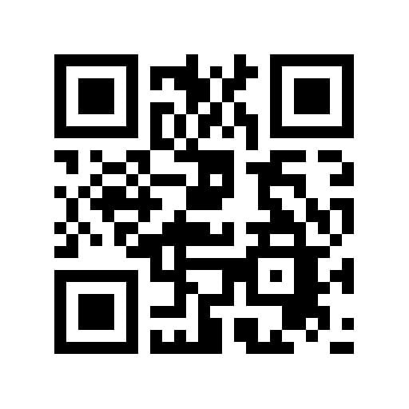
THE WEBAPP

Slide 11
GROUP MEMBERS:
ABDALLAH ADEL
AHMED ISMAIL ELBROLOSY
ZIAD SALAMA
NADINE MOHAMED ELFARAMAWY

Slide 12

THANK YOU

